Slide 1
Pipelining IMPLEMENTATION
4.6
Notes:
Q: What was our analogy for pipelining? Give me a high-level overview of pipelining

Slide 2
Pipeline Summary
The BIG Picture
Pipelining improves performance by increasing instruction throughput
Executes multiple instructions in parallel
Each instruction has the same latency
Subject to hazards
Structure, data, control
Instruction set design affects complexity of pipeline implementation
Notes:
Examples on p. 285
Stall on lw result
Bypass the first add result written into $t1
No stall or bypass required.

Slide 3
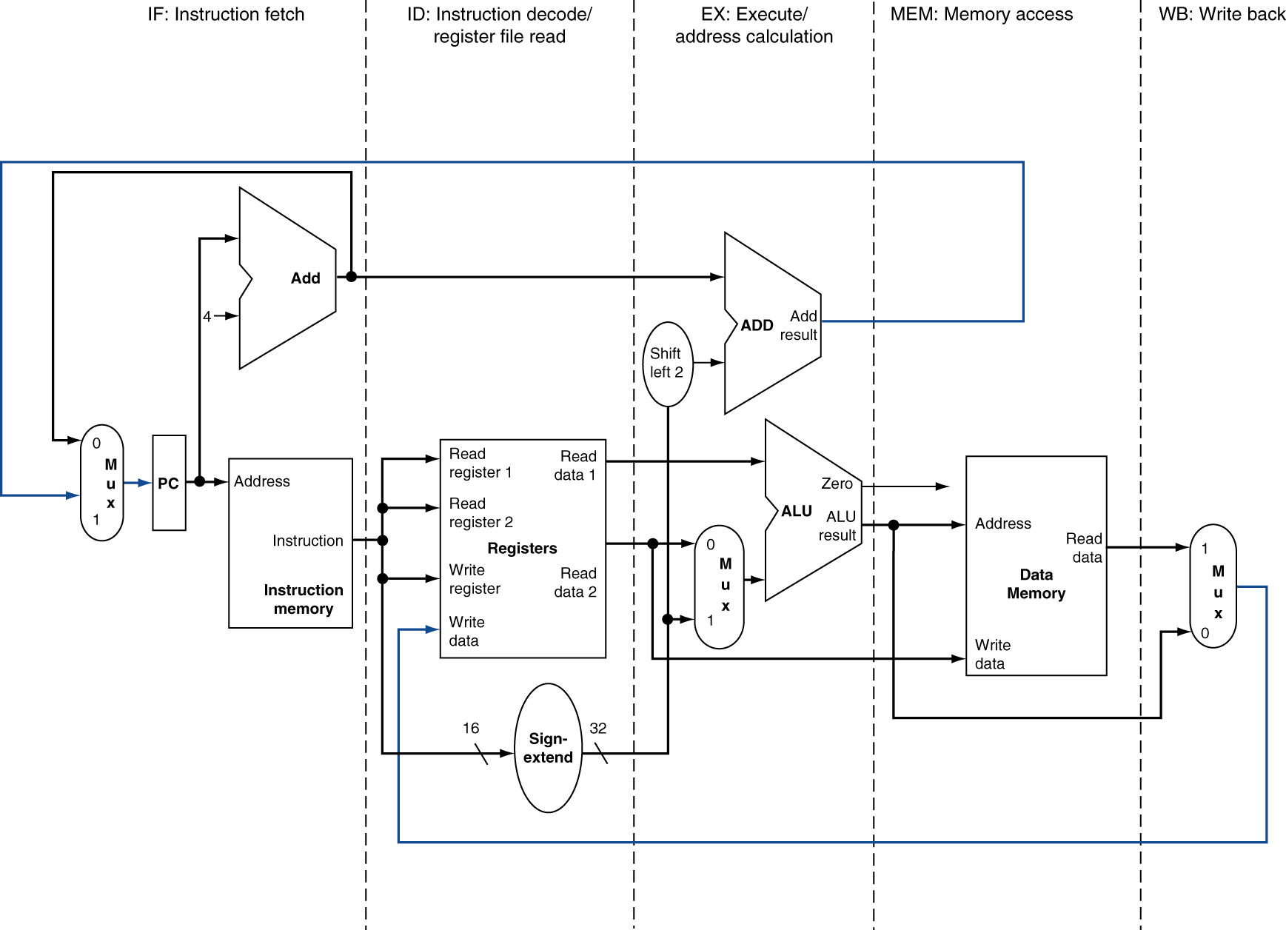
MIPS Pipelined Datapath
§4.6 Pipelined Datapath and Control
MEM
Right-to-left flow leads to hazards
WB
Notes:
Not only data hazards (WB) and control hazards (branch MEM), also just synchronization: time it takes to go down a wire vs. through the register file
e.g., don’t want instruction fetch to overwrite wires to registers if maybe registers are slow to use those values.

Slide 4
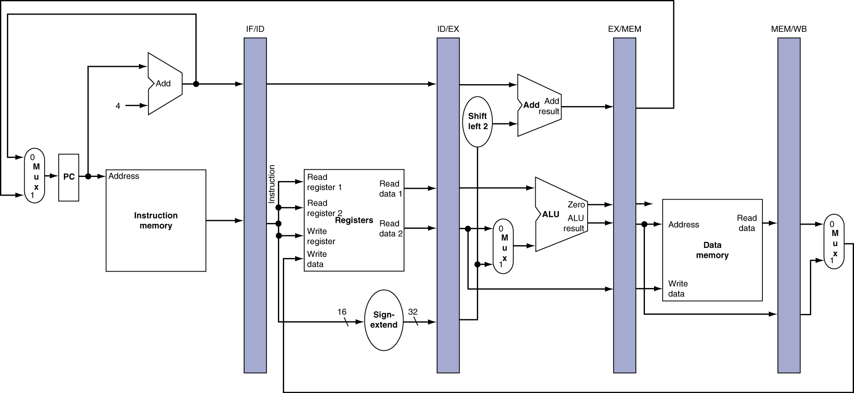
Pipeline registers
Need registers between stages
To hold information produced in previous cycle

Slide 5
Pipeline Operation
Cycle-by-cycle flow of instructions through the pipelined datapath
“Single-clock-cycle” pipeline diagram
Shows pipeline usage in a single cycle
Highlight resources used
c.f. “multi-clock-cycle” diagram
Graph of operation over time
We’ll look at “single-clock-cycle” diagrams for load & store

Slide 6
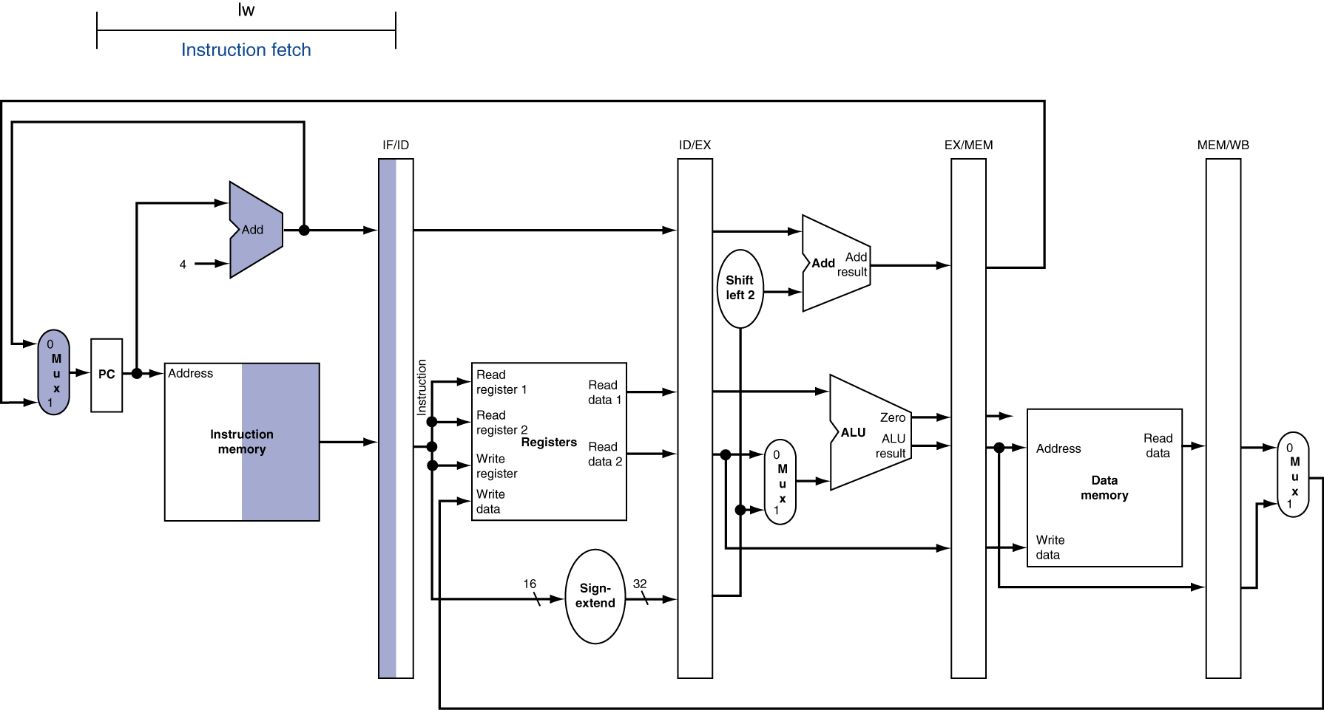
IF for Load, Store, …

Slide 7
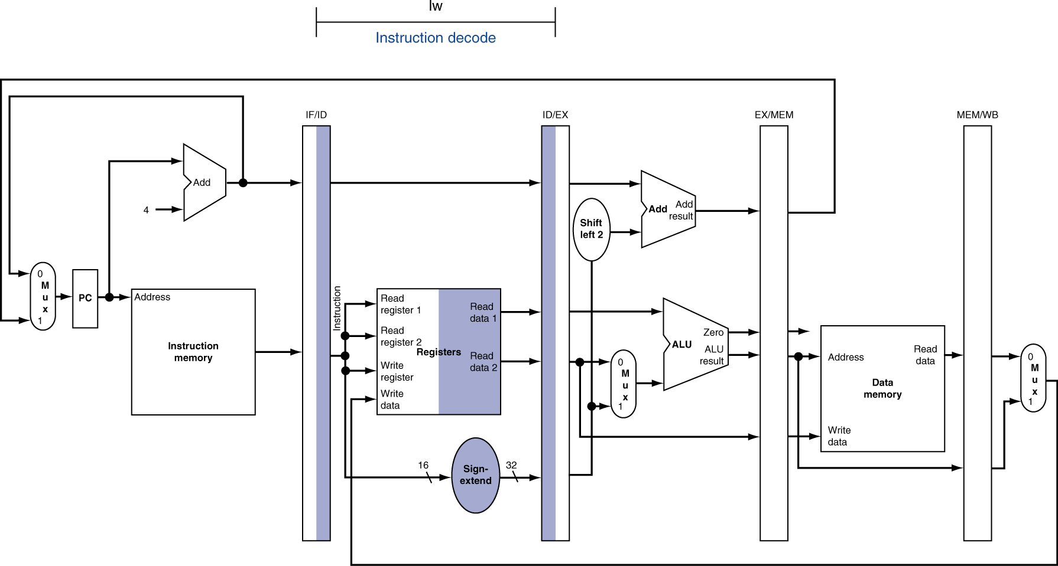
ID for Load, Store, …

Slide 8
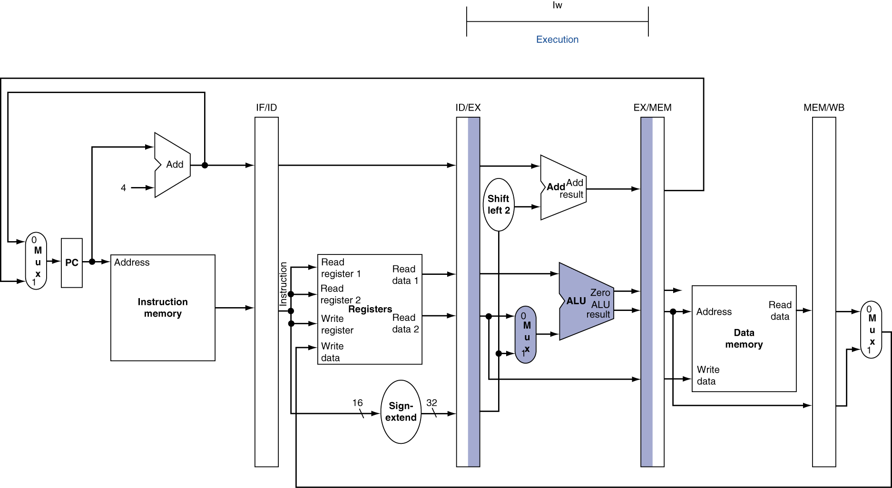
EX for Load

Slide 9
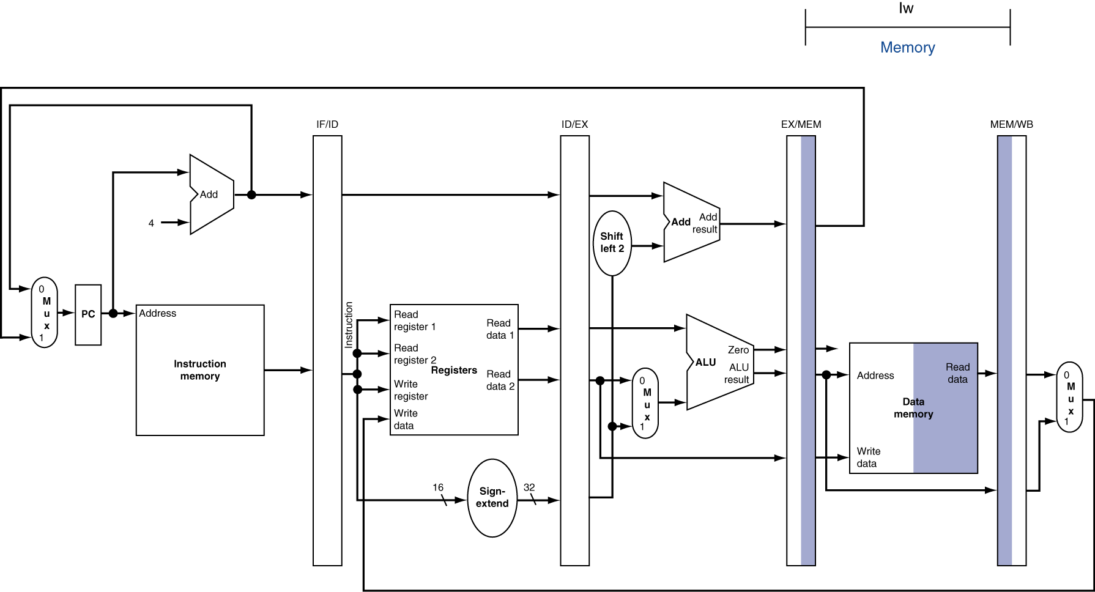
MEM for Load

Slide 10
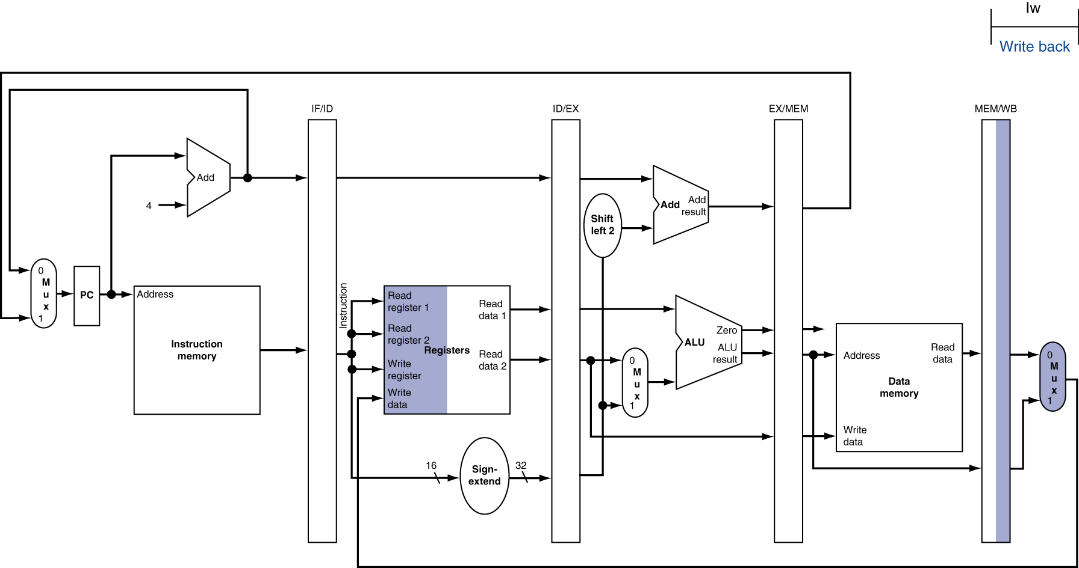
WB for Load
Wrong register number
Notes:
Q: Anyone see a bug here?

Slide 11
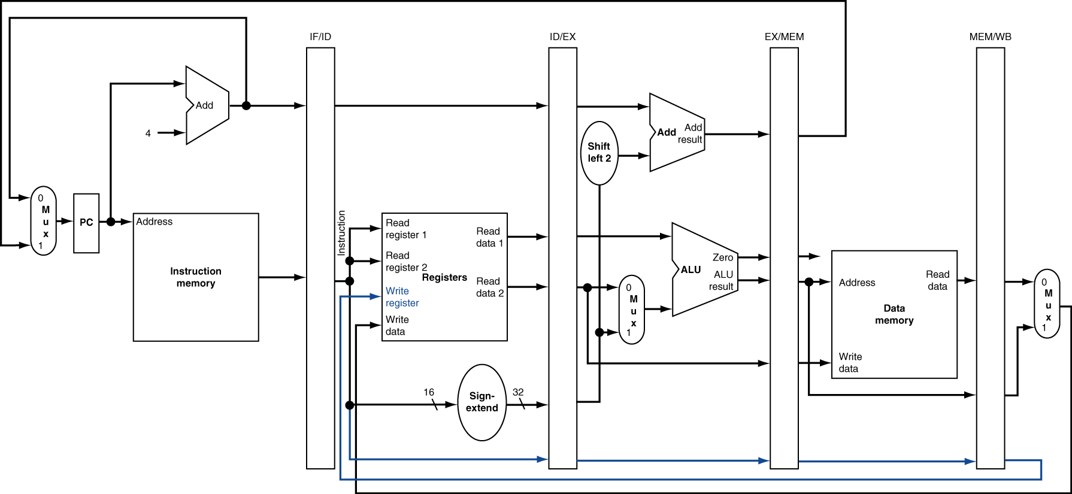
Corrected Datapath for Load

Slide 12

EX for Store

Slide 13
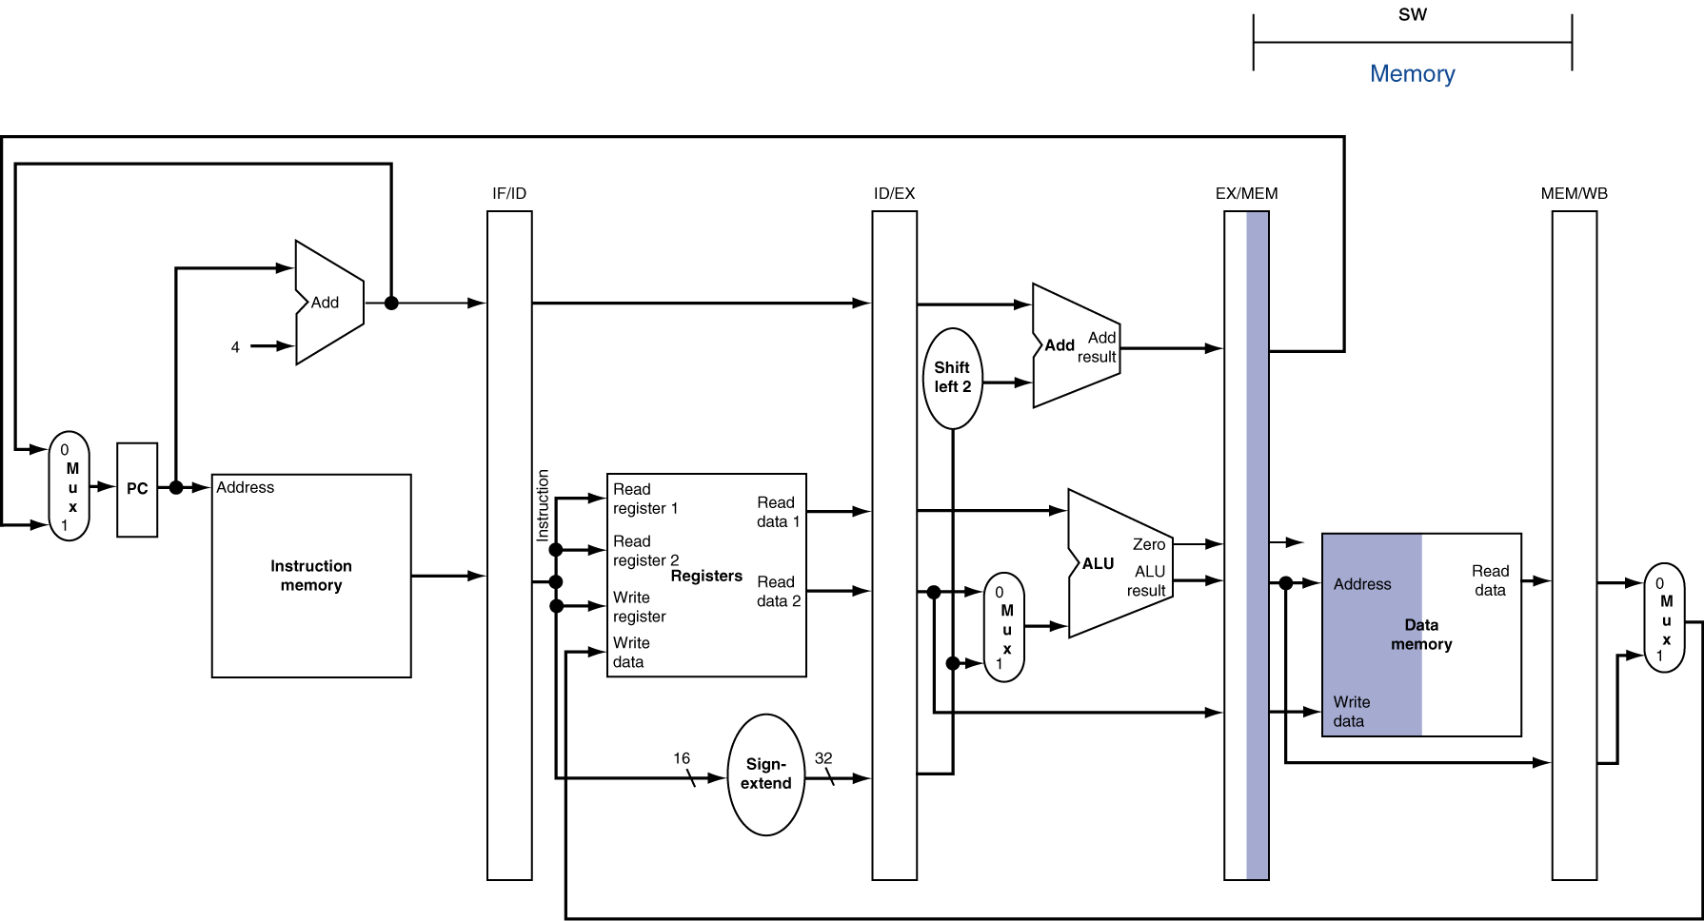
MEM for Store

Slide 14
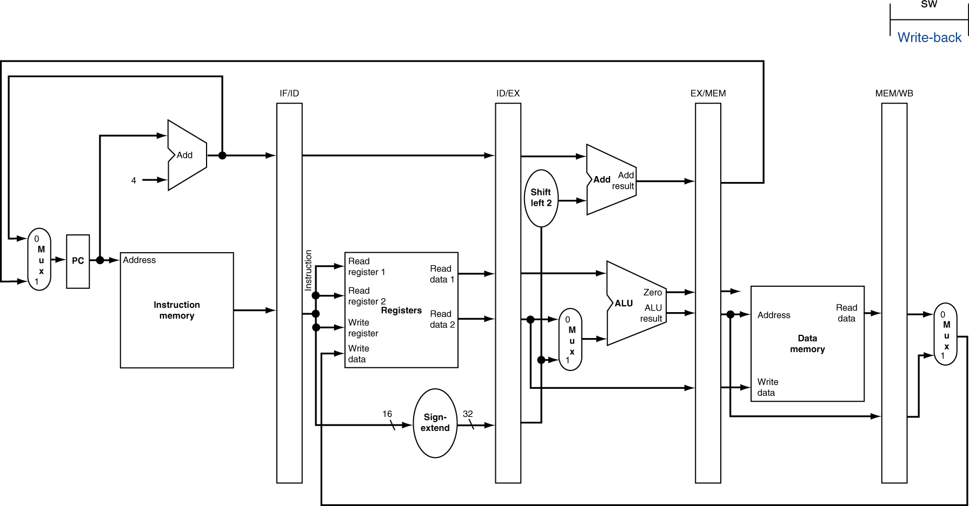
WB for Store

Slide 15
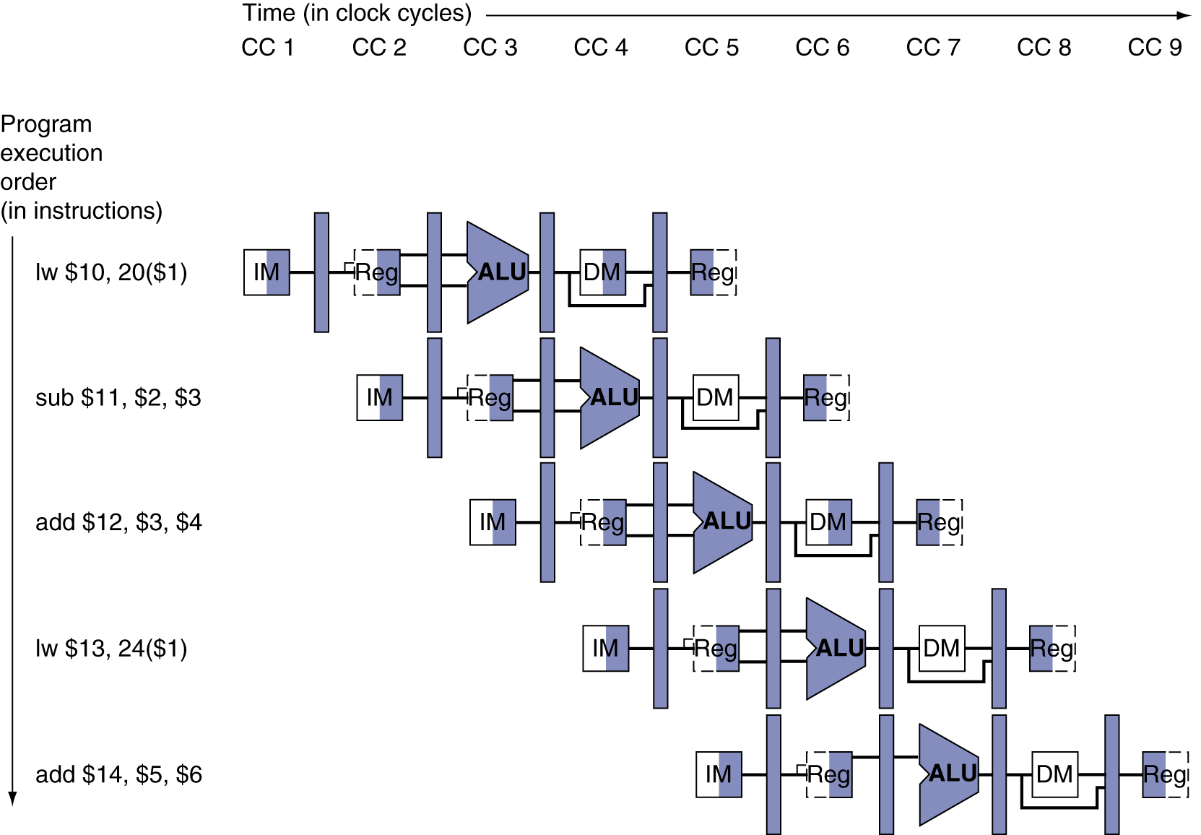
Multi-Cycle Pipeline Diagram
Form showing resource usage
Notes:
Q: There are two bugs in the shading of this diagram…what are they?
A1: add doesn’t need to use DM
A2: lw does need to use DM

Slide 16
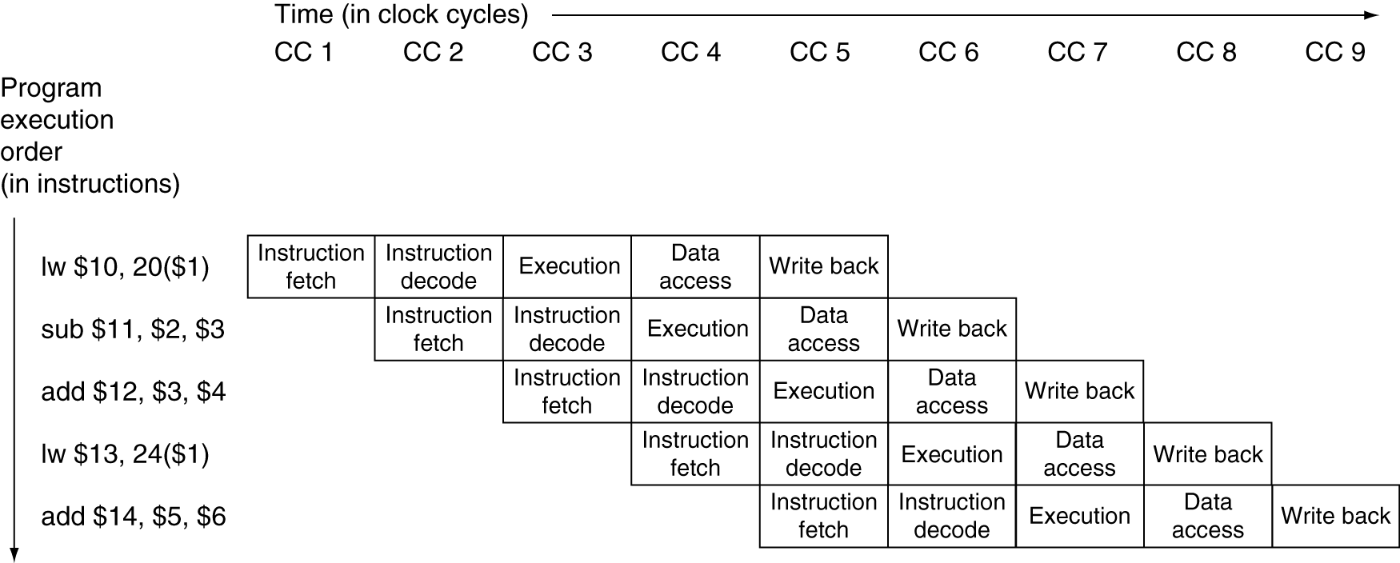
Multi-Cycle Pipeline Diagram
Traditional form
Notes:
Can take a vertical “cross cut” to get a more detailed look at any given clock cycle…
For example, take cycle 5 here
Visualize that cross cut on next slide…

Slide 17
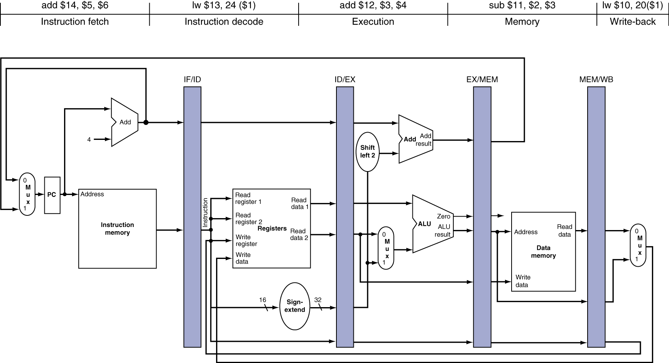
Single-Cycle Pipeline Diagram
State of pipeline in a given cycle
Notes:
Here’s where we get to really bring everything together in our heads at once…
Now let’s go back to talking about the control signals…

Slide 18
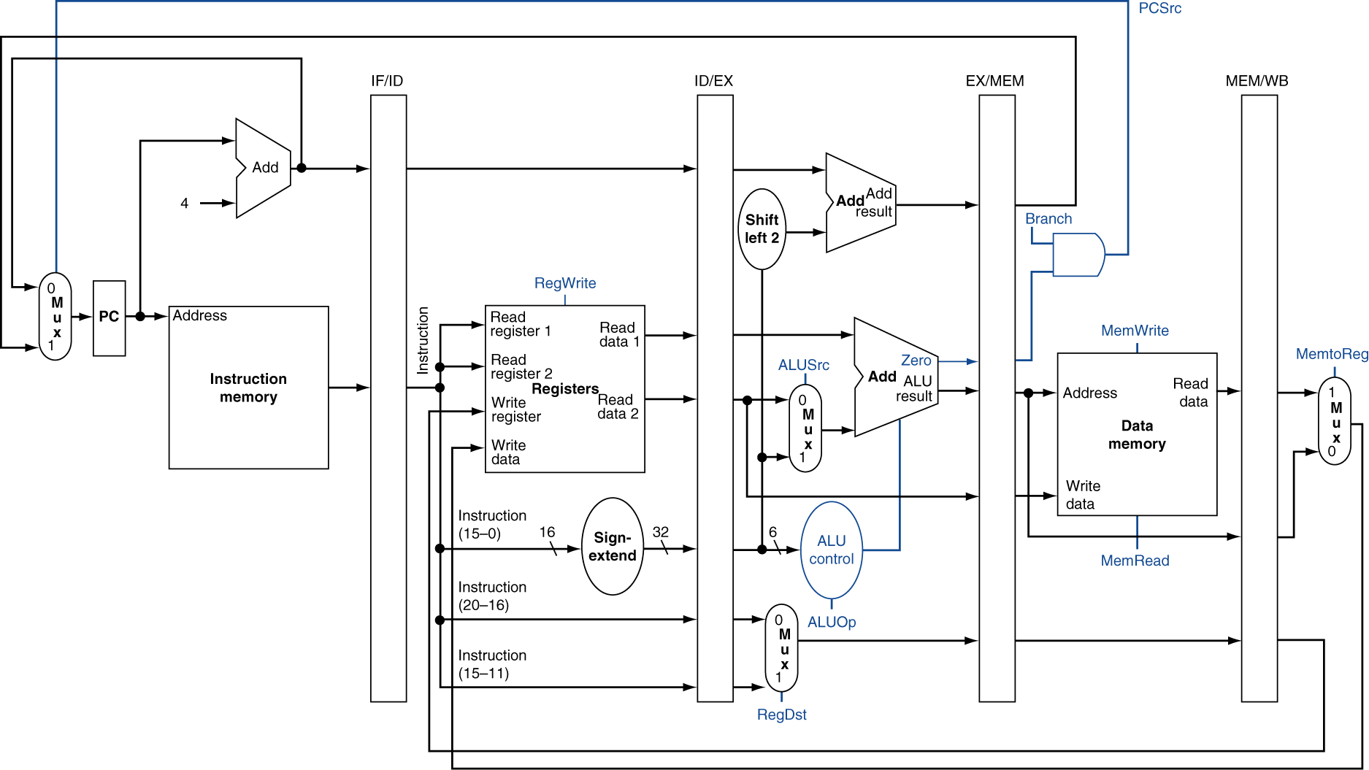
Pipelined Control (Simplified)
Notes:
Control has the same kind of synchronization issues as the data path.
e.g., we generate the ALUSrc signal presumable in the ID stage, but need to make sure it’s not set until the EX stage.
so we should also include them in the pipeline registers.

Slide 19
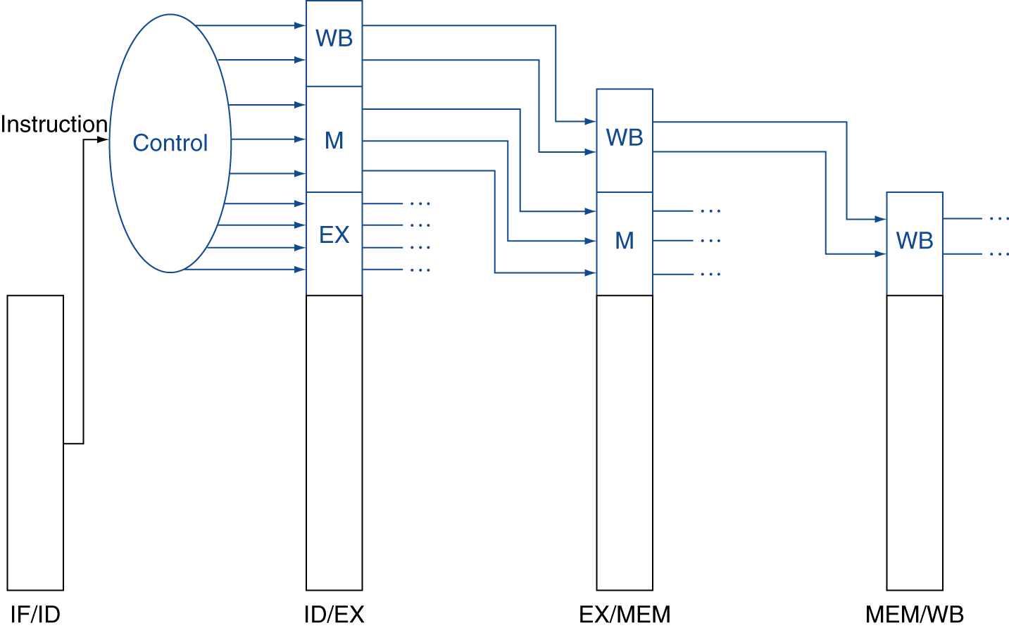
Pipelined Control
Control signals derived from instruction
As in single-cycle implementation
Notes:
Basically, save the multiplexor choices for a future stage (plus ALUop…)

Slide 20
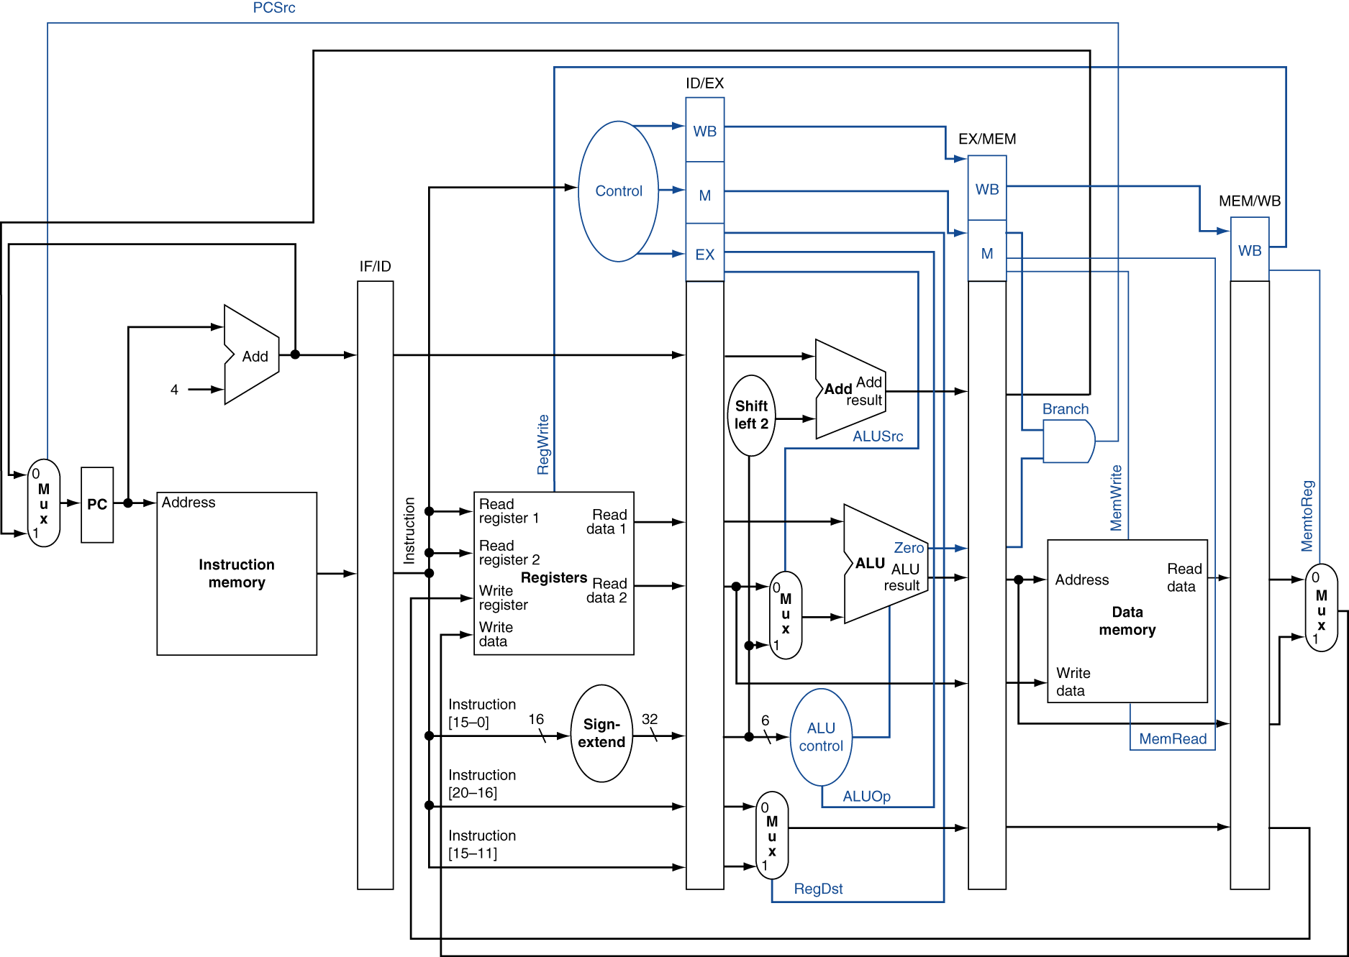
Pipelined Control

Slide 21
Pipelining Details
4.7 - Detecting and handling data hazards
4.8 – Control hazards
4.9 – Exceptions
Arithmetic overflow
I/O device request
Undefined operation
Hardware malfunction
Notes:
No time for the fun details :(

Slide 22
Data Hazards in ALU Instructions
Consider this sequence:
sub $2, $1,$3 and $12,$2,$5 or $13,$6,$2 add $14,$2,$2 sw $15,100($2)
We can resolve hazards with forwarding
How do we detect when to forward?
§4.7 Data Hazards: Forwarding vs. Stalling

Slide 23
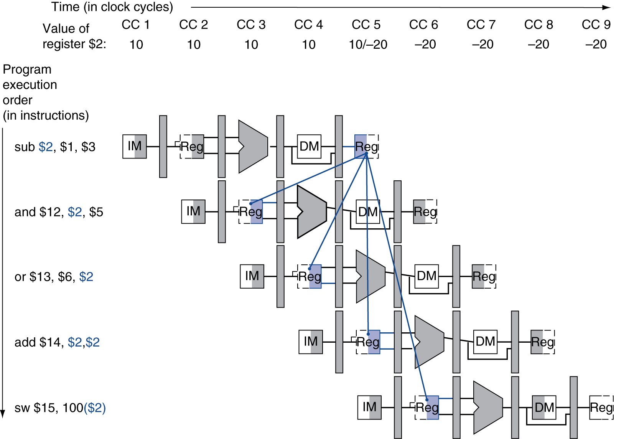
Dependencies & Forwarding
Notes:
If you draw the diagram, forward whenever we would go back in time.

Slide 24
Detecting the Need to Forward
Pass register numbers along pipeline
e.g., ID/EX.RegisterRs = register number for Rs sitting in ID/EX pipeline register
ALU operand register numbers in EX stage are given by
ID/EX.RegisterRs, ID/EX.RegisterRt
Data hazards when
1a. EX/MEM.RegisterRd = ID/EX.RegisterRs
1b. EX/MEM.RegisterRd = ID/EX.RegisterRt
2a. MEM/WB.RegisterRd = ID/EX.RegisterRs
2b. MEM/WB.RegisterRd = ID/EX.RegisterRt
Fwd from EX/MEM pipeline reg
Fwd from MEM/WB pipeline reg
Notes:
1 – i.e. instruction is one ahead
2 – i.e. instruction is two ahead
We’re only going to consider forwarding to the EX stage, though in real life there is more forwarding.

Slide 25
Detecting the Need to Forward
But only if forwarding instruction will write to a register!
EX/MEM.RegWrite, MEM/WB.RegWrite
And only if Rd for that instruction is not $zero
EX/MEM.RegisterRd ≠ 0, MEM/WB.RegisterRd ≠ 0
Notes:
Last part is just enforcing that we don’t write to the zero register; design choice.

Slide 26
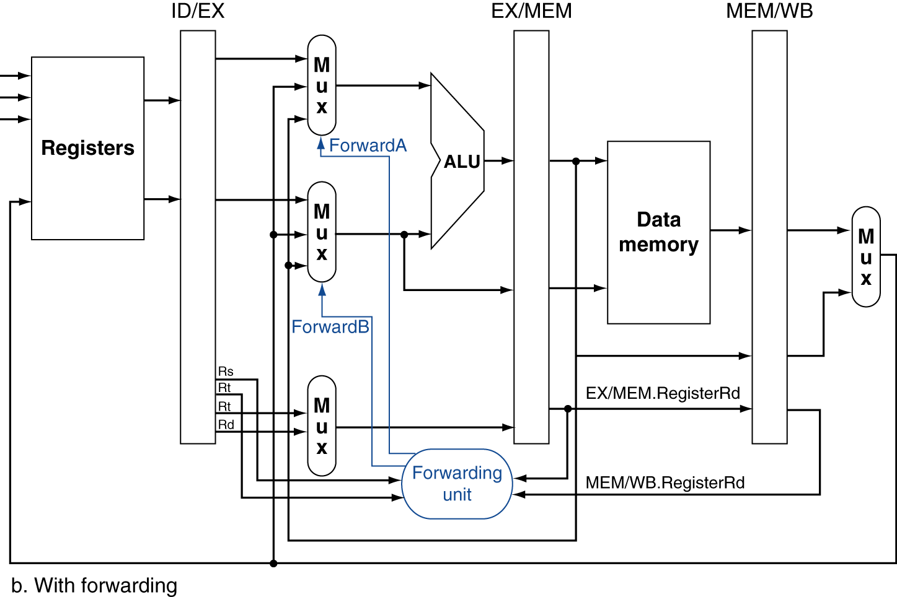
Forwarding Paths

Slide 27
Forwarding Conditions
EX hazard
if (EX/MEM.RegWrite and (EX/MEM.RegisterRd ≠ 0) and (EX/MEM.RegisterRd = ID/EX.RegisterRs)) ForwardA = 10
if (EX/MEM.RegWrite and (EX/MEM.RegisterRd ≠ 0) and (EX/MEM.RegisterRd = ID/EX.RegisterRt)) ForwardB = 10
MEM hazard
if (MEM/WB.RegWrite and (MEM/WB.RegisterRd ≠ 0) and (MEM/WB.RegisterRd = ID/EX.RegisterRs)) ForwardA = 01
if (MEM/WB.RegWrite and (MEM/WB.RegisterRd ≠ 0) and (MEM/WB.RegisterRd = ID/EX.RegisterRt)) ForwardB = 01
Notes:
Otherwise 00 and use actual result from register file.

Slide 28
Double Data Hazard
Consider the sequence:
add $1,$1,$2 add $1,$1,$3 add $1,$1,$4
Both hazards occur
Want to use the most recent
Revise MEM hazard condition
Only fwd if EX hazard condition isn’t true

Slide 29
Revised Forwarding Condition
MEM hazard
if (MEM/WB.RegWrite and (MEM/WB.RegisterRd ≠ 0) and not (EX/MEM.RegWrite and (EX/MEM.RegisterRd ≠ 0) and (EX/MEM.RegisterRd = ID/EX.RegisterRs)) and (MEM/WB.RegisterRd = ID/EX.RegisterRs)) ForwardA = 01
if (MEM/WB.RegWrite and (MEM/WB.RegisterRd ≠ 0) and not (EX/MEM.RegWrite and (EX/MEM.RegisterRd ≠ 0) and (EX/MEM.RegisterRd = ID/EX.RegisterRt)) and (MEM/WB.RegisterRd = ID/EX.RegisterRt)) ForwardB = 01

Slide 30
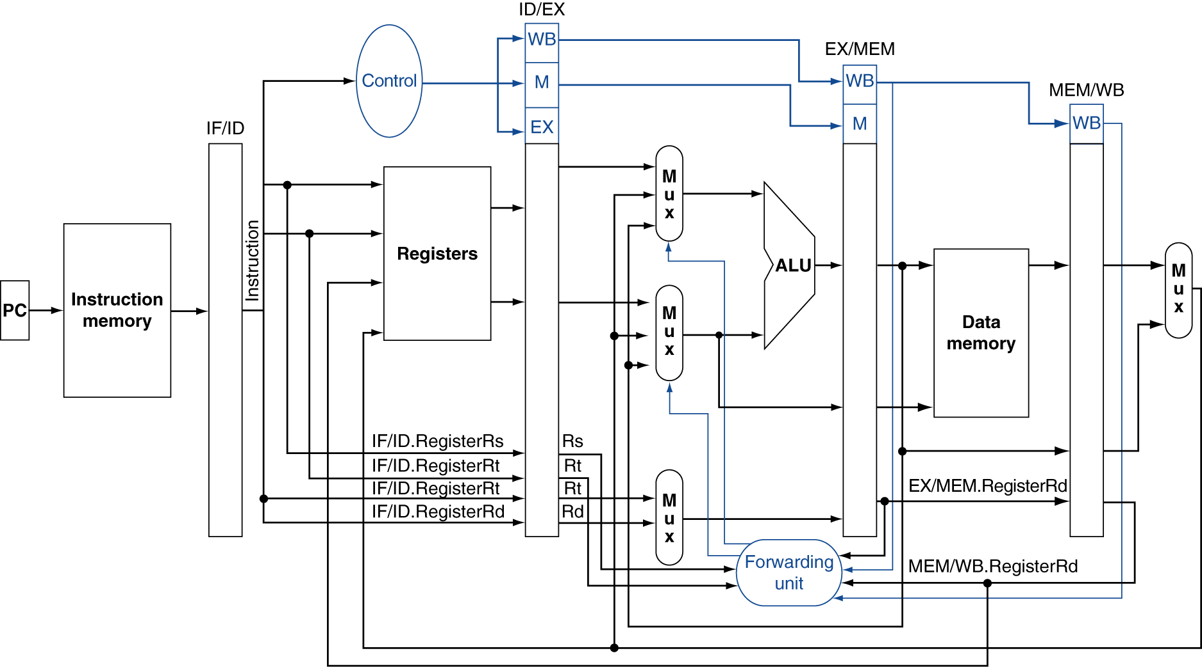
Datapath with Forwarding
Notes:
It’s starting to get too complicated to put everything up at once, so this is simplified; has branch stuff missing.

Slide 31
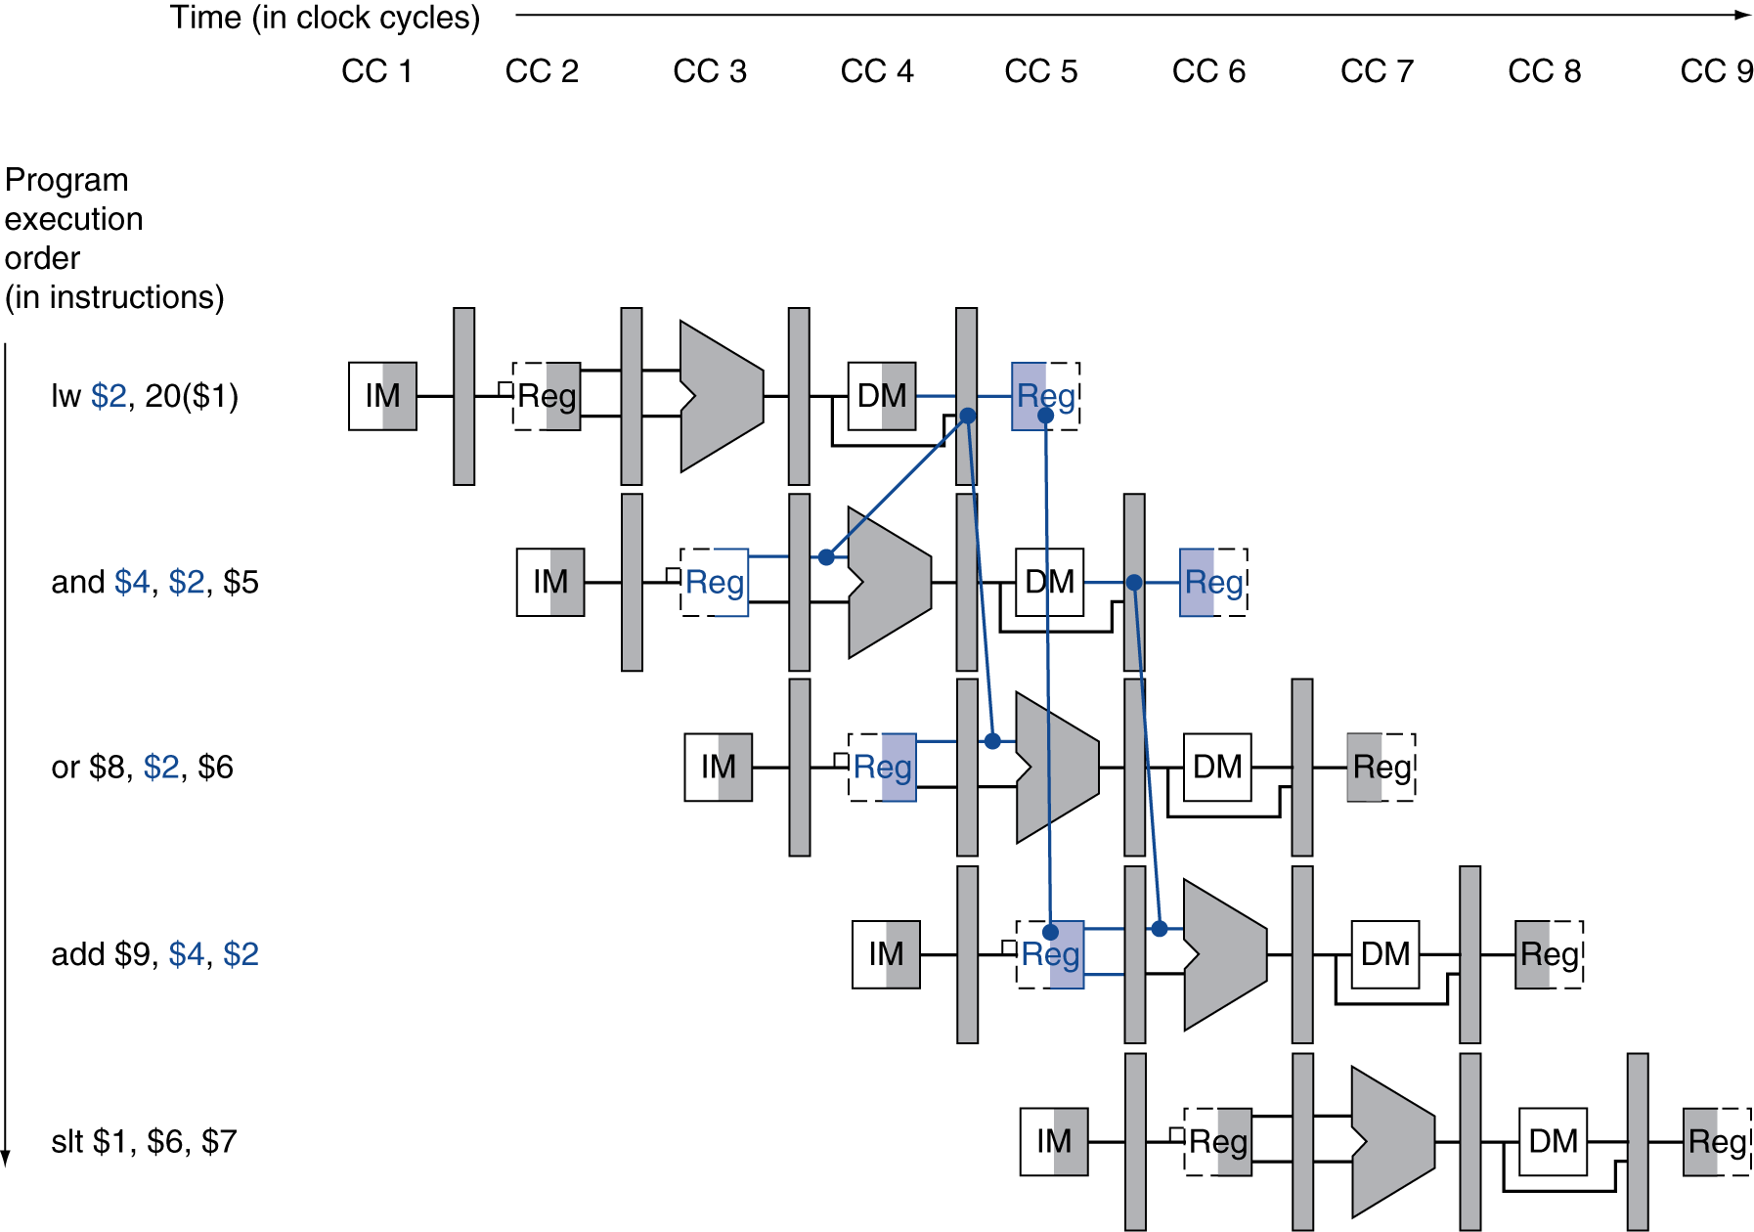
Load-Use Data Hazard
Need to stall for one cycle
Notes:
We still need to detect when this happens and do something about it!

Slide 32
Load-Use Hazard Detection
Check when using instruction is decoded in ID stage
ALU operand register numbers in ID stage are given by
IF/ID.RegisterRs, IF/ID.RegisterRt
Load-use hazard when
ID/EX.MemRead and ((ID/EX.RegisterRt = IF/ID.RegisterRs) or (ID/EX.RegisterRt = IF/ID.RegisterRt))
If detected, stall and insert bubble

Slide 33
How to Stall the Pipeline
Force control values in ID/EX register to 0
EX, MEM and WB do nop (no-operation)
Prevent update of PC and IF/ID register
Current instruction is decoded again
Following instruction is fetched again
1-cycle stall allows MEM to read data for lw
Can subsequently forward to EX stage

Slide 34
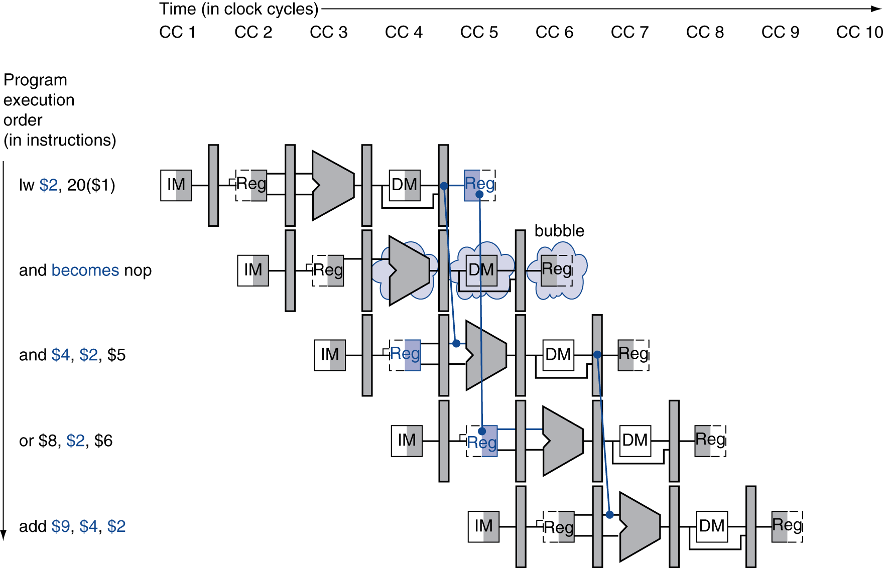
Stall/Bubble in the Pipeline
Stall inserted here

Slide 35
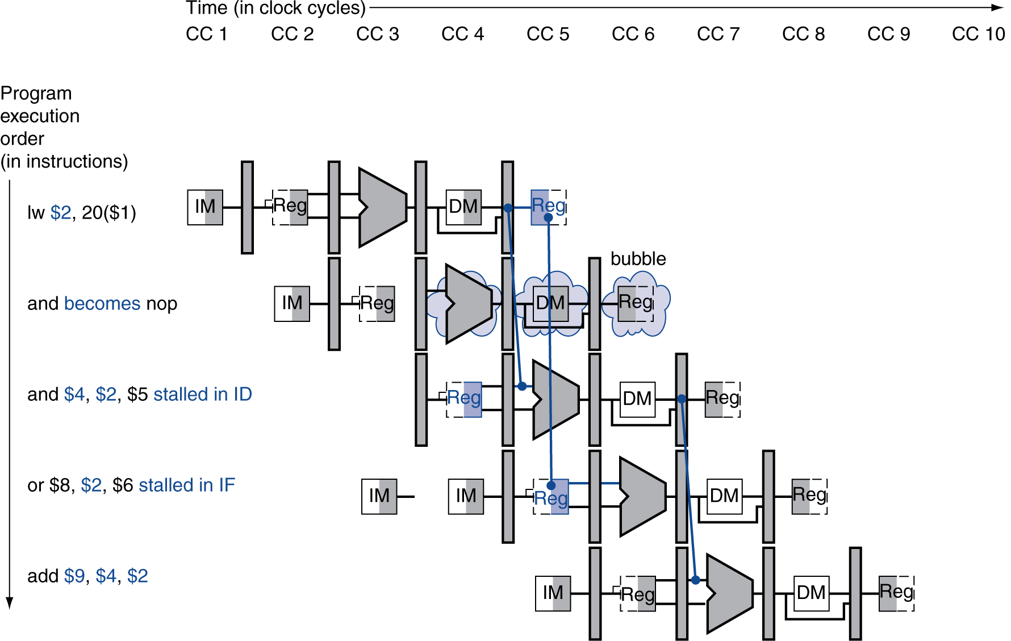
Stall/Bubble in the Pipeline
Or, more accurately…

Slide 36
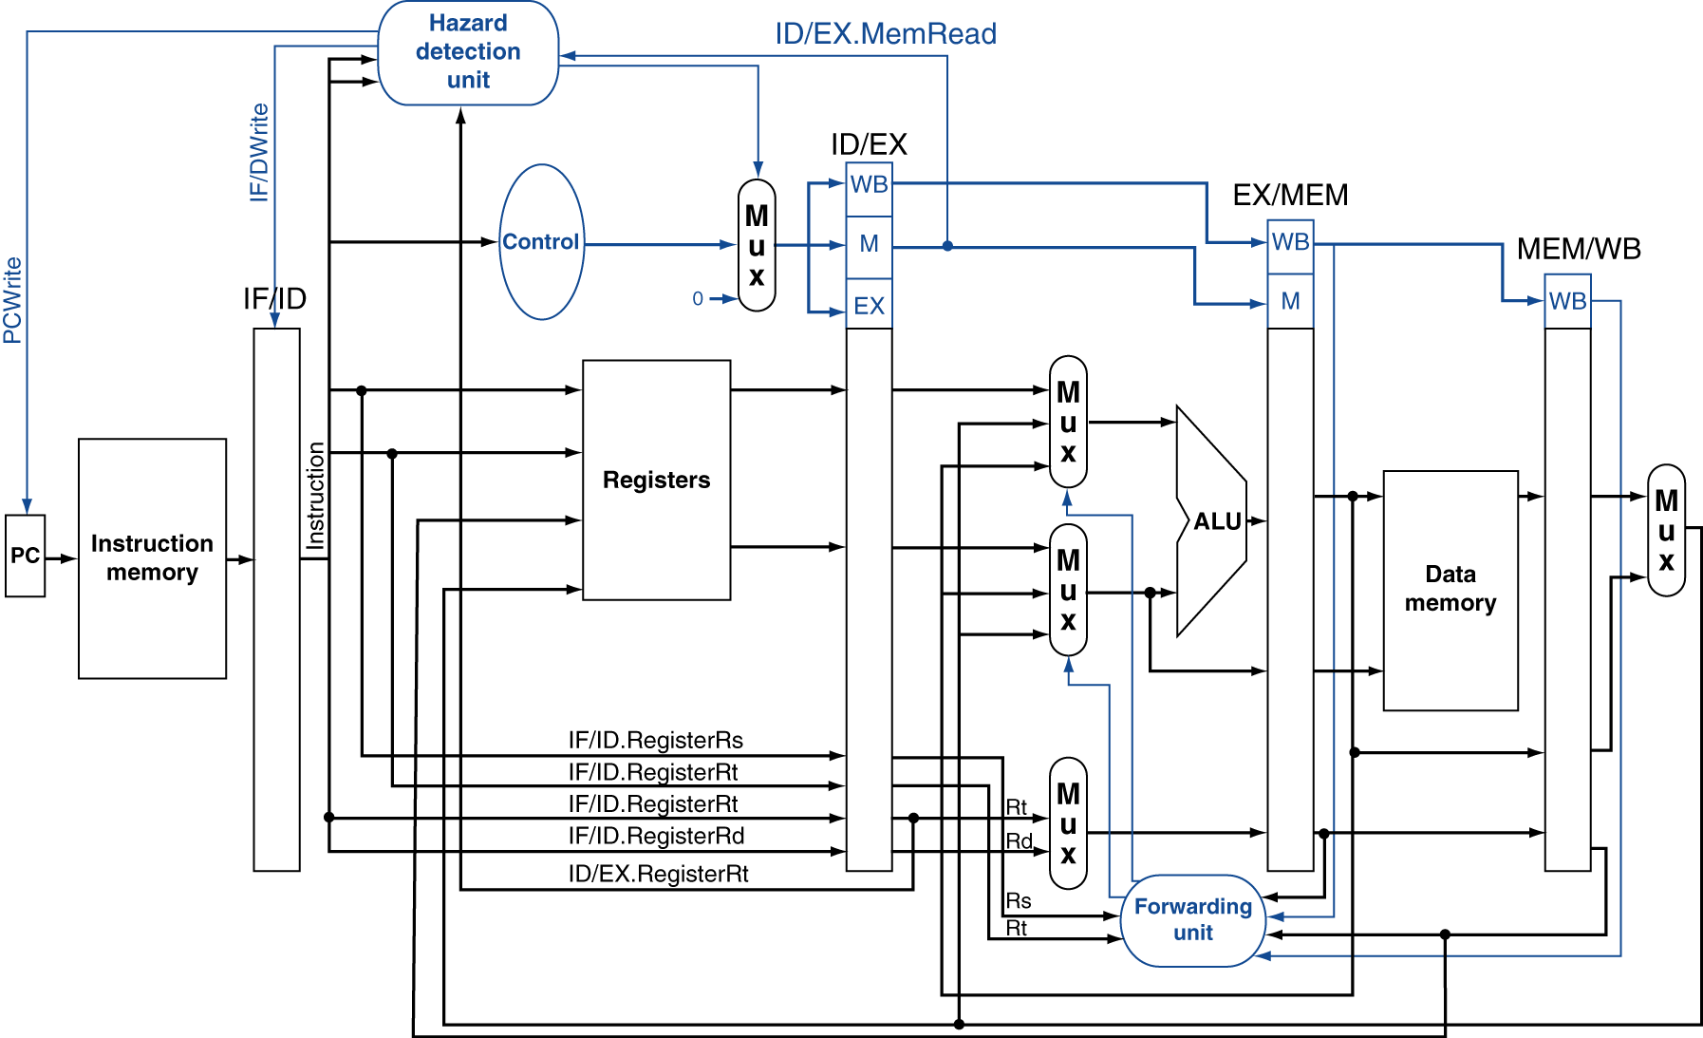
Datapath with Hazard Detection

Slide 37
Stalls and Performance
The BIG Picture
Stalls reduce performance
But are required to get correct results
Compiler can arrange code to avoid hazards and stalls
Requires knowledge of the pipeline structure

Slide 38
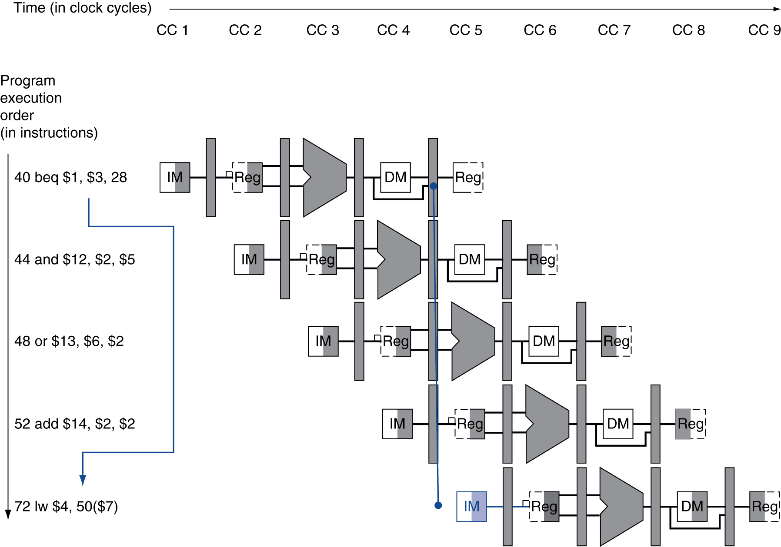
Branch Hazards
§4.8 Control Hazards
If branch outcome determined in MEM
Flush these instructions
(Set control values to 0)
PC

Slide 39
Reducing Branch Delay
Move hardware to determine outcome to ID stage
Target address adder
Register comparator
Example: branch taken
36: sub $10, $4, $8 40: beq $1, $3, 7 44: and $12, $2, $5 48: or $13, $2, $6 52: add $14, $4, $2 56: slt $15, $6, $7 ... 72: lw $4, 50($7)

Slide 40
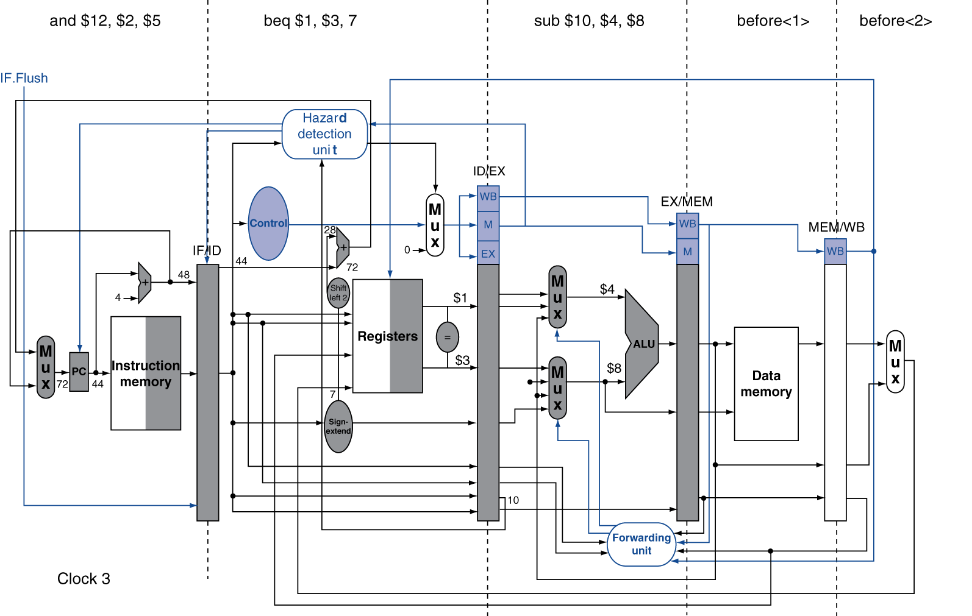
Example: Branch Taken

Slide 41
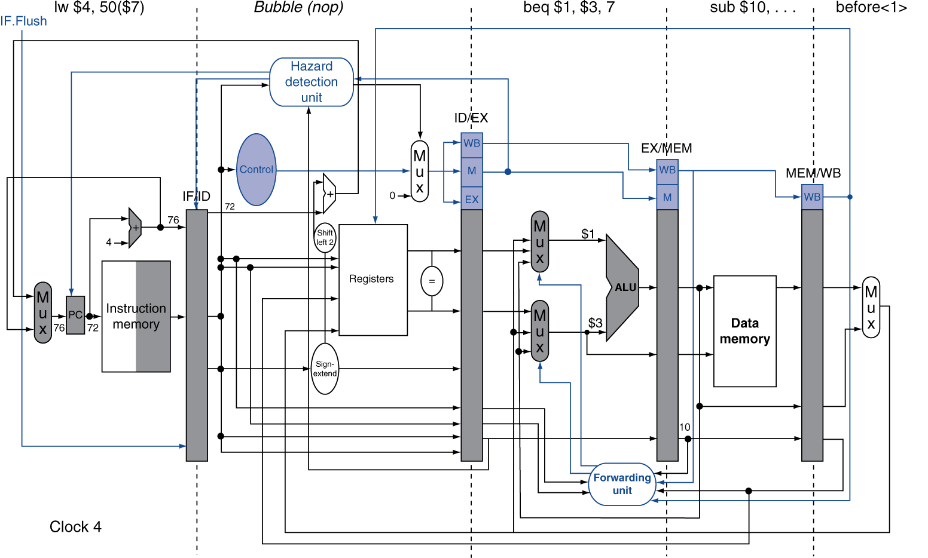
Example: Branch Taken

Slide 42
Data Hazards for Branches
If a comparison register is a destination of 2nd or 3rd preceding ALU instruction
add $1, $2, $3
IF
ID
EX
MEM
WB
add $4, $5, $6
IF
ID
EX
MEM
WB
…
IF
ID
EX
MEM
WB
beq $1, $4, target
IF
ID
EX
MEM
WB
Can resolve using forwarding

Slide 43
Data Hazards for Branches
If a comparison register is a destination of preceding ALU instruction or 2nd preceding load instruction
Need 1 stall cycle
lw $1, addr
IF
ID
EX
MEM
WB
add $4, $5, $6
IF
ID
EX
MEM
WB
beq stalled
IF
ID
beq $1, $4, target
ID
EX
MEM
WB

Slide 44
Data Hazards for Branches
If a comparison register is a destination of immediately preceding load instruction
Need 2 stall cycles
lw $1, addr
IF
ID
EX
MEM
WB
beq stalled
IF
ID
beq stalled
ID
beq $1, $0, target
ID
EX
MEM
WB

Slide 45
Dynamic Branch Prediction
In deeper and superscalar pipelines, branch penalty is more significant
Use dynamic prediction
Branch prediction buffer (aka branch history table)
Indexed by recent branch instruction addresses
Stores outcome (taken/not taken)
To execute a branch
Check table, expect the same outcome
Start fetching from fall-through or target
If wrong, flush pipeline and flip prediction

Slide 46
1-Bit Predictor: Shortcoming
Inner loop branches mispredicted twice!
outer: … … inner: …
…
beq …, …, inner … beq …, …, outer
Mispredict as taken on last iteration of inner loop
Then mispredict as not taken on first iteration of inner loop next time around

Slide 47
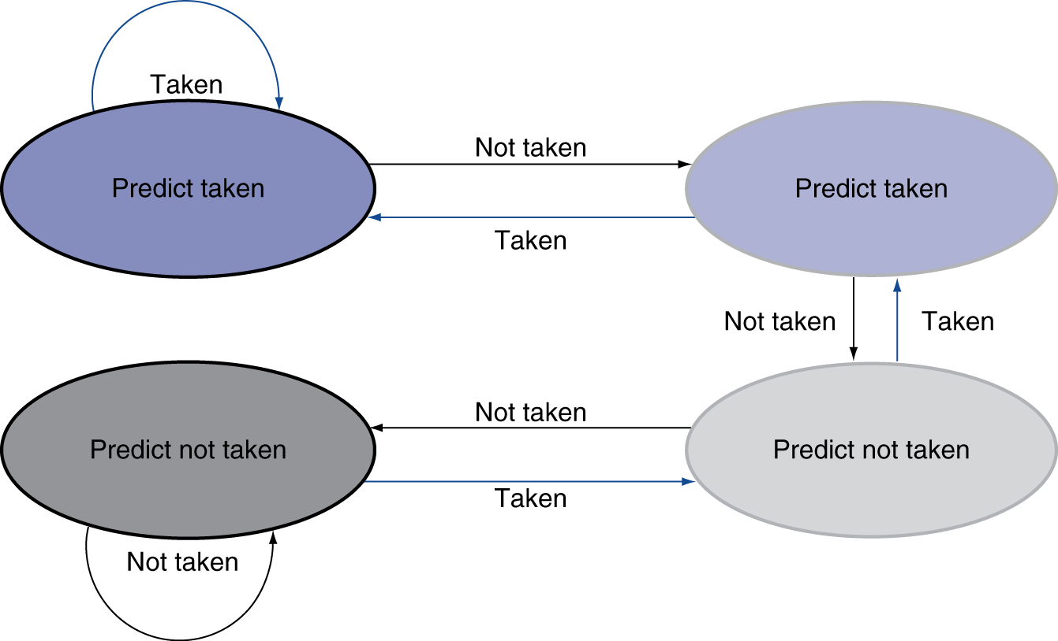
2-Bit Predictor
Only change prediction on two successive mispredictions
Notes:
Start at 00 with strong predict not taken (maybe).

Slide 48
Calculating the Branch Target
Even with predictor, still need to calculate the target address
1-cycle penalty for a taken branch
Branch target buffer
Cache of target addresses
Indexed by PC when instruction fetched
If hit and instruction is branch predicted taken, can fetch target immediately

Slide 49
Exceptions and Interrupts
§4.9 Exceptions
“Unexpected” events requiring change in flow of control
Different ISAs use the terms differently
Exception
Arises within the CPU
e.g., undefined opcode, overflow, syscall, …
Interrupt
From an external I/O controller
Dealing with them without sacrificing performance is hard

Slide 50
Handling Exceptions
In MIPS, exceptions managed by a System Control Coprocessor (CP0)
Save PC of offending (or interrupted) instruction
In MIPS: Exception Program Counter (EPC)
Save indication of the problem
In MIPS: Cause register
We’ll assume 1-bit
0 for undefined opcode, 1 for overflow
Jump to handler at 8000 00180

Slide 51
An Alternate Mechanism
Vectored Interrupts
Handler address determined by the cause
Example:
Undefined opcode: C000 0000
Overflow: C000 0020
…: C000 0040
Instructions either
Deal with the interrupt, or
Jump to real handler

Slide 52
Handler Actions
Read cause, and transfer to relevant handler
Determine action required
If restartable
Take corrective action
use EPC to return to program
Otherwise
Terminate program
Report error using EPC, cause, …

Slide 53
Exceptions in a Pipeline
Another form of control hazard
Consider overflow on add in EX stage
add $1, $2, $1
Prevent $1 from being clobbered
Complete previous instructions
Flush add and subsequent instructions
Set Cause and EPC register values
Transfer control to handler
Similar to mispredicted branch
Use much of the same hardware

Slide 54
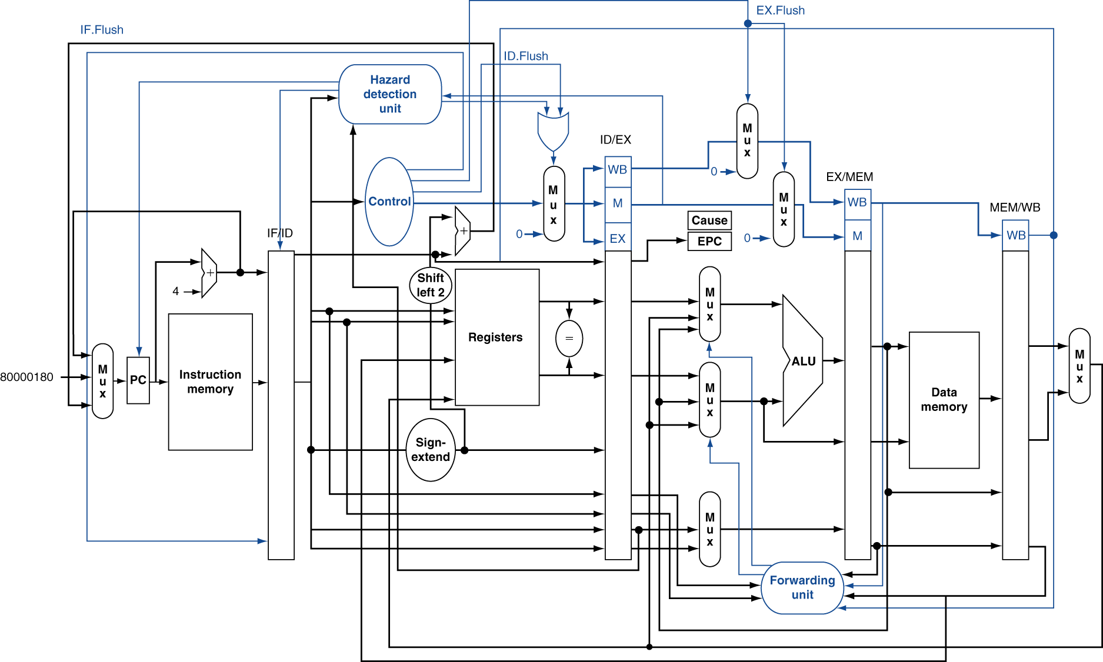
Pipeline with Exceptions

Slide 55
Exception Properties
Restartable exceptions
Pipeline can flush the instruction
Handler executes, then returns to the instruction
Refetched and executed from scratch
PC saved in EPC register
Identifies causing instruction
Actually PC + 4 is saved
Handler must adjust

Slide 56
Exception Example
Exception on add in
40 sub $11, $2, $4 44 and $12, $2, $5 48 or $13, $2, $6 4C add $1, $2, $1 50 slt $15, $6, $7 54 lw $16, 50($7) …
Handler
80000180 sw $25, 1000($0) 80000184 sw $26, 1004($0) …

Slide 57
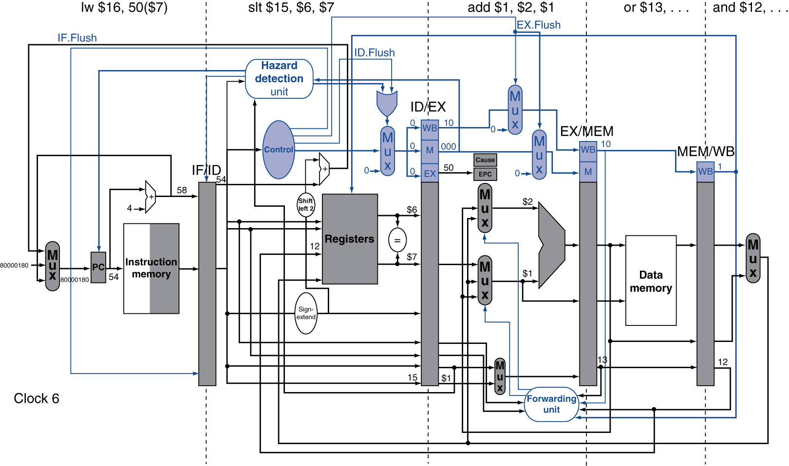
Exception Example

Slide 58
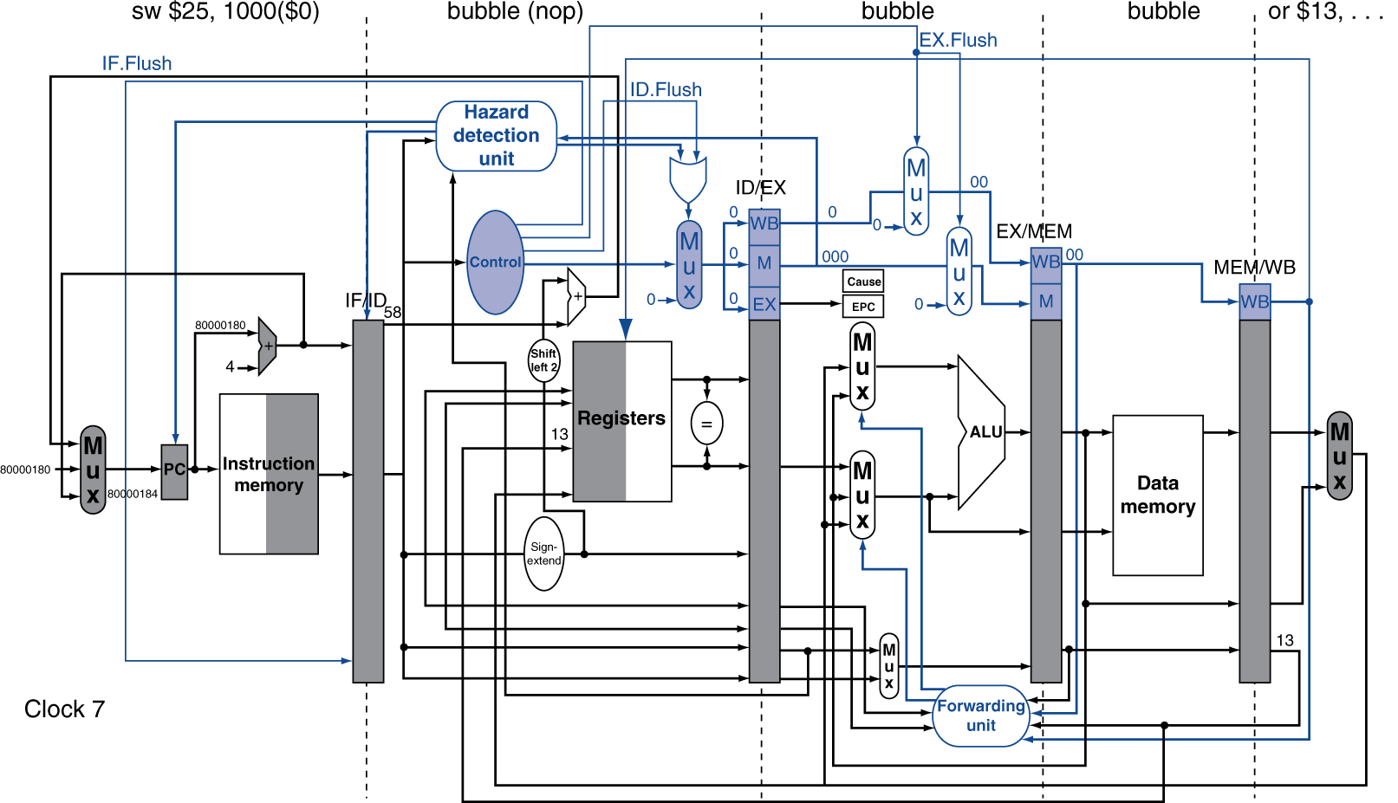
Exception Example

Slide 59
Multiple Exceptions
Pipelining overlaps multiple instructions
Could have multiple exceptions at once
Simple approach: deal with exception from earliest instruction
Flush subsequent instructions
“Precise” exceptions
In complex pipelines
Multiple instructions issued per cycle
Out-of-order completion
Maintaining precise exceptions is difficult!

Slide 60
Imprecise Exceptions
Just stop pipeline and save state
Including exception cause(s)
Let the handler work out
Which instruction(s) had exceptions
Which to complete or flush
May require “manual” completion
Simplifies hardware, but more complex handler software
Not feasible for complex multiple-issue out-of-order pipelines

