Slide 1
Combinational Logic (B.3)
Instructor: Robert Utterback
Lecture 6
Notes:
In this lecture you’re going to learn a lot of new things: the basic building blocks of a computer. We’ll slowly combine these to learn how many components of a computer are built up.

Slide 2
Two-level Logic
Remember: Any Boolean Logic function can be implemented with only NOT, AND, OR functions
We can also find that all logic functions can be written in a canonical form
Sum of Products
Logical Sum (OR) of terms joined by Product (AND)
Product of Sums
Logical Product (AND) of terms joined by Sum (OR)
Notes:
In fact, we can say something even stronger. The textbook uses Sum of Products.

Slide 3

Review: Sum of Products
Convert $Y=\overline{\overline{\left(A+B\right)}∙C+D}$ to sum of products

Slide 4

Review: Sum of Products
Convert $Y=\overline{\overline{\left(A+B\right)}∙C+D}$ to sum of products using De Morgan’s laws

Slide 5
Read Only Memory
Read Only Memory (ROM)
Has a set of locations that can be read
Contents of these locations are fixed
Programmable ROM (PROM)
Can be burnt using a device called a “ROM programmer”
Erasable Programmable Read Only Memory (EPROM)
Data in the ROM can be deleted under ultra-violet rays
EEPROM (Electrically Erasable Read Only Memory)
Data in the ROM can be erased by a simple electric current

Slide 6
ROM
Height
m inputs
2^{m} addressable entries (input lines)
Width
n outputs (functions)
2^{n} output bits
mxn is the shape of the ROM

Slide 7
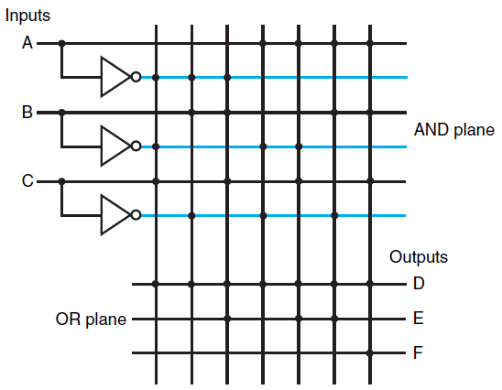
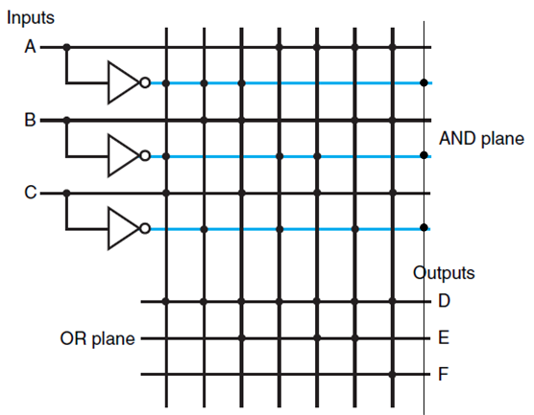
ROMs and PLAs
PLA is partially decoded
ROM is fully decoded
Contains a full output word for every possible input combination
Always contain more entries than PLA
PLA (7 entries)
ROM (8 entries – 1 unused)
Notes:
As the number of inputs grows, the number of entries in ROM grows exponentially. For most logic functions, the size of PLAs grows much more slowly, so it’s more efficient to use PLAs.
However, if your logic function changes, you made need to build a new PLA. A ROM can be changed to implement any logic function with the same # inputs and outputs.

Slide 8
Don’t Care
Don’t Care
We don’t care about the actual values
Output Don’t Care
We don’t care about the value of an output for some input combination
Input Don’t Care
An output only depends on some of the inputs
Advantages of Don’t Care
Easier to optimize the implementation of a logic function
Notes:
Basically this gives you lots of flexibility in how you can implement such a circuit, since for these don’t cares the output could be either 0 or 1.

Slide 9
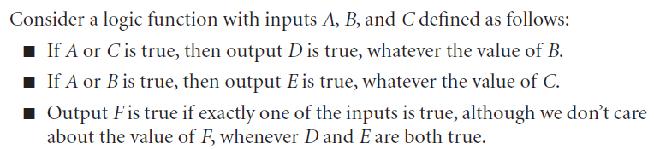
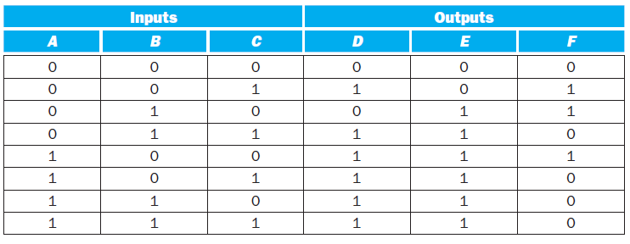
Example of Don’t Cares
Original Truth Table
Notes:
First, note that when D and E are true, we don’t care about F, so we can put X’s there…
A is in both the top two statements – if A is true, it forces both D and E to be true and we don’t care about B and C. This actually lets us remove multiple rows! Now if both B and C are true, then we don’t care about A.

Slide 10
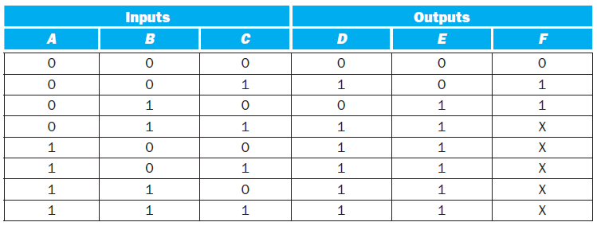
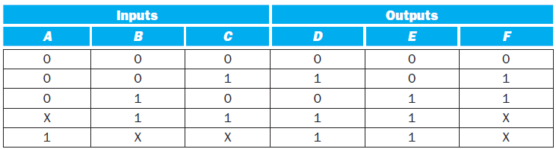
Example of Don’t Cares
Output Don’t Cares
Input Don’t Cares
Notes:
Don’t Care terms are key to getting efficient logic function implementations; they give us a lot of flexibility. These days, though, design tools can help you do logic minimization very well, without a lot of knowledge.

Slide 11
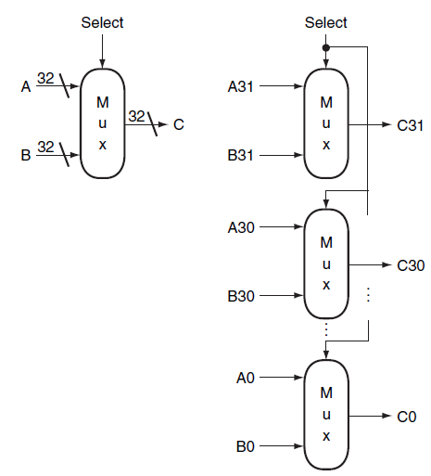
Array of Logic Elements
Bus
In logic design, a collection of data lines that is treated together as a single logical signal
Shared collection of lines with multiple sources
32-bit wide 2-to-1 multiplexor
Notes:
We’re almost to ALUs now. One other thing we need to talk about: “arrays” of logic elements.
Notice the difference between this and an n-to-1 multiplexor, say 32-to-1. Who can explain the difference to me?

Slide 12
1-Bit Arithmetic Logic Unit (B.5)
Notes:
In this lecture you’re going to learn a lot of new things: the basic building blocks of a computer. We’ll slowly combine these to learn how many components of a computer are built up.

Slide 13
Bit, Byte, and Word
1 Bit – 0 or 1
1 Byte – 8 bits
1 Word – N bytes (in general)
4 bytes in a word (in our book)

Slide 14


Most Significant Bit and Least Significant Bit
Most Significant Bit (High-Order Bit)
The bit position having the greatest value
Usually the left-most bit
Least Significant Bit (Low-Order Bit)
The bit position having the smallest value
Usually the right-most bit
Notes:
Some terminology…

Slide 15


Endianness
Big Endian
The Most Significant Bit is first
Little Endian
The Least Significant Bit is first
Notes:
MIPS is big-endian, but Intel x86 is little endian! You will not need to deal with this usually, unless you are working with something smaller than a word. Or if you take Networking -- most networking protocols are big-endian.

Slide 16
Binary Representation of Integers
Unsigned Integers
0 and positive integers only
Signed Integers
0, negative, and positive integers
Three ways
Sign-Magnitude
1’s Complement
2’s Complement
Notes:
We talked before about representing positive integers…we call those “unsigned.”
But obviously sometimes we want to talk about negative numbers. There are a few different ways to represent negative numbers.
Some of this is foreshadowing chapter 2, but it will help to understand how the Adder works.

Slide 17
Unsigned Integers
Unsigned Integers
Consider a word = 4 bytes
Can represent numbers from 0 to 4294967295
Decimal:
0 to 2³²-1
Binary:
0 to 11111111111111111111111111111111₂
Example
6712₁₀ = 00000000 00000000 00011010 00111000₂
Notes:
Now, take a moment: you’re a Cpu designer 50 years ago and you need to compute with negative numbers. How would you implement signed integers (the ability to have both positive and negative numbers)?

Slide 18
Signed Integer – Sign Magnitude
Sign Magnitude
Use the most significant bit of the word to represent the sign
0 – Positive
1 – Negative
Rest of the number is encoded in magnitude part
Example
6712₁₀ = 00000000 00000000 00011010 00111000₂
-6712₁₀ = 10000000 00000000 00011010 00111000₂
Two representations of 0
0 = 00000000 00000000 00000000 00000000
-0 = 10000000 00000000 00000000 00000000
Cumbersome in Arithmetic
Notes:
Think about adding a negative number and a positive number

Slide 19
1’s Complement
1’s Complement
Negative number is stored as bit-wise complement of corresponding positive number
Use the most significant bit of the word to represent the sign
0 – Positive
1 – Negative
Example
6712₁₀ = 00000000 00000000 00011010 00111000₂
-6712₁₀ = 11111111 11111111 11100101 11000111₂
Still two representations of zero
0 = 00000000 00000000 00000000 00000000
-0 = 11111111 11111111 11111111 11111111

Slide 20
2’s Complement
2’s Complement
Positive number represented in the same way as sign-magnitude and 1’s complement
Negative number obtained by taking 1’s complement of positive number and adding 1
6712₁₀ = 00000000 00000000 00011010 00111000₂
1’s comp: -6712₁₀ = 11111111 11111111 11100101 11000111₂
2’s comp: -6712₁₀ = 11111111 11111111 11100101 11001000₂
One version of 0
Convenient in arithmetic

Slide 21
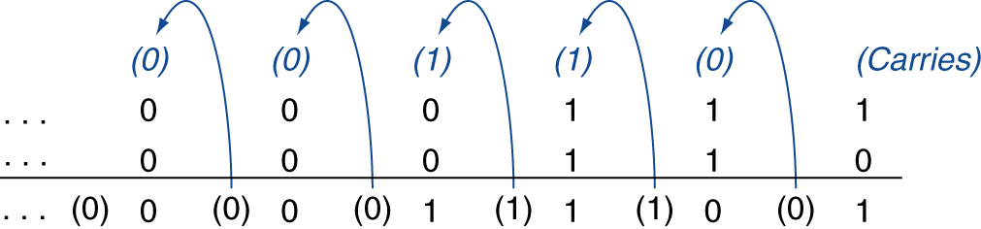
Integer Addition
Example: 7 + 6
00000000 00000000 00000000 00000111
+ 00000000 00000000 00000000 00000110
00000000 00000000 00000000 00001101
§3.2 Addition and Subtraction
Notes:
So let’s add two numbers…exercise with at least one negative number.

