Slide 1
Ch 3: Computer Arithmetic
Instructor: Robert Utterback
Lecture 25

Slide 2
Arithmetic for Computers
§3.1 Introduction
Operations on integers
Addition and subtraction
Multiplication and division
Dealing with overflow
Floating-point real numbers
Representation and operations

Slide 3
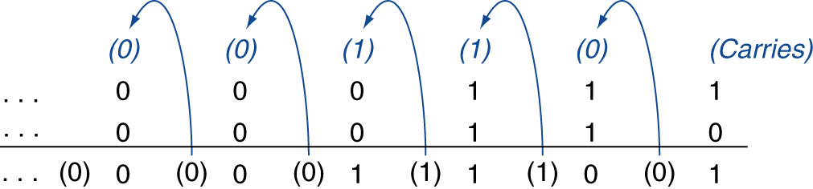
Integer Addition
Example: 7 + 6
§3.2 Addition and Subtraction
Overflow if result out of range
Adding +ve and –ve operands, no overflow
Adding two +ve operands
Overflow if result sign is 1
Adding two –ve operands
Overflow if result sign is 0
Notes:
When do we know if we had overflow?

Slide 4
Integer Subtraction
Add negation of second operand
Example: 7 – 6 = 7 + (–6)
+7: 0000 0000 … 0000 0111 –6: 1111 1111 … 1111 1010 +1: 0000 0000 … 0000 0001
Overflow if result out of range
Subtracting two +ve or two –ve operands, no overflow
Subtracting +ve from –ve operand
Overflow if result sign is 0
Subtracting –ve from +ve operand
Overflow if result sign is 1

Slide 5
Overflow Detection
0
0
1
0
1
1
0
0
0
0
1
0
2
1
1
0
0
- 4
+
0
0
1
1
3
+
1
1
1
0
- 2
0
1
0
1
5
1
0
1
0
- 6
0
1
1
1
1
0
1
0
0
1
1
1
7
1
1
0
0
- 4
+
0
0
1
1
3
+
1
0
1
1
- 5
1
0
1
0
-6
0
1
1
1
7
So how do we detect overflow for signed arithmetic?
Notes:
Check last carryIn vs. carryout.

Slide 6
Dealing with Overflow
Some languages (e.g., C) ignore overflow
Use MIPS addu, addui, subu instructions
Other languages (e.g., Ada, Fortran) require raising an exception
Use MIPS add, addi, sub instructions
On overflow, invoke exception handler
Save PC in exception program counter (EPC) register
Jump to predefined handler address
mfc0 (move from coprocessor reg) instruction can retrieve EPC value, to return after corrective action
Notes:
By the way, depends on the language to utilize these…C does not!
Not the only way to handle overflow…

Slide 7
Arithmetic for Multimedia
Saturating operations
On overflow, result is largest representable value
c.f. 2s-complement modulo arithmetic
E.g., clipping in audio, saturation in video
Notes:
e.g. volume knob/button

Slide 8
Multiplication

Slide 9
Sequential Version of Multiplication Algorithm and Hardware
Start with long-multiplication approach
multiplicand
1000
× 1001
1000
0000
0000
1000
1001000
multiplier
product
Length of product is the sum of operand lengths

Slide 10
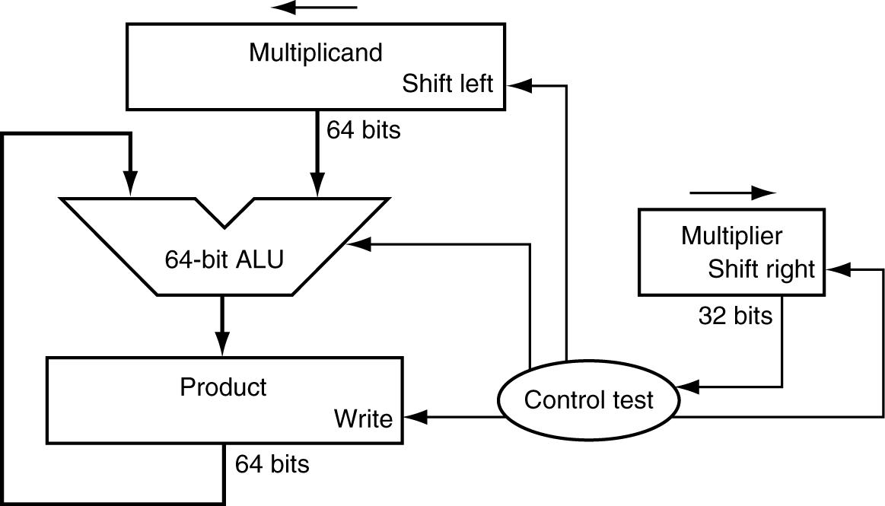
Multiplication Hardware
First version of Multiplication Hardware
32-bit multiplier
64-bit ALU
64-bit product (initialized to 0)
Notes:
Unsigned numbers!

Slide 11
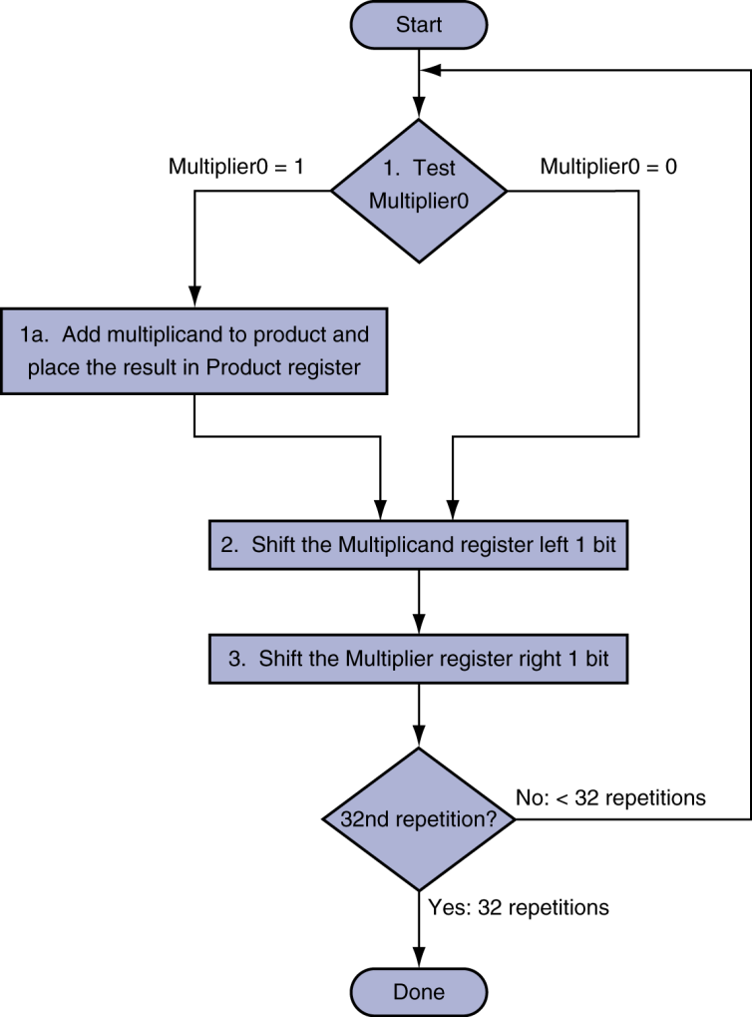
Multiplication Hardware
Initially 0
Notes:
Try an example: 2 * 3 with just 4 bits
Table:
Iteration #, Step (1a,2,3), Multiplier, Multiplicand, Product

Slide 12
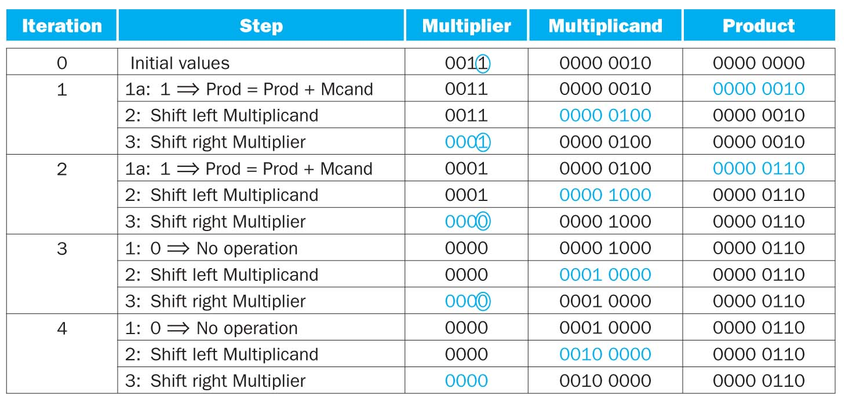
Example
2*3
Notes:
#Now do an example with 8 bits: 0x62 * 0x12
What about -4 * 3 (don’t need to do the hardware process, you can work it out by hand)
Use 4 bits for multiplicand and multiplier, 8 for result.
Results is 40! Should be -12!

