Slide 1
Simple DataPath Implementation (4.4)
Lecture 36
Notes:
Try to come up with as much of the data path diagram as we can

Slide 2
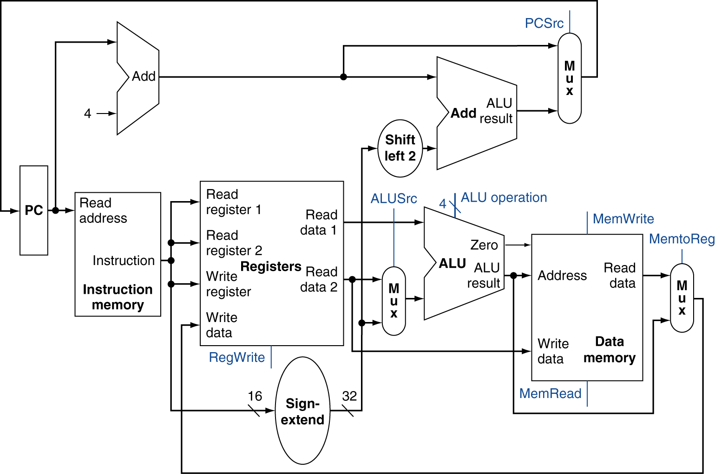
Full Datapath

Slide 3
ALU Control
ALU used for
Load/Store: add
Branch: subtract
R-type: depends on funct field
§4.4 A Simple Implementation Scheme
ALU control | Function
0000 | AND
0001 | OR
0010 | add
0110 | subtract
0111 | set-on-less-than
1100 | NOR
Notes:
Why that relationship between add and subtract? Remember the picture of our ALU?
Need to generate these 4 ALU control bits based on the instruction we are currently executing..

Slide 4
ALU Control
Assume 2-bit ALUOp derived from opcode
Combinational logic derives ALU control
opcode | ALUOp | Operation | funct | ALU function | ALU control
lw | 00 | load word | XXXXXX | add | 0010
sw | 00 | store word | XXXXXX | add | 0010
beq | 01 | branch equal | XXXXXX | subtract | 0110
R-type | 10 | add | 100000 | add | 0010
 |  | subtract | 100010 | subtract | 0110
 |  | AND | 100100 | AND | 0000
 |  | OR | 100101 | OR | 0001
 |  | set-on-less-than | 101010 | set-on-less-than | 0111

Slide 5
The Main Control Unit
Control signals derived from instruction
R-type
0
rs
rt
rd
shamt
funct
31:26
25:21
20:16
15:11
10:6
5:0
Load/ Store
35 or 43
rs
rt
address
31:26
25:21
20:16
15:0
Branch
4
rs
rt
address
31:26
25:21
20:16
15:0
opcode
always read
read, except for load
write for R-type and load
sign-extend and add

Slide 6
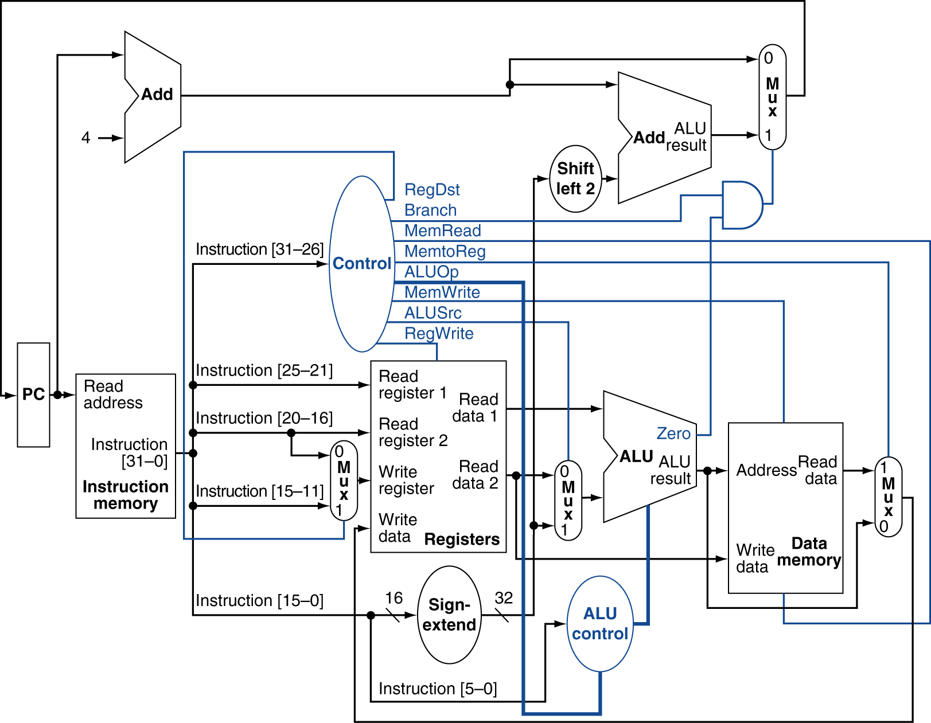
Datapath With Control
Notes:
Trace through an add, someone. How would an addi work?

Slide 7
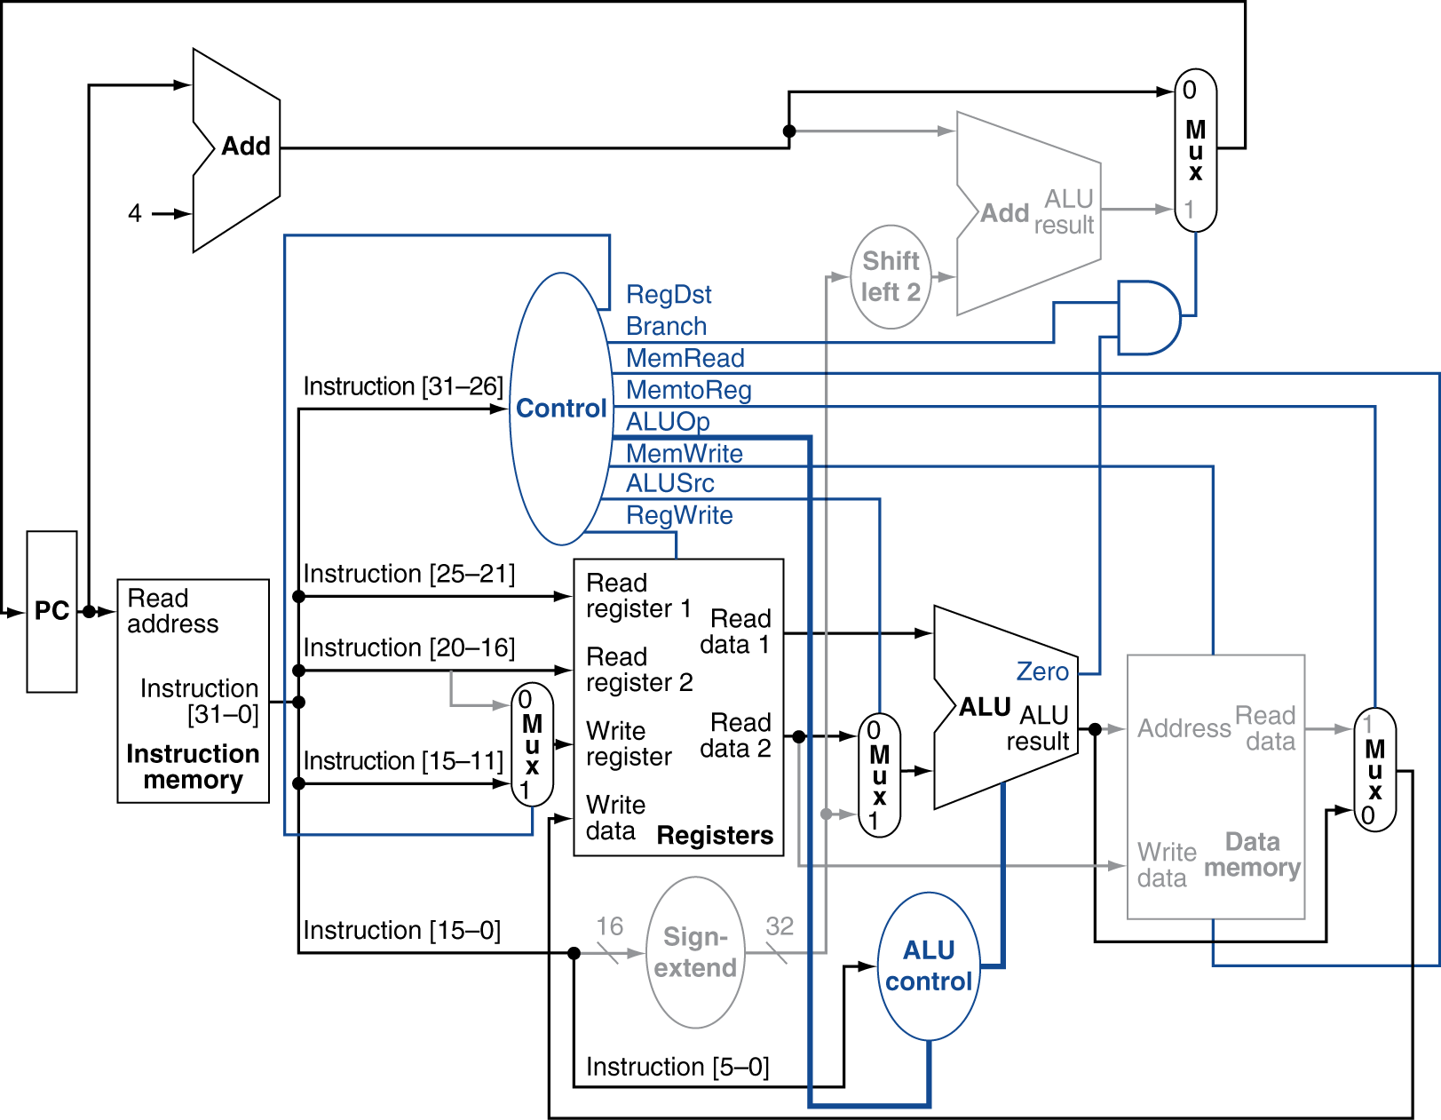
R-Type Instruction
Notes:
Now trace through a lw.

Slide 8
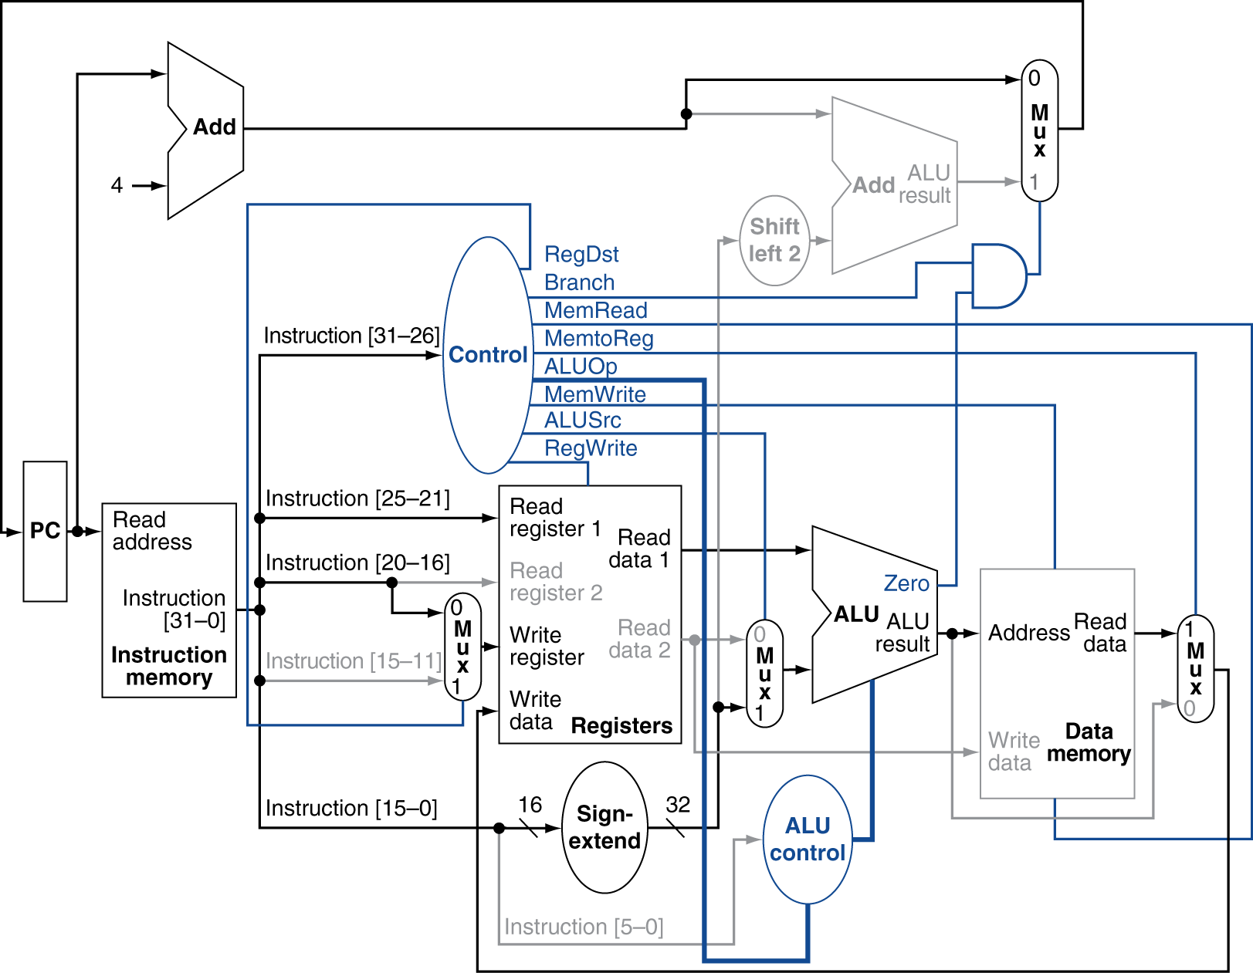
Load Instruction
Notes:
Now trace through a beq.

Slide 9
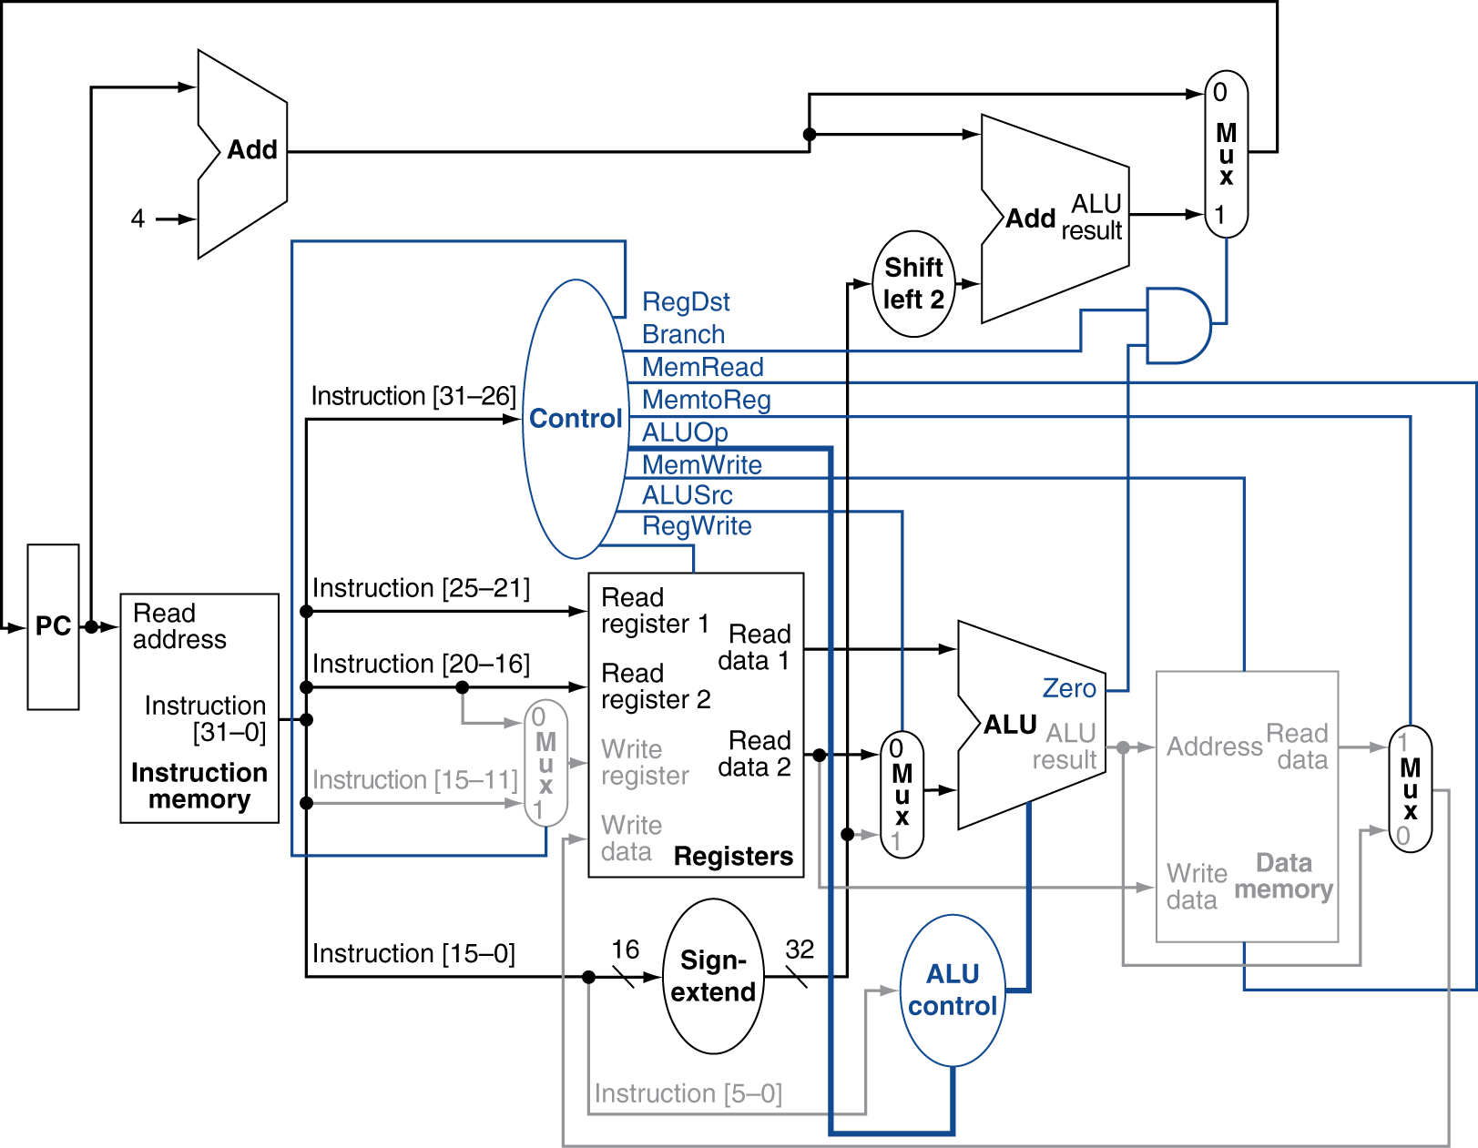
Branch-on-Equal Instruction
Notes:
Now, this is almost complete. How might we implement the jump instruction? What do we need to DO (what is the specification of jump)? What components do we need to add?

