Slide 1
Procedures (Functions)
Instructor: Robert Utterback
Lecture 18

Slide 2
Procedure Calling
Don’t overwrite registers other procedures are using
Don’t overwrite memory used in other procedures
Need to pass in parameters
Need to get result from function
§2.8 Supporting Procedures in Computer Hardware
Notes:
The previous procedure (e.g. main) was using some registers…what if the procedure it calls also wants to use those registers.
It is way to complex to always be aware of which procedures are active and which registers they are using…

Slide 3
Procedure Calling
Steps required
Place parameters in registers
Transfer control to procedure
Acquire storage for procedure
Each procedure instance has own storage area
Perform procedure’s operations
Place result in register for caller
Return to place of call
§2.8 Supporting Procedures in Computer Hardware
Notes:
All the procedures use an area of memory called the stack, and each procedure instance has its own stack FRAME.
So far I have just assumed everything is in registers…

Slide 4
Register Usage
$a0 – $a3: arguments (reg’s 4 – 7)
$v0, $v1: result values (reg’s 2 and 3)
$t0 – $t9: temporaries
Can be overwritten by callee
$s0 – $s7: saved
Must be saved/restored by callee
$gp: global pointer for static data (reg 28)
$sp: stack pointer (reg 29)
$fp: frame pointer (reg 30)
$ra: return address (reg 31)
Notes:
Need to save the s registers, use them, then restore them when we’re done…where do we save them?
Any compiled language will have an ABI, which defines, among other things, the registers used for parameters. Notice this is a feature of a language and/or compiler, NOT the assembly language.

Slide 5
Non-Leaf Procedures
Procedures that call other procedures
For nested call, caller needs to save on the stack:
Its return address
Any arguments and temporaries needed after the call
Restore from the stack after the call

Slide 6
Non-Leaf Procedure Example
C code:
int fact (int n) { if (n < 1) return 1; else return n * fact(n - 1); }
Argument n in $a0
Result in $v0
Notes:
fact: addi $sp, $sp, -8 # adjust stack for 2 items sw $ra, 4($sp) # save return address sw $a0, 0($sp) # save argument slti $t0, $a0, 1 # test for n < 1 beq $t0, $zero, L1 addi $v0, $zero, 1 # if so, result is 1 addi $sp, $sp, 8 # pop 2 items from stack jr $ra # and return L1: addi $a0, $a0, -1 # else decrement n jal fact # recursive call lw $a0, 0($sp) # restore original n lw $ra, 4($sp) # and return address addi $sp, $sp, 8 # pop 2 items from stack mul $v0, $a0, $v0 # multiply to get result jr $ra # and return

Slide 7
Non-Leaf Procedure Example
MIPS code:
fact: addi $sp, $sp, -8 # adjust stack for 2 items sw $ra, 4($sp) # save return address sw $a0, 0($sp) # save argument slti $t0, $a0, 1 # test for n < 1 beq $t0, $zero, L1 addi $v0, $zero, 1 # if so, result is 1 addi $sp, $sp, 8 # pop 2 items from stack jr $ra # and return L1: addi $a0, $a0, -1 # else decrement n jal fact # recursive call lw $a0, 0($sp) # restore original n lw $ra, 4($sp) # and return address addi $sp, $sp, 8 # pop 2 items from stack mul $v0, $a0, $v0 # multiply to get result jr $ra # and return
Notes:
Notice there is some waste here…

Slide 8
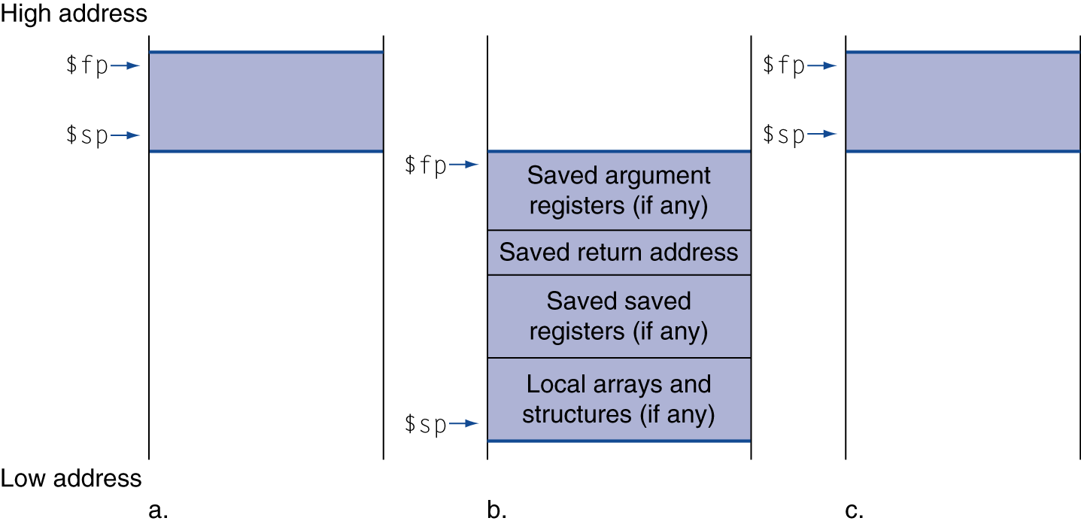
Local Data on the Stack
Local data allocated by callee
e.g., C automatic variables
Procedure frame (activation record)
Used by some compilers to manage stack storage

Slide 9
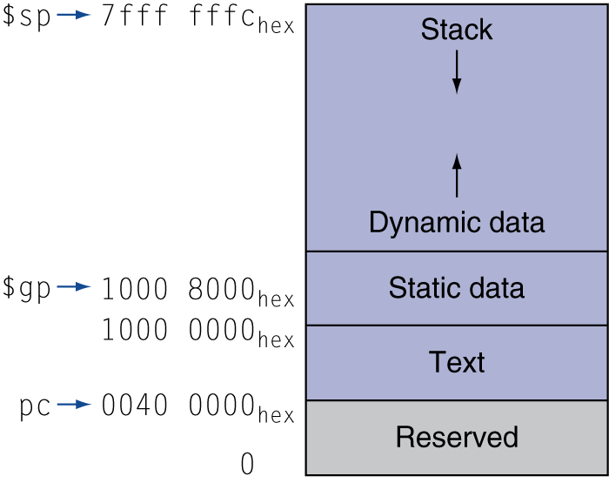
Memory Layout
Text: program code
Static data: global variables
e.g., static variables in C, constant arrays and strings
$gp initialized to address allowing ±offsets into this segment
Dynamic data: heap
E.g., malloc in C, new in Java and C++
Stack: automatic storage

Slide 10
Summary
Procedure Call
Registers used
Stack
jal and jr
leaf and no-leaf procedure
Allocating space for new data on the heap

