Slide 1
Ch 3: Multiplication
Instructor: Robert Utterback
Lecture 28

Slide 2
Sequential Version of Multiplication Algorithm and Hardware
Start with long-multiplication approach
multiplicand
1000
× 1001
1000
0000
0000
1000
1001000
multiplier
product
Length of product is the sum of operand lengths

Slide 3
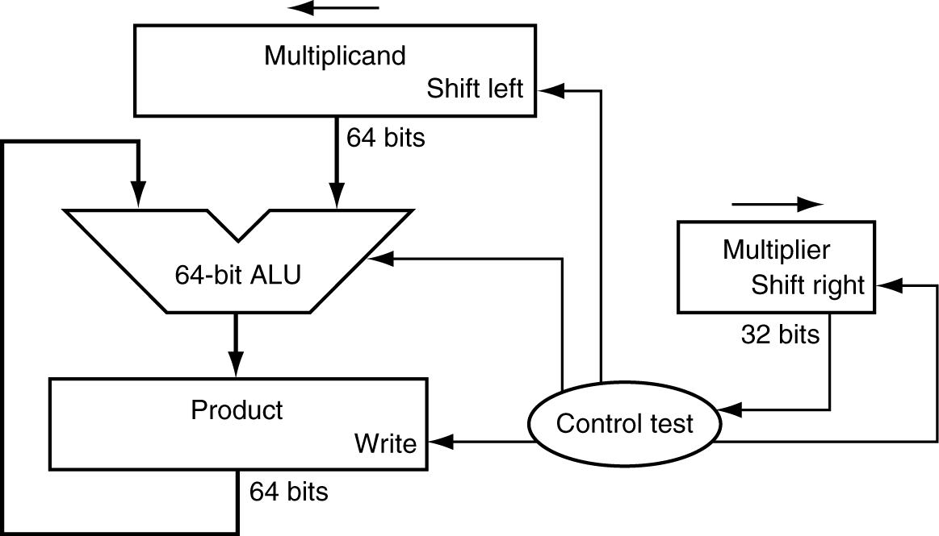
Multiplication Hardware
First version of Multiplication Hardware
32-bit multiplier
64-bit ALU
64-bit product (initialized to 0)
Notes:
Unsigned numbers!

Slide 4
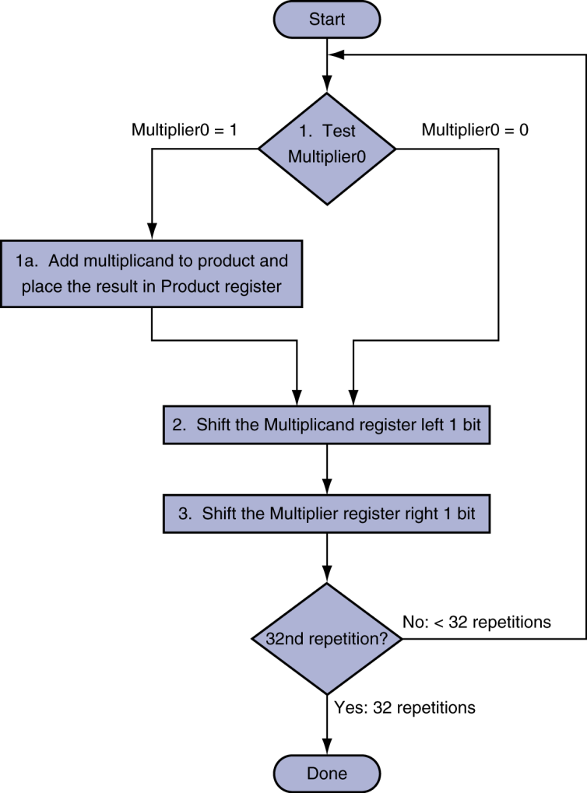
Multiplication Hardware
Initially 0
Notes:
Try an example: 2 * 3 with just 4 bits
Table:
Iteration #, Step (1a,2,3), Multiplier, Multiplicand, Product

Slide 5
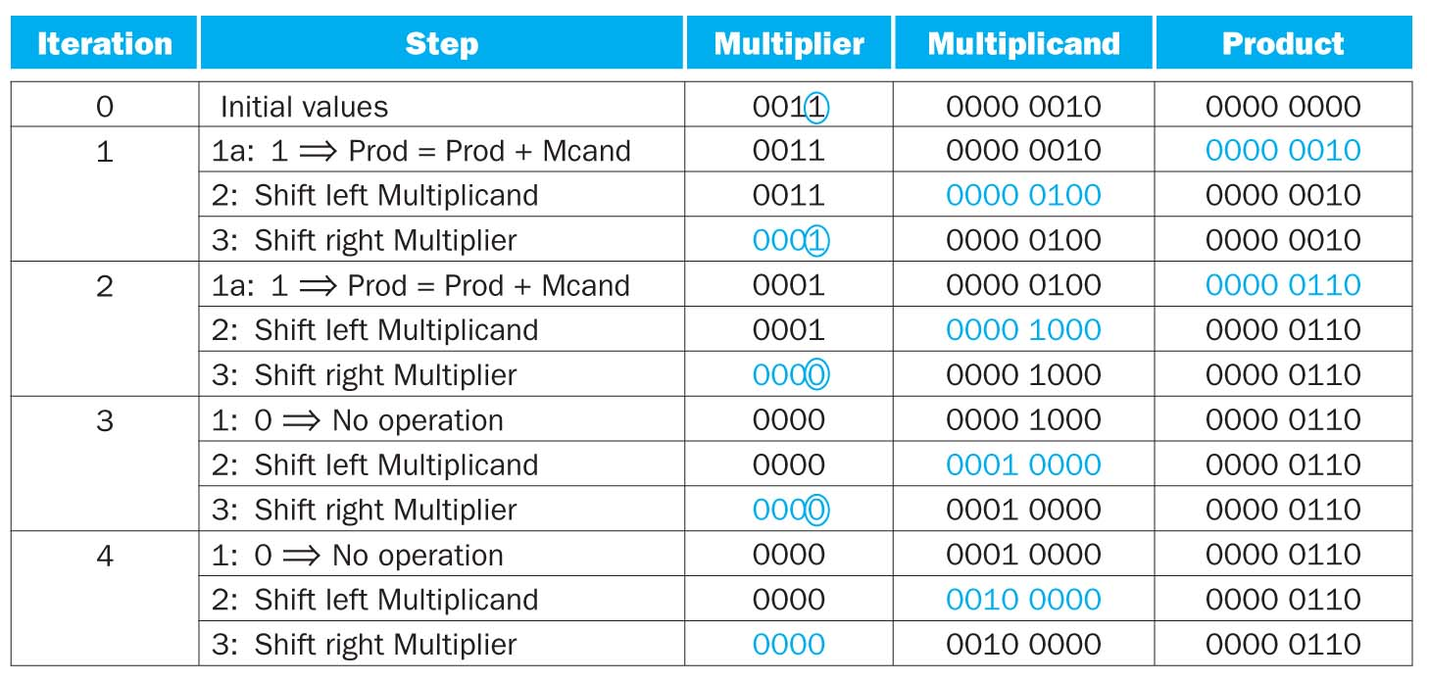
Example
2*3
Notes:
Now do an example with 8 bits: 0x62 * 0x12

Slide 6
Signed Multiplication
Option 1:
Multiply with absolute value
Compute the correct sign at end
Option 2:
Previously algorithm almost works
“Sign extend” when shifting

Slide 7
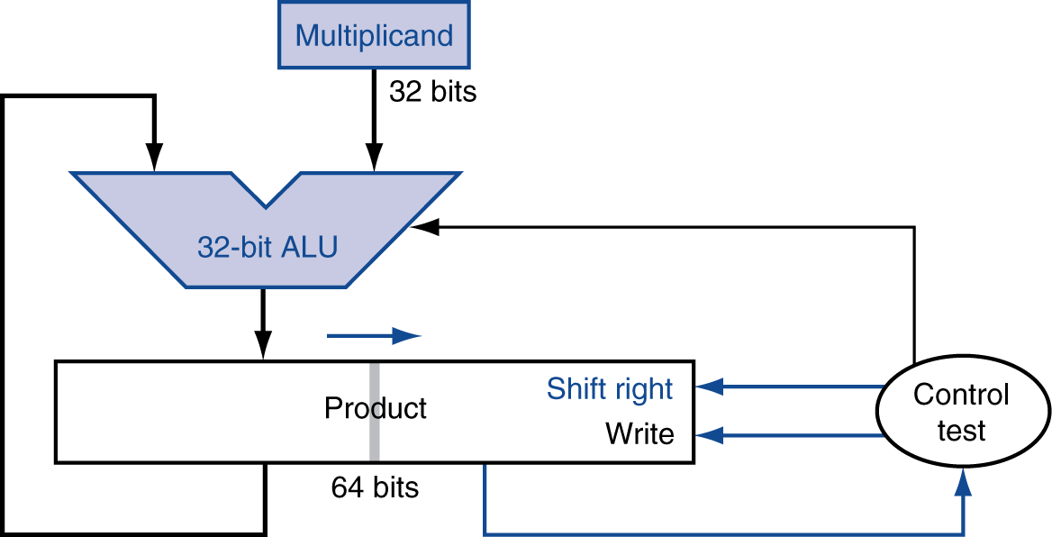
Optimized Multiplier
Refined Multiplier
32-bit multiplicand and ALU
Multiplier is placed in the right half of the product register
64-bit product register

Slide 8
Optimized Multiplier
Perform steps in parallel: add/shift
One cycle per partial-product addition
That’s ok, if frequency of multiplications is low

