Slide 1
3.3: Multiplication
Instructor: Robert Utterback
Lecture 29

Slide 2
Sequential Version of Multiplication Algorithm and Hardware
Start with long-multiplication approach
multiplicand
1000
× 1001
1000
0000
0000
1000
1001000
multiplier
product
Length of product is the sum of operand lengths
Notes:
Which is the multiplier, which is multiplicand?

Slide 3
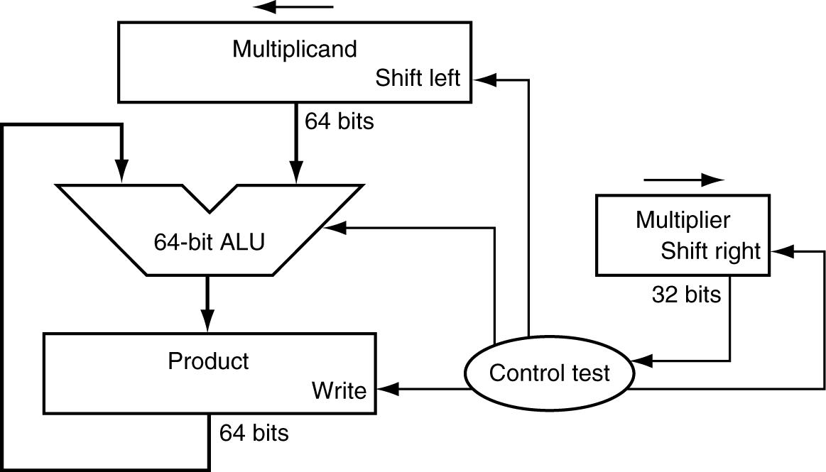
Multiplication Hardware
First version of Multiplication Hardware
32-bit multiplier
64-bit ALU
64-bit product (initialized to 0)
Notes:
Unsigned numbers!

Slide 4
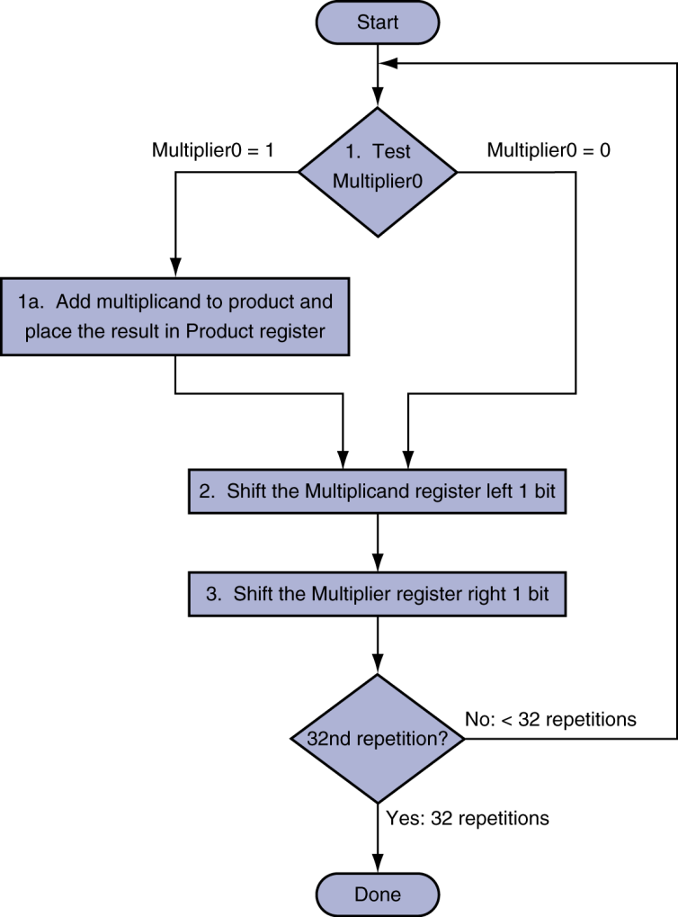
Multiplication Hardware
Initially 0
Notes:
Try an example: 2 * 3 with just 4 bits
Table:
Iteration #, Step (1a,2,3), Multiplier, Multiplicand, Product

Slide 5
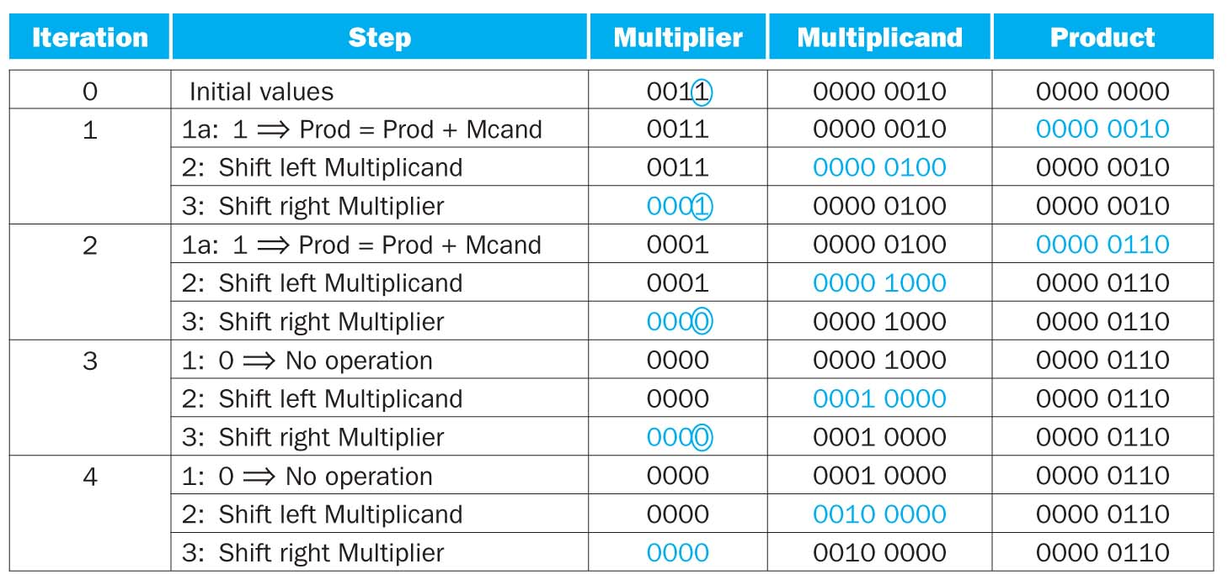
Example
2*3
Notes:
Now do an example with 8 bits: 0x62 * 0x12

Slide 6
Signed Multiplication
Option 1:
Multiply with absolute value
Compute the correct sign at end
Option 2:
Previously algorithm almost works
“Sign extend” when shifting

Slide 7
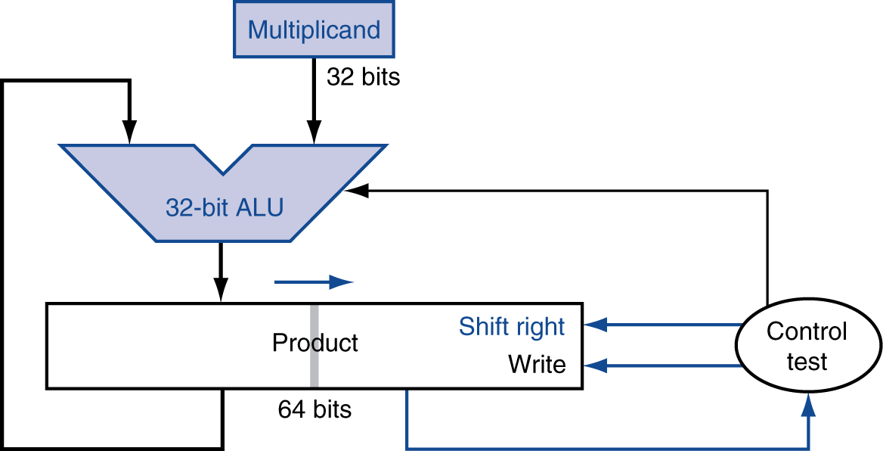
Optimized Multiplier
Refined Multiplier
32-bit multiplicand and ALU
Multiplier is placed in the right half of the product register
64-bit product register

Slide 8
Optimized Multiplier
Perform steps in parallel: add/shift
One cycle per partial-product addition
That’s ok, if frequency of multiplications is low
Notes:
Multiplier is in the right half of the product register.

Slide 9
Alternative Multiplier
One 32-bit adder for each bit of multiplier
Input1 is multiplicand AND multiplier bit
Input2 is output of previous adder
“Chain” of adders, 32 high

Slide 10
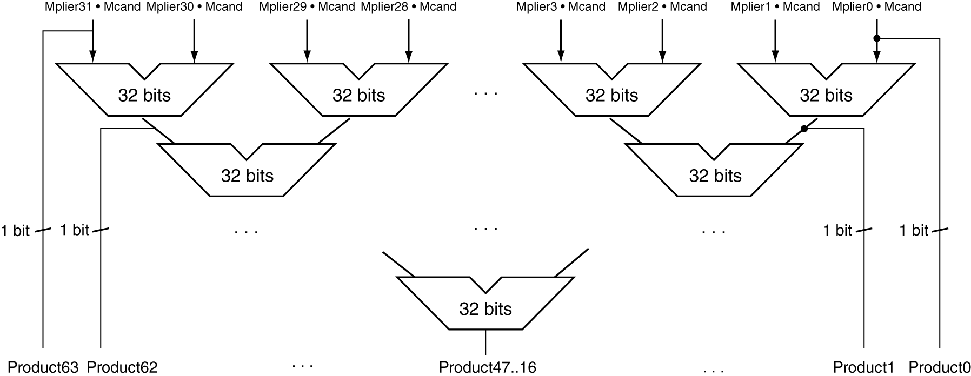
Faster Multiplier
Uses multiple adders
Cost/performance tradeoff
Can be pipelined
Several multiplication performed in parallel
Notes:
Not correct!

Slide 11
MIPS Multiplication
Two 32-bit registers for product
HI: most-significant 32 bits
LO: least-significant 32-bits
Instructions
mult rs, rt / multu rs, rt
64-bit product in HI/LO
mfhi rd / mflo rd
Move from HI/LO to rd
Can test HI value to see if product overflows 32 bits
mul rd, rs, rt
Least-significant 32 bits of product –> rd
Notes:
This last is a pseudoinstruction

Slide 12
Back to the Example
A better way to do 2*3?
3 << 1
using SLL
Almost all compilers will perform a strength reduction optimization by replacing multiplication of power of 2 by shifting

Slide 13
Division
§3.4 Division
Check for 0 divisor
Long division approach
If divisor ≤ dividend bits
1 bit in quotient, subtract
Otherwise
0 bit in quotient, bring down next dividend bit
Restoring division
Do the subtract, and if remainder goes < 0, add divisor back
Signed division
Divide using absolute values
Adjust sign of quotient and remainder as required
quotient
dividend
1001
1000 1001010
-1000
10
101
1010
-1000
10
divisor
remainder
n-bit operands yield n-bit quotient and remainder

Slide 14
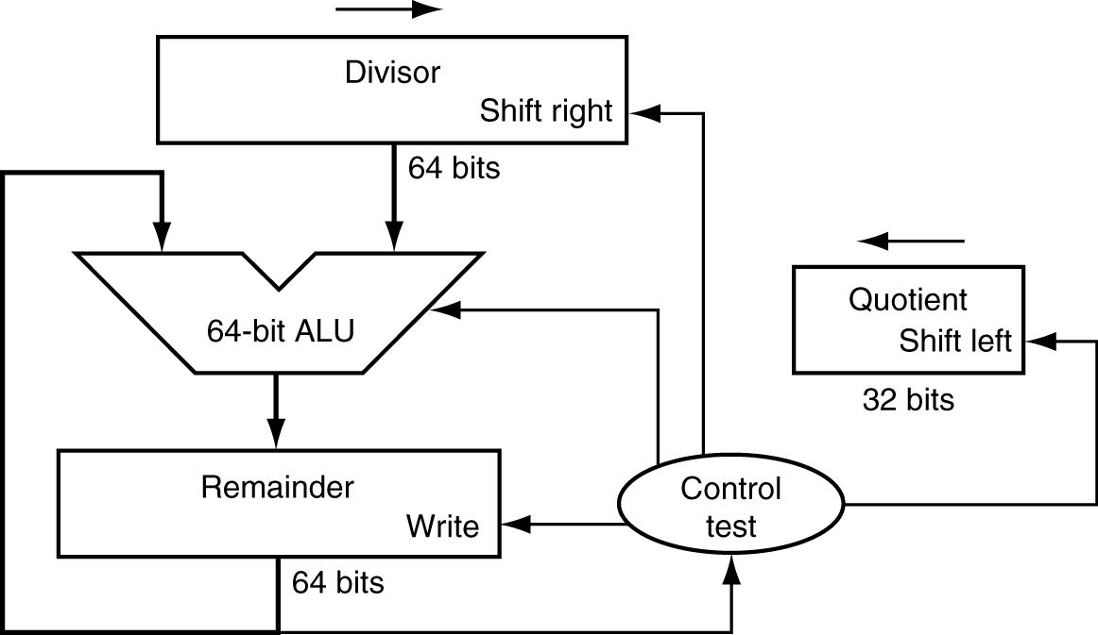
Division Hardware
First version of Division Hardware
32-bit quotient
64-bit ALU
64-bit remainder
Initially divisor in left half
Initially dividend
Notes:
Divisor starts in left half of divisor register, remainder initialized to dividend

Slide 15
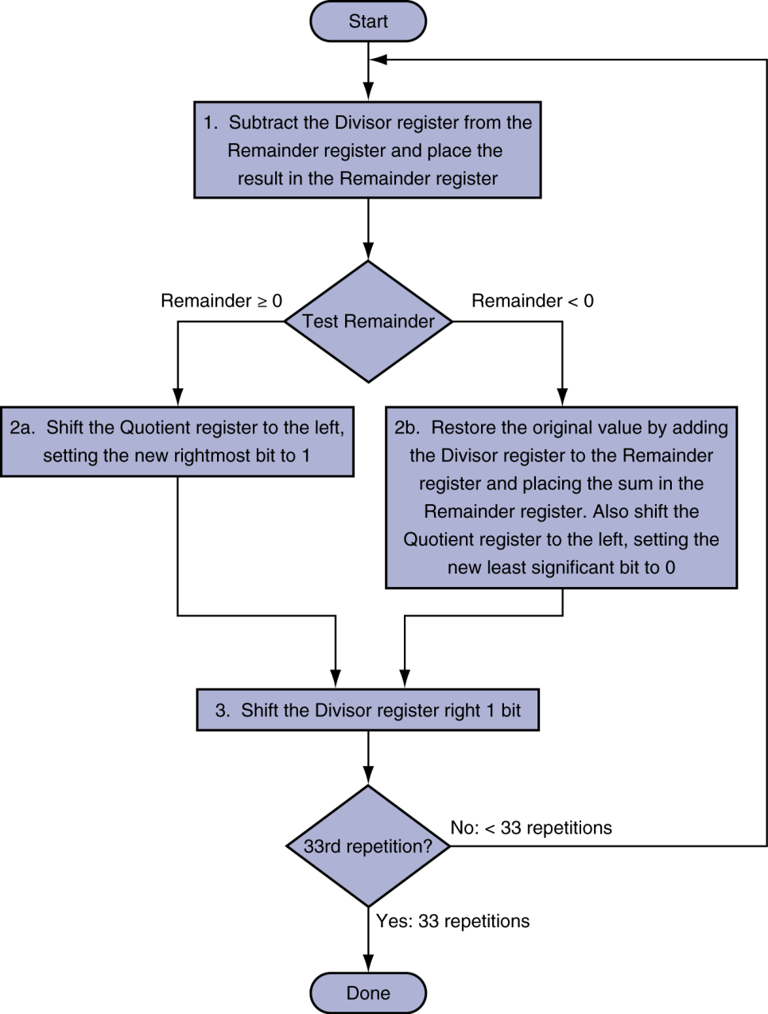
First Version Division Hardware
Initially divisor in left half
Initially dividend
Notes:
Example: Fill out a table for 7/2
Table:
Iteration, Step (1,2b,3), Quotient, Divisor, Remainder

Slide 16
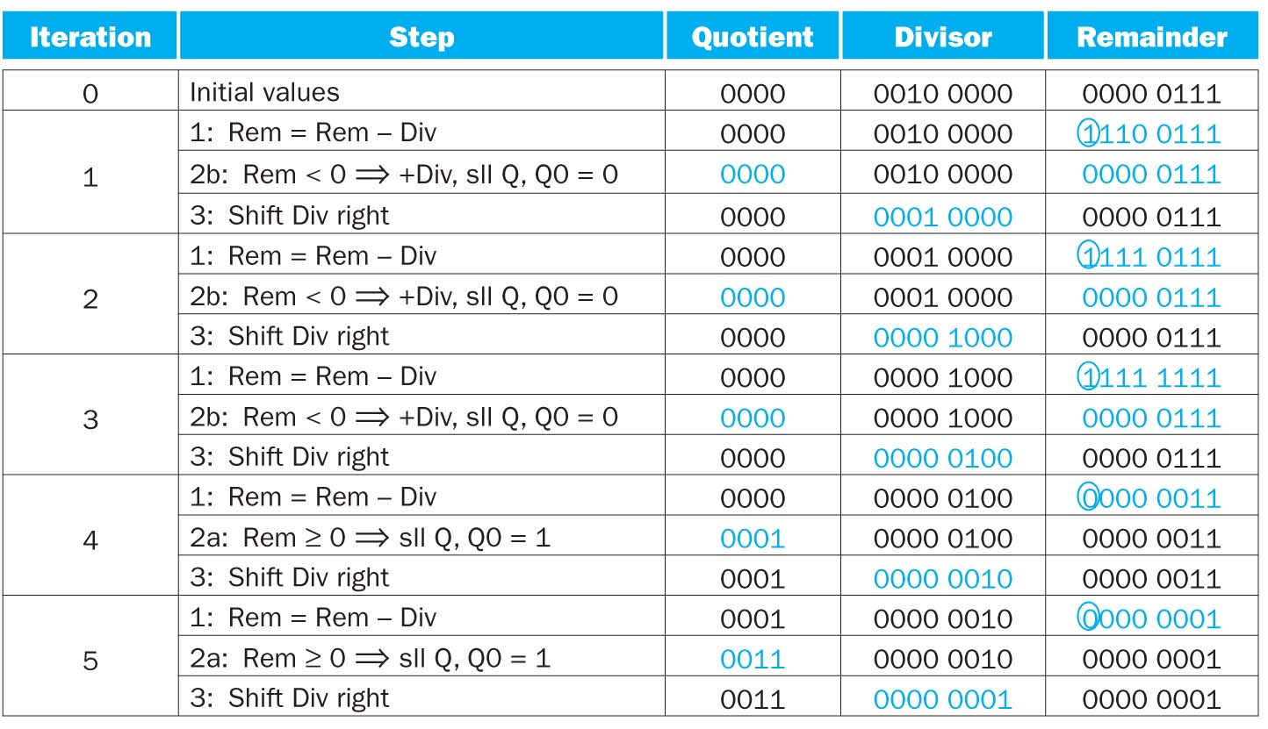
Example
7/2

