Slide 1
Finish Performance + Logic Design
Instructor: Robert Utterback
Lecture 4
Notes:
In this lecture you’re going to learn a lot of new things: the basic building blocks of a computer. We’ll slowly combine these to learn how many components of a computer are built up.

Slide 2
SPEC CPU Benchmark
Programs used to measure performance
Supposedly typical of actual workload
Standard Performance Evaluation Corp (SPEC)
Develops benchmarks for CPU, I/O, Web, …
SPEC CPU2006
Elapsed time to execute a selection of programs
Negligible I/O, so focuses on CPU performance
Normalize relative to reference machine
Summarize as geometric mean of performance ratios
CINT2006 (integer) and CFP2006 (floating-point)
Notes:
Section 1.9
In general, for units that are proportional to time (like latency or response time), use arithmetic mean.
For unitless quantities (e.g. speedup ratios) use the geometric mean
Note that this is also measuring the compiler! So if you want a true comparison, compare with the same compiler.

Slide 3
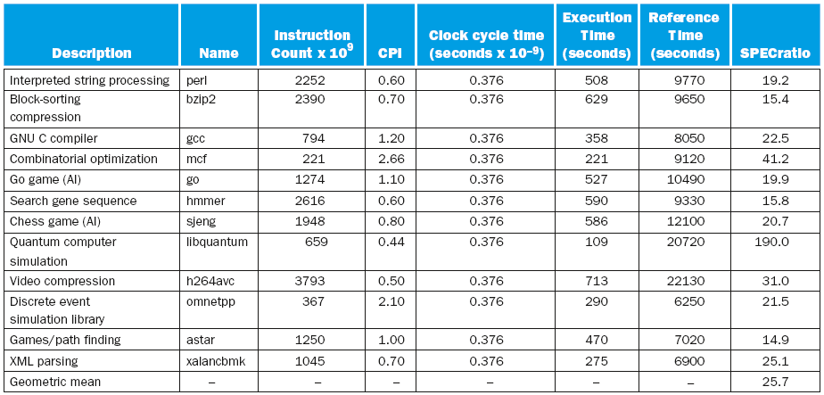
CINT2006 for Intel Core i7 920
Notes:
Notice the high CPI values in some of the benchmarks. This is typically because of high cache miss rates.
Also, note importance of geomean here. Otherwise 190 for quantum simulation would be given too much weight.

Slide 4
SPEC Power Benchmark
Power consumption of server at different workload levels
Performance: ssj_ops/sec
Power: Watts (Joules/sec)

Slide 5
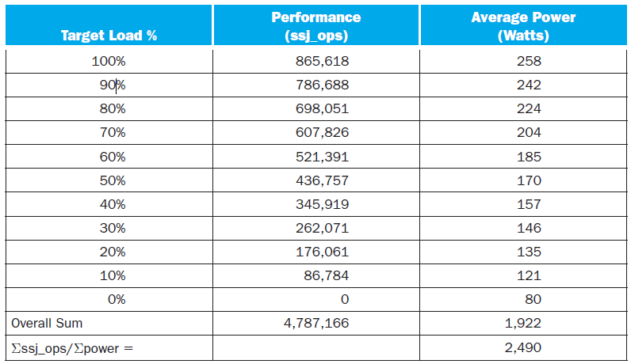
SPECpower_ssj2008 for Xeon X5650

Slide 6
Fallacy: Low Power at Idle
Look back at i7 power benchmark
At 100% load: 258W
At 50% load: 170W (66%)
At 10% load: 121W (47%)
Google data center
Mostly operates at 10% – 50% load
At 100% load less than 1% of the time
Consider designing processors to make power proportional to load

Slide 7
Pitfall: MIPS as a Performance Metric
MIPS: Millions of Instructions Per Second
Doesn’t account for
Differences in ISAs between computers
Differences in complexity between instructions
CPI varies between programs on a given CPU
Notes:
Big picture: execution time is the only measure of performance that is always valid. Sometimes other metrics are valid in a limited context, but it is an error to use them beyond that context.
Can be useful to compare same program across same ISA. Otherwise, can be deceptive: make the clock rate really fast and execute noops.

Slide 8
Performance Marketing
“Speed Demons” vs. “Brainiacs”
Get CPI down vs. get CT down
CPI
Clean ISA
Performance depends on program
CT
Common ISA among many chips
Easy to market – doesn’t depend on program
Notes:
This is just a story telling slide but I feel the students find it interesting. I tell them about these two competing companies. One focuses on getting CPI down, the other on CT faster. The CPI focused designers have a much cleaner ISA as well, but the CT designers have a more common ISA and, more importantly, they recognize it’s easy to market CT. CT is a fixed number whereas CPI depends on programs. So when the average consumer goes to buy a processor, they only see CT. CT focused won (Intel) and CPI focused lost (Alpha). But now that we’ve hit the power and thermal wall, CT is stagnant. So the CT focused company has to remarket to something other than CT.
If we can’t use something like raw processor speed (CT), if we want CPI - we need to look at performance on benchmarks
Based on a slide by Leo Porter.

Slide 9
Pitfall: Amdahl’s Law
Improving an aspect of a computer and expecting a proportional improvement in overall performance
§1.10 Fallacies and Pitfalls
Notes:
Section 1.10
A pitfall to expect that performance improvement, but Amdahl's law itself is actually a really useful tool.

Slide 10
Pitfall: Amdahl’s Law
Improving an aspect of a computer and expecting a proportional improvement in overall performance
§1.10 Fallacies and Pitfalls
Example: A program runs for 100 s. 80 s are due to multiplication instructions.
How much do we need to improve the multiply to achieve 2x performance?
Notes:
Section 1.10
Example: a program runs 100 s, with multiply operations accounting for 80 s of the time
Basically law of diminishing returns

Slide 11
Amdahl’s Law
Example: A program runs for 100 seconds. Of the 100 seconds, 80 seconds are due to multiplies.
2x improvement: n = 2.66
3x improvement: n = 6
4x improvement: n = 16
5x improvement: n = ?
Can’t be done!
Corollary: make the common case fast
Notes:
Make the common case fast, b/c improving the other parts can only give you limited improvement.
Also used for calculating how much improvement you can get when writing a parallel program.

Slide 12
Amdahl’s Law and Parallelism
Our program is 90% parallelizable (segment of code executable in parallel on multiple cores) and runs in 100 seconds with a single core. What is the execution time if you use 2 cores (assume no overhead for parallelization)?
Execution time
after improvement
Execution Time Affected
=
+
Execution Time Unaffected
Amount of Improvement
Selection | Execution Time
A | 55 seconds
B | 50 seconds
C | 100 seconds
D | 95 seconds
E | None of the above
Notes:
Correct answer A
Close to half.
Slide by Leo Porter.

Slide 13
Amdahl’s Law and Parallelism
Our program is 90% parallelizable (segment of code executable in parallel on multiple cores) and runs in 100 seconds with a single core. What is the execution time if you use 4 cores (assume no overhead for parallelization)?
Execution time
after improvement
Execution Time Affected
=
+
Execution Time Unaffected
Amount of Improvement
Selection | Execution Time
A | 25 seconds
B | 32.5 seconds
C | 50 seconds
D | 92.5 seconds
E | None of the above
Notes:
Correct answer: B
Although these two questions are plug and chug questions to some degree, they serve two purposes. 1. To understand how to use Amdahl’s Law and 2. to get a glimpse of the relationship between serial and parallel code.
Not as close to ¼ of the total sequential time.
Slide by Leo Porter.

Slide 14
Amdahl’s Law
So what does Amdalh’s Law mean at a high level?
Selection | “BEST” message from Amdahl’s Law
A | Parallel programming is critical for improving performance
B | Improving serial code execution is ultimately the most important goal.
C | Performance is strictly tied to the ability to determine which percentage of code is parallelizable.
D | The impact of a performance improvement is limited by the percent of execution time affected by the improvement
E | None of the above
Notes:
Correct answer: D
All of these are true in some degree, but A-C are what we’ve learned from using Amdahl’s Law to evaluation parallel speedups on multi-core processors. D is the only one which is a universal interpretation of Amdahl’s Law.
Slide by Leo Porter.

Slide 15
Concluding Remarks
Be careful how you specify “performance”
Execution time is best measure
ET = IC * CPI * CT
Instruction set architecture
The hardware/software interface
Use real application to benchmark
Make the common case fast
Power is a limiting factor
Use parallelism to improve performance
§1.9 Concluding Remarks
Notes:
Section 1.11
Based off of a slide by Leo Porter.

Slide 16
Logic Design
Notes:
In this lecture you’re going to learn a lot of new things: the basic building blocks of a computer. We’ll slowly combine these to learn how many components of a computer are built up.

Slide 17
0s and 1s
Modern Computers are Digital
1
Corresponding to a high voltage
Signal asserted
Logical True
0
Corresponding to low voltage
Signal deasserted
Logical False
0s and 1s are complimentary
0’s inverse is 1
1’s inverse is 0
Notes:
Everything we’re going to do involves just these two values! Everything can be represented this way, and all the operations we need to do just combine 0s and 1s. This is also the reason we use the binary system to represent numbers….

Slide 18
Binary Representation of Positive Integers
0 : 0000 0000
1 : 0000 0001
2 : 0000 0010
3 : 0000 0011
4 : 0000 0100
5 : 0000 0101
6 : 0000 0110
7 : 0000 1111
8 : 0000 1000
16: 0001 0000
32: 0010 0000
64: 0100 0000
128:1000 0000
Notes:
Each of the columns represents a power of 2. Just like in decimal each column represents a power of 10. Example...

Slide 19
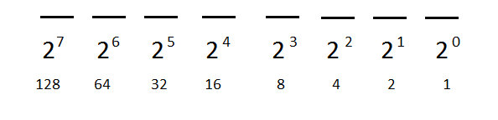
Binary Representation of Positive Integers
100
100 = 64 + 32 + 4
0 1 1 0 0 1 0 0
Notes:
Using a different numbering system has been done before – Babylonians used a base-60 system, Mayans used a base-20 system.

Slide 20
Binary Representation of Positive Integers
45
45 = 32 + 8 + 4 + 1
0 0 1 0 1 1 0 1
Notes:
So we can represent all our numbers in binary. And in fact we can represent everything we want in binary. AND we can perform any operations by just manipulating ones and zeros. We'll do it by building up blocks of logic functions.

Slide 21
Combinational Logic and Sequential Logic
Combinational Logic
A logic system without (changeable) memory
Computes the same output given the same input
Sequential Logic
A group of logic elements that contain memory
Value depends on the inputs as well as the current contents of the memory
Notes:
Logic: performs “logical” operations on boolean inputs. Everything we want to do can be built up from just a few logical operations…

Slide 22

Boolean Logic -- AND
AND (Logical Product)
Its output = 1, only if both inputs are 1
Truth table
A | B | A·B
0 | 0 | 0
0 | 1 | 0
1 | 0 | 0
1 | 1 | 1
Notes:
We can actually do a special type of algebra: Boolean algebra (named after George Boole, a 19th century mathematician)

Slide 23

Boolean Logic -- OR
OR (Logical Sum)
Its output = 1 if either input = 1
Truth table
A | B | A+B
0 | 0 | 0
0 | 1 | 1
1 | 0 | 1
1 | 1 | 1

Slide 24
Boolean Logic -- NOT
NOT (Logical Inversion)
or ~A
The output is the opposite of the input
Truth Table
A | ~A
0 | 1
1 | 0

Slide 25
Order of Precedence
Precedence Rule
Parentheses (Highest)
NOT
AND
OR
Example
Notes:
Having AND before OR fits with using multiplication symbol for AND and plus for OR. But if you ever forget this and/or just want to make it clear, just use parentheses! It’s never wrong. This goes for basically any situation where precedence might not be clear, especially while programming.

Slide 26
Boolean Logic
Any Boolean Logic function can be implemented with only NOT, AND, OR functions
NOT, AND, OR functions are the basic logic functions
Others can be implemented by the basic logic functions NOT, AND, OR
Notes:
Because a combinational logic block has no memory, we can specify it just by defining the values of the outputs for each set of input values.

Slide 27
Truth Table
Example: A logic functions with three inputs, A, B, and C, and three outputs, D, E, and F.
D is true if at most two inputs are true
E is true if exactly two inputs are true
F is true only if all three inputs are false
Notes:
Because a combinational logic block has no memory, we can specify it just by defining the values of the outputs for each set of input values.

Slide 28
Answer
Inputs |  |  | Outputs
A | B | C | D | E | F
0 | 0 | 0 | 1 | 0 | 1
0 | 0 | 1 | 1 | 0 | 0
0 | 1 | 0 | 1 | 0 | 0
0 | 1 | 1 | 1 | 1 | 0
1 | 0 | 0 | 1 | 0 | 0
1 | 0 | 1 | 1 | 1 | 0
1 | 1 | 0 | 1 | 1 | 0
1 | 1 | 1 | 0 | 0 | 0

