Slide 1
A simple Arithmetic Logic Unit (B.5)
Instructor: Robert Utterback
Lecture 7
Notes:
In this lecture you’re going to learn a lot of new things: the basic building blocks of a computer. We’ll slowly combine these to learn how many components of a computer are built up.

Slide 2
Review
What is Two’s Complement used for?
8-bit representation of -42 using two’s complement
Why is it nice?
Notes:
Overflow question comes later

Slide 3
Binary Representation of Integers
Unsigned Integers
0 and positive integers only
Signed Integers
0, negative, and positive integers
Three ways
Sign-Magnitude
1’s Complement
2’s Complement
Notes:
We talked before about representing positive integers…we call those “unsigned.”
But obviously sometimes we want to talk about negative numbers. There are a few different ways to represent negative numbers.
Some of this is foreshadowing chapter 2, but it will help to understand how the Adder works.

Slide 4
Unsigned Integers
Unsigned Integers
Consider a word = 4 bytes
Can represent numbers from 0 to 4294967295
Decimal:
0 to 2³²-1
Binary:
0 to 11111111111111111111111111111111₂
Example
6712₁₀ = 00000000 00000000 00011010 00111000₂
Notes:
Now, take a moment: you’re a Cpu designer 50 years ago and you need to compute with negative numbers. How would you implement signed integers (the ability to have both positive and negative numbers)?

Slide 5
Signed Integer – Sign Magnitude
Sign Magnitude
Use the most significant bit of the word to represent the sign
0 – Positive
1 – Negative
Rest of the number is encoded in magnitude part
Example
6712₁₀ = 00000000 00000000 00011010 00111000₂
-6712₁₀ = 10000000 00000000 00011010 00111000₂
Two representations of 0
0 = 00000000 00000000 00000000 00000000
-0 = 10000000 00000000 00000000 00000000
Cumbersome in Arithmetic
Notes:
Think about adding a negative number and a positive number

Slide 6
1’s Complement
1’s Complement
Negative number is stored as bit-wise complement of corresponding positive number
Use the most significant bit of the word to represent the sign
0 – Positive
1 – Negative
Example
6712₁₀ = 00000000 00000000 00011010 00111000₂
-6712₁₀ = 11111111 11111111 11100101 11000111₂
Still two representations of zero
0 = 00000000 00000000 00000000 00000000
-0 = 11111111 11111111 11111111 11111111

Slide 7
2’s Complement
2’s Complement
Positive number represented in the same way as sign-magnitude and 1’s complement
Negative number obtained by taking 1’s complement of positive number and adding 1
6712₁₀ = 00000000 00000000 00011010 00111000₂
1’s comp: -6712₁₀ = 11111111 11111111 11100101 11000111₂
2’s comp: -6712₁₀ = 11111111 11111111 11100101 11001000₂
One version of 0
Convenient in arithmetic
Notes:
Here’s a different way to think about it:
for zero, use all 0's.
for positive integers, start counting up, with a maximum of 2^{(number of bits - 1)}-1.
for negative integers, do exactly the same thing, but switch the role of 0's and 1's (so instead of starting with 0000, start with 1111 - that's the "complement" part).
Name: The two's complement of an N-bit number is defined as its complement with respect to 2^{N}. For instance, for the three-bit number 010, the two's complement is 110, because 010 + 110 = 1000.

Slide 8
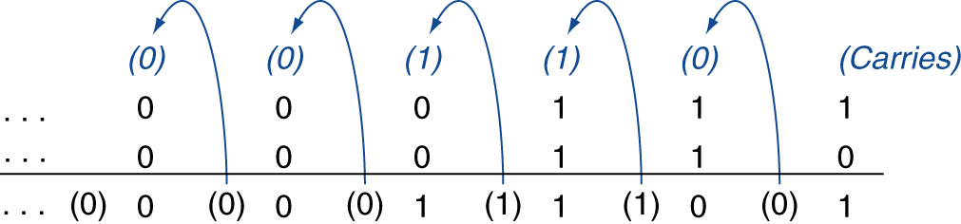
Integer Addition
Example: 7 + 6
00000000 00000000 00000000 00000111
+ 00000000 00000000 00000000 00000110
00000000 00000000 00000000 00001101
§3.2 Addition and Subtraction
Notes:
So let’s add two numbers…exercise with at least one negative number.

Slide 9
Integer Subtraction
Subtraction is actually an addition
Example: 7 – 6 = 7 + (-6)
2’s complement
00000000 00000000 00000000 00000111
+ 11111111 11111111 11111111 11111010
00000000 00000000 00000000 00000001
Notes:
Rather than implementing both add and subtract, we can save some transistors and just implement add.
This also exhibits how we don't need to treat negative numbers any differently when using 2's complement!
Add a number and its complement, e.g. 4, -4. We’ll have an extra 1, which is called? (Q)

Slide 10
Overflow
Overflow if result out of range
Adding +value and –value operands, no overflow
Adding two +value operands
Overflow if result sign is -
Adding two –value operands
Overflow if result sign is +

Slide 11
Arithmetic Logic Unit
Arithmetic Logic Unit (ALU)
Heart of a CPU
Operations
Arithmetic operations
Addition
Subtraction
Logical operations
NOT
AND
OR

Slide 12
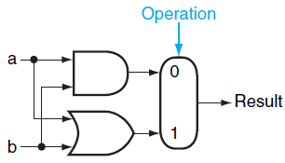
1-bit Logical Unit for AND and OR
1-bit logical unit for AND and OR
Notes:
You can generalize this to the basic idea behind an ALU: it’s a big multiplexor. ALL the operations actually get computed, but the CPU instruction tells the ALU which result we actually want.
Q: If you want to do AND, what value do you send to multiplexor?
Now we need to do the adder, i.e. we need to build addition with just AND, OR, and NOT.

Slide 13
1-bit adder
Result = (a + b)
CarryOut = (ab)
Notes:
What is the result of adding two inputs (single-bit), in terms of our logic functions…
This is actually called a half-adder.
Now if we’re adding multibit numbers, we also have to have carry, so what’s the CarryOut bit in terms of logic functions…

Slide 14
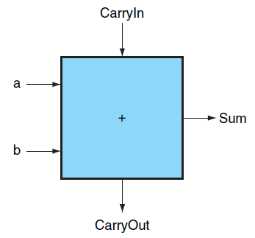
1-bit adder with Carry In
Notes:
The sum is just if exactly 1 or all 3 inputs are 1.

Slide 15
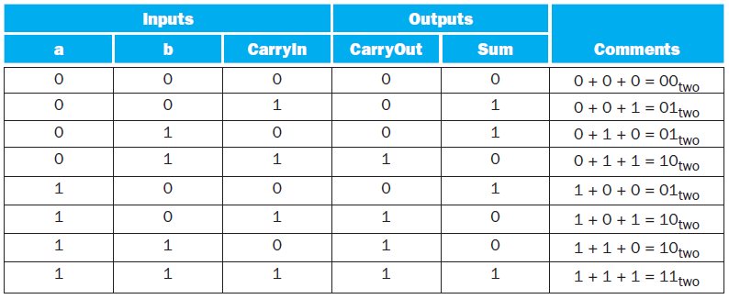
1-bit adder truth table

Slide 16
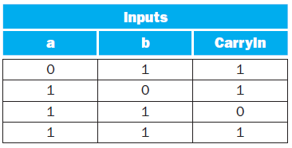
Simplifying 1-bit adder
If a and b and CarryIn are true, then the three other terms are true as well
can be simplified as
Values when CarryOut is true
Notes:
Q: Draw a set of gates for this. Hint: It’s three and gates and 1 or gate.

Slide 17
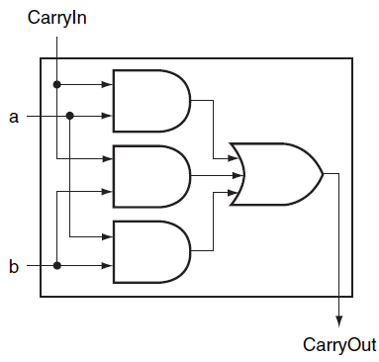
Logic of CarryOut Bit

Slide 18
Logic of Sum Bit
Notes:
Exactly 1 bit is set or all three are set. Draw a PLA for this, together with the CarryOut bit.

Slide 19
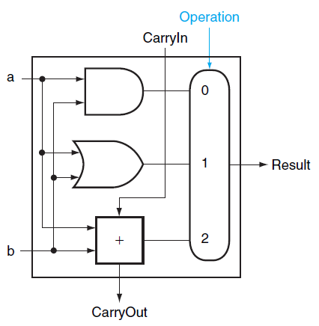
Overall 1-bit ALU
Notes:
Q: What would we pass in to the multiplexor to add? Foreshadow machine instructions…

Slide 20
Extending to 32 Bits

Slide 21
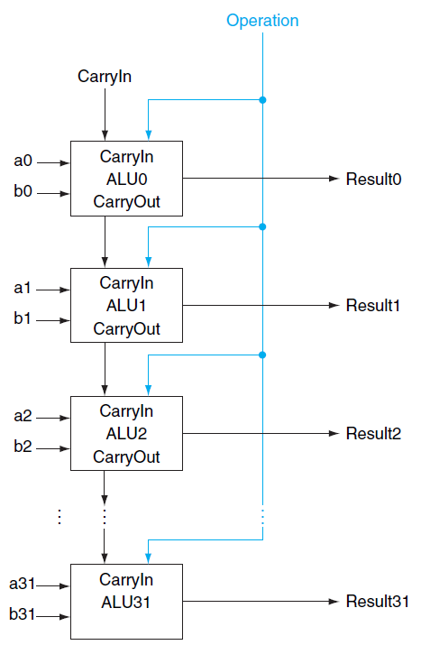
32-bit ALU
Notes:
Similar to multiplexors…
To operate on two WORDS, which are a set of bits, we again use an array of logic blocks, in this case 32 1-bit ALUs. Notice how we have to connect the carryout of one to the carryin of the next.
This WORKS, although it is actually really slow…we have to wait for 32 1-bit additions…we will see later how to improve this. (time scales linearly with # bits)
This is called a "ripple" adder, since the carry bit ripples through.

Slide 22
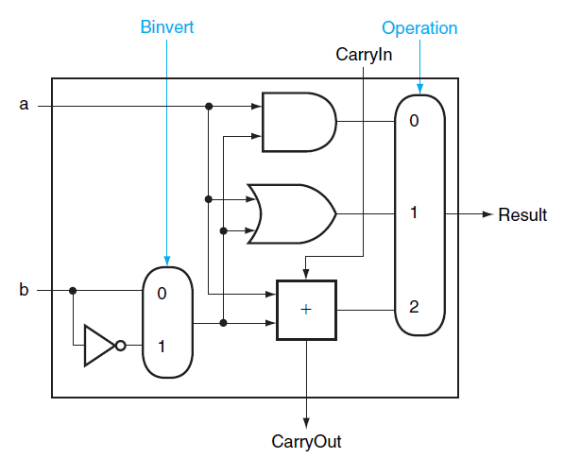
Subtraction
Subtraction can be done by adding a and b’s negate and 1
Notes:
In other words, we set Operation to 2 (10) and set Binvert to 1,also set the CarryIn of the first bit to 1, which gets us -b.
Q: Now…how might you add a NOR operation here? One way is to implement it with a gate and make the big multiplexor bigger. But this makes the multiplexor more expensive.

Slide 23
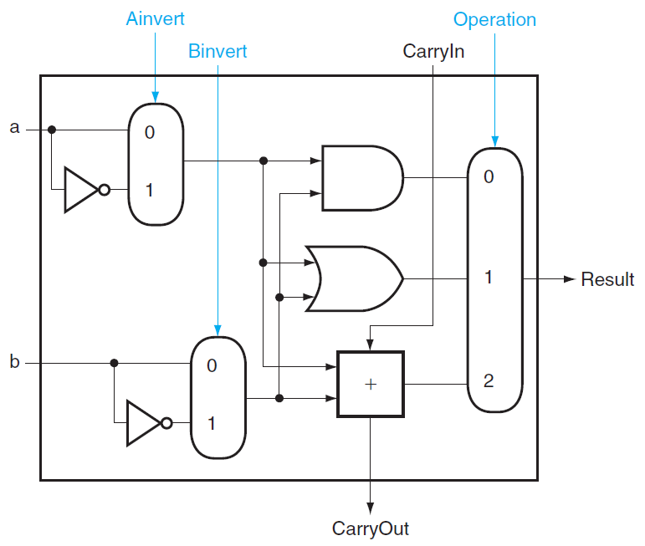
NOR
Ainvert =1, Binvert =1, Operation =00
Notes:
It turns out that MIPS actually needs a NOR operation as well. Rather than adding a NOR gate and extending the multiplexor, we can implement it with what we already have, adding an additional (simple) multiplexor.
Using DeMorgan’s: A NOR B = NOT (A or B) = (Not A) AND (Not B), so just invert both A and B and then OR them together.

Slide 24
Set on less than (slt)
For comparison of two integers a and b
Least significant bit
1 if a < b
0 otherwise
Other bits
0
Notes:
MIPS also needs this special instruction “Set on less” (slt). It should return 1 if and only if a < b. Specially, the least significant bit should be set.

Slide 25

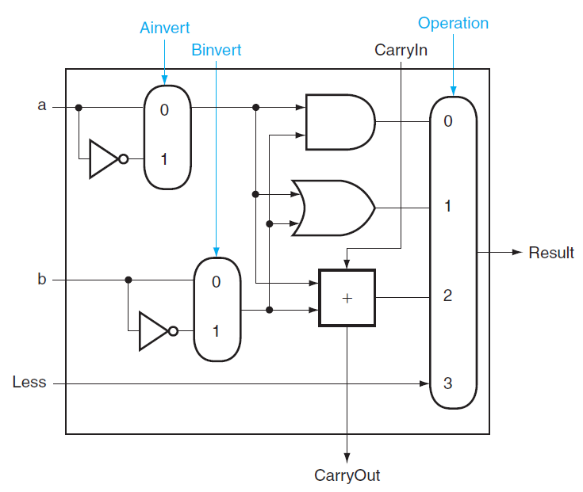
Set on less than
Notes:
Of course, whether or not a < b is just whether or not a-b < 0. So we just do subtraction (which is addition). BUT the output is the result of the subtraction, but all we care about is the sign of the result!

Slide 26
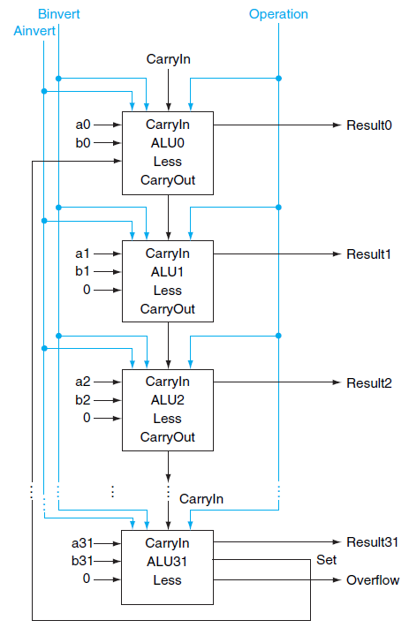
32-bit ALU
Bit 0-30: normal 1-bit ALU
Bit 31: 1-bit ALU with overflow detection
Notes:
Set gets loop back around to the Less input for ALU0, all the other less inputs get 0. Also, note that we can detect overflow with that Set output…

Slide 27
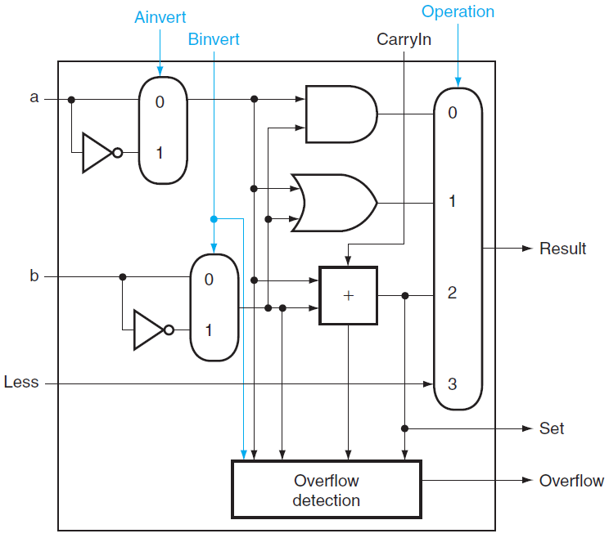
Handling Overflow
Notes:
We want the result of the add, but ONLY the most significant bit. So we get the output of just that one bit, and that’s the output set. Then, to get that as the overall ALU output, we need to wrap that around to the Less input.

Slide 28
Exercise: SLT Problem
Notes:
Let’s ask if -7 < 6. So 1001 – 0110 = 1001 + 1010 = (1)0011, which suggests that -7 > 6! What’s the problem? Our addition overflowed. How can we fix this?
Need to XOR the Set and Overflow output, this result becomes Less. You might think just OR, but what happens is both overflow and set? Consider 7 < -1. False, obviously. But
1001
1111
(1)1000
If we did OR we’d say yes, 7 < -1, so we must use XOR.
Notice the the last carry out bit is not enough to know overflow: consider -4 + -4, which has the last carry out bit set, but doesn’t actually overflow! You need to consider the sign of each input versus the sign of the output

