Slide 1
procedures
Instructor: Robert Utterback
Lecture 18
Notes:
What did we talk about last time?
A: Procedures
Q: What instr to call a procedure? A: jal Q: Returning? A: jr

Slide 2
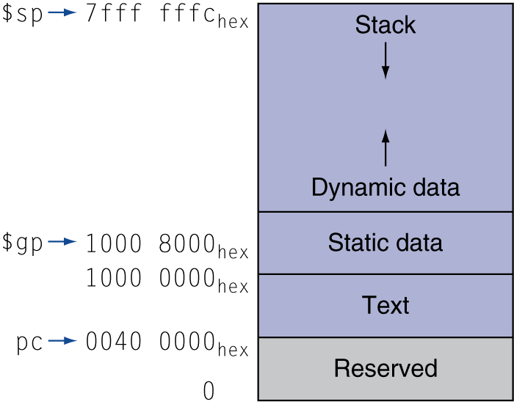
Memory Layout
Text: program code
Static data: global variables
e.g., static variables in C, constant arrays and strings
$gp initialized to address allowing ±offsets into this segment
Dynamic data: heap
E.g., malloc in C, new in Java and C++
Stack: automatic storage
Notes:
Use free to deallocate storage in C – very important! Many bugs caused by freeing too early/late.
C++ uses delete, Java does not require this --- uses garbage collection, prevents these bugs.

Slide 3
Registers to Save
Every function:
Save any $s registers you want to use
Restore at end
Any function that needs to call another (non-leaf)
Save $ra (jal will change this!)
Save $a registers if you need them
Save $t registers if you’re using them
Bottom line: save anything that might change!
Notes:
Q: What if we have more than 4 parameters?
A: Put the others on the stack and use the stack to address them (frame pointer)

Slide 4
Summary: Procedure Calls
Registers used
Stack
jal and jr
leaf and no-leaf procedure
Allocating space for new data on the heap

Slide 5
Non-Leaf Procedure Example
C code:
int foo(int n) {
int f = 42;
f += bar(); return f - n;
}
Use $s0 for f
Notes:
foo:
# prologue
addi $sp, $sp, -12
sw $ra, 0($sp)
sw $s0, 4($sp)
sw $a0, 8($sp) # bar might overwrite $a0!
# body
addi $s0, $zero, 42
jal bar
add $s0, $s0, $v0
# epilogue
lw $a0, 8($sp)
sub $v0, $s0, $a0
lw $s0, 4($sp)
lw $ra, 0($sp)
jr $ra

Slide 6
Non-Leaf Procedure Example
MIPS code:
foo: addi $sp, $sp, -12
sw $ra, 0($sp)
sw $s0, 4($sp)
sw $a0, 8($sp) # bar might overwrite $a0!
addi $s0, $zero, 42
jal bar
add $s0, $s0, $v0
lw $a0, 8($sp)
sub $v0, $s0, $a0
lw $s0, 4($sp)
lw $ra, 0($sp)
addi $sp, $sp, 12
jr $ra
Notes:
Notice there is some waste here…Ways to improve?

Slide 7
Non-Leaf Procedure Example
MIPS code:
foo: addi $sp, $sp, -8
sw $ra, 0($sp)
sw $a0, 4($sp) # bar might overwrite $a0!
jal bar
addi $v0, $v0, 42 # no calls after this
lw $a0, 4($sp)
sub $v0, $v0, $a0
lw $ra, 0($sp)
addi $sp, $sp, 8
jr $ra
Notes:
Since we’re adding a constant, just combine the adds. And after the call to bar there are no more calls, so we can freely use v0

Slide 8
A Note on Arrays
So far we’ve seen only arrays of words
But in general, arrays can have elements of any # numbers
Array of bytes
Array of half-words (2 bytes)
Array of double words (8 bytes, for floating point)
Changes indexing
Memory indexed by byte
lw and sw address must be multiple of 4

Slide 9
Character Data
Byte-encoded character sets
ASCII: 128 characters
95 graphic, 33 control
Latin-1: 256 characters
ASCII, +96 more graphic characters
Unicode: 32-bit character set
Used in Java, C++ wide characters, …
Most of the world’s alphabets, plus symbols
UTF-8, UTF-16: variable-length encodings
§2.9 Communicating with People
Notes:
A mapping from numbers to characters. First 7 bits of Unicode are ASCII, which is convenient.
Book has a table of ASCII characters.

Slide 10
Byte/Halfword Operations
Could use bitwise operations
MIPS byte/halfword load/store
String processing is a common case
lb rt, offset(rs) lh rt, offset(rs)
Sign extend to 32 bits in rt
lbu rt, offset(rs) lhu rt, offset(rs)
Zero extend to 32 bits in rt
sb rt, offset(rs) sh rt, offset(rs)
Store just rightmost byte/halfword

Slide 11
String Copy Example
C code (naïve):
Null-terminated string
void strcpy (char x[], char y[]) { int i; i = 0; while ((x[i]=y[i])!='\0') i += 1; }
Addresses of x, y in $a0, $a1
i in $s0
Notes:
In C++, we have a nice string class, which handles most things for us automatically. (and it’s naïve b/c it will just keep going…security threat. Should have a max # chars)
This is actually pretty nasty C code…
strcpy: addi $sp, $sp, -4 # adjust stack for 1 item sw $s0, 0($sp) # save $s0 add $s0, $zero, $zero # i = 0 L1: add $t1, $s0, $a1 # addr of y[i] in $t1 lbu $t2, 0($t1) # $t2 = y[i] add $t3, $s0, $a0 # addr of x[i] in $t3 sb $t2, 0($t3) # x[i] = y[i] beq $t2, $zero, L2 # exit loop if y[i] == 0 addi $s0, $s0, 1 # i = i + 1 j L1 # next iteration of loop L2: lw $s0, 0($sp) # restore saved $s0 addi $sp, $sp, 4 # pop 1 item from stack jr $ra # and return

Slide 12
String Copy Example
MIPS code:
strcpy: addi $sp, $sp, -4 # adjust stack for 1 item sw $s0, 0($sp) # save $s0 add $s0, $zero, $zero # i = 0 L1: add $t1, $s0, $a1 # addr of y[i] in $t1 lbu $t2, 0($t1) # $t2 = y[i] add $t3, $s0, $a0 # addr of x[i] in $t3 sb $t2, 0($t3) # x[i] = y[i] beq $t2, $zero, L2 # exit loop if y[i] == 0 addi $s0, $s0, 1 # i = i + 1 j L1 # next iteration of loop L2: lw $s0, 0($sp) # restore saved $s0 addi $sp, $sp, 4 # pop 1 item from stack jr $ra # and return
Notes:
Q: Why don’t we have sbu? A: We’re chopping off the first 24 bits, no matter what they are. Lb/lbu must sign extend.

