Slide 1
Measuring and discussing Performance
Instructor: Robert Utterback
Lecture 3

Slide 2
Review
What is performance?
1 / Execution Time
Formula for CPU Time?

Slide 3
Clock Cycles per Instruction (CPI)
Clock Cycles per Instruction (CPI)
Number of clock cycles per instruction for a program
Notes:
Now let's also account for the instructions we have. So let's talk about CPI.

Slide 4
Instruction Count and CPI
Instruction Count for a program
Determined by program, ISA and compiler
Average cycles per instruction
Determined by CPU hardware
If different instructions have different CPI
Average CPI affected by instruction mix
Notes:
Notice how this is the same formula as before, we've just expanded "clock cycles" into two components.

Slide 5
CPI Example
Computer A: Cycle Time = 250ps, CPI = 2.0
Computer B: Cycle Time = 500ps, CPI = 1.2
Same ISA
Which is faster, and by how much?
A is faster…
…by this much
Notes:
Note: we have IC in our formula, but in this case it's the same for each...
First compute CPU time for A and B, then compute the correct ratio.

Slide 6
CPI in More Detail
If different instruction classes take different numbers of cycles
Weighted average CPI
Relative frequency
Notes:
This depends on the instruction mix, which means it depends on the program! Different programs have different CPI, and if you ever need to profile and performance engineer and program, one thing you might check is the CPI and if it can be improved, by, say, rearranging some instructions. (though compilers do a pretty good job of this)
This is one formula for CPI, which actually is kind of annoying. The easier way is just to sum all the clock cycles taken and divide by the instruction count. Though sometimes you may have the instruction mix and not the # clock cycles taken...

Slide 7
CPI Example
Alternative compiled code sequences using instructions in classes A, B, C
Class | A | B | C
CPI for class | 1 | 2 | 3
IC in sequence 1 | 2 | 1 | 2
IC in sequence 2 | 4 | 1 | 1
Sequence 1:
IC
Clock Cycles
Avg. CPI
Sequence 2:
IC
Clock Cycles
Avg. CPI
Notes:
(together) Sequence 1: IC = 5
Clock Cycles = 2×1 + 1×2 + 2×3 = 10
Avg. CPI = 10/5 = 2.0

Slide 8
CPI Example
Alternative compiled code sequences using instructions in classes A, B, C
Class | A | B | C
CPI for class | 1 | 2 | 3
IC in sequence 1 | 2 | 1 | 2
IC in sequence 2 | 4 | 1 | 1
Sequence 1: IC = 5
Clock Cycles = 2×1 + 1×2 + 2×3 = 10
Avg. CPI = 10/5 = 2.0
Sequence 2: IC = 6
Clock Cycles = 4×1 + 1×2 + 1×3 = 9
Avg. CPI = 9/6 = 1.5

Slide 9
Performance Summary
The BIG Picture
Performance depends on
Algorithm: affects IC, possibly CPI
Programming language: affects IC, CPI
Compiler: affects IC, CPI
Instruction set architecture: affects IC, CPI, T_{c}
Notes:
Response time and Throughput
Performance measures: CPI, IC
Performance = 1/Execution Time

Slide 10
Memorize this, Know it
seconds
CPU Execution Time
Instruction Count
CPI
Clock Cycle Time
=
X
X
instructions
seconds/cycle
cycles/instruction
Notes:
Going to work through a few more problems, speed voting here.
Slide by Leo Porter.

Slide 11
CPU Execution Time
Instruction Count
CPI
Clock Cycle Time
=
X
X
IC = 1 billion, 500 MHz processor, execution time of 3 seconds. What is the CPI for this program?
Selection | CPI
A | 3
B | 15
C | 1.5
D | 15*10^9
E | None of the above
Notes:
500 MHz = 5 * 10^8...
3 sec = 1*10^9 inst*CPI * 1sec/(5*10^8)cycles
1.5*10^9 cycles = 10^9insts*CPI
1.5 = CPI
Correct answer: C
This is kinda plug and chug, but they need to get this right as we’ll be using this equation throughout the class. Most common errors are not understanding how to do 1 billion (1*10^9) or incorrectly thinking (1/(5*10^8)) = (5*10^-8)
Slide by Leo Porter.

Slide 12
Who Affects Performance?
CPU Execution Time
Instruction Count
CPI
Clock Cycle Time
=
X
X
IC
CT
What can a programmer influence?
Selection | Impacts
A | IC
B | IC, CPI
C | IC, CPI, and CT
D | IC and CT
E | None of the above
Notes:
Correct answer B
They know IC (whole point of algorithms, etc.) but CPI is a different matter. I tell them “If I told you divide takes more cycles than subtract would that change your answer?” and they usually get the idea. CT is interesting as in general, they can’t change it. But with today’s DVFS (dynamic voltage and frequency scaling), they might be able to. So I mention that.
Slide by Leo Porter.

Slide 13
Who Affects Performance?
CPU Execution Time
Instruction Count
CPI
Clock Cycle Time
=
X
X
IC
CT
What can a compiler influence?
Selection | Impacts
A | IC
B | IC, CPI
C | IC, CPI, and CT
D | CPI and CT
E | None of the above
Notes:
Correct answer B
This flows pretty cleanly from the previous question.
Slide by Leo Porter

Slide 14
Who Affects Performance?
CPU Execution Time
Instruction Count
CPI
Clock Cycle Time
=
X
X
IC
CT
What can an instruction set architect influence?
Selection | Impacts
A | IC
B | IC, CPI
C | IC, CPI, and CT
D | CPI and CT
E | None of the above
Notes:
Correct answer C
I like to point out I could have a single instruction called factorial. That could really change IC and CPI, but depending on how complex or simple my instructions are, I might impact CT as well.
Slide by Leo Porter

Slide 15
Who Affects Performance?
CPU Execution Time
Instruction Count
CPI
Clock Cycle Time
=
X
X
IC
CT
What can an hardware designer influence? (fixed ISA)
Selection | Impacts
A | IC
B | IC, CPI
C | IC, CPI, and CT
D | CPI and CT
E | None of the above
Notes:
Correct answer D
They have a fixed ISA, but they can make multiply faster or change the hardware to have better CPI.
Slide by Leo Porter

Slide 16
Performance Variation
CPU Execution Time
Instruction Count
CPI
Clock Cycle Time
=
X
X
Selection | Row(s) Correct
A | 1
B | 1 and 3
C | 2
D | 2 and 3
E | None of the above
ROW
1
Same
Diff
Same
2
Same
Same
Diff
3
Same
Diff
Diff
Notes:
Correct answer E
A bit tricky, but this one usually sparks a good discussion. They usually realize that 1 is incorrect. Sometimes they see that 3 is wrong. But seeing that the same ISA, same program could have a different CPI is hard. They saw it, arguably, in the reading. But again, their understanding of CPI is very tenuous at this point so I want to give them at least some intuition about it so when we dive into it in more detail later, they have a feel for it.
Slide by Leo Porter

Slide 17
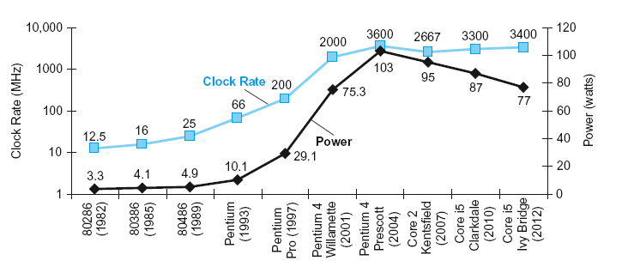
Power Trends
§1.7 The Power Wall
In CMOS IC technology
×30
5V → 1V
×1000
Notes:
Section 1.7
Power and clock rate increased until we hit a wall...too much power, plus this causes heat which you have to cool
CMOS = Complementary metal oxide semiconductor
Capacitive load: resist changes in voltage
Frequency of transitions for the transistor

Slide 18
The Power Wall
Reduce Voltage
With lower voltage, transistors “leak”. Currently responsible for 40% of the power consumption
Reduce Heat
More powerful cooling
How else can we improve performance?
Notes:
We can’t reduce voltage further
We can’t remove more heat

Slide 19
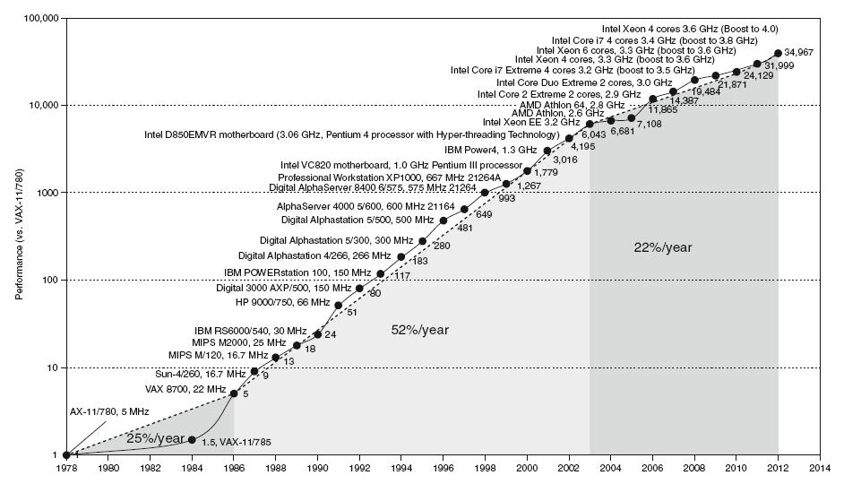
Uniprocessor Performance
§1.8 The Sea Change: The Switch to Multiprocessors
Constrained by power, instruction-level parallelism, memory latency
Notes:
Section 1.8

Slide 20
Multiprocessors
Multicore microprocessors
More than one processor per chip
Requires explicitly parallel programming
Compare with instruction level parallelism
Hardware executes multiple instructions at once
Hidden from the programmer
Hard to do
Programming for performance
Load balancing
Optimizing communication and synchronization

Slide 21
What I want you to do
Finish Chapter 1
Read Appendix B.1-B.3
Work on homework 1

