Slide 1
The Memory Hierarchy
Chapter 5

Slide 2
The Problem
Pick 1
Fast memory
Cheap (=> large) memory
Registers are fast, but we only have a few
SRAM larger, but slower
DRAM is dense but very slow
Disks are extremely dense but even slower

Slide 3
The Fix: Hierarchy of Memory
Registers
Cache (SRAM)
Main Memory (DRAM)
Disks (HDD and/or SDD)
Notes:
Relies on speculation to work correctly. We can’t always speculate correctly, but luckily we often can because of locality…
Library metaphor

Slide 4
Movie Rental Store
You have a huge warehouse with EVERY movie ever made (hits, training films, etc.).
Getting a movie from the warehouse takes 15 minutes.
You can’t stay in business if every rental takes 15 minutes.
You have some small shelves in the front office.
Office
Warehouse
Notes:
Book uses library analogy. Lots of similar things about stocking shelves.
Think for a bit about what you
Might do to improve this (on your own)

Slide 5
Principle of Locality
§5.1 Introduction
Programs access a small proportion of their address space at any time
Temporal locality
Items accessed recently are likely to be accessed again soon
e.g., instructions in a loop, induction variables
Spatial locality
Items near those accessed recently are likely to be accessed soon
E.g., sequential instruction access, array data

Slide 6
Here are some suggested improvements to the store:
Whenever someone rents a movie, just keep it in the front office for a while in case someone else wants to rent it.
Watch the trends in movie watching and attempt to guess movies that will be rented soon – put those in the front office.
Whenever someone rents a movie in a series (Star Wars), grab the other movies in the series and put them in the front office.
Buy motorcycles to ride in the warehouse to get the movies faster
Extending the analogy to locality for caches, which pair of changes most closely matches the analogous cache locality?
Selection | Spatial | Temporal
A | 2 | 1
B | 4 | 2
C | 4 | 3
D | 3 | 1
E | None of the above
Office
Warehouse
Notes:
Correct Answer - D

Slide 7
Taking Advantage of Locality
Memory hierarchy
Store everything on disk
Copy recently accessed (and nearby) items from disk to smaller DRAM memory
Main memory
Copy more recently accessed (and nearby) items from DRAM to smaller SRAM memory
Cache memory attached to CPU
Notes:
SRAM used to be on separate chips on the motherboard, but now they are built onto the same chip as the CPU

Slide 8
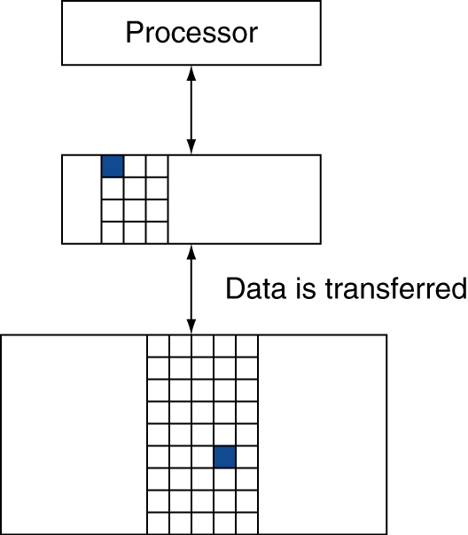
Memory Hierarchy Levels
If accessed data is present in upper level
Hit: access satisfied by upper level
Hit ratio: hits/accesses
If accessed data is absent
Miss: block copied from lower level
Time taken: miss penalty
Miss ratio: misses/accesses = 1 – hit ratio
Then accessed data supplied from upper level
Notes:
We will always be talking about inclusive memory hierarchy…
cache hit -- an access where the data is found in the cache.
cache miss -- an access which isn’t
hit time -- time to access the cache
miss penalty -- time to move data from further level to closer, then to cpu
hit ratio -- percentage of time the data is found in the cache
miss ratio -- (1 - hit ratio)

Slide 9
Memory Hierarchy Levels
Hit Time
Time to access cache
Miss Penalty
Time to move data from lower level to this level, then to CPU
Block (aka line): unit of copying
May be multiple words
Instruction cache
Holds only instructions
Data cache
Holds only data
Unified cache
Holds both
Notes:
We will always be talking about inclusive memory hierarchy…
cache hit -- an access where the data is found in the cache.
cache miss -- an access which isn’t
hit time -- time to access the cache
miss penalty -- time to move data from further level to closer, then to cpu
hit ratio -- percentage of time the data is found in the cache
miss ratio -- (1 - hit ratio)

Slide 10
Memory Technology
Static RAM (SRAM)
0.5ns – 2.5ns, $500 – $1000 per GB
Dynamic RAM (DRAM)
50ns – 70ns, $10 – $20 per GB
Flash (USB stick, SSD)
5000-50000ns, $0.75-$1.00 per GB
Magnetic disk
5ms – 20ms, $0.05 – $0.10 per GB
Ideal memory
Access time of SRAM
Capacity and cost/GB of disk
§5.2 Memory Technologies
Notes:
These are 2012 prices

Slide 11
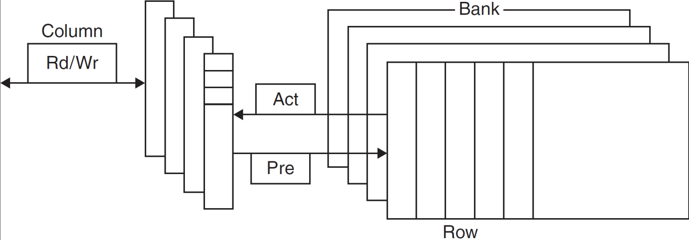
DRAM Technology
Data stored as a charge in a capacitor
Single transistor used to access the charge
Must periodically be refreshed
Read contents and write back
Performed on a DRAM “row”

Slide 12
Advanced DRAM Organization
Bits in a DRAM are organized as a rectangular array
DRAM accesses an entire row
Burst mode: supply successive words from a row with reduced latency
Double data rate (DDR) DRAM
Transfer on rising and falling clock edges
Quad data rate (QDR) DRAM
Separate DDR inputs and outputs

Slide 13
DRAM Generations
Year | Capacity | $/GB
1980 | 64Kbit | $1500000
1983 | 256Kbit | $500000
1985 | 1Mbit | $200000
1989 | 4Mbit | $50000
1992 | 16Mbit | $15000
1996 | 64Mbit | $10000
1998 | 128Mbit | $4000
2000 | 256Mbit | $1000
2004 | 512Mbit | $250
2007 | 1Gbit | $50

Slide 14
DRAM Performance Factors
Row buffer
Allows several words to be read and refreshed in parallel
Synchronous DRAM (SDRAM)
Allows for consecutive accesses in bursts without needing to send each address
Improves bandwidth
DRAM banking
Allows simultaneous access to multiple DRAMs
Improves bandwidth

Slide 15
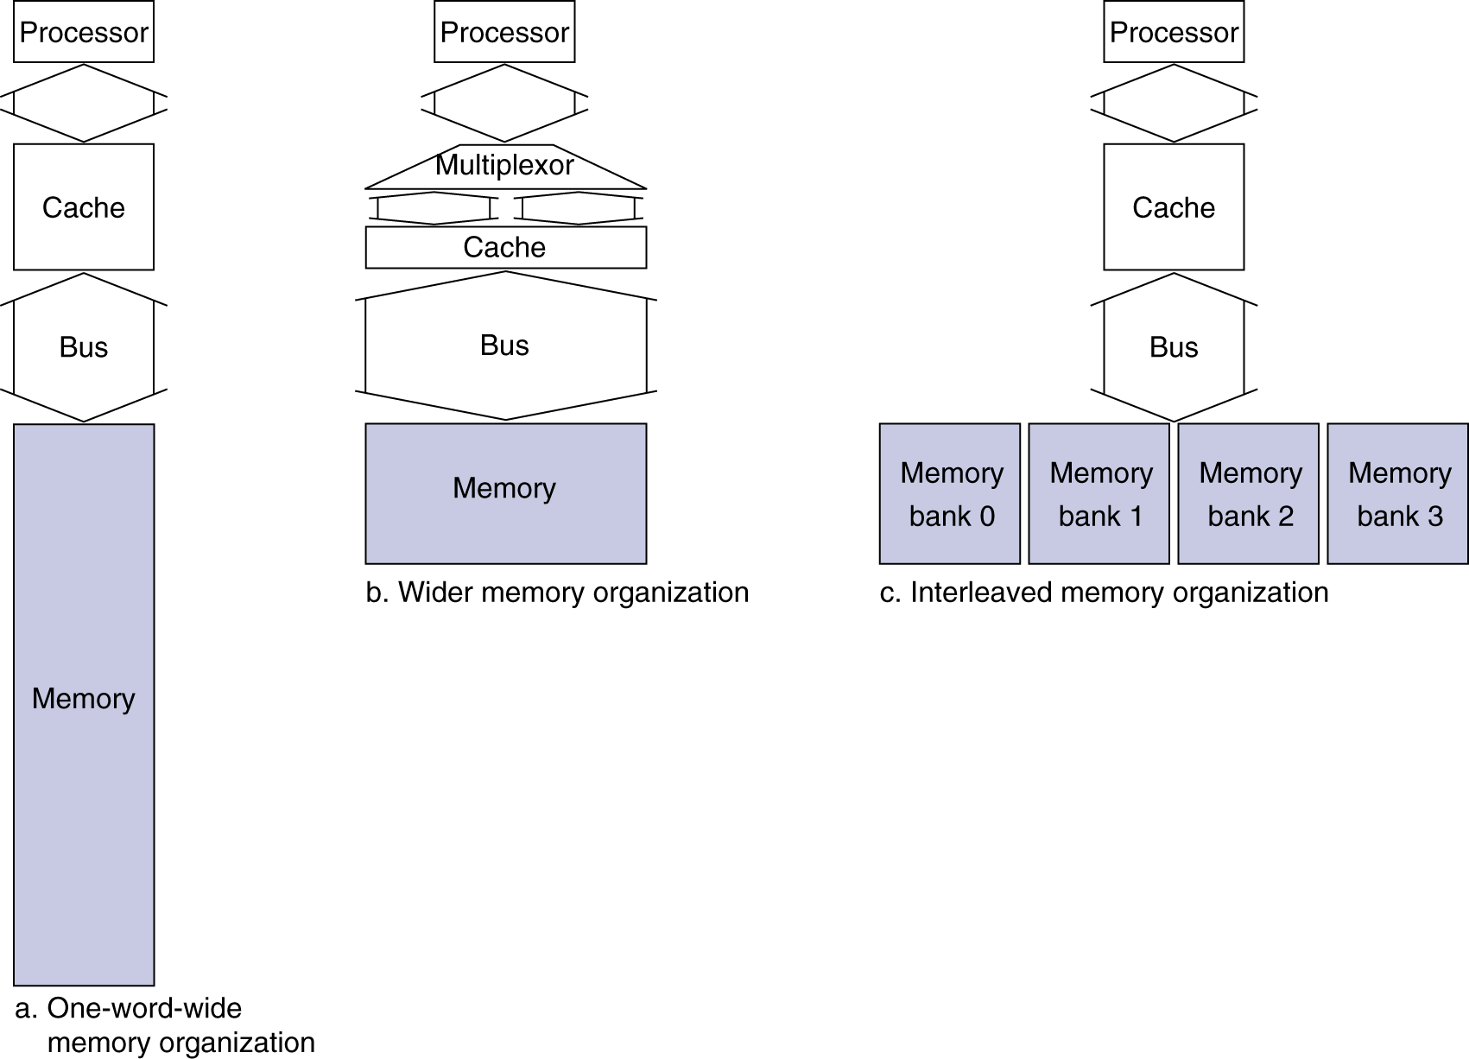
Increasing Memory Bandwidth
4-word wide memory
Miss penalty = 1 + 15 + 1 = 17 bus cycles
Bandwidth = 16 bytes / 17 cycles = 0.94 B/cycle
4-bank interleaved memory
Miss penalty = 1 + 15 + 4×1 = 20 bus cycles
Bandwidth = 16 bytes / 20 cycles = 0.8 B/cycle
Notes:
Change DRAM to support the cache – improve bandwidth
If you had single word wide DRAM but 4 wide cache, would add extra multiplier of 4 tom middle term.
1 cycle to notice the miss, 15 cycles to access the words, 1 more to travel across bus
Interleaved is slightly slower, BUT a lot easier to build

Slide 16
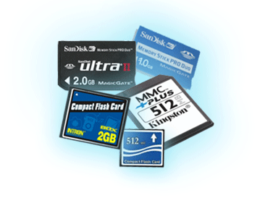
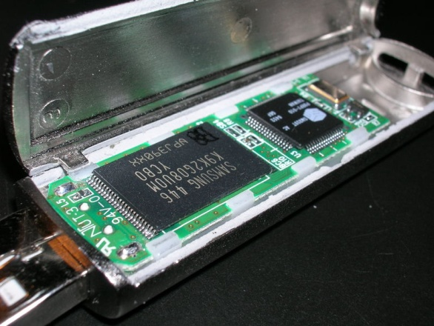
Flash Storage
§6.4 Flash Storage
Nonvolatile semiconductor storage
100× – 1000× faster than disk
Smaller, lower power, more robust
But more $/GB (between disk and DRAM)
Notes:
Big area of change/research currently! Lots of new technologies!
Some may already have an SSD on their laptops…

Slide 17
Flash Types
NOR flash: bit cell like a NOR gate
Random read/write access
Used for instruction memory in embedded systems
NAND flash: bit cell like a NAND gate
Denser (bits/area), but block-at-a-time access
Cheaper per GB
Used for USB keys, media storage, …
Flash bits wears out after 1000’s of accesses
Not suitable for direct RAM or disk replacement
Wear leveling: remap data to less used blocks
Notes:
Flash is typically EEPROM, which we briefly talked about in Appendix B.
I don’t actually know that much about the specifics of the types of memory; it quickly gets into electrical engineering territory.

Slide 18
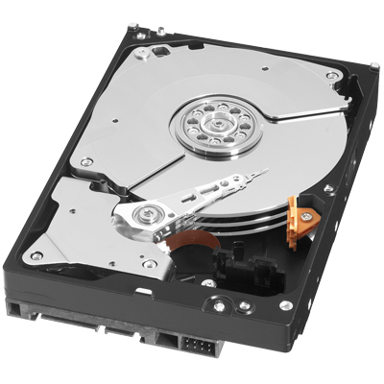
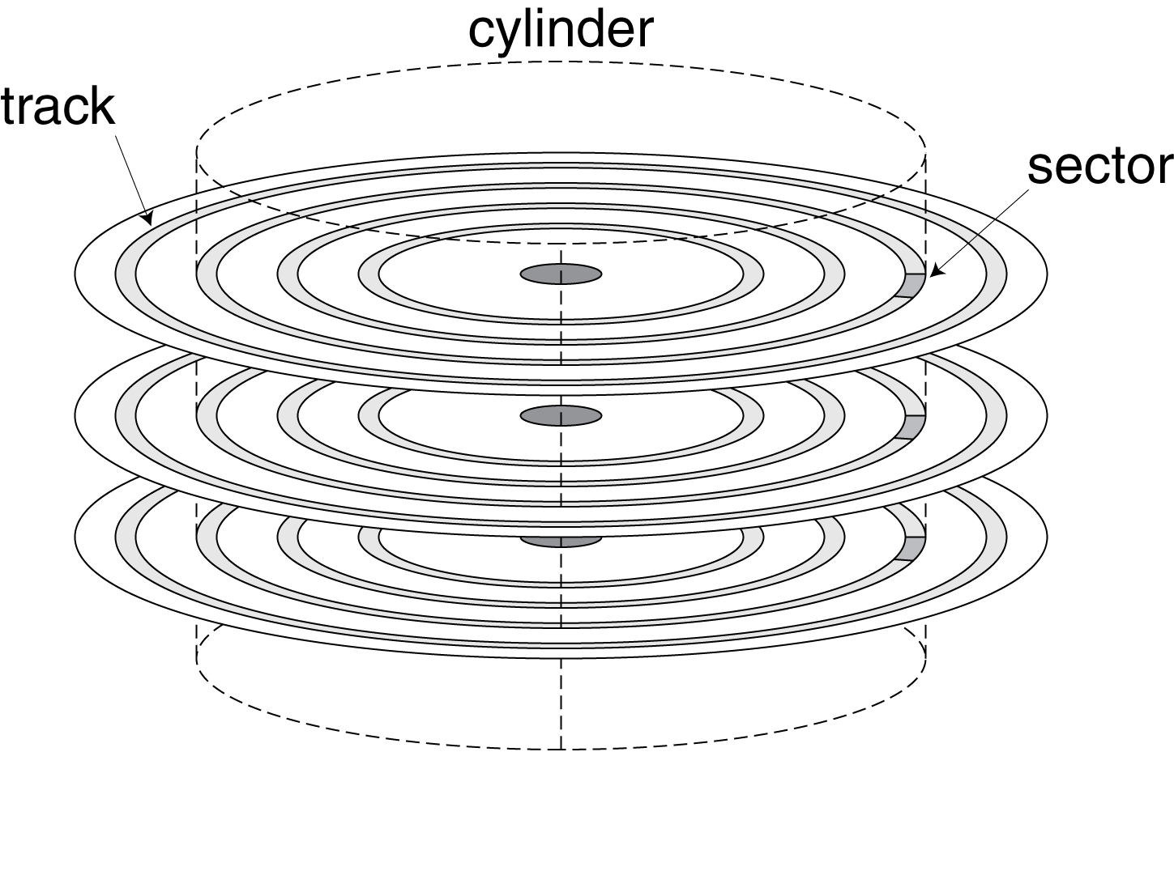
Disk Storage
§6.3 Disk Storage
Nonvolatile, rotating magnetic storage

Slide 19
Disk Sectors and Access
Each sector records
Sector ID
Data (512 bytes, 4096 bytes proposed)
Error correcting code (ECC)
Used to hide defects and recording errors
Synchronization fields and gaps
Access to a sector involves
Queuing delay if other accesses are pending
Seek: move the heads
Rotational latency
Data transfer
Controller overhead

Slide 20
Disk Access Example
Given
512B sector, 15,000rpm, 4ms average seek time, 100MB/s transfer rate, 0.2ms controller overhead, idle disk
Average read time
4ms seek time + ½ / (15,000/60) = 2ms rotational latency + 512 / 100MB/s = 0.005ms transfer time + 0.2ms controller delay = 6.2ms
If actual average seek time is 1ms
Average read time = 3.2ms
Notes:
This *seems* fast, but is super slow compared to other memory…
“Average” initially over all possible locations
Q: But that’s actually rather pessimistic, b/c of what kind of locality?
A: spatial

Slide 21
Disk Performance Issues
Manufacturers quote average seek time
Based on all possible seeks
Locality and OS scheduling lead to smaller actual average seek times
Smart disk controller allocate physical sectors on disk
Present logical sector interface to host
SCSI, ATA, SATA
Disk drives include caches
Prefetch sectors in anticipation of access
Avoid seek and rotational delay
Notes:
There are lots of other memory technologies. Magnetic tape, for example, is EXTREMELY slow but very dense.
Lots of companies used to use tape for backups, and a few still do. I bet there’s warehouses worth of old tape backups sittings somewhere.

Slide 22
From the book we know SRAM is very fast, expensive ($/GB), and small. We also know Disks are slow, inexpensive ($/GB), and large. Which statement best describes the role of cache when it works.
Selection | Role of caching
A | Locality allows us to keep frequently touched data in SRAM.
B | Locality allows us the illusion of memory as fast as SRAM but as large as a disk.
C | SRAM is too expensive to have large – so it must be small and caching helps use it well.
D | Disks are too slow – we have to have something faster for our processor to access.
E | None of these accurately describes the roll of cache.

Slide 23
Cache Memory
Memory access
How to tell if hit or miss?
Cache miss
Where to put data?
What to throw out?
How to remember what data this is?
§5.3 The Basics of Caches
Notes:
The cache is smaller than the rest of memory, so we can only store some things in here.
Brainstorm some ideas on how to do this?

Slide 24
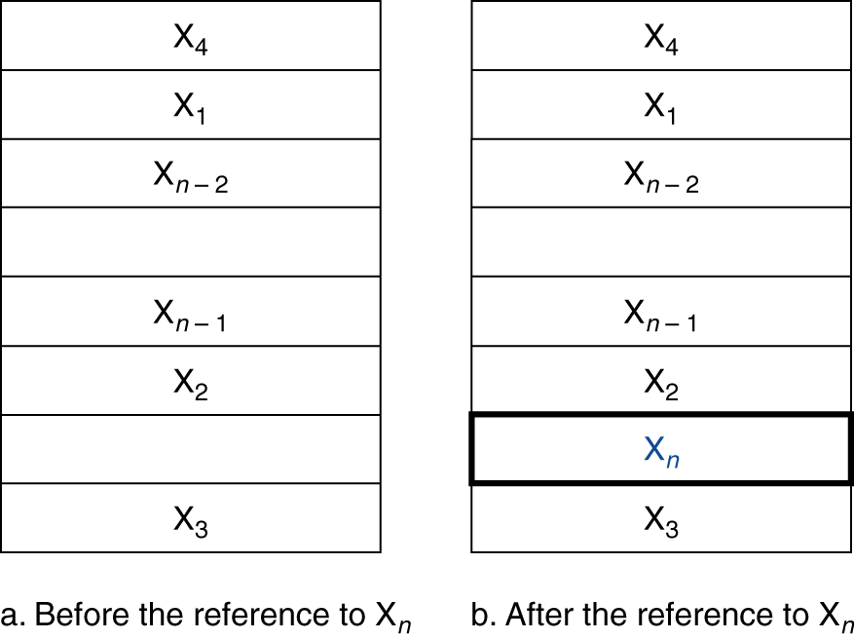
Cache Memory
Cache memory
The level of the memory hierarchy closest to the CPU
Given accesses X₁, …, X_{n–1}, X_{n}
§5.3 The Basics of Caches
How do we know if the data is present?
Where do we look?
Notes:
Focus on these questions first.
Brainstorm some ideas on how to do this?

Slide 25
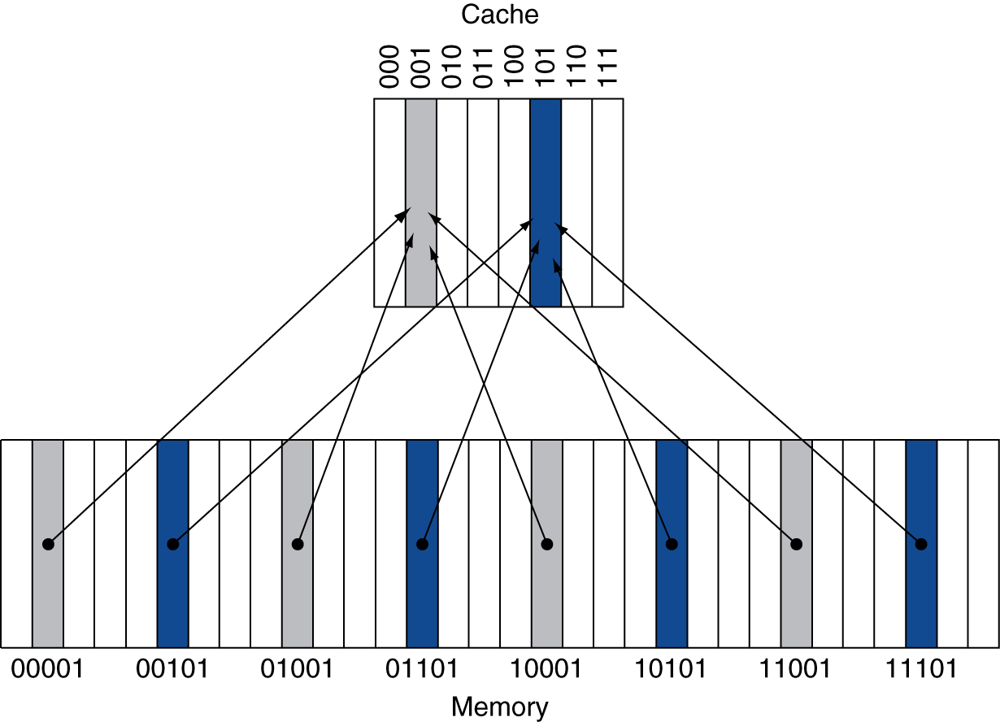
Direct Mapped Cache
Location determined by address
Direct mapped: only one choice
(Block address) modulo (#Blocks in cache)
#Blocks is a power of 2
Use low-order address bits
Notes:
BTW, what’s the problem with this approach?
We may have two slots and also use two memory locations. Theoretically they should both fit in cache, but if they both map to the same slot they don’t!

