Slide 1
Computer Architecture and Organization
Instructor: Robert Utterback

Slide 2
Housekeeping
Syllabus/Webpage
Schedule
Notes
Assignments

Slide 3
Syllabus and Webpage
Course webpage: robertutterback.github.io/courses/comp230/f17/
Serves as syllabus and schedule
Assignments will be released there

Slide 4
Getting Help
Email
rutterback@monmouthcollege.edu
Office: CSB 342
Office Hours:
M 9-10 AM
Tu 2-3 PM
F 10-11 AM
By appointment (see my schedule at robertutterback.github.io/schedule/)

Slide 5
Grading
(7-8) Assignments: 35%
Some will include programming
(3) Exams:
2 midterms: 15% each
Final: 25%
Participation: 10%

Slide 6
Textbook
Computer Organization and Design: The Hardware/Software Interface, 5th Edition, by Patterson and Hennessy, Morgan and Kaufman Publishers, Inc., 2014

Slide 7
Tips for getting an A
Come to class
Ask questions and participate
Review your notes after class
Start the homework early
Come to office hours with questions

Slide 8
Content
Chapters 1, 2, 3
Appendix B
Part of chapters 4 and 5 (briefly)

Slide 9
Why this course?
Foundation for Operating Systems
Understanding hardware makes you a better programmer
Lots of new hardware and devices
Even more important to know what’s going on “under the hood”

Slide 10
Computer Evolution
Moore’s Law
The number of transistors that can be placed inexpensively on an integrated circuit doubles approximately every two years
For many years this also meant chip performance double every two years

Slide 11
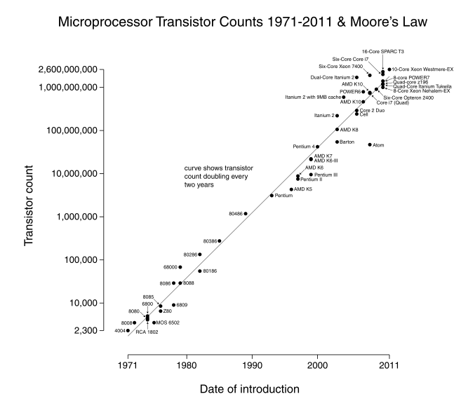
Moore’s Law

Slide 12
The Computer Revolution
§1.1 Introduction
Progress in computer technology
Underpinned by Moore’s Law
Makes novel applications feasible
Computers in automobiles
Cell phones
Human genome project
World Wide Web
Search Engines
Computers are pervasive

Slide 13
Classes of Computers
Personal computers
General purpose, variety of software
Subject to cost/performance tradeoff
Server computers
Network based
High capacity, performance, reliability
Range from small servers to building sized

Slide 14
Classes of Computers
Supercomputers
High-end scientific and engineering calculations
Highest capability but represent a small fraction of the overall computer market
Embedded computers
Hidden as components of systems
Stringent power/performance/cost constraints

Slide 15
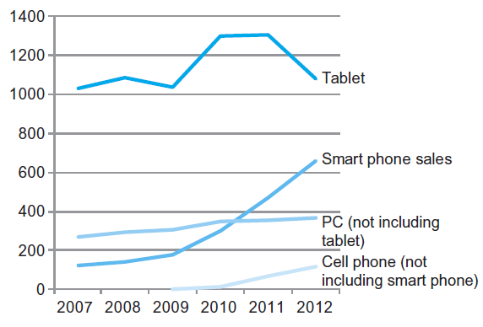
The PostPC Era

Slide 16
The PostPC Era
Personal Mobile Device (PMD)
Battery operated
Connects to the Internet
Hundreds of dollars
Smart phones, tablets, electronic glasses
Cloud computing
Warehouse Scale Computers (WSC)
Software as a Service (SaaS)
Portion of software run on a PMD and a portion run in the Cloud
Amazon and Google

Slide 17
What You Will Learn
How programs are translated into the machine language
And how the hardware executes them
The hardware/software interface
What determines program performance
And how it can be improved
How hardware designers improve performance
What is parallel processing

Slide 18
Understanding Performance
Algorithm
Determines number of operations executed
Programming language, compiler, architecture
Determine number of machine instructions executed per operation
Processor and memory system
Determine how fast instructions are executed
I/O system (including OS)
Determines how fast I/O operations are executed

Slide 19
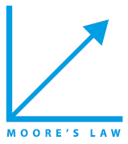






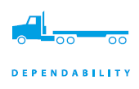
Eight Great Ideas
Design for Moore’s Law
Use abstraction to simplify design
Make the common case fast
Performance via parallelism
Performance via pipelining
Performance via prediction
Hierarchy of memories
Dependability via redundancy
§1.2 Eight Great Ideas in Computer Architecture
Notes:
Section 1.2

Slide 20
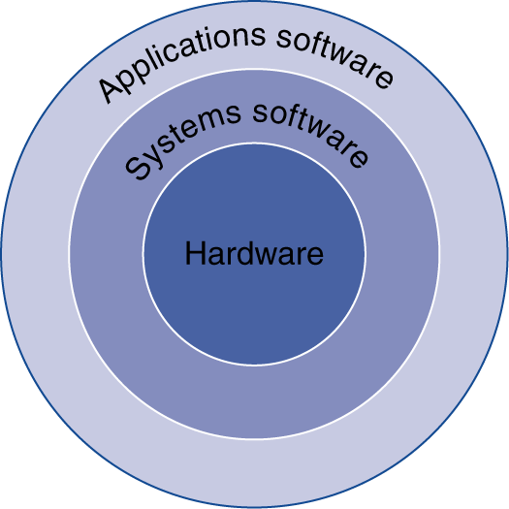
Below Your Program
Application software
Written in high-level language
System software
Compiler: translates HLL code to machine code
Operating System: service code
Handling input/output
Managing memory and storage
Scheduling tasks & sharing resources
Hardware
Processor, memory, I/O controllers
§1.3 Below Your Program
Notes:
Section 1.3

Slide 21
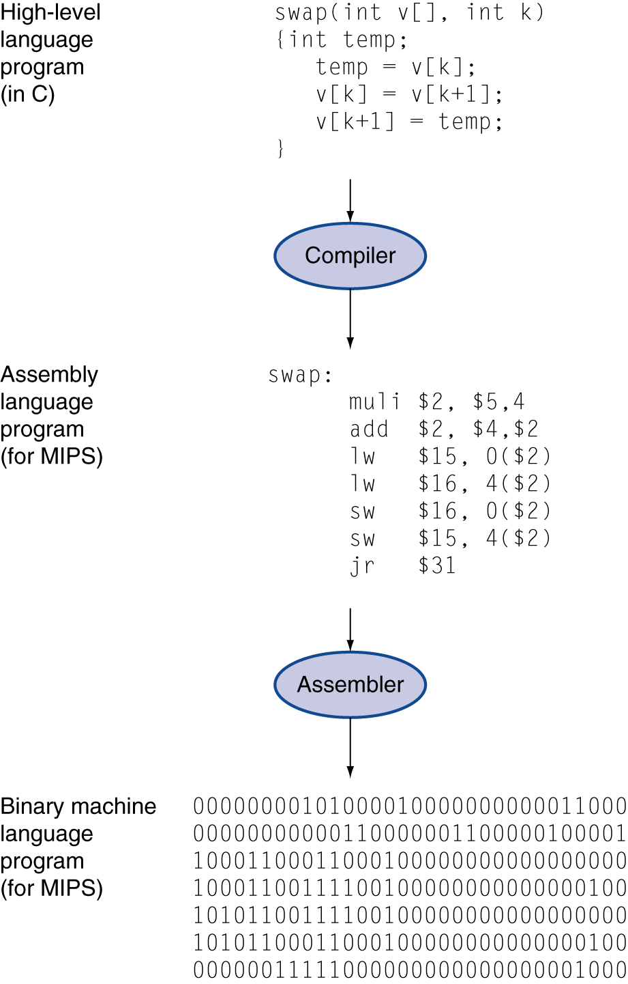
Levels of Program Code
High-level language
Level of abstraction closer to problem domain
Provides for productivity and portability
Assembly language
Textual representation of instructions
Hardware representation
Binary digits (bits)
Encoded instructions and data

Slide 22
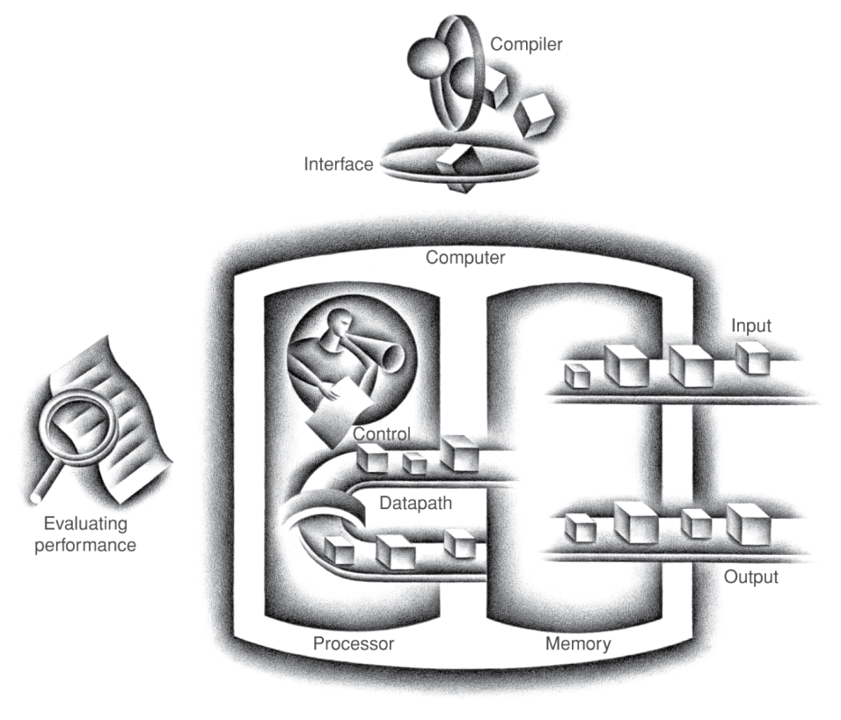
Components of a Computer
Same components for all kinds of computer
Desktop, server, embedded
Input/output includes
User-interface devices
Display, keyboard, mouse
Storage devices
Hard disk, CD/DVD, flash
Network adapters
For communicating with other computers
§1.4 Under the Covers
The BIG Picture
Notes:
Section 1.4

Slide 23
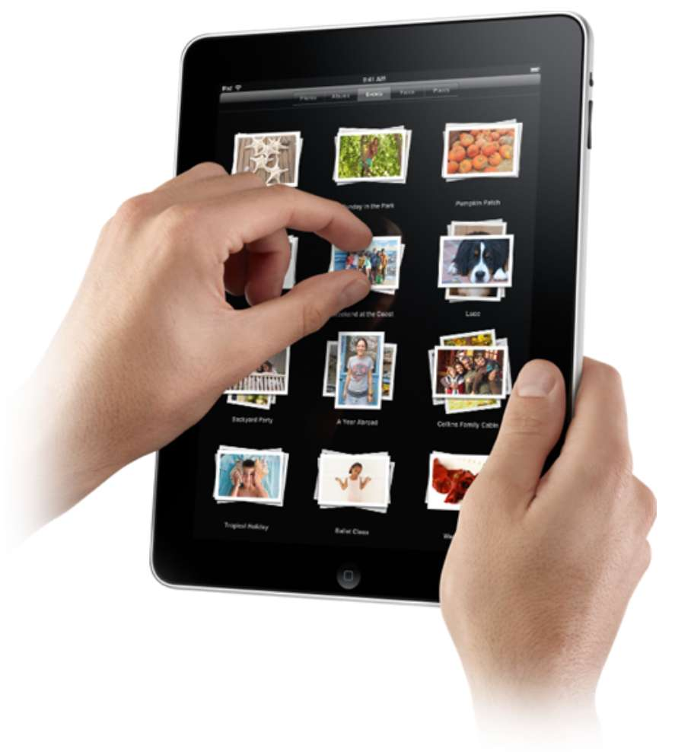
Touchscreen
PostPC device
Supersedes keyboard and mouse
Resistive and Capacitive types
Most tablets, smart phones use capacitive
Capacitive allows multiple touches simultaneously

Slide 24
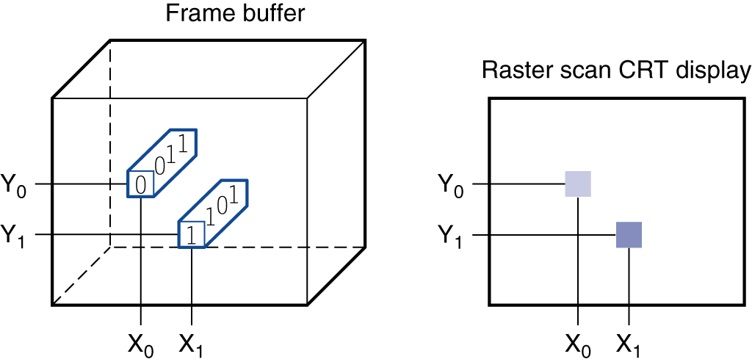
Through the Looking Glass
LCD screen: picture elements (pixels)
Mirrors content of frame buffer memory

Slide 25
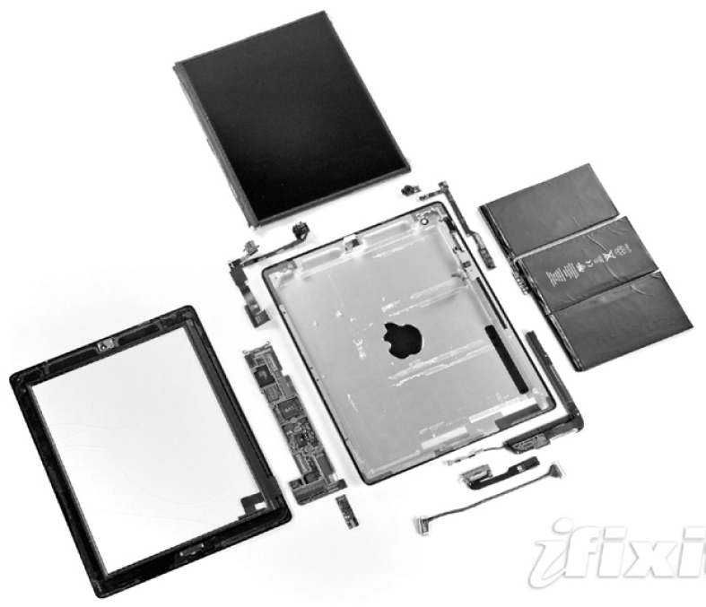
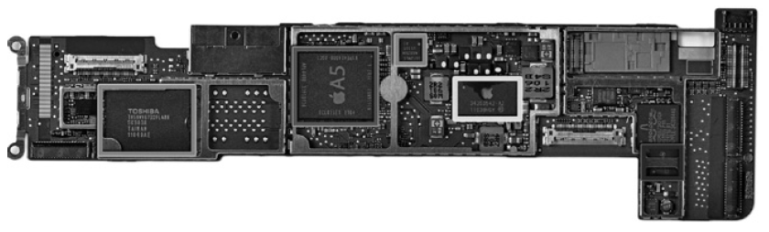
Opening the Box
Capacitive multitouch LCD screen
3.8 V, 25 Watt-hour battery
Computer board

Slide 26
Inside the Processor (CPU)
Datapath: performs operations on data
Control: sequences datapath, memory, ...
Cache memory
Small fast SRAM memory for immediate access to data

Slide 27
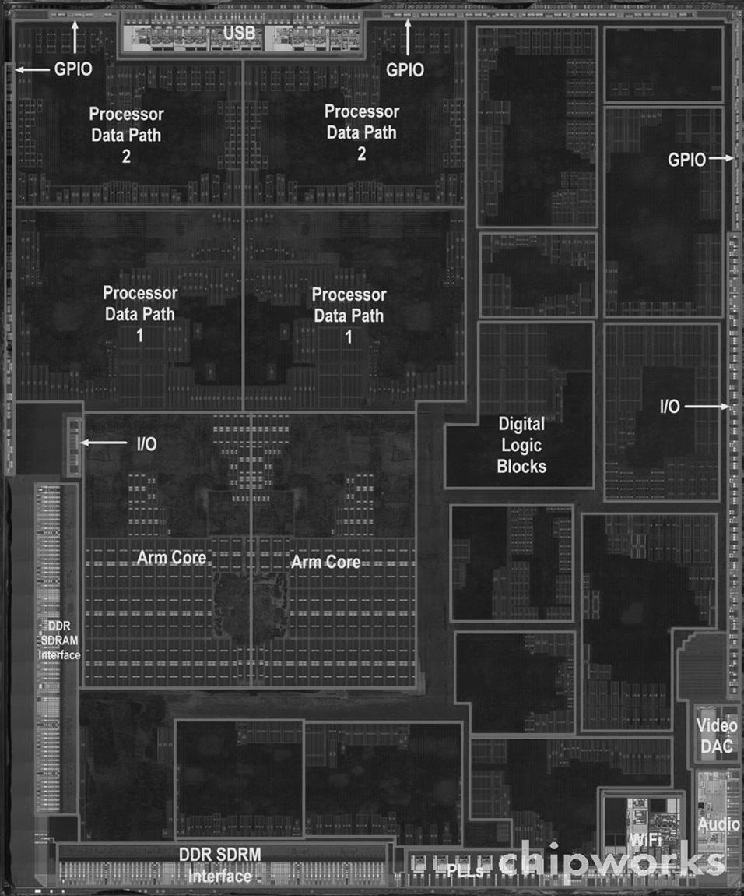
Inside the Processor
Apple A5

Slide 28
Abstractions
The BIG Picture
Abstraction helps us deal with complexity
Hide lower-level detail
Instruction set architecture (ISA)
The hardware/software interface
Application binary interface
The ISA plus system software interface
Implementation
The details underlying and interface
Notes:
Example of abstractions. Implementation example: lots of ARM chips, all use the same (or similar) ISA.

Slide 29
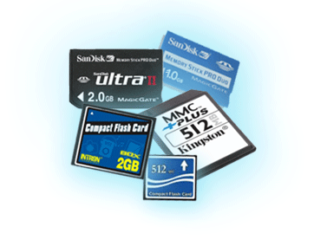
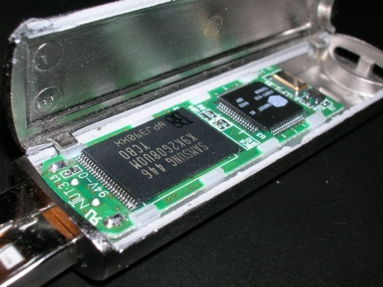
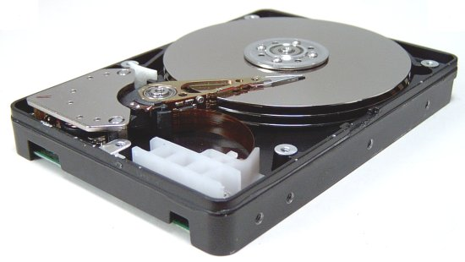
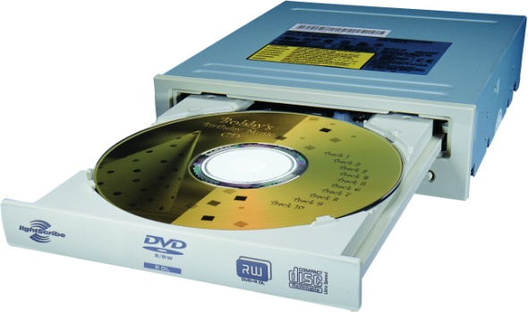
A Safe Place for Data
Volatile main memory
Loses instructions and data when power off
Non-volatile secondary memory
Magnetic disk
Flash memory
Optical disk (CDROM, DVD)

Slide 30
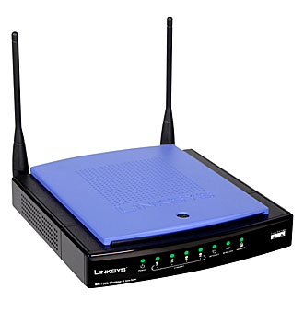
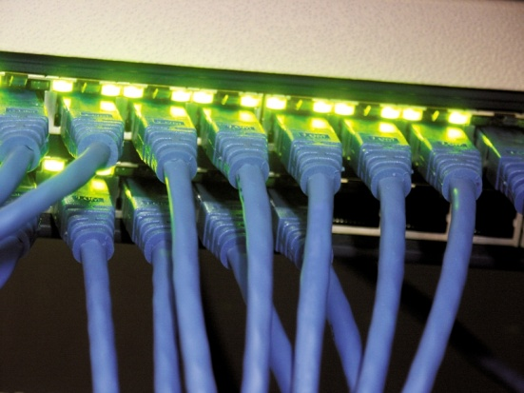
Networks
Communication, resource sharing, nonlocal access
Local area network (LAN): Ethernet
Wide area network (WAN): the Internet
Wireless network: WiFi, Bluetooth

Slide 31
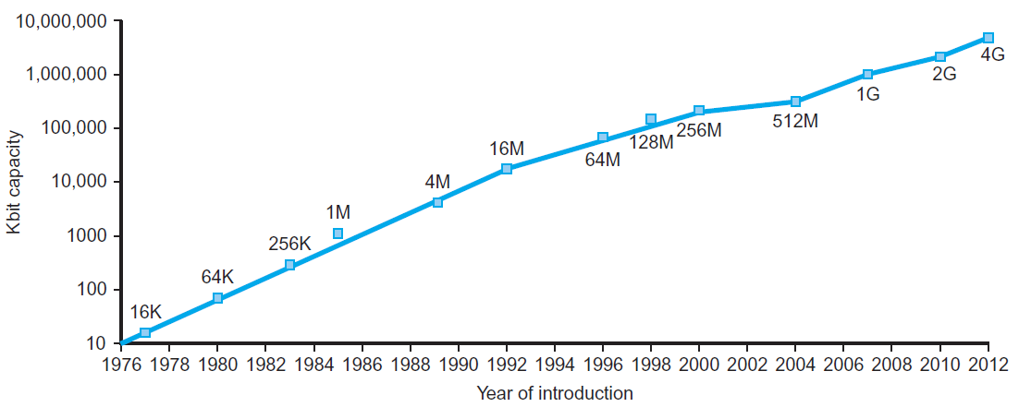
Technology Trends
Electronics technology continues to evolve
Increased capacity and performance
Reduced cost
§1.5 Technologies for Building Processors and Memory
DRAM capacity
Year | Technology | Relative performance/cost
1951 | Vacuum tube | 1
1965 | Transistor | 35
1975 | Integrated circuit (IC) | 900
1995 | Very large scale IC (VLSI) | 2,400,000
2013 | Ultra large scale IC | 250,000,000,000
Notes:
Section 1.5. Moore’s law is actually about transistors.

Slide 32
Semiconductor Technology
Silicon: semiconductor
Add materials to transform properties:
Conductors
Insulators
Switch

Slide 33
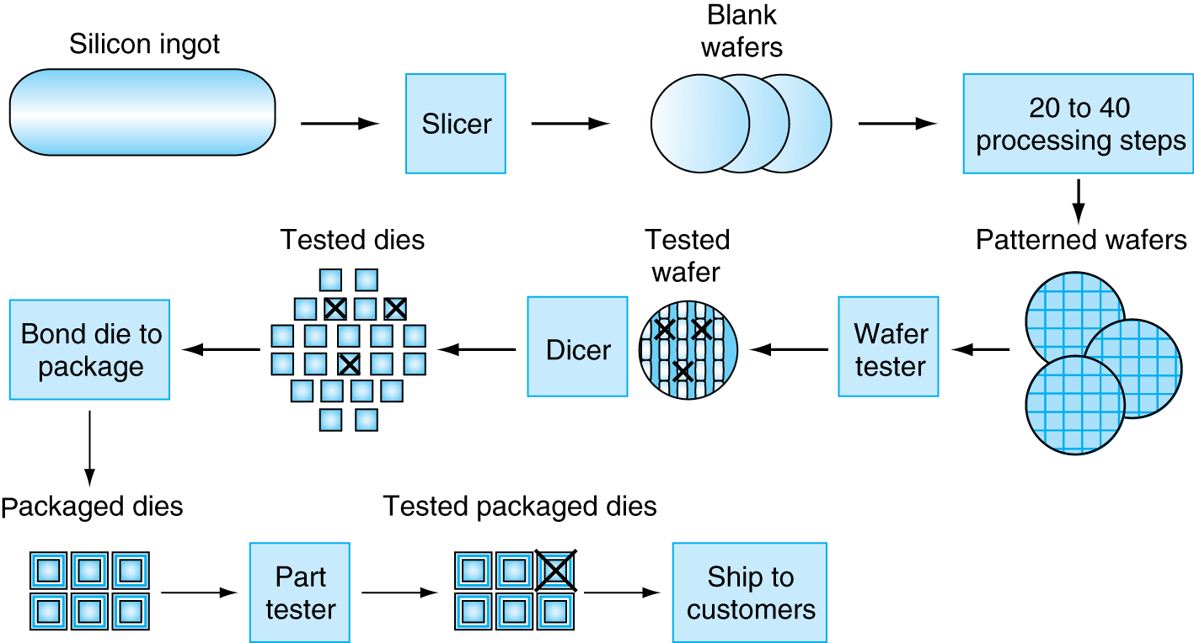
Manufacturing ICs
Yield: proportion of working dies per wafer

Slide 34
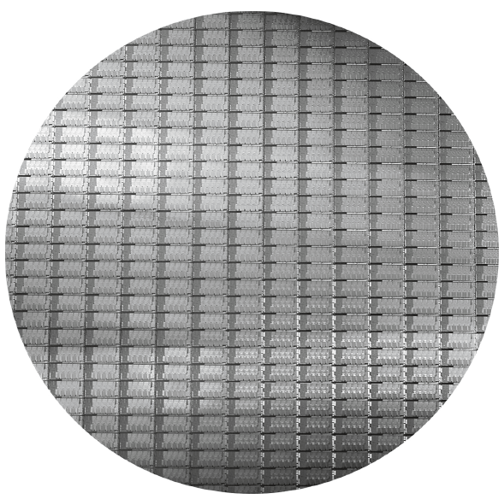
Intel Core i7 Wafer
300mm wafer, 280 chips, 32nm technology
Each chip is 20.7 x 10.5 mm

Slide 35
Integrated Circuit Cost
Nonlinear relation to area and defect rate
Wafer cost and area are fixed
Defect rate determined by manufacturing process
Die area determined by architecture and circuit design

Slide 36
Summary
Syllabus
Moore’s Law
Classes of Computers
Performance of a Computer
Components of a Computer

Slide 37
What I want you to do
Read/review chapter 1
Enjoy the new semester!

