Slide 1
Measuring Performance
Instructor: Robert Utterback
Lecture 2
Notes:
Pace of course: let me know if too fast/slow
Ask questions! Experienced professors are good at noticing when students are confused. I’m still working on it.
Read the syllabus carefully -- I'm not going to hold your hand.

Slide 2
Review
What are the steps to transform a program written in C into a representation that is directly executed by a computer processor?

Slide 3
An Analogy
Which airplane is the best?

Slide 4
An Analogy
Which airplane is the best?

Slide 5
Defining Performance
§1.6 Performance
Which airplane has the best performance?
Notes:
Section 1.6

Slide 6
Answer
That depends on …
If performance means
“the least time of transferring 1 passenger from one place to another”
Concorde
“the least time of transferring 450 passenger from one place to another”
Boeing 747
Performance can be defined in different ways

Slide 7
Response Time and Throughput
Response time (AKA Execution Time)
How long it takes to do a task
Throughput (AKA Bandwith)
Total work done per unit time
e.g., tasks/transactions/… per hour
How are response time and throughput affected by
Replacing the processor with a faster version?
Adding more processors?
We’ll focus on response time for now…
Notes:
Faster processor: reduces response time AND increases throughput
More processors: Increase throughput, same response time (probably, unless there is a backlog of tasks)

Slide 8
Performance and Execution Time
Performance

Slide 9
Relative Performance
Define Performance = 1/Execution Time
“X is n time faster than Y”
Example: time taken to run a program
10s on A, 15s on B
Execution Time_{B} / Execution Time_{A} = 15s / 10s = 1.5
So A is 1.5 times faster than B

Slide 10
Class Exercise
Computer B runs a program in 24 seconds.
Computer A runs the program 1.2 times faster.
How long does the program take on computer A?
Notes:
Perf_A / Perf_B = 1.2 = Time_B / Time_A
=> Time_A = Time_B / 1.2 = 24 * 5/6 = 20 s

Slide 11
Measuring Execution Time
Elapsed (Wallclock) time
Total response time, including all aspects
Processing, I/O, OS overhead, idle time
Determines system performance
CPU time
Time spent processing a given job
Discounts I/O time, other jobs’ shares
Comprises user CPU time and system CPU time
User CPU time: CPU time spent in a program itself
System CPU time: CPU time spent in the OS performing task on behalf of the program
Different programs are affected differently by CPU and system performance
Notes:
When we talk about elapsed time for a single program, we typically mean total response time on an unloaded machine.

Slide 12
CPU Clocking
Operation of digital hardware governed by a constant-rate clock
Clock period
Clock (cycles)
Data transfer and computation
Update state
Clock period: duration of a clock cycle
e.g., 250ps = 0.25ns = 250×10^{–12}s
Clock frequency (rate): cycles per second
e.g., 4.0GHz = 4000MHz = 4.0×10⁹Hz

Slide 13
CPU Time

Slide 14
CPU Time
Performance improved by
Reducing number of clock cycles
Increasing clock rate
Hardware designer must often trade off clock rate against cycle count
Notes:
Increasing clock rate
=> shorter clock period
=> Shorter instructions, but more of them
=> More total clock cycles
Reduce number of clock cycles
=> Fewer instructions,
but they become longer since they must be more complicated
=> longer clock period
=> reduced clock rate

Slide 15
CPU Time Example
Computer A: 2GHz clock, 10s CPU time
Designing Computer B
Aim for 6s CPU time
Can do faster clock, but causes 1.2 × clock cycles
How fast must Computer B clock be?
Notes:
CPU Time = Clock cycles / Clock Rate

Slide 16
Instruction Set Architecture
Instruction Set Architecture (ISA)
An abstract interface between the hardware and the lowest-level software that encompasses all the information necessary to write a machine language program that will run correctly
Repertoire of instructions
Registers
Memory access
I/O

Slide 17
Clock Cycles per Instruction (CPI)
Clock Cycles per Instruction (CPI)
Average number of clock cycles per instruction for a program

Slide 18
Instruction Count and CPI
Instruction Count for a program
Determined by program, ISA and compiler
Average cycles per instruction
Determined by CPU hardware
If different instructions have different CPI
Average CPI affected by instruction mix

Slide 19
CPI Example
Computer A: Cycle Time = 250ps, CPI = 2.0
Computer B: Cycle Time = 500ps, CPI = 1.2
Same ISA
Which is faster, and by how much?
A is faster…
…by this much

Slide 20
CPI in More Detail
If different instruction classes take different numbers of cycles
Weighted average CPI
Relative frequency

Slide 21
CPI Example
Alternative compiled code sequences using instructions in classes A, B, C
Class | A | B | C
CPI for class | 1 | 2 | 3
IC in sequence 1 | 2 | 1 | 2
IC in sequence 2 | 4 | 1 | 1
Sequence 1:
IC
Clock Cycles
Avg. CPI
Sequence 2:
IC
Clock Cycles
Avg. CPI

Slide 22
CPI Example
Alternative compiled code sequences using instructions in classes A, B, C
Class | A | B | C
CPI for class | 1 | 2 | 3
IC in sequence 1 | 2 | 1 | 2
IC in sequence 2 | 4 | 1 | 1
Sequence 1: IC = 5
Clock Cycles = 2×1 + 1×2 + 2×3 = 10
Avg. CPI = 10/5 = 2.0
Sequence 2: IC = 6
Clock Cycles = 4×1 + 1×2 + 1×3 = 9
Avg. CPI = 9/6 = 1.5

Slide 23
Performance Summary
The BIG Picture
Performance depends on
Algorithm: affects IC, possibly CPI
Programming language: affects IC, CPI
Compiler: affects IC, CPI
Instruction set architecture: affects IC, CPI, T_{c}
Notes:
Response time and Throughput
Performance measures: CPI, IC
Performance = 1/Execution Time

Slide 24
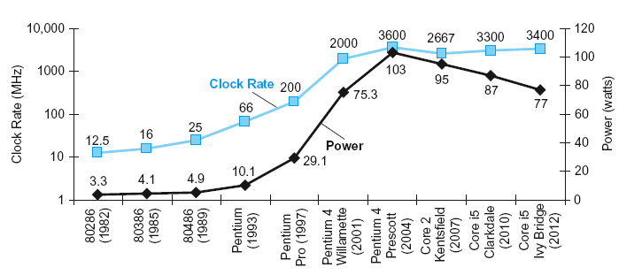
Power Trends
§1.7 The Power Wall
In CMOS IC technology
×30
5V → 1V
×1000
Notes:
Section 1.7
Power and clock rate increased until we hit a wall...too much power, plus this causes heat which you have to cool
CMOS = Complementary metal oxide semiconductor
Capacitive load: resist changes in voltage
Frequency of transitions for the transistor

Slide 25
Reducing Power
Suppose a new CPU has
85% of capacitive load of old CPU
15% voltage and 15% frequency reduction
Notes:
We can’t reduce voltage further
We can’t remove more heat

Slide 26
The Power Wall
Reduce Voltage
With lower voltage, transistors “leak”. Currently responsible for 40% of the power consumption
Reduce Heat
More powerful cooling
How else can we improve performance?

Slide 27
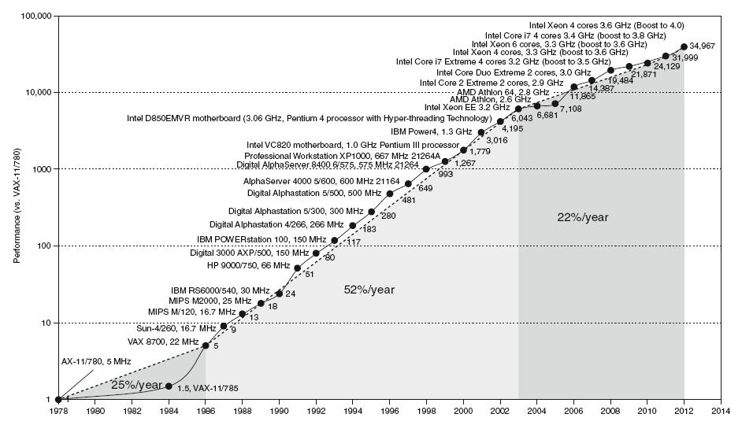
Uniprocessor Performance
§1.8 The Sea Change: The Switch to Multiprocessors
Constrained by power, instruction-level parallelism, memory latency
Notes:
Section 1.8

Slide 28
Multiprocessors
Multicore microprocessors
More than one processor per chip
Requires explicitly parallel programming
Compare with instruction level parallelism
Hardware executes multiple instructions at once
Hidden from the programmer
Hard to do
Programming for performance
Load balancing
Optimizing communication and synchronization

