Slide 1
The Memory Hierarchy
Chapter 5

Slide 2
Measuring Cache Performance
Components of CPU time
Program execution cycles
Includes cache hit time
Memory stall cycles
Mainly from cache misses
With simplifying assumptions:
§5.4 Measuring and Improving Cache Performance
Notes:
Now let’s dig a little deeper into cache performance.
In particular, we assume that our write buffer never gets too full, or if it does it’s too infrequent to matter.

Slide 3
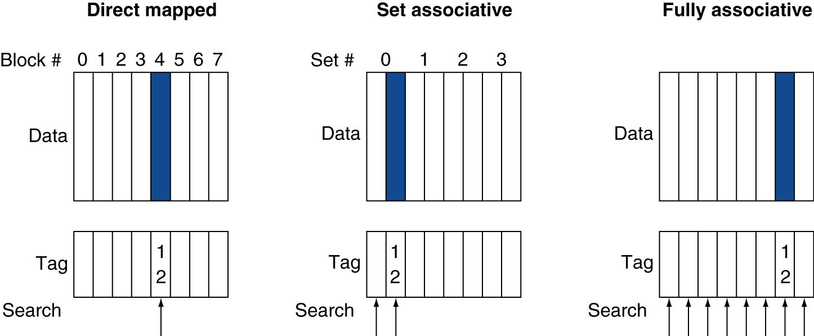
Associative Cache Example
Notes:
Two-way set associative (middle)

Slide 4
Associativity Example
2-way set associative
Block address | Cache index | Hit/miss | Cache content after access
 |  |  | Set 0 |  | Set 1
0 | 0 | miss | Mem[0]
8 | 0 | miss | Mem[0] | Mem[8]
0 | 0 | hit | Mem[0] | Mem[8]
6 | 0 | miss | Mem[0] | Mem[6]
8 | 0 | miss | Mem[8] | Mem[6]
Fully associative
Block address |  | Hit/miss | Cache content after access
0 |  | miss | Mem[0]
8 |  | miss | Mem[0] | Mem[8]
0 |  | hit | Mem[0] | Mem[8]
6 |  | miss | Mem[0] | Mem[8] | Mem[6]
8 |  | hit | Mem[0] | Mem[8] | Mem[6]
Notes:
Q: How does increasing associativity affect miss rate? A: lower, to a point

Slide 5
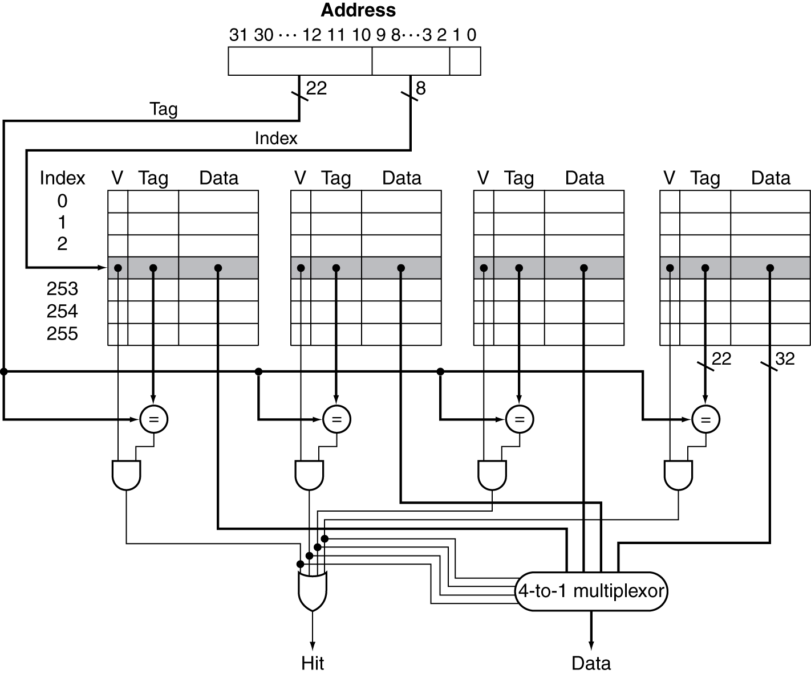
Set Associative Cache Organization
Notes:
But as soon as we allow multiple ways, we have a new choice to make.
When we need to kick something out of cache, which way do we choose?

Slide 6
Multilevel Caches
Primary cache attached to CPU
Small, but fast
Level-2 cache services misses from primary cache
Larger, slower, but still faster than main memory
Main memory services L2 cache misses
Many systems include L3 cache
Notes:
Your tablet/phone may not have an L3, but it’s very likely your desktop/laptop does.

Slide 7
Multilevel Cache Example
Given
CPU base CPI = 1, clock rate = 4GHz
Miss rate/instruction = 2%
Main memory access time = 100ns
With just primary cache, effective CPI?
Notes:
Calculate the effective CPI with just a primary cache…
100e-9/ 1/(4e9)
Miss penalty = 100ns/0.25ns = 400 cycles
Effective CPI = 1 + 0.02 × 400 = 9

Slide 8
Multilevel Cache Example
Given
CPU base CPI = 1, clock rate = 4GHz
Miss rate/instruction = 2%
Main memory access time = 100ns
With just primary cache
Miss penalty = 100ns/0.25ns = 400 cycles
Effective CPI = 1 + 0.02 × 400 = 9

Slide 9
Example (cont.)
Now add L2 cache
Access time = 5ns
Global miss rate to main memory = 0.5%
Primary miss with L2 hit
Penalty = ???
Notes:
Penalty (in cycles?)
5ns/0.25ns = 20 cycles

Slide 10
Example (cont.)
Now add L2 cache
Access time = 5ns
Global miss rate to main memory = 0.5%
Main memory access time = 100ns (still)
Primary miss with L2 hit
Penalty = 5ns/0.25ns = 20 cycles
Primary miss with L2 miss
Extra penalty = ???
Notes:
Extra penalty in cycles?
100ns/0.25ns = 400 cycles

Slide 11
Example (cont.)
Now add L2 cache
Access time = 5ns
Global miss rate to main memory = 0.5%
Main memory access time = 100ns (still)
Primary miss with L2 hit
Penalty = 5ns/0.25ns = 20 cycles
Primary miss with L2 miss
Extra penalty = 100ns/0.25ns = 400 cycles
CPI = ???
Notes:
Note still pay L2 hit cost with an L2 miss!
Our caches are inclusive, which Is why you can use the global miss rate here.
If it’s not in L2, it’s also not in L1, so we pay the full price.
1 + 0.02 × 20 + 0.005 × 400 = 3.4

Slide 12
Example (cont.)
Now add L2 cache
Access time = 5ns
Global miss rate to main memory = 0.5%
Primary miss with L2 hit
Penalty = 5ns/0.25ns = 20 cycles
Primary miss with L2 miss
Extra penalty = 100ns/0.25ns = 400 cycles
CPI = 1 + 0.02 × 20 + 0.005 × 400 = 3.4
Performance ratio = 9/3.4 = 2.6
Notes:
Notice you could have calculated this a different way, too….

Slide 13
Multilevel Cache Considerations
Primary cache
Focus on minimal hit time
L2 cache
Focus on low miss rate to avoid main memory access
Hit time has less overall impact
Results
L1 cache usually smaller than a single cache
L1 block size smaller than L2 block size
Notes:
L1 typically tries to be 1 or maybe just a few cycles.
The l2 (or l3) is kind of like your last-ditch/resort effort

Slide 14
Interactions with Advanced CPUs
Out-of-order CPUs can execute instructions during cache miss
Pending store stays in load/store unit
Dependent instructions wait in reservation stations
Independent instructions continue
Effect of miss depends on program data flow
Much harder to analyse
Use system simulation
Notes:
Next section – stop?

Slide 15
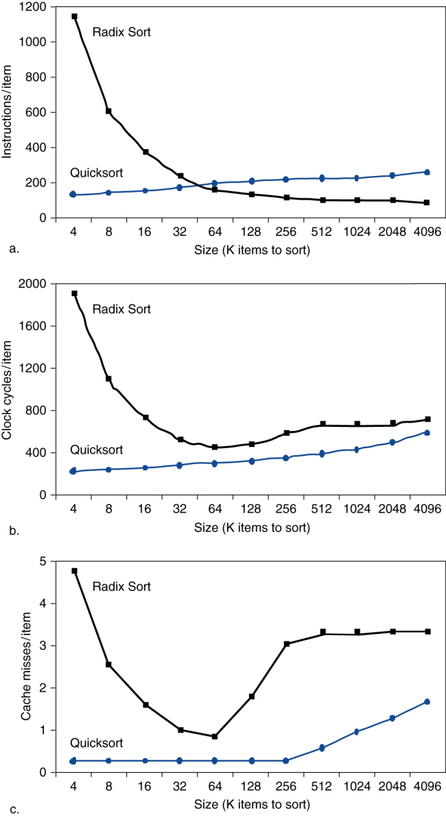
Interactions with Software
Misses depend on memory access patterns
Algorithm behavior
Compiler optimization for memory access
Hardware prefetch

Slide 16
Software Optimization via Blocking
Goal: maximize accesses to data before it is replaced
Consider inner loops of DGEMM:
for (int j = 0; j < n; ++j)
{
double cij = C[i+j*n];
for( int k = 0; k < n; k++ )
cij += A[i+k*n] * B[k+j*n];
C[i+j*n] = cij;
}

Slide 17
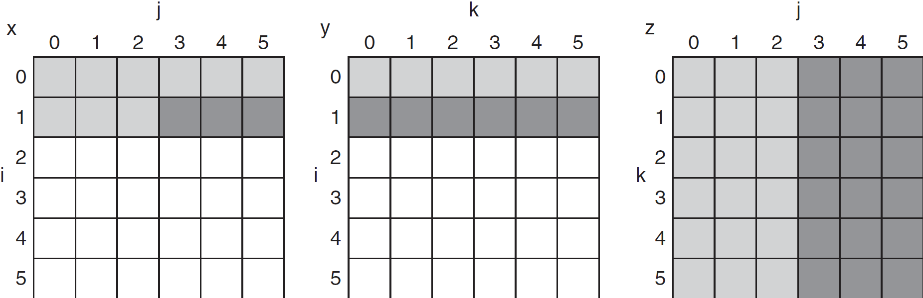
DGEMM Access Pattern
C, A, and B arrays
older accesses
new accesses
Notes:
C = A * B
Reads full row of A over and over, N total reads
Reads all elements of B, all rows, all columns
Writes one row of N elements of C
Whether you store by row or by column you’re going to get a lot of misses. Ex: Reading a column of B, then all the others, then need to come back to it for a different row of C.

Slide 18
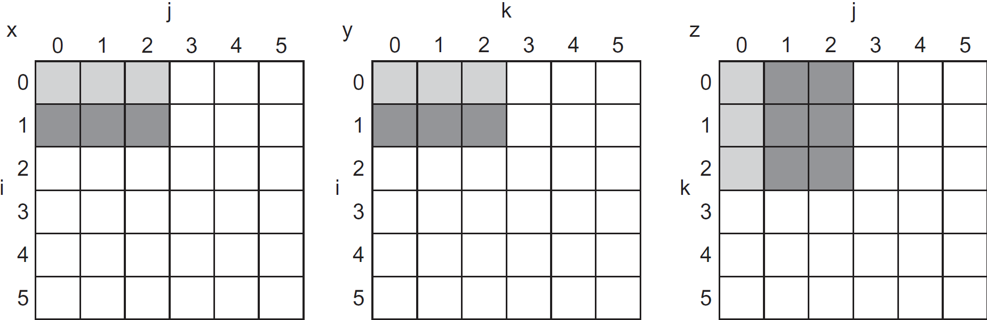
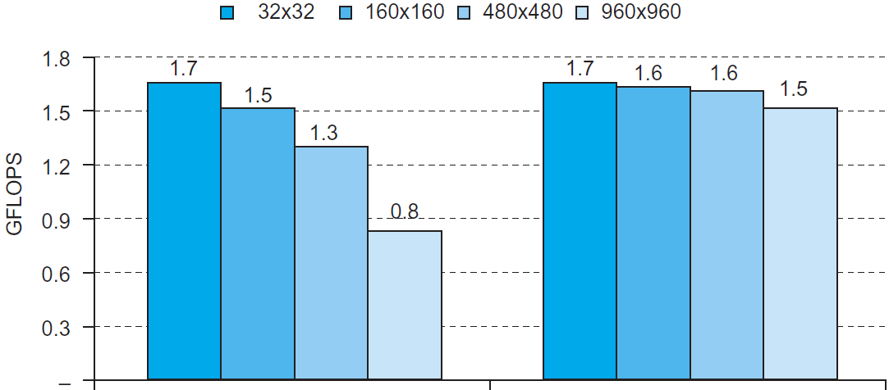
Blocked DGEMM Access Pattern
Unoptimized
Blocked
Notes:
Idea is to make the blocks small enough that everything fits into cache

Slide 19
Cache Blocked DGEMM
1 #define BLOCKSIZE 32
2 void do_block (int n, int si, int sj, int sk, double *A, double
3 *B, double *C)
4 {
5 for (int i = si; i < si+BLOCKSIZE; ++i)
6 for (int j = sj; j < sj+BLOCKSIZE; ++j)
7 {
8 double cij = C[i+j*n];/* cij = C[i][j] */
9 for( int k = sk; k < sk+BLOCKSIZE; k++ )
10 cij += A[i+k*n] * B[k+j*n];/* cij+=A[i][k]*B[k][j] */
11 C[i+j*n] = cij;/* C[i][j] = cij */
12 }
13 }
14 void dgemm (int n, double* A, double* B, double* C)
15 {
16 for ( int sj = 0; sj < n; sj += BLOCKSIZE )
17 for ( int si = 0; si < n; si += BLOCKSIZE )
18 for ( int sk = 0; sk < n; sk += BLOCKSIZE )
19 do_block(n, si, sj, sk, A, B, C);
20 }
Notes:
S{i,j,k} = starting position of submatrices

