Slide 1
The Memory Hierarchy
Chapter 5

Slide 2
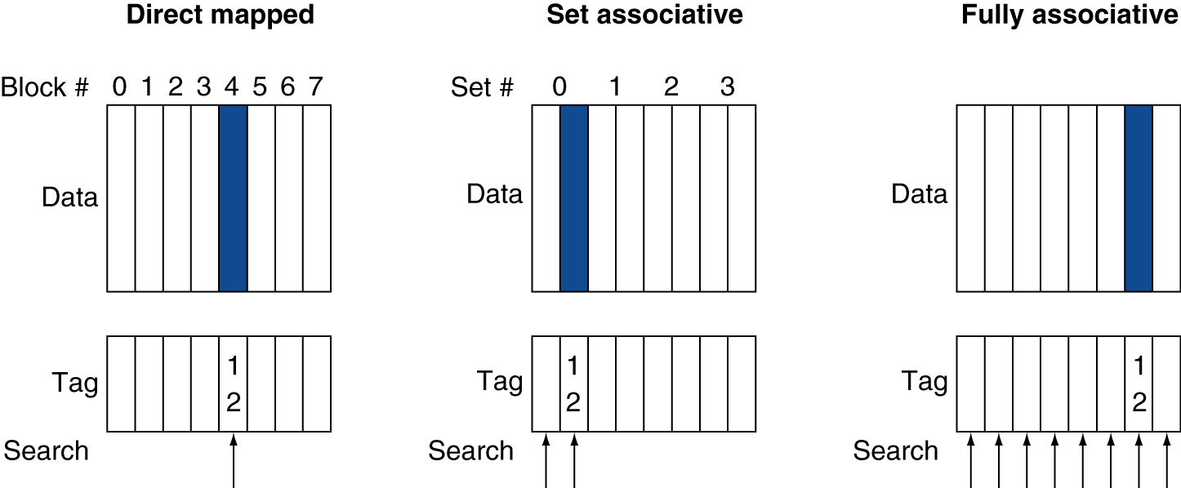
Associative Cache Example
Notes:
Two-way set associative (middle)

Slide 3
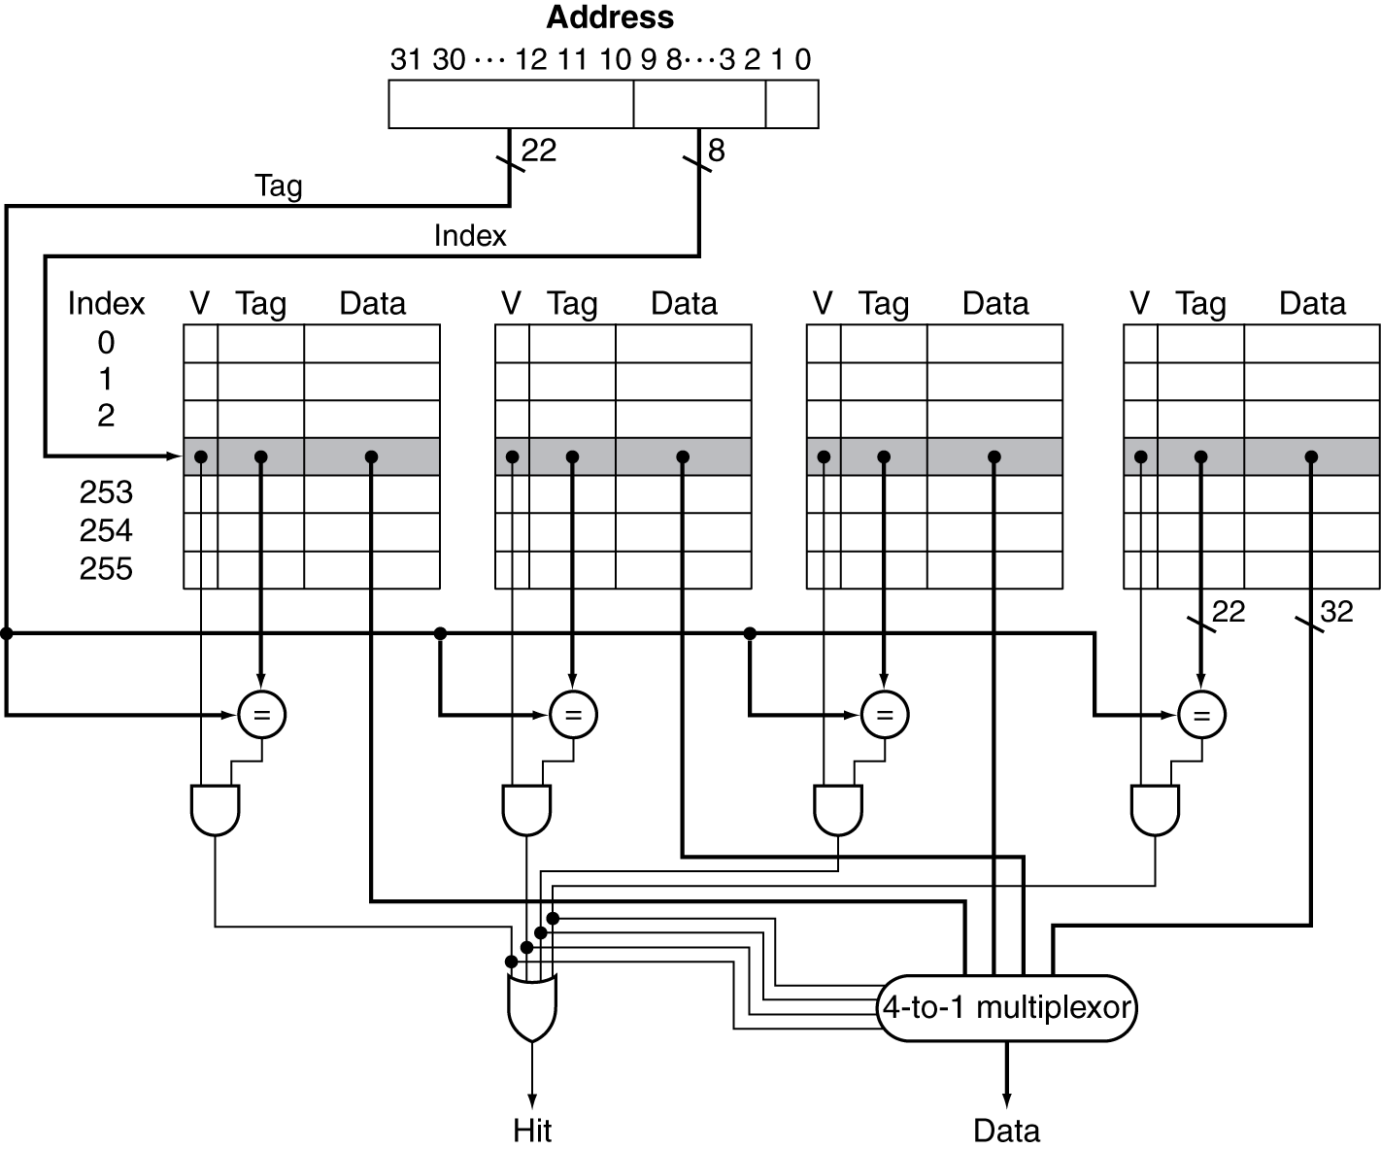
Set Associative Cache Organization
Notes:
But as soon as we allow multiple ways, we have a new choice to make.
When we need to kick something out of cache, which way do we choose?

Slide 4
Multilevel Caches
Primary cache attached to CPU
Small, but fast
Level-2 cache services misses from primary cache
Larger, slower, but still faster than main memory
Main memory services L2 cache misses
Many systems include L3 cache
Notes:
Your tablet/phone may not have an L3, but it’s very likely your desktop/laptop does.

Slide 5
Multilevel Cache Considerations
Primary cache
Focus on minimal hit time
L2 cache
Focus on low miss rate to avoid main memory access
Hit time has less overall impact
Results
L1 cache usually smaller than a single cache
L1 block size smaller than L2 block size
Notes:
L1 typically tries to be 1 or maybe just a few cycles.
The l2 (or l3) is kind of like your last-ditch/resort effort

Slide 6
Interactions with Advanced CPUs
Out-of-order CPUs can execute instructions during cache miss
Pending store stays in load/store unit
Dependent instructions wait in reservation stations
Independent instructions continue
Effect of miss depends on program data flow
Much harder to analyse
Use system simulation
Notes:
Next section – stop?

Slide 7
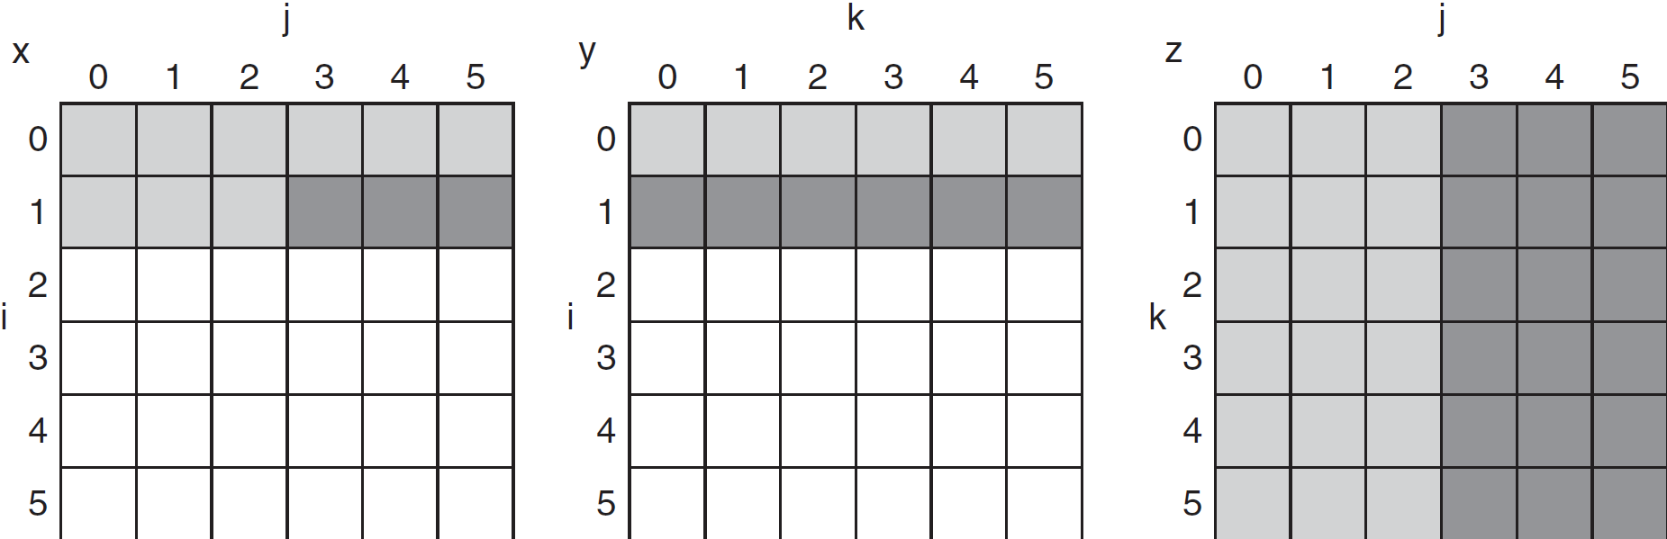
DGEMM Access Pattern
C, A, and B arrays
older accesses
new accesses
Notes:
C = A * B
Reads full row of A over and over, N total reads
Reads all elements of B, all rows, all columns
Writes one row of N elements of C
Whether you store by row or by column you’re going to get a lot of misses. Ex: Reading a column of B, then all the others, then need to come back to it for a different row of C.

Slide 8
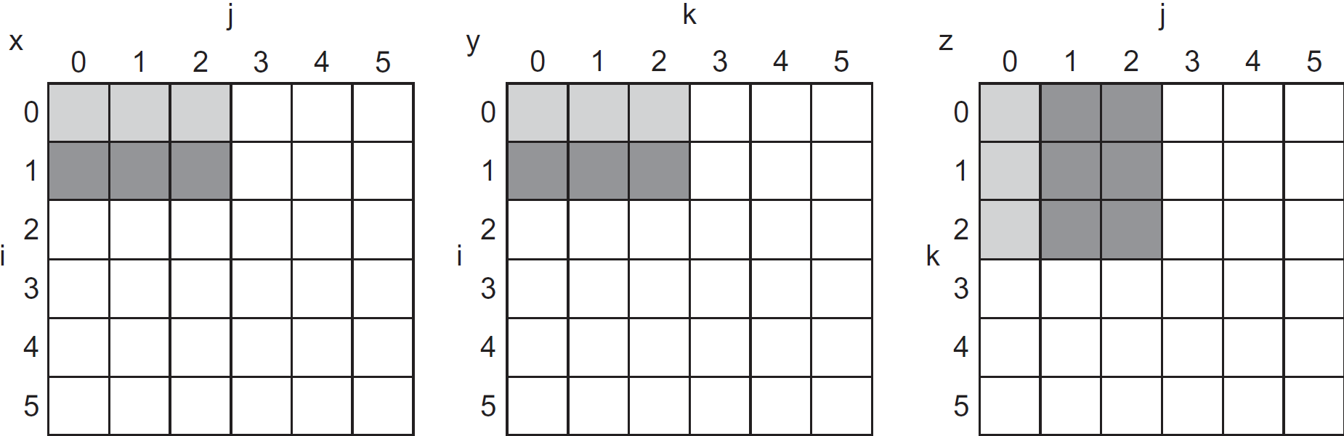
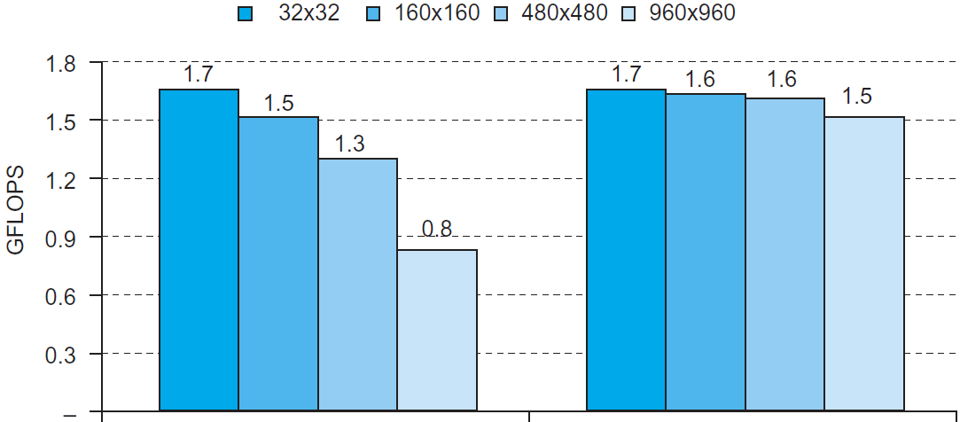
Blocked DGEMM Access Pattern
Unoptimized
Blocked
Notes:
Idea is to make the blocks small enough that everything fits into cache

Slide 9
Dependability
Service accomplishment
Service delivered as specified
§5.5 Dependable Memory Hierarchy
Fault: failure of a component
May or may not lead to system failure
Restoration
Failure
Service interruption
Deviation from specified service
Notes:
Increasing important with warehouse-scale data centers.

Slide 10
Dependability Measures
Reliability: mean time to failure (MTTF)
Service interruption: mean time to repair (MTTR)
Mean time between failures
MTBF = MTTF + MTTR
Availability = MTTF / (MTTF + MTTR)
Improving Availability
Increase MTTF: fault avoidance, fault tolerance, fault forecasting
Reduce MTTR: improved tools and processes for diagnosis and repair
Notes:
These terms are often thrown around vaguely, but we have actual definitions for them.

Slide 11
The Hamming SEC Code
Hamming distance
Number of bits that are different between two bit patterns
Minimum distance = 2 provides single bit error detection
E.g. parity code
Minimum distance = 3 provides single error correction, 2 bit error detection
Notes:
Idea: Add some bits so that the minimum distance between valid bit strings is x. Then if you get an invalid bit string you know you have an error. Even better, if your valid strings are very far away and an error is closer to 1 than others, that 1 is probably the correct string.

Slide 12
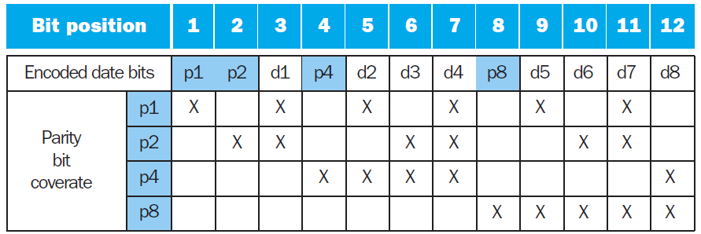
Encoding ECC
To calculate Hamming code:
Number bits from 1 on the left
All bit positions that are a power 2 are parity bits
Each parity bit checks certain data bits:

Slide 13
Decoding SEC
Value of parity bits indicates which bits are in error
Use numbering from encoding procedure
E.g.
Parity error bits = 0000 indicates no error
Parity error bits = 1010 indicates bit 10 was flipped
Notes:
___x = was there a parity error in first group
__x_ = was parity error in second group?
And so on…
1010 = 8 + 2 = 10 = bit 3 from right

Slide 14
SEC/DEC Code
Add an additional parity bit for the whole word (p_{n})
Make Hamming distance = 4
Decoding:
Let H = SEC parity bits
H even, p_{n} even, no error
H odd, p_{n} odd, correctable single bit error
H even, p_{n} odd, error in p_{n} bit
H odd, p_{n} even, double error occurred
Note: ECC DRAM uses SEC/DEC with 8 bits protecting each 64 bits
Notes:
This is why DIMM are often 72 bits wide instead of 64.

Slide 15
Virtual Machines
Host computer emulates guest operating system and machine resources
Improved isolation of multiple guests
Avoids security and reliability problems
Aids sharing of resources
Virtualization has some performance impact
Feasible with modern high-performance comptuers
Examples
IBM VM/370 (1970s technology!)
VMWare
Microsoft Virtual PC
§5.6 Virtual Machines
Notes:
Who’s heard of VirtualBox? Similar concept is containers; might have heard of Docker.
Amazon and lots of cloud providers are using these heavily.
Most of the time people aren’t using full capabilities of a server, so try to get multiple people to use the same hardware.

Slide 16
Virtual Machine Monitor
Maps virtual resources to physical resources
Memory, I/O devices, CPUs
Guest code runs on native machine in user mode
Traps to VMM on privileged instructions and access to protected resources
Guest OS may be different from host OS
VMM handles real I/O devices
Emulates generic virtual I/O devices for guest

Slide 17
Example: Timer Virtualization
In native machine, on timer interrupt
OS suspends current process, handles interrupt, selects and resumes next process
With Virtual Machine Monitor
VMM suspends current VM, handles interrupt, selects and resumes next VM
If a VM requires timer interrupts
VMM emulates a virtual timer
Emulates interrupt for VM when physical timer interrupt occurs
Notes:
e.g. timer for scheduling multiple processes

Slide 18
Instruction Set Support
User and System modes
Privileged instructions only available in system mode
Trap to system if executed in user mode
All physical resources only accessible using privileged instructions
Including page tables, interrupt controls, I/O registers
Renaissance of virtualization support
Current ISAs (e.g., x86) adapting
Notes:
Problem: OSes running in VMs are running in user mode!

Slide 19
The Problem with Memory
§5.7 Virtual Memory
Two programs running at the same time
Prog A has bug – bad pointer value
Overwrites into memory used by Prog B!
Buying from Amazon.com
Enter CC info into browser
Another program reads the browser memory and gets CC info
Some memory locations reserved for OS, communication with devices, etc.
Some programs need more memory than a machine has
But we have plenty of disk space

Slide 20
Virtual Memory
Use main memory as a “cache” for secondary (disk) storage
Managed jointly by CPU hardware and the operating system (OS)
Programs share main memory
Each gets a private virtual address space holding its frequently used code and data
Protected from other programs
CPU and OS translate virtual addresses to physical addresses
VM “block” is called a page
VM translation “miss” is called a page fault

Slide 21
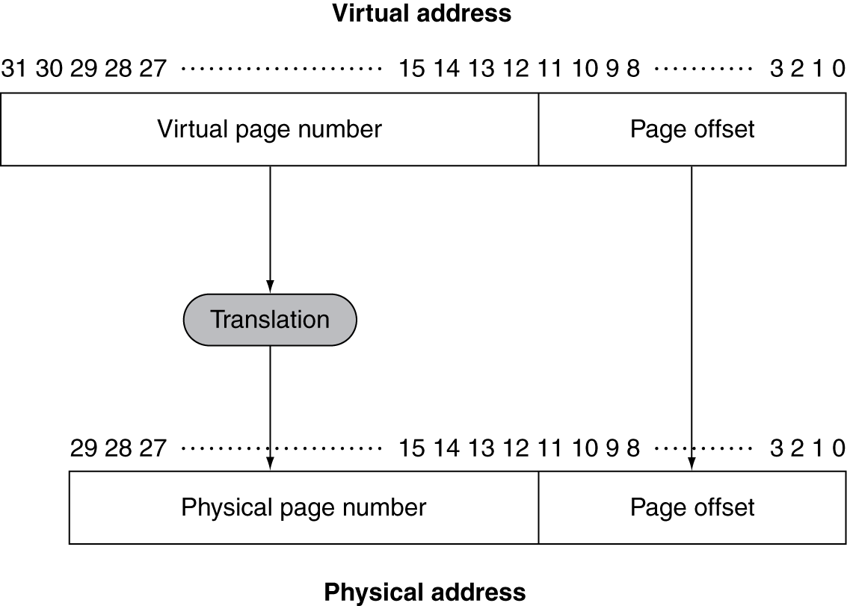
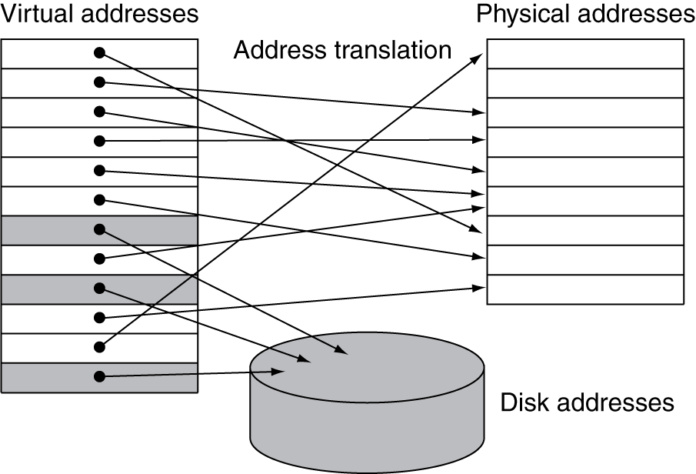
Address Translation
Fixed-size pages (e.g., 4K)

Slide 22
Page Fault Penalty
On page fault, the page must be fetched from disk
Takes millions of clock cycles
Handled by OS code
Try to minimize page fault rate
Fully associative placement
Smart replacement algorithms
Notes:
Disks are slow, so okay to handle in software and be smart about it…
…BUT this is changing! SSDs are changing everything – much faster than disks!

Slide 23
Page Tables
Stores placement information
Array of page table entries, indexed by virtual page number
Page table register in CPU points to page table in physical memory
If page is present in memory
PTE stores the physical page number
Plus other status bits (referenced, dirty, …)
If page is not present
PTE can refer to location in swap space on disk
Notes:
Each process has its own page table, usually allocated in operating system memory space
So the page table register just points to the page table

Slide 24
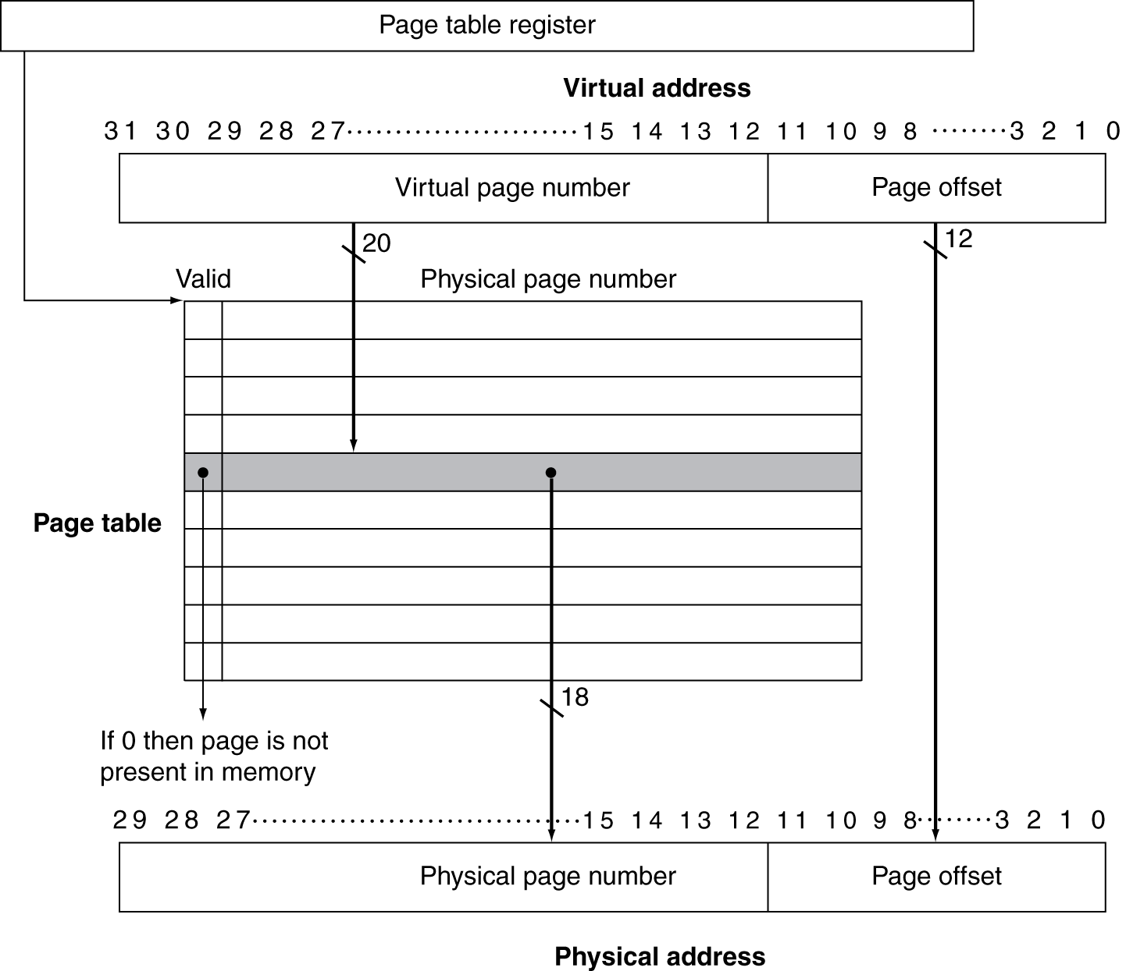
Translation Using a Page Table
Notes:
Notice that the physical page number means something different depending on the valid bit.
If valid, it’s the physical address in memory
If not, it’s a disk address.

Slide 25
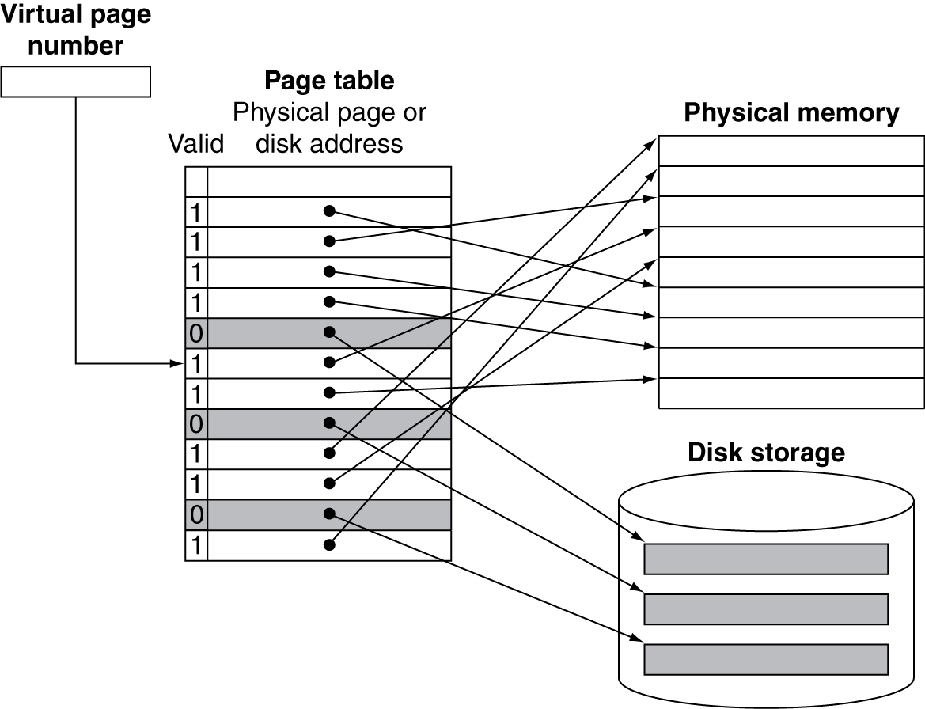
Mapping Pages to Storage
Notes:
Q: Do you think we use write-through or write-back for virtual memory?

