Slide 1
The Memory Hierarchy
Chapter 5
Notes:
Next time open this chapter with an analogy, like the book does with library books.
What two types of locality do we have?

Slide 2
Principle of Locality
§5.1 Introduction
Programs access a small proportion of their address space at any time
Temporal locality
Items accessed recently are likely to be accessed again soon
e.g., instructions in a loop, induction variables
Spatial locality
Items near those accessed recently are likely to be accessed soon
E.g., sequential instruction access, array data
Notes:
And what do we call it when we have the value we want in cache? If not?

Slide 3
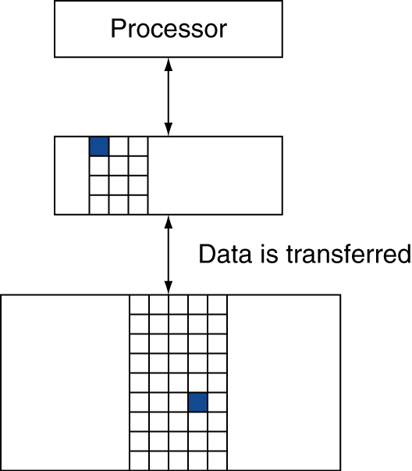
Memory Hierarchy Levels
Block (aka line): unit of copying
May be multiple words
If accessed data is present in upper level
Hit: access satisfied by upper level
Hit ratio: hits/accesses
If accessed data is absent
Miss: block copied from lower level
Time taken: miss penalty
Miss ratio: misses/accesses = 1 – hit ratio
Then accessed data supplied from upper level
Notes:
We will always be talking about inclusive memory hierarchy…

Slide 4
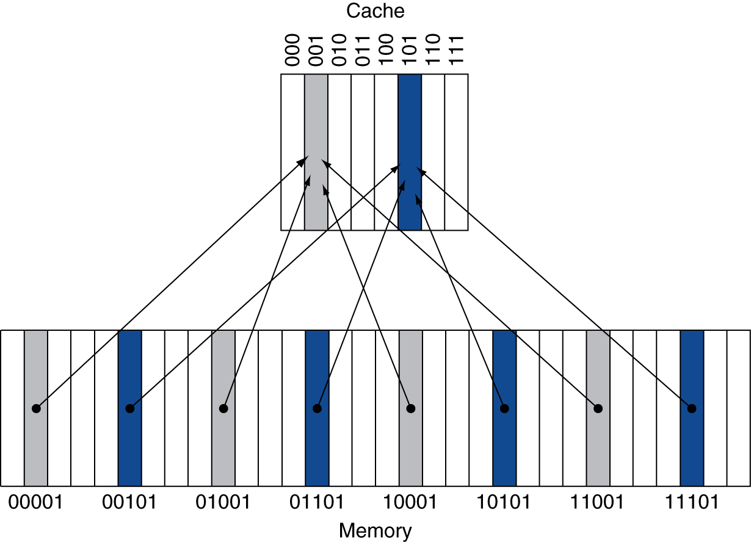
Direct Mapped Cache
Location determined by address
Direct mapped: only one choice
(Block address) modulo (#Blocks in cache)
#Blocks is a power of 2
Use low-order address bits
Notes:
BTW, what’s the problem with this approach?
We may have two slots and also use two memory locations. Theoretically they should both fit in cache, but if they both map to the same slot they don’t!

Slide 5
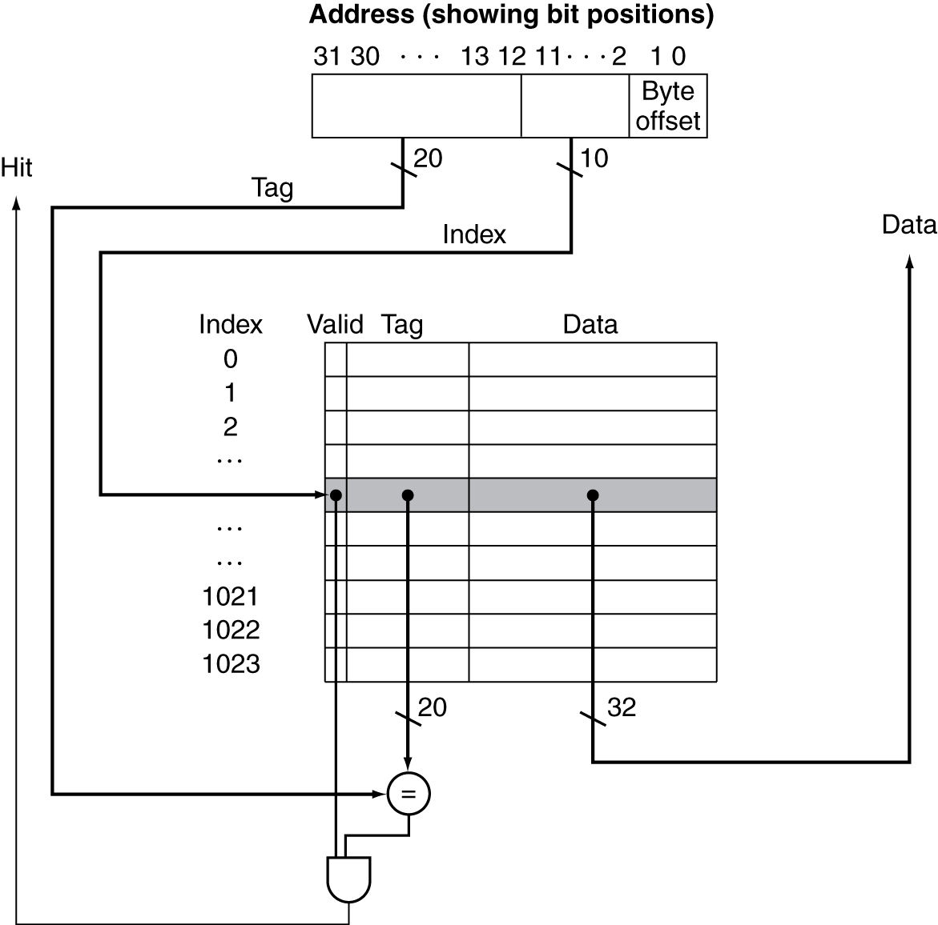
Address Subdivision

Slide 6
Write-Through
On data-write hit, could just update the block in cache
But then cache and memory would be inconsistent
Write through: also update memory
But makes writes take longer
e.g., if base CPI = 1, 10% of instructions are stores, write to memory takes 100 cycles
Effective CPI = 1 + 0.1×100 = 11
Solution: write buffer
Holds data waiting to be written to memory
CPU continues immediately
Only stalls on write if write buffer is already full
Notes:
Consider a write hit (ONLY – think about write misses later…)

Slide 7
Write-Back
Alternative: On data-write hit, just update the block in cache
Keep track of whether each block is dirty
When a dirty block is replaced
Write it back to memory
Can use a write buffer to allow replacing block to be read first

Slide 8
Write Allocation
What should happen on a write miss?
Alternatives for write-through
Allocate on miss: fetch the block
Write around: don’t fetch the block
Since programs often write a whole block before reading it (e.g., initialization)
For write-back
Usually fetch the block

Slide 9
Example: Intrinsity FastMATH
Embedded MIPS processor
12-stage pipeline
Instruction and data access on each cycle
Split cache: separate I-cache and D-cache
Each 16KB: 256 blocks × 16 words/block
D-cache: write-through or write-back
SPEC2000 miss rates
I-cache: 0.4%
D-cache: 11.4%
Weighted average: 3.2%
Notes:
This is an embedded processor. Actually let’s the programmer (operating system, really) decide whether to use write-through or write-back.
How many bits will we need to specify the word we want? (4) (also 2 wasted b/c we always address by word)
How many to specify the block (8, b/c 256)
How many tag bits? (32 – 8 – 6 = 18)

Slide 10
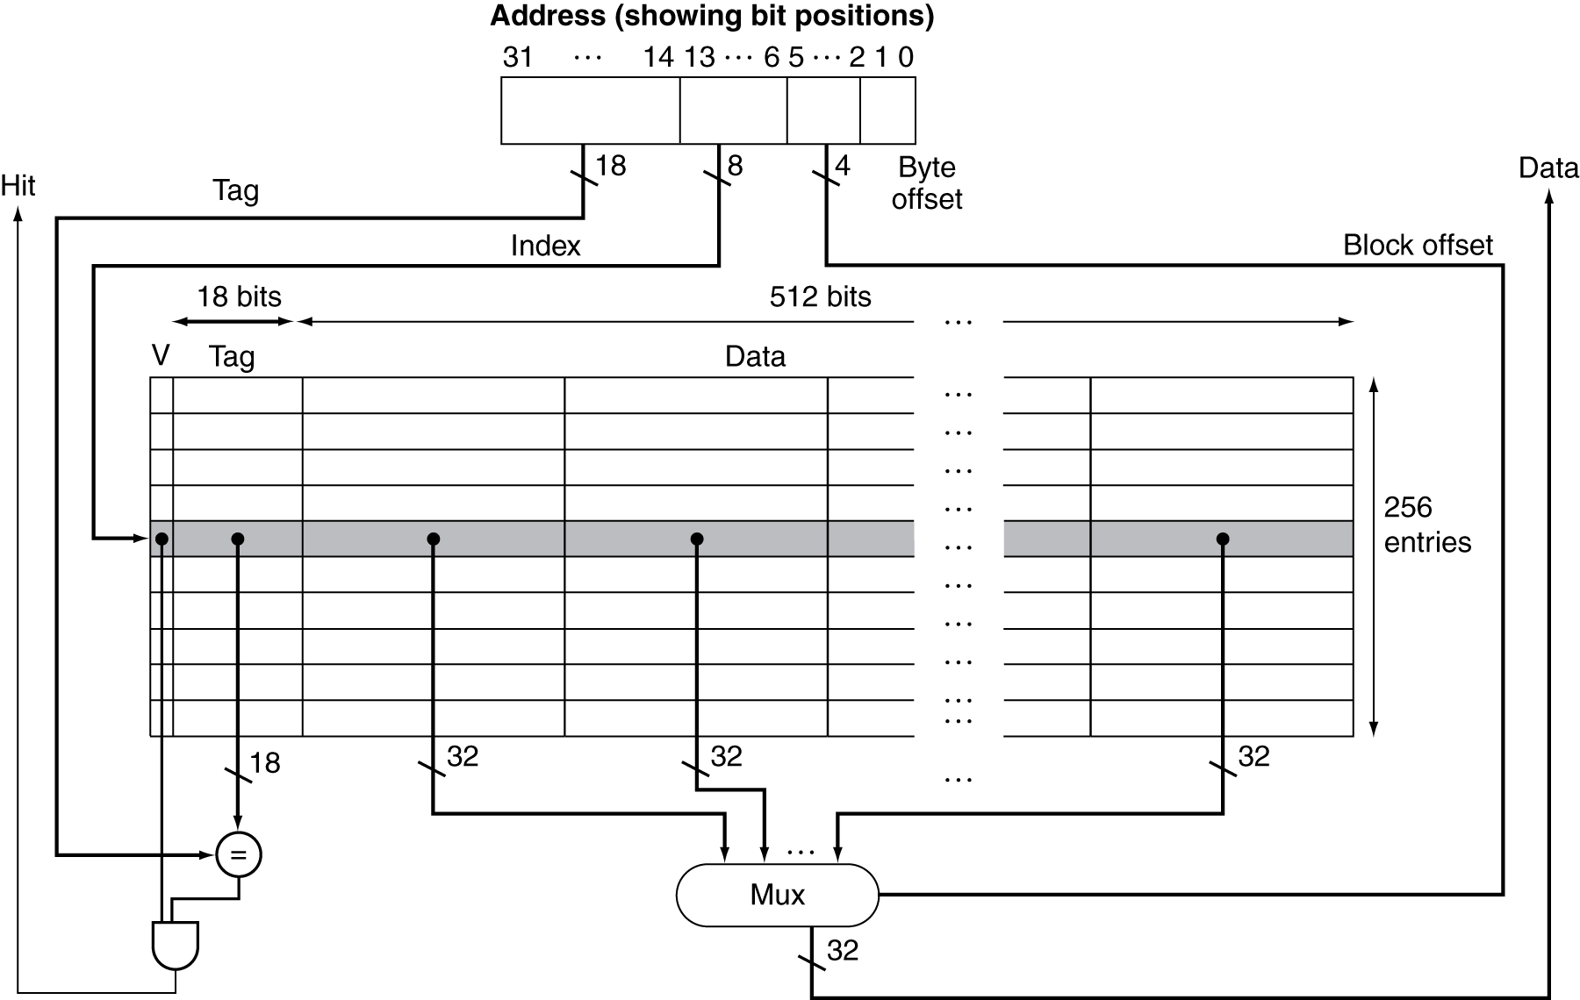
Example: Intrinsity FastMATH

Slide 11
Main Memory Supporting Caches
Use DRAMs for main memory
Fixed width (e.g., 1 word)
Connected by fixed-width clocked bus
Bus clock is typically slower than CPU clock
Example cache block read
1 bus cycle for address transfer
15 bus cycles per DRAM access
1 bus cycle per data transfer
For 4-word block, 1-word-wide DRAM
Miss penalty = 1 + 4×15 + 4×1 = 65 bus cycles
Bandwidth = 16 bytes / 65 cycles = 0.25 B/cycle
Notes:
If we make our bus and DRAM 4 words wide we can get rid of both of these 4s.
If we make DRAM 4 words wide (or make it 4 banks), we can keep the bus small while removing the first 4.

Slide 12
Measuring Cache Performance
Components of CPU time
Program execution cycles
Includes cache hit time
Memory stall cycles
Mainly from cache misses
With simplifying assumptions:
§5.4 Measuring and Improving Cache Performance
Notes:
Now let’s dig a little deeper into cache performance.
In particular, we assume that our write buffer never gets too full, or if it does it’s too infrequent to matter.

Slide 13
Cache Performance Example
Given
I-cache miss rate = 2%
D-cache miss rate = 4%
Miss penalty = 100 cycles
Base CPI (ideal cache) = 2
Load & stores are 36% of instructions
Notes:
Step 1: I-cache miss cycles
Step 2: D-Cache miss cycles
Step 3: Add these to normal cycles (2 / instruction), divide by # instructions

Slide 14
Cache Performance Example
Given
I-cache miss rate = 2%
D-cache miss rate = 4%
Miss penalty = 100 cycles
Base CPI (ideal cache) = 2
Load & stores are 36% of instructions
Miss cycles per instruction
I-cache: 0.02 × 100 = 2
D-cache: 0.36 × 0.04 × 100 = 1.44
Actual CPI = 2 + 2 + 1.44 = 5.44
Ideal CPU is 5.44/2 =2.72 times faster

Slide 15
Average Access Time
Hit time is also important for performance
Average memory access time (AMAT)
AMAT = Hit time + Miss rate × Miss penalty
Example
CPU with 1ns clock, hit time = 1 cycle, miss penalty = 20 cycles, I-cache miss rate = 5%
AMAT = 1 + 0.05 × 20 = 2ns
2 cycles per instruction

Slide 16
Performance Summary
When CPU performance increased
Miss penalty becomes more significant
Decreasing base CPI
Greater proportion of time spent on memory stalls
Increasing clock rate
Memory stalls account for more CPU cycles
Can’t neglect cache behavior when evaluating system performance
Notes:
This relates to Amdahl’s law…who remembers what this is?
Improved performance = fraction of time in improved component / improvement factor + fraction of time in other components

Slide 17
Associative Caches
Fully associative
Allow a given block to go in any cache entry
Requires all entries to be searched at once
Comparator per entry (expensive)
n-way set associative
Each set contains n entries
Block number determines which set
(Block number) modulo (#Sets in cache)
Search all entries in a given set at once
n comparators (less expensive)
Notes:
Fully associative is actually the scheme Abhi suggested, though it’s faster than I implied, since we can do all the searches in parallel.

Slide 18
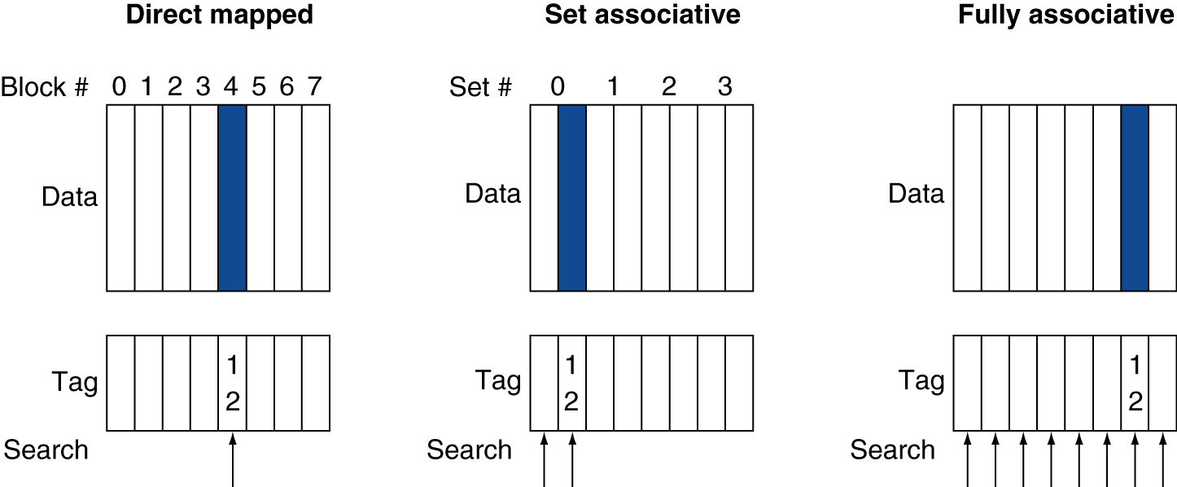
Associative Cache Example

Slide 19
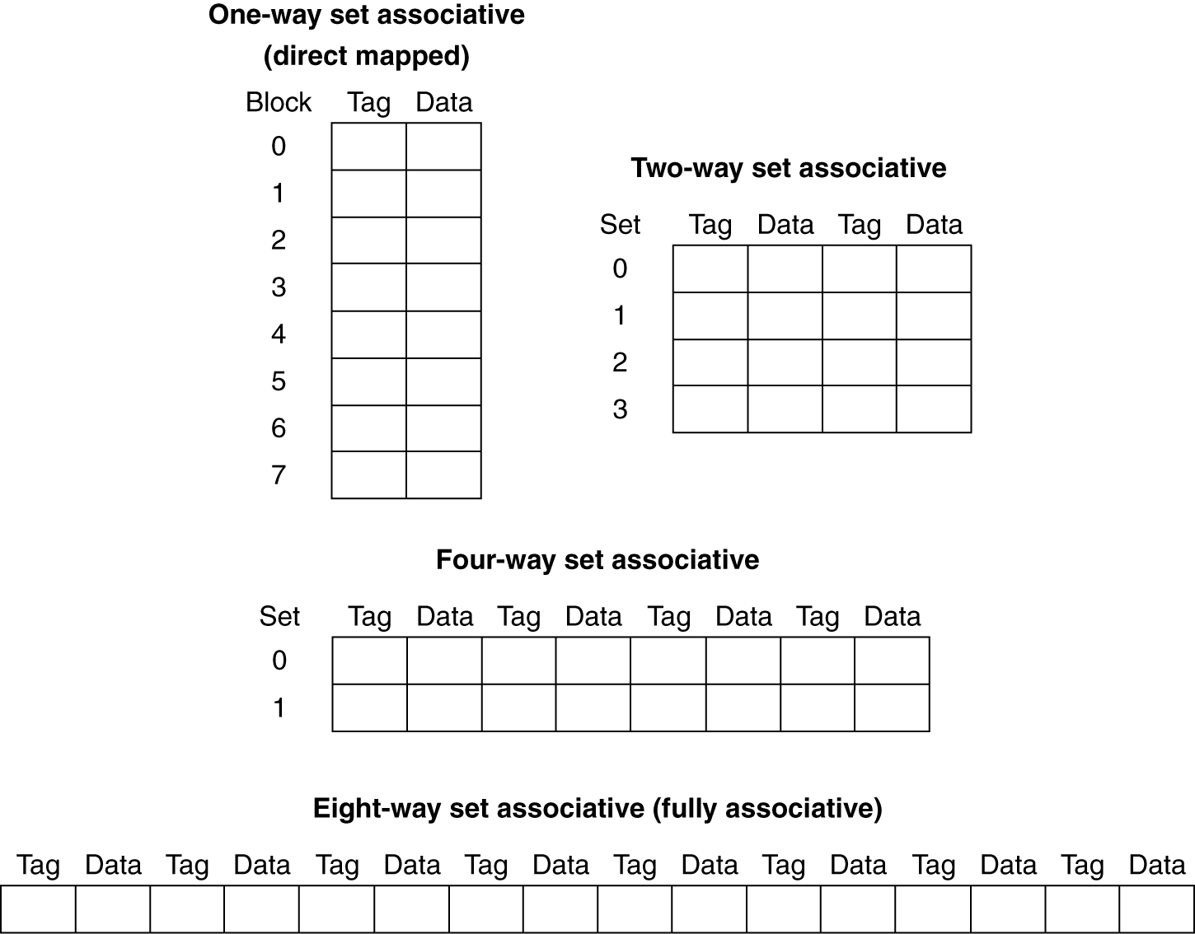
Spectrum of Associativity
For a cache with 8 entries

