Slide 1
Carry lookAhead Addition (B.6)
Instructor: Robert Utterback
Lecture 9/10

Slide 2
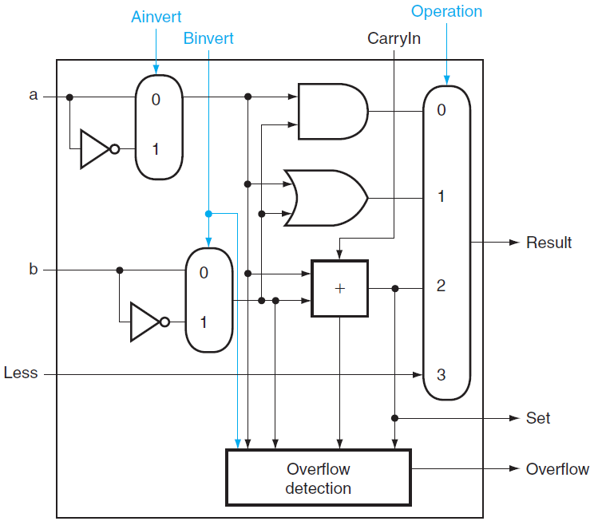
1-BIT ALU
Notes:
What are the operations we can support? (combine Binvert and CarryIn)

Slide 3
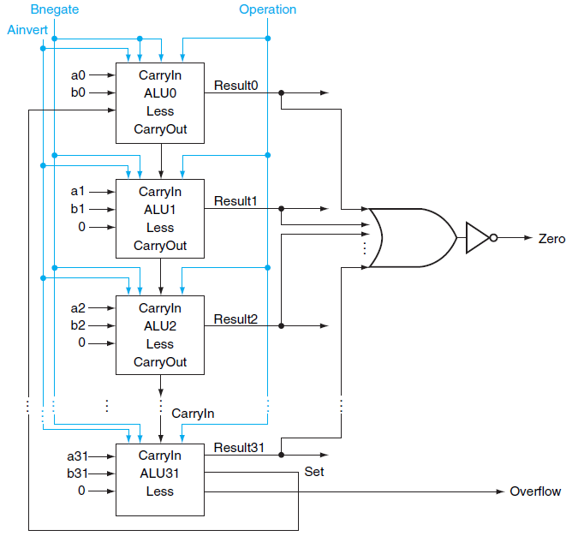
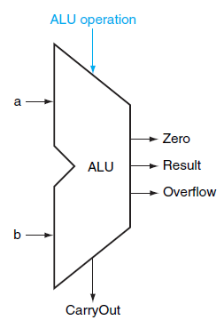
Final 32-bit ALU
Notes:
How many bits do we use to choose our operation? Note this is tricky because the “Operation” only concerns the multiplexor result, but we have other choices…
What bit strings mean what? (Notice there are strings we don’t mention. These will either cause your CPU to error or produce nonsense)
0000=and ----- 0100=??
0001=or ------ 0101=??
0010=add -----
0011=?
0110=subtract
1100=NOR
1101=NAND
0111=set on less than

Slide 4
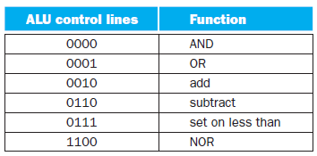
ALU Control Signals

Slide 5
Faster Addition
Carry Lookahead
Speeding up addition
Determining the carry in to the high-order bits sooner
Key mechanism
Hardware executes in parallel
Notes:
STOP! Explanation of gate delay, so we can compare the time for ripple carry vs. carry lookahead. Let’s assume a fixed time to pass through any gate, regardless of type or fan-in. Unrealistic, but that’s what we’ll assume.

Slide 6

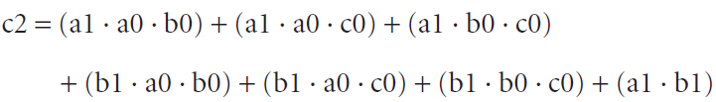
Explanation of Carry Lookahead
Remember
CarryOuti+1=CarryIni
Abbreviation of ci for CarryIni
Then c2 can be evaluated faster without waiting for c1
How about c30?
Grows rapidly with the number of bits
Very complex

Slide 7


Fast Carry Using the First Level of Abstraction
Consider
Generate (gi) and Propagate (pi)
Then

Slide 8
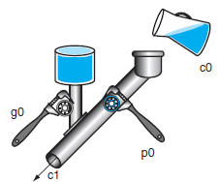
Generates and Propagates
Why gi is called generate?
when gi is 1
ci+1 is “generated”
Why pi is called propagate?
when gi is 0 and pi is 1
ci+1 is “propagated” from ci

Slide 9
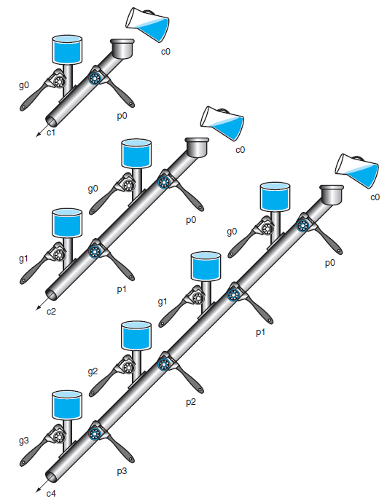
A Plumbing Analog
Wrenches open and close valves
ci+1 will be full
if the nearest generate value gi is on
or pi is on there is water further upstream
c0 can result in a carry out without the help of any generates but the help of all propagates
Notes:
Picture with carry lookahead unit is helpful here…

Slide 10
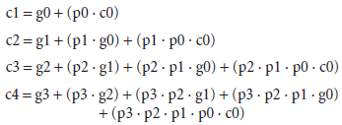
4-bit CarryIn
Notes:
Work out a 4-bit addition example here. Show what c4,c3,c2,c1,c0 are when using a 4-bit carry lookahead adder. Calculate propagate and generate for each.
So the steps are (draw diagram?) Hook up all the necessary to calculate propagate and generate for each (max 2 gate path), then calculate the sum result (also max 2 gate path).
This works well, but again, it starts to get complicated at the 4th carry bit, and it would be really complicated at the 31st carry bit. It’s still better than the alternative we talked about (full evaluation), but not great.
As the book talks about, one of the big ideas in computer architecture is abstraction. So we’re going to apply another level of abstraction…

Slide 11
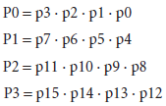
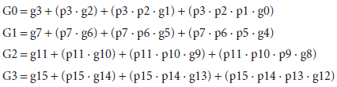
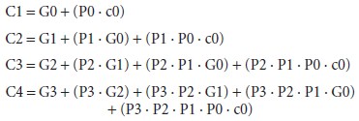
Second Level of Abstraction
Super Propagate
Super Generate
Carryin for 16-bit adder
Notes:
We’re going to group the bits to add into groups of 4, and use what we just talked about for each group. Now each group will compute whether or not the group AS A WHOLE generates a carry bit (to the next group), or propagates one.

Slide 12
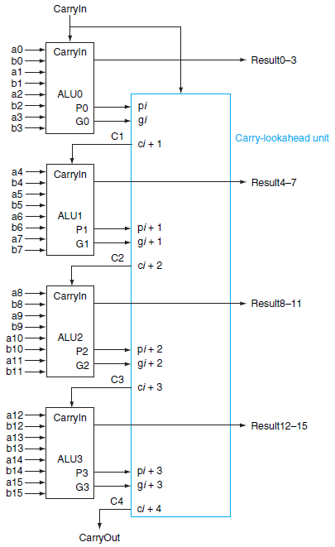
Four 4-bit ALUs with Carry Lookahead to form a 16-bit adder
Notes:
Consider adding 16-bit
0001 1010 0011 0011
1110 0101 1110 1011

Slide 13


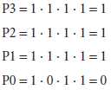
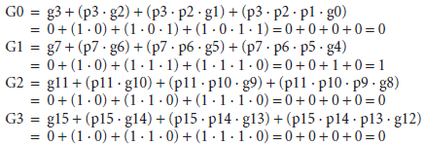
Example of Fast Carry Lookahead
Consider adding two 16-bit integers a and b
generate gi=ai·bi and propagate pi=ai+bi
Super generate and Super Propagate

Slide 14

Example of Fast Carry Lookahead (cont.)
Finally
How many “steps”?
step 1: produce generate and propagate
step 2: produce super generate and super propagate
step 3: produce carryout
much faster than adder without fast carry lookahead
Notes:
Still gets complicated! When you have 4 such (4-bit) groups, you have the same complication as the 4-bit adder. So a 16-bit adder is complex. But you can just add another layer of abstraction! Each group of 4 4-bit adders can generate a super-super generate and super-super propate!
So for a 64-bit adder we might have 4 groups of 16-bit adders, which are themselves 4 groups of 4-bit adders. And you can do this as many times as you need. Notice that each time we do this abstraction, we add another (fixed, constant) number of gates. Each time we’re group of gates into groups, so we start with n bits, then group them into n/4 groups, then n/16 groups, then n/4^3 groups, etc. For those of you in 220, what does this remind you of? It’s a little bit like a logarithm, and in general when you work this out, the time to do addition for ANY number of bits can be done in this way in O(log n) time. So why do we say in 220 that it’s just constant time (a primitive operation)? We’re missing an assumption…
The time is logarithmic – you can think of splitting into groups as division…

Slide 15
Four 4-bit ALUs with Carry Lookahead to form a 16-bit adder
Notes:
Consider adding 16-bit
0001 1010 0011 0011
1110 0101 1110 1011

Slide 16
Clocks

Slide 17
Clock Cycle
Clock cycle time (clock period)
Two portions
Clock is high
Clock is low
Edge-triggered clocking
All state changes occur on a clock edge

Slide 18
Combinational Logic and Sequential Logic
Combinational Logic
A logic system whose blocks do not contain memory and hence compute the same output given the same input
NOTE: So far EVERYTHING has been combinational logic.
Sequential Logic
A group of logic elements that contain memory and hence whose value depends on the inputs as well as the current contents of the memory
Made up of combinational logic and some memory

Slide 19
State Element and Valid State
State Element
A memory element
Signals written into state elements must be valid when the active clock edge occurs
Valid means stable (not changing)
Will not change again until the inputs change
Synchronous System
A memory system that employs clocks and where data signals are read only when the clock indicates that the signal values are stable

Slide 20
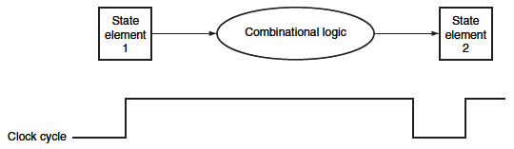
Inputs to a combinational logic block from a state element, and the outputs are written into a state element
Clock edge determines when the state elements are updated

Slide 21
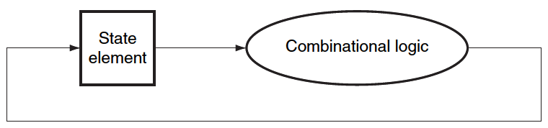
Read and Write in one cycle
Edge-triggered methodology allows a state element to be read and written in the same clock cycle
Read the value of a state element
Send it through some combinational logic
Value does not change during the clock cycle
Write it back to the same state element
All in one cycle

Slide 22
Memory Elements
Memory Elements
Store States
Output depends on
The inputs, and
The value stored in the memory element
Elements
Flip-Flops
Latches
Registers
Register Files
SRAMS
DRAMS

Slide 23
What I want you to do
Read Appendix B.6-B.8

