Slide 1
Addressing Modes
Instructor: Robert Utterback
Lecture 21

Slide 2
32-bit Constants
Most constants are small
16-bit immediate is sufficient
For the occasional 32-bit constant
lui rt, constant
Copies 16-bit constant to left 16 bits of rt
Clears right 16 bits of rt to 0
§2.10 MIPS Addressing for 32-Bit Immediates and Addresses
lui $s0, 61
0000 0000 0111 1101 0000 0000 0000 0000
ori $s0, $s0, 2304
0000 0000 0111 1101 0000 1001 0000 0000
Notes:
61 -> 007d 0000
2304 = 0900
Ori: 007d 0900 = 8192000
Note: The assembler can handle this for us…

Slide 3
Assembler Pseudoinstructions
Most assembler instructions represent machine instructions one-to-one
Pseudoinstructions: figments of the assembler’s imagination
move $t0, $t1 → add $t0, $zero, $t1
blt $t0, $t1, L → slt $at, $t0, $t1 bne $at, $zero, L
$at (register 1): assembler temporary
Notes:
In some sense, we’re defining another language just slightly more convenient than assembly…
Don’t use these on the exam…
In addition to handling large constants, what about large addresses? Beq,bne only have 16 bits to specify an address!

Slide 4
Branch Addressing
Branch instructions specify
Opcode, two registers, target address
Most branch targets are near branch
Forward or backward
op
rs
rt
constant or address
6 bits
5 bits
5 bits
16 bits
PC-relative addressing
Target address = PC + offset × 4
PC already incremented by 4 by this time
Notes:
Problem: Only 16 bits for branch target addresses! 2^16 is not that big…64K
PC already incremented for efficiency reasons, we’ll see in Ch 4. Basically, we need to load an instruction from memory, and THEN go through the process of executing it. Well, as soon as the instruction is fetched from memory (before it has executed), the PC is incremented.
Notice that this doesn’t completely solve our problem! It only solves it for the common case. Which means we can afford expensive solutions for the uncommon case, i.e. when we need to branch very far away. We’ll see that in a minute.
Big picture: You don’t need to worry about this when writing in MIPS assembly, since you just need labels. But the assembler needs to do this, and if you want to understand what it’s doing you should understand it.

Slide 5
Jump Addressing
Jump (j and jal) targets could be anywhere in text segment
Encode full address in instruction
op
address
6 bits
26 bits
(Pseudo)Direct jump addressing
Target address = PC_{31…28} : (address × 4)
Notes:
Does anyone see why we have 26 bits in the address but we only concatenate with 31..28, not 31..26?

Slide 6
Address Example
Loop: sll $t1, $s3, 2
add $t1, $t1, $s6
lw $t0, 0($t1)
bne $t0, $s5, Exit
addi $s3, $s3, 1
j Loop
Exit: …
Notes:
Assuming the “Loop” instruction is at memory address 60000, what should Exit and Loop be replaced with by the assembler?

Slide 7
Target Addressing Example
Loop code from earlier example
Assume Loop at location 60000
Loop: sll $t1, $s3, 2 | 60000 | 0 | 0 | 19 | 9 | 4 | 0
add $t1, $t1, $s6 | 60004 | 0 | 9 | 22 | 9 | 0 | 32
lw $t0, 0($t1) | 60008 | 35 | 9 | 8 | 0
bne $t0, $s5, Exit | 60012 | 5 | 8 | 21 | 2
addi $s3, $s3, 1 | 60016 | 8 | 19 | 19 | 1
j Loop | 60020 | 2 | 15000
Exit: … | 60024
Notes:
15000 = 0011 1010 1001 1000
60020 = 1110 1010 0111 0100
60000 = 1110 1010 0110 0000

Slide 8
Branching Far Away
If branch target is too far to encode with 16-bit offset, assembler rewrites the code
Example
beq $s0,$s1, L1
↓
bne $s0,$s1, L2 j L1 L2: …
Notes:
Occasionally, even PC relative branching isn’t enough…
But this is pretty rare

Slide 9
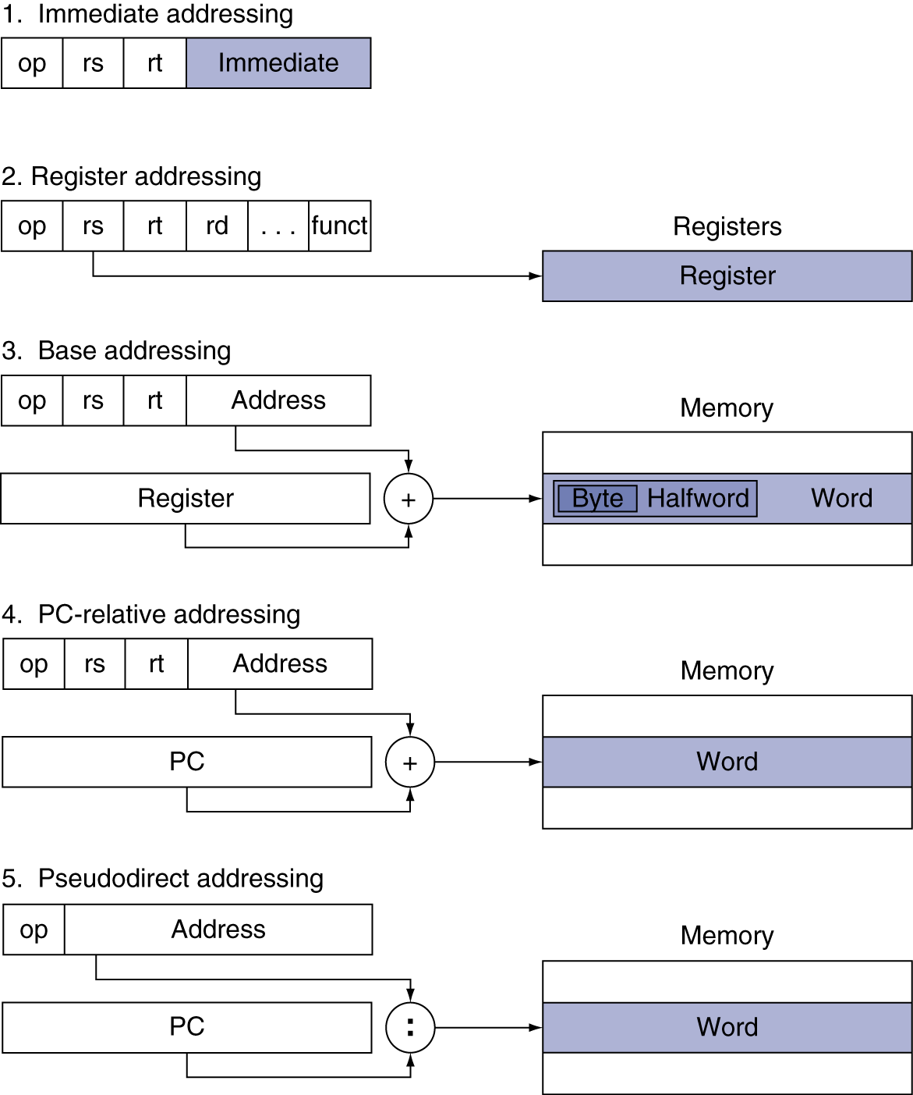
Addressing Mode Summary
Notes:
Example of 1? (addi)
Example of 2? (jr)
3? (lw,sw)
4? (bne)
5? (j,jal)

