Slide 1
The Memory Hierarchy
Chapter 5
Notes:
On a write hit, one thing we could do it always write the result back to memory. What is this called (write-through)
What’s the alternative? (write-back, which only writes back to memory when a block is kicked out of memory)
It’s a waste to write back to memory if we haven’t changed the block since it came into cache. How do we handle this? (dirty bit)

Slide 2
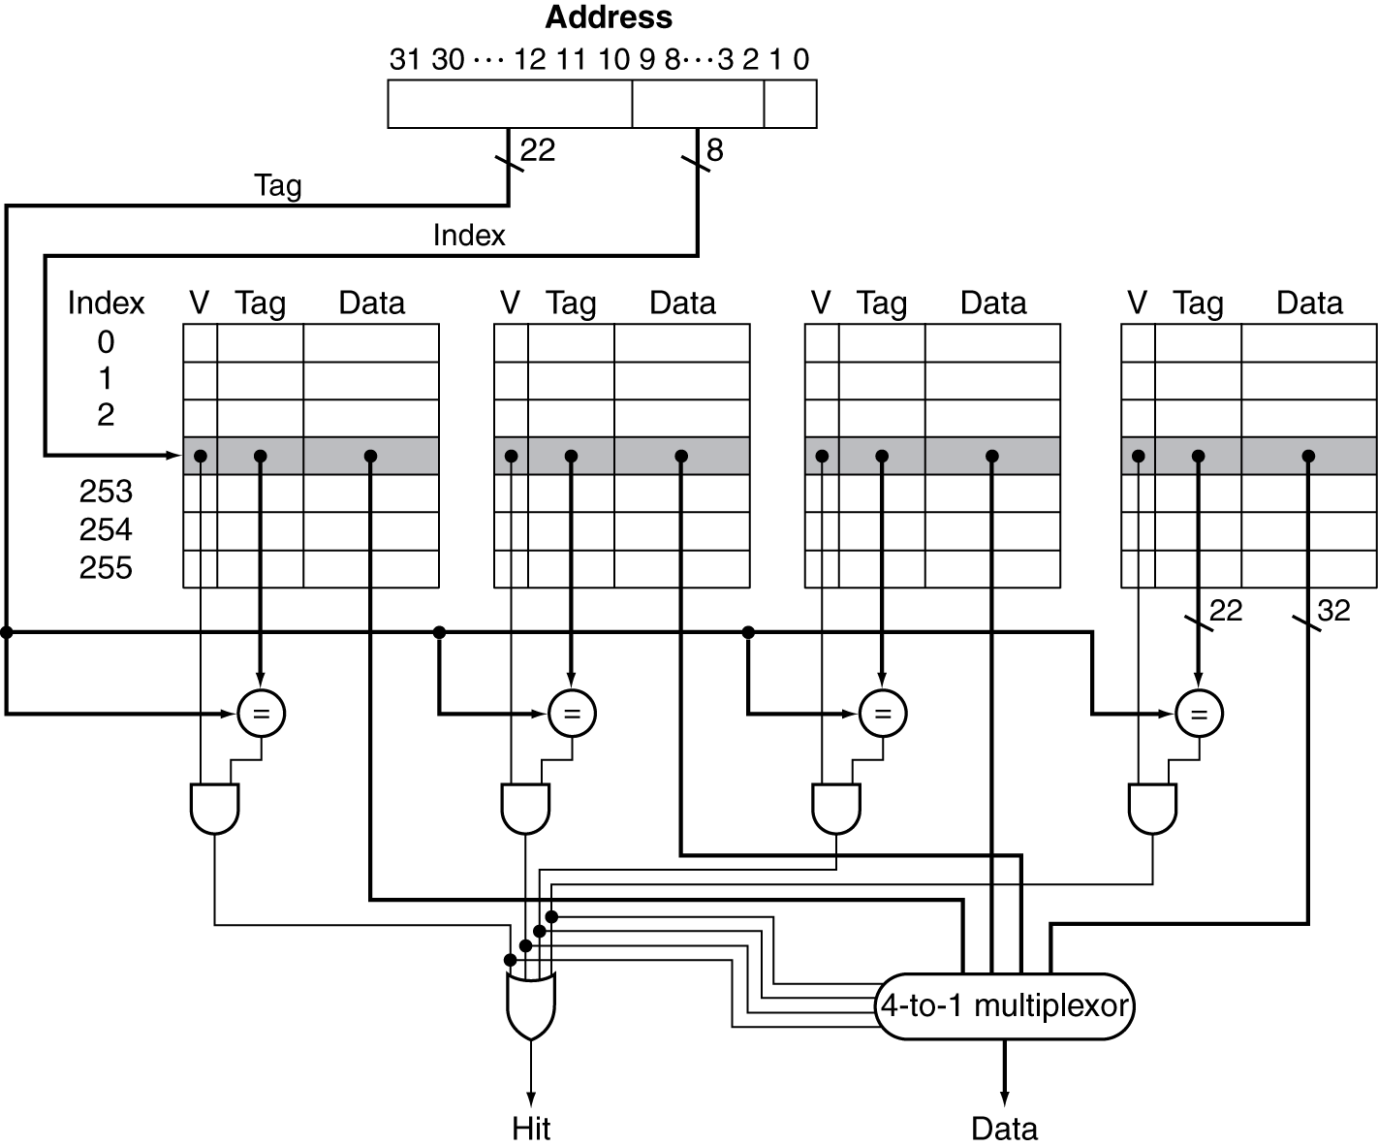
Set Associative Cache Organization
Notes:
But as soon as we allow multiple ways, we have a new choice to make.
When we need to kick something out of cache, which way do we choose?

Slide 3
Replacement Policy
Direct mapped: no choice
Set associative
Prefer non-valid entry, if there is one
Otherwise, choose among entries in the set
Least-recently used (LRU)
Choose the one unused for the longest time
Simple for 2-way, manageable for 4-way, too hard beyond that
Random
Gives approximately the same performance as LRU for high associativity

Slide 4
Multilevel Cache Considerations
Primary cache
Focus on minimal hit time
L2 cache
Focus on low miss rate to avoid main memory access
Hit time has less overall impact
Results
L1 cache usually smaller than a single cache
L1 block size smaller than L2 block size
Notes:
The l2 (or l3) is kind of like your last-ditch/resort effort

Slide 5
Interactions with Advanced CPUs
Out-of-order CPUs can execute instructions during cache miss
Pending store stays in load/store unit
Dependent instructions wait in reservation stations
Independent instructions continue
Effect of miss depends on program data flow
Much harder to analyse
Use system simulation
Notes:
Misses depend on memory access patterns, including algorithm behavior and compiler optimizations

Slide 6
The Hamming SEC Code
Hamming distance
Number of bits that are different between two bit patterns
Minimum distance = 2 provides single bit error detection
E.g. parity code
Minimum distance = 3 provides single error correction, 2 bit error detection
Notes:
I’m actually not going to cover any more of this. There’s some more details in the book, but I doubt it will be useful to you all, so let’s just skip it.

Slide 7
Virtual Machines
Host computer emulates guest operating system and machine resources
Improved isolation of multiple guests
Avoids security and reliability problems
Aids sharing of resources
Virtualization has some performance impact
Feasible with modern high-performance comptuers
Examples
IBM VM/370 (1970s technology!)
VMWare
Microsoft Virtual PC
§5.6 Virtual Machines
Notes:
Who’s heard of VirtualBox? Similar concept is containers; might have heard of Docker.
Amazon and lots of cloud providers are using these heavily.

Slide 8
Virtual Machine Monitor
Maps virtual resources to physical resources
Memory, I/O devices, CPUs
Guest code runs on native machine in user mode
Traps to VMM on privileged instructions and access to protected resources
Guest OS may be different from host OS
VMM handles real I/O devices
Emulates generic virtual I/O devices for guest

Slide 9
Example: Timer Virtualization
In native machine, on timer interrupt
OS suspends current process, handles interrupt, selects and resumes next process
With Virtual Machine Monitor
VMM suspends current VM, handles interrupt, selects and resumes next VM
If a VM requires timer interrupts
VMM emulates a virtual timer
Emulates interrupt for VM when physical timer interrupt occurs
Notes:
e.g. timer for scheduling multiple processes

Slide 10
Instruction Set Support
User and System modes
Privileged instructions only available in system mode
Trap to system if executed in user mode
All physical resources only accessible using privileged instructions
Including page tables, interrupt controls, I/O registers
Renaissance of virtualization support
Current ISAs (e.g., x86) adapting

Slide 11
The Problem with Memory
§5.7 Virtual Memory
Two programs running at the same time
Prog A has bug – bad pointer value
Overwrites into memory used by Prog B!
Buying from Amazon.com
Enter CC info into browser
Another program reads the browser memory and gets CC info
Some memory locations reserved for OS, communication with devices, etc.
Some programs need more memory than a machine has
But we have plenty of disk space

Slide 12
Virtual Memory
Use main memory as a “cache” for secondary (disk) storage
Managed jointly by CPU hardware and the operating system (OS)
Programs share main memory
Each gets a private virtual address space holding its frequently used code and data
Protected from other programs
CPU and OS translate virtual addresses to physical addresses
VM “block” is called a page
VM translation “miss” is called a page fault

Slide 13
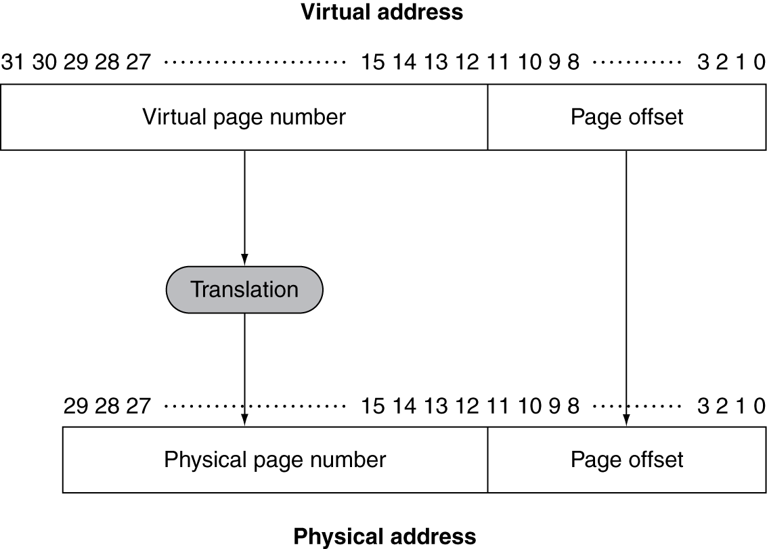
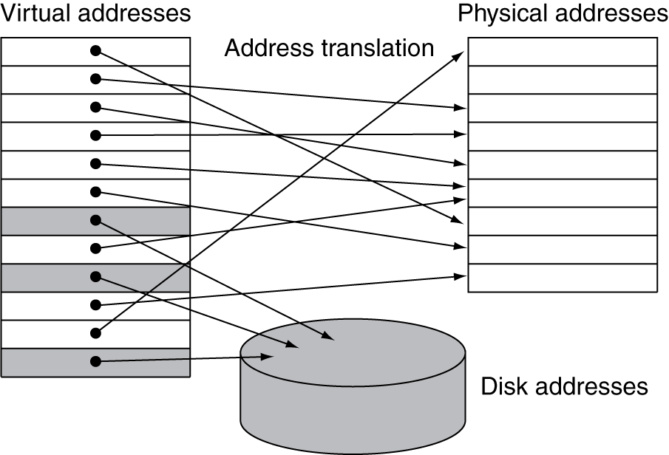
Address Translation
Fixed-size pages (e.g., 4K)

Slide 14
Page Fault Penalty
On page fault, the page must be fetched from disk
Takes millions of clock cycles
Handled by OS code
Try to minimize page fault rate
Fully associative placement
Smart replacement algorithms

Slide 15
Page Tables
Stores placement information
Array of page table entries, indexed by virtual page number
Page table register in CPU points to page table in physical memory
If page is present in memory
PTE stores the physical page number
Plus other status bits (referenced, dirty, …)
If page is not present
PTE can refer to location in swap space on disk
Notes:
Each process has its own page table, usually allocated in operating system memory space
So the page table register just points to the page table

Slide 16
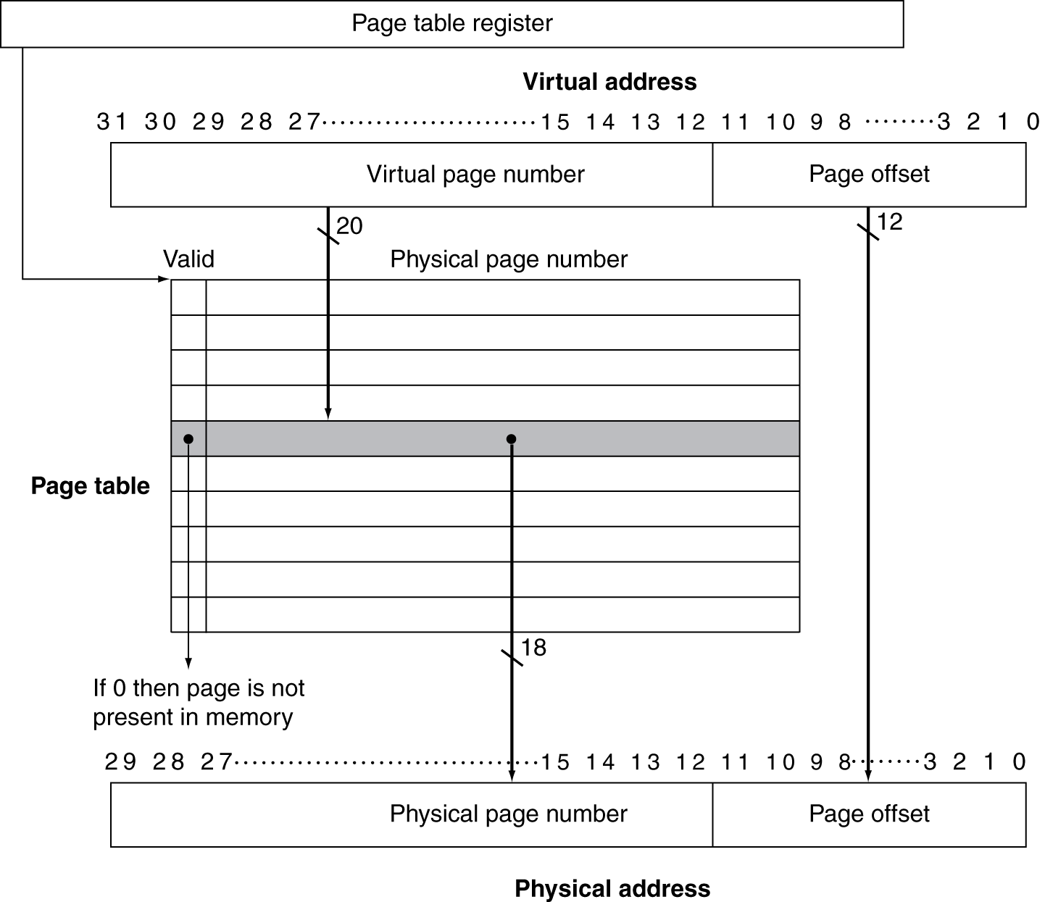
Translation Using a Page Table
Notes:
Notice that the physical page number means something different depending on the valid bit.
If valid, it’s the physical address in memory
If not, it’s a disk address.

Slide 17
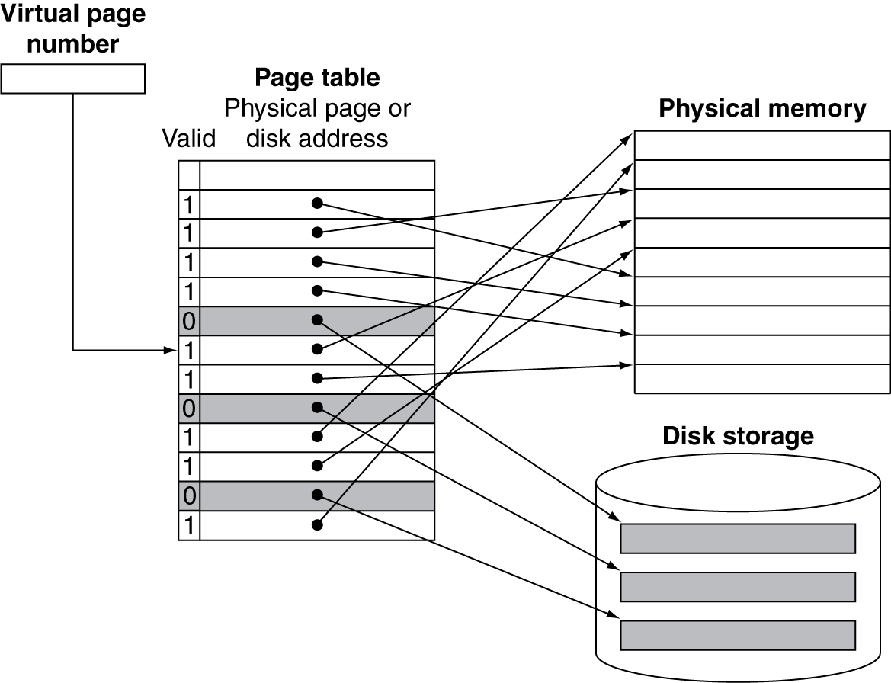
Mapping Pages to Storage

Slide 18
Replacement and Writes
To reduce page fault rate, prefer least-recently used (LRU) replacement
Reference bit (aka use bit) in PTE set to 1 on access to page
Periodically cleared to 0 by OS
A page with reference bit = 0 has not been used recently
Disk writes take millions of cycles
Block at once, not individual locations
Write through is impractical
Use write-back
Dirty bit in PTE set when page is written

Slide 19
Fast Translation Using a TLB
Address translation would appear to require extra memory references
One to access the PTE
Then the actual memory access
But access to page tables has good locality
So use a fast cache of PTEs within the CPU
Called a Translation Look-aside Buffer (TLB)
Typical: 16–512 PTEs, 0.5–1 cycle for hit, 10–100 cycles for miss, 0.01%–1% miss rate
Misses could be handled by hardware or software

Slide 20
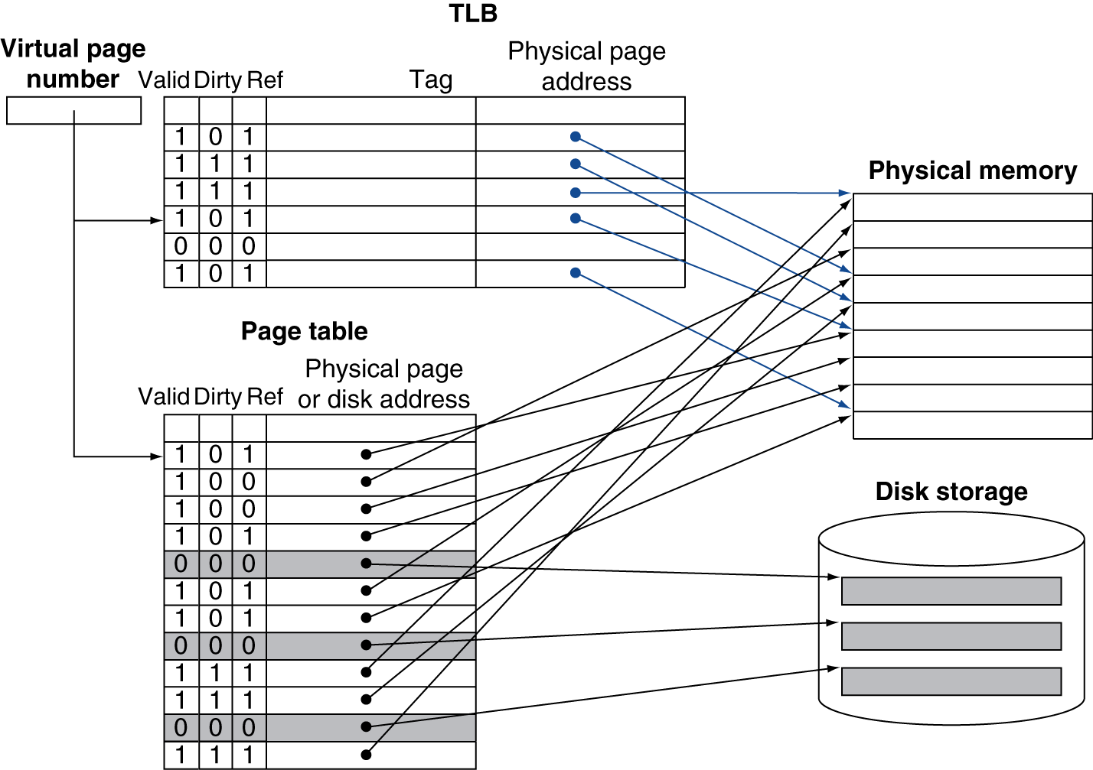
Fast Translation Using a TLB
Notes:
Draw a matrix:
TLB hit vs. miss x page table valid vs. not valid
If TLB hit, must be in physical memory

Slide 21
TLB Misses
If page is in memory
Load the PTE from memory and retry
Could be handled in hardware
Can get complex for more complicated page table structures
Or in software
Raise a special exception, with optimized handler
If page is not in memory (page fault)
OS handles fetching the page and updating the page table
Then restart the faulting instruction

