Slide 1
simple ALU (Continued) (B.4)
Instructor: Robert Utterback
Lecture 7

Slide 2
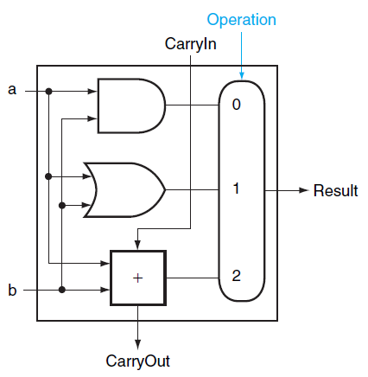
Overall 1-bit ALU

Slide 3
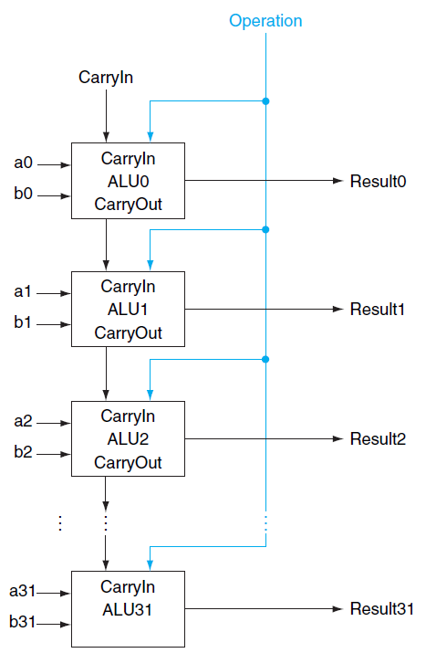
32-bit ALU
Notes:
To operate on two WORDS, which are a set of bits, we again use an array of logic blocks, in this case 32 1-bit ALUs. Notice how we have to connect the carryout of one to the carryin of the next.
This WORKS, although it is actually really slow…we have to wait for 32 1-bit additions…we will see later how to improve this.
This is called a "ripple" adder, since the carry bit ripples through.

Slide 4
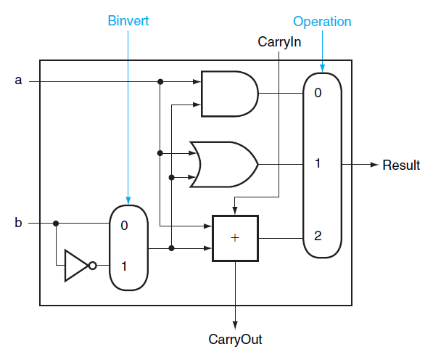
Subtraction
Subtraction can be done by adding a and b’s negate and 1
Notes:
In other words, we set Operation to 2 (10) and set Binvert to 1,also set the CarryIn of the first bit to 1, which gets us -b.
Now…how might you add a NOR operation here? One way is to implement it with a gate and make the big multiplexor bigger. But this makes the multiplexor more expensive.

Slide 5
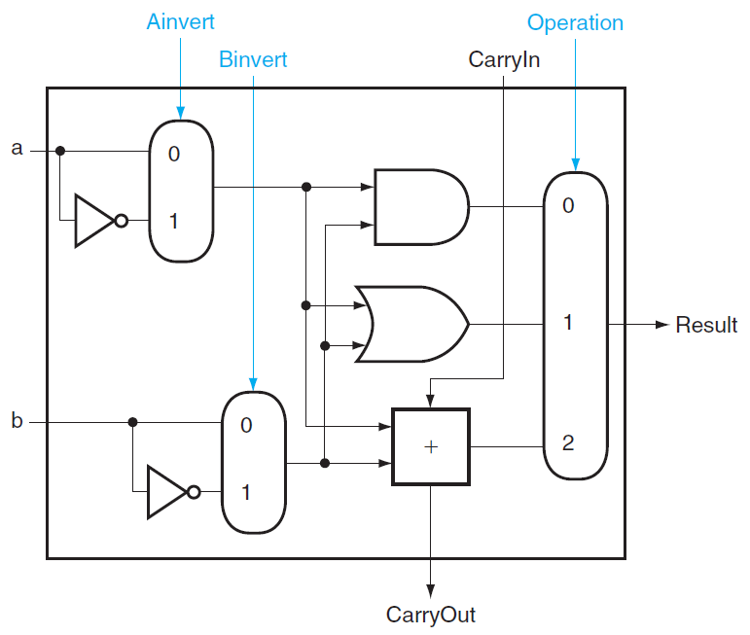
NOR
Ainvert =1, Binvert =1, Operation =00
Notes:
It turns out that MIPS actually needs a NOR operation as well. Rather than adding a NOR gate and extending the multiplexor, we can implement it with what we already have, adding an additional (simple) multiplexor.
Using DeMorgan’s: A NOR B = NOT (A or B) = (Not A) AND (Not B), so just invert both A and B and then OR them together.

Slide 6
Set on less than
Set on less than (slt)
For comparison of two integers a and b
Least significant bit
1 if a < b
0 otherwise
Other bits
0
Notes:
MIPS also needs this special instruction “Set on less” (slt). It should return 1 if and only if a < b. Specially, the least significant bit should be set.

Slide 7

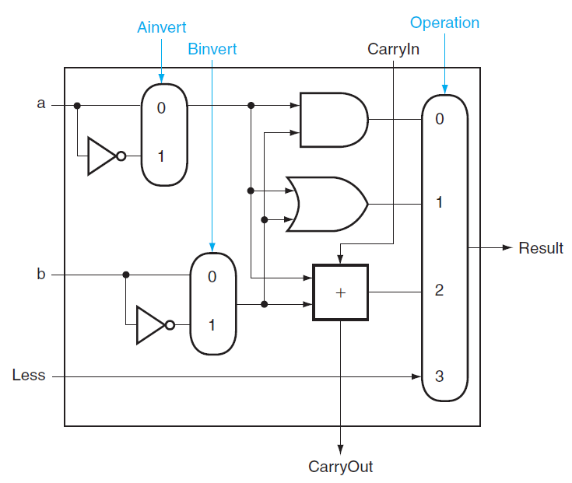
Set on less than
Notes:
Of course, whether or not a < b is just whether or not a-b < 0. So we just do subtraction (which is addition). BUT the output is the result of the subtraction, but all we care about is the sign of the result!

Slide 8
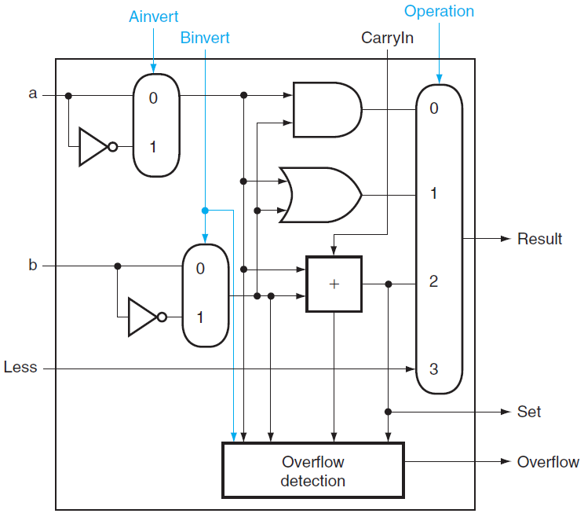
Handling Overflow
Notes:
We want the result of the add, but ONLY the most significant bit. So we get the output of just that one bit, and that’s the output set. Then, to get that as the overall ALU output, we need to wrap that around to the Less input.

Slide 9
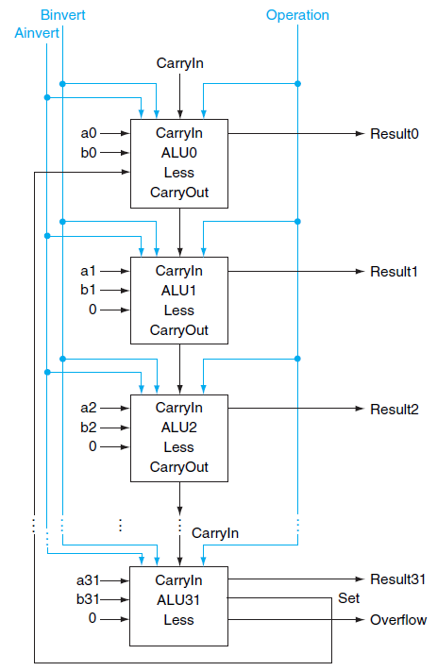
32-bit ALU
Bit 0-30: normal 1-bit ALU
Bit 31: 1-bit ALU with overflow detection
Notes:
Set gets loop back around to the Less input for ALU0, all the other less inputs get 0. Also, note that we can detect overflow with that Set output…

Slide 10
Exercise: SLT Problem
Notes:
Let’s ask if -7 < 6. So 1001 – 0110 = 1001 + 1010 = (1)0011, which suggests that -7 > 6! What’s the problem? Our addition overflowed. How can we fix this?
Need to XOR the Set and Overflow output, this result becomes Less. You might think just OR, but what happens for, say, 7 < -7?
Notice the the last carry out bit is not enough to know overflow: consider -4 + -4, which has the last carry out bit set, but doesn’t actually overflow! You need to consider the sign of each input versus the sign of the output

Slide 11
Final 32-bit ALU
Bnegate
Every time we want the ALU to subtract, we set both CarryIn and Binvert to 1
Otherwise, both CarryIn and Binvert are set to 0
NOR operation: Binvert is 1, but CarryIn is Don’t Care
We can combine CarryIn and Binvert to a single line of Bnegate

Slide 12
Test of Zero
We want to quickly test if two integers are equal
Design a single signal of Zero

Slide 13
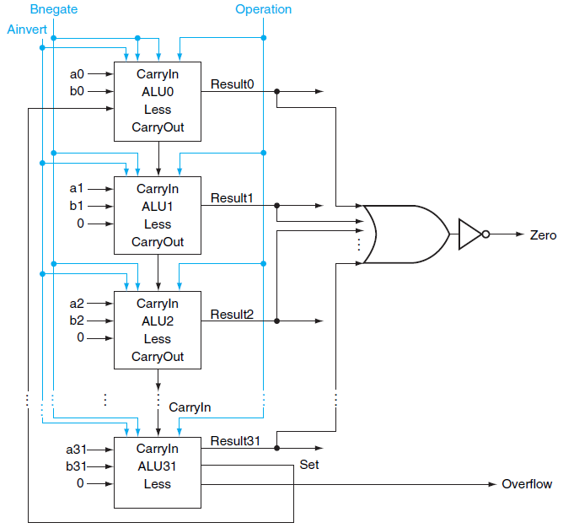
Final 32-bit ALU
Notes:
This is why, as we will see later, you first do an (a-b) instruction, THEN you have a separate je or jne instruction. As opposed to doing it all in one instruction.

Slide 14
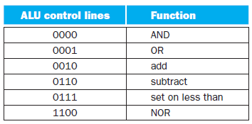
ALU Control Signals

Slide 15
1-BIT ALU
Notes:
Although I haven’t shown it here, we combine Binvert and CarryIn.

Slide 16
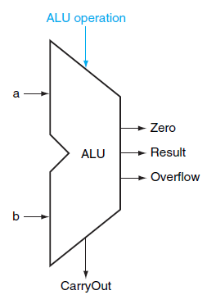
Symbol of ALU

Slide 17
Summary
1-bit ALU
Logic Functions
Arithmetic Functions
32-bit ALU
Set on less than
Test of Zero
Notes:
The adder we saw is too slow…

