Slide 1
Translating and Starting Programs
Instructor: Robert Utterback
Lecture 24

Slide 2
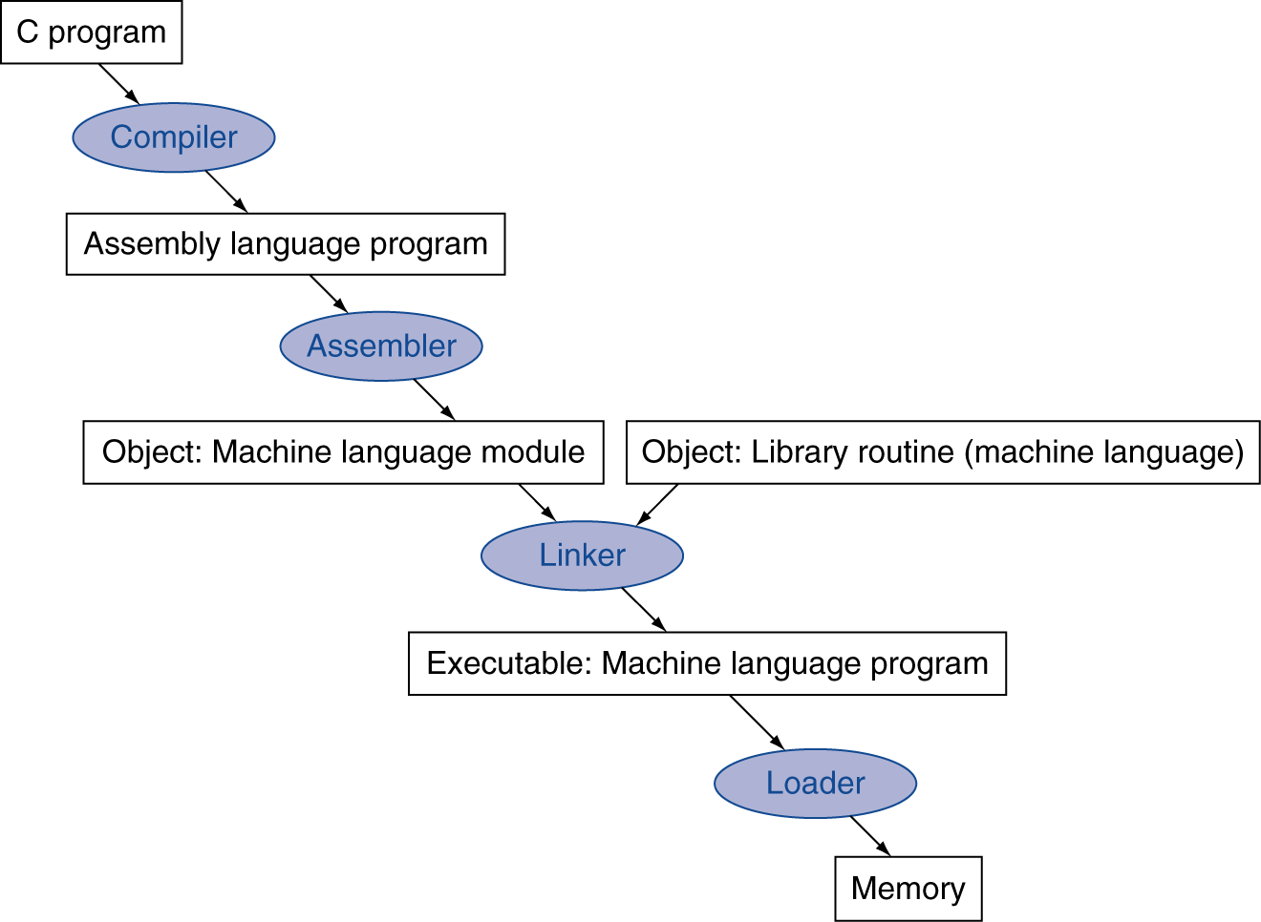
Translation and Startup
Many compilers produce object modules directly
§2.12 Translating and Starting a Program
Static linking
Notes:
When we have said compiler previously, really we mean this whole process, which often happens automatically for us.
This is an overview of the process, now let’s go into detail…

Slide 3
Producing an Object Module
Assembler (or compiler) translates program into machine instructions
Provides information for building a complete program from the pieces
Header: described contents of object module
Text segment: translated instructions
Static data segment: data allocated for the life of the program
Symbol table: global definitions and external refs
Debug info: for associating with source code
Relocation info: for contents that depend on absolute location of loaded program
Notes:
Draw a picture on the board.

Slide 4
Linking Object Modules
Produces an executable image
1. Merges segments
2. Resolve labels (determine their addresses)
3. Patch location-dependent and external refs
This only works because of virtual memory
Every program thinks it has the entire memory to itself
Program can be loaded into absolute location in virtual memory space
Notes:
In a nutshell, virtual memory makes every process thinks it has the entire memory to itself.
An alternative would be to leave the location dependencies for the loader, adding extra work at load-time.

Slide 5
Loading a Program
Load from image file on disk into memory
1. Read header to determine segment sizes
2. Create virtual address space
3. Copy text and initialized data into memory
Or set page table entries so they can be faulted in
4. Set up arguments on stack
5. Initialize registers (including $sp, $fp, $gp)
6. Jump to startup routine
Copies arguments to $a0, … and calls main
When main returns, cleanup and exit

Slide 6
Problems with Static Linking
Static linking problems:
Many programs use the same library code (C stdlib, C++ stdlib, etc…)
Need to recompile to change library version used
Slow bug fixes

Slide 7
Dynamic Linking
Only link/load library procedure when it is called
Avoids image bloat caused by static linking of all (transitively) referenced libraries
Automatically picks up new library versions
Requires procedure code to be relocatable

Slide 8
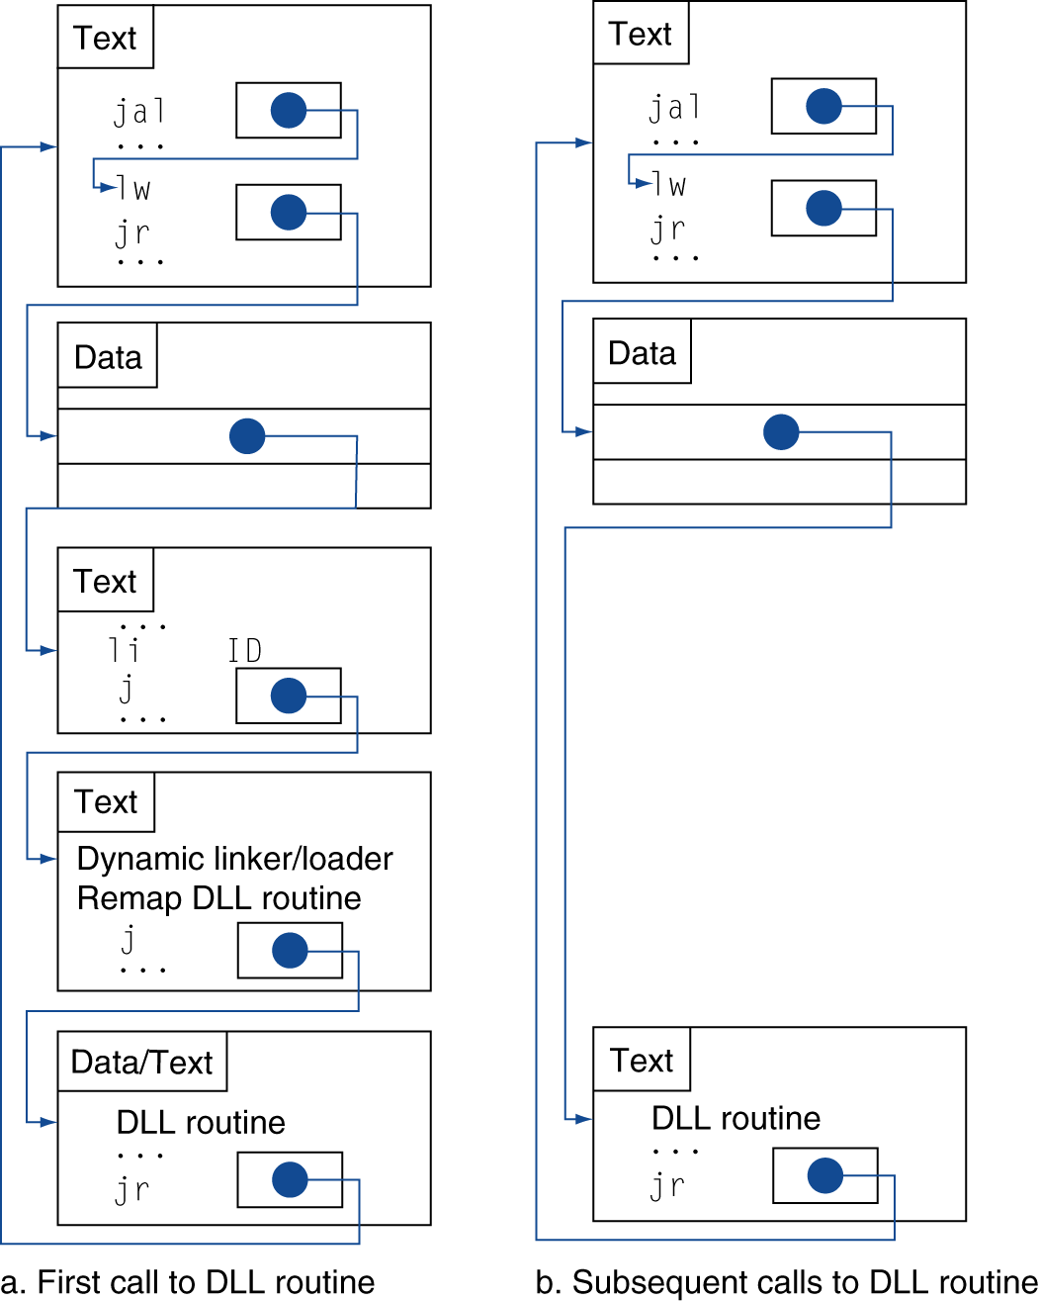
Lazy Linkage
Indirection table
Stub: Loads routine ID, Jump to linker/loader
Linker/loader code
Dynamically mapped code
Notes:
All problems in computer science can be solved by indirection.

Slide 9
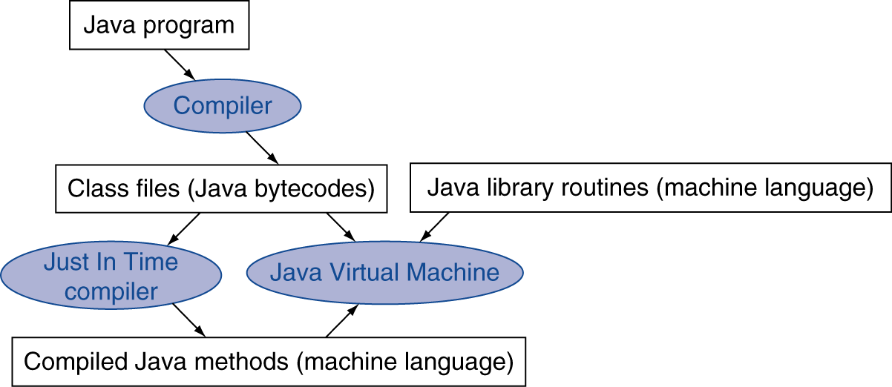
Starting Java Applications
Simple portable instruction set for the JVM
Compiles bytecodes of “hot” methods into native code for host machine
Interprets bytecodes

Slide 10
C Sort Example
Illustrates use of assembly instructions for a C bubble sort function
Swap procedure (leaf)
void swap(int v[], int k) { int temp; temp = v[k]; v[k] = v[k+1]; v[k+1] = temp; }
v in $a0, k in $a1, temp in $t0
§2.13 A C Sort Example to Put It All Together

Slide 11
The Procedure Swap
swap: sll $t1, $a1, 2 # $t1 = k * 4
add $t1, $a0, $t1 # $t1 = v+(k*4)
# (address of v[k])
lw $t0, 0($t1) # $t0 (temp) = v[k]
lw $t2, 4($t1) # $t2 = v[k+1]
sw $t2, 0($t1) # v[k] = $t2 (v[k+1])
sw $t0, 4($t1) # v[k+1] = $t0 (temp)
jr $ra # return to calling routine

Slide 12
The Sort Procedure in C
Non-leaf (calls swap)
void sort (int v[], int n)
{
int i, j;
for (i = 0; i < n; i += 1) {
for (j = i – 1;
j >= 0 && v[j] > v[j + 1];
j -= 1) {
swap(v,j);
}
}
}
v in $a0, k in $a1, i in $s0, j in $s1

Slide 13
The Procedure Body
move $s2, $a0 # save $a0 into $s2
move $s3, $a1 # save $a1 into $s3
move $s0, $zero # i = 0
for1tst: slt $t0, $s0, $s3 # $t0 = 0 if $s0 ≥ $s3 (i ≥ n)
beq $t0, $zero, exit1 # go to exit1 if $s0 ≥ $s3 (i ≥ n)
addi $s1, $s0, –1 # j = i – 1
for2tst: slti $t0, $s1, 0 # $t0 = 1 if $s1 < 0 (j < 0)
bne $t0, $zero, exit2 # go to exit2 if $s1 < 0 (j < 0)
sll $t1, $s1, 2 # $t1 = j * 4
add $t2, $s2, $t1 # $t2 = v + (j * 4)
lw $t3, 0($t2) # $t3 = v[j]
lw $t4, 4($t2) # $t4 = v[j + 1]
slt $t0, $t4, $t3 # $t0 = 0 if $t4 ≥ $t3
beq $t0, $zero, exit2 # go to exit2 if $t4 ≥ $t3
move $a0, $s2 # 1st param of swap is v (old $a0)
move $a1, $s1 # 2nd param of swap is j
jal swap # call swap procedure
addi $s1, $s1, –1 # j –= 1
j for2tst # jump to test of inner loop
exit2: addi $s0, $s0, 1 # i += 1
j for1tst # jump to test of outer loop
Move params
Outer loop
Inner loop
Pass params & call
Inner loop
Outer loop

Slide 14
The Full Procedure
sort: addi $sp,$sp, –20 # make room on stack for 5 registers
sw $ra, 16($sp) # save $ra on stack
sw $s3,12($sp) # save $s3 on stack
sw $s2, 8($sp) # save $s2 on stack
sw $s1, 4($sp) # save $s1 on stack
sw $s0, 0($sp) # save $s0 on stack
… # procedure body
…
exit1: lw $s0, 0($sp) # restore $s0 from stack
lw $s1, 4($sp) # restore $s1 from stack
lw $s2, 8($sp) # restore $s2 from stack
lw $s3,12($sp) # restore $s3 from stack
lw $ra,16($sp) # restore $ra from stack
addi $sp,$sp, 20 # restore stack pointer
jr $ra # return to calling routine

