Slide 1
A simple Arithmetic Logic Unit (B.5)
Instructor: Robert Utterback
Lecture 8
Notes:
In this lecture you’re going to learn a lot of new things: the basic building blocks of a computer. We’ll slowly combine these to learn how many components of a computer are built up.

Slide 2
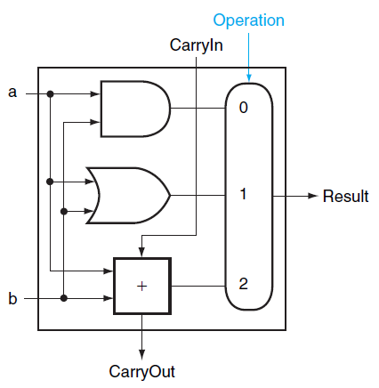
Overall 1-bit ALU
Notes:
Extending to 32 bits…

Slide 3
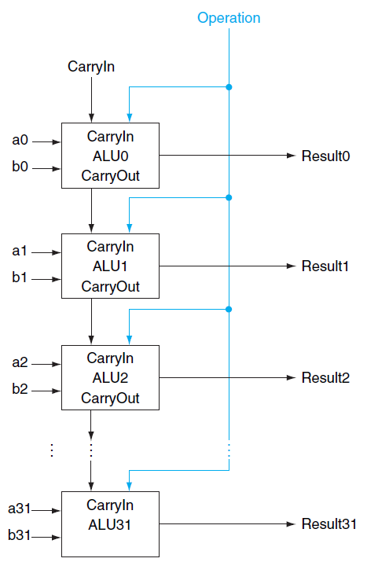
32-bit ALU
Notes:
Similar to multiplexors…
To operate on two WORDS, which are a set of bits, we again use an array of logic blocks, in this case 32 1-bit ALUs. Notice how we have to connect the carryout of one to the carryin of the next.
This WORKS, although it is actually really slow…we have to wait for 32 1-bit additions…we will see later how to improve this. (time scales linearly with # bits)
This is called a "ripple" adder, since the carry bit ripples through.

Slide 4
Review
How do we modify the ALU to do subtraction easily?
Notes:
Negating B and setting carryIn to 1.

Slide 5
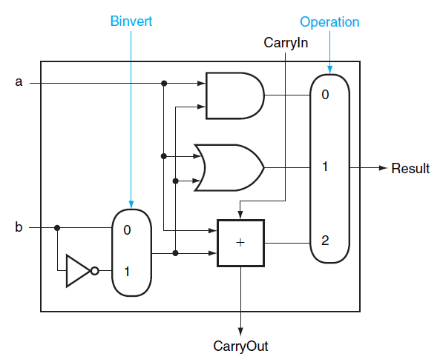
Subtraction
Subtraction can be done by adding a and b’s negate and 1
Notes:
In other words, we set Operation to 2 (10) and set Binvert to 1,also set the CarryIn of the first bit to 1, which gets us -b.
Q: Now…how might you add a NOR operation here? One way is to implement it with a gate and make the big multiplexor bigger. But this makes the multiplexor more expensive.

Slide 6
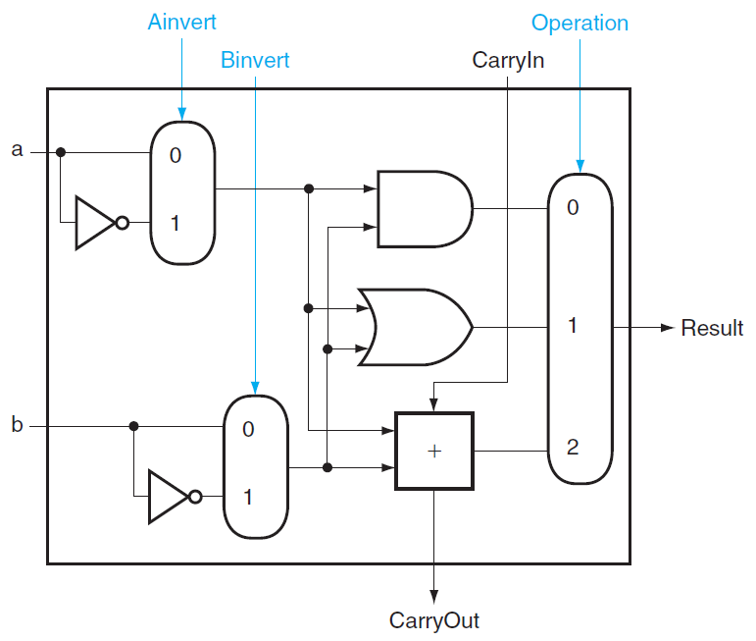
NOR
Ainvert =1, Binvert =1, Operation =00
Notes:
It turns out that MIPS actually needs a NOR operation as well. Rather than adding a NOR gate and extending the multiplexor, we can implement it with what we already have, adding an additional (simple) multiplexor.
Using DeMorgan’s: A NOR B = NOT (A or B) = (Not A) AND (Not B), so just invert both A and B and then OR them together.

Slide 7
Review
How do we modify the ALU to do subtraction easily?
How do we compute set on less than?
Notes:
Negating B and setting carryIn to 1.
Compute a-b, route msb to lsb.

Slide 8
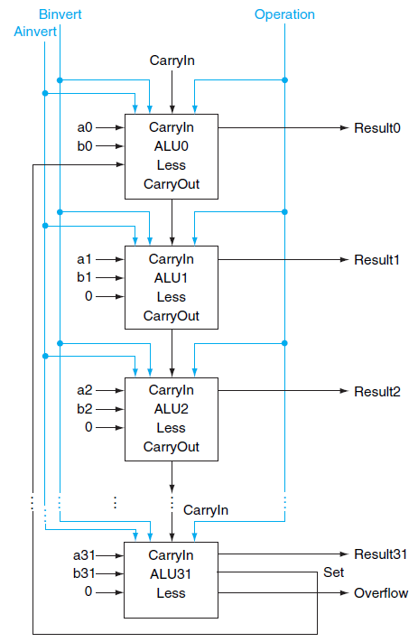
32-bit ALU
Bit 0-30: normal 1-bit ALU
Bit 31: 1-bit ALU with overflow detection
Notes:
Set gets loop back around to the Less input for ALU0, all the other less inputs get 0. Also, note that we can detect overflow with that Set output…
Actually must also look at the overflow bit (ex: -7 < 6). Actually, XOR: 7 < -1.

Slide 9
Final 32-bit ALU
Bnegate
Every time we want the ALU to subtract, we set both CarryIn and Binvert to 1
Otherwise, both CarryIn and Binvert are set to 0
NOR operation: Binvert is 1, but CarryIn is Don’t Care
We can combine CarryIn and Binvert to a single line of Bnegate

Slide 10
Test of Zero
We want to quickly test if two integers are equal
Design a single signal of Zero

Slide 11
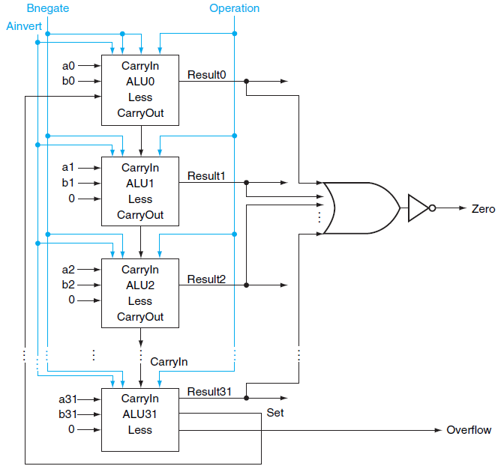
Final 32-bit ALU
Notes:
This is why, as we will see later, you first do an (a-b) instruction, THEN you have a separate je or jne instruction. As opposed to doing it all in one instruction.

Slide 12
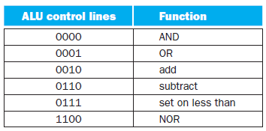
ALU Control Signals
Notes:
Ainvert, Bnegate, then 2 bits for multiplexor

Slide 13
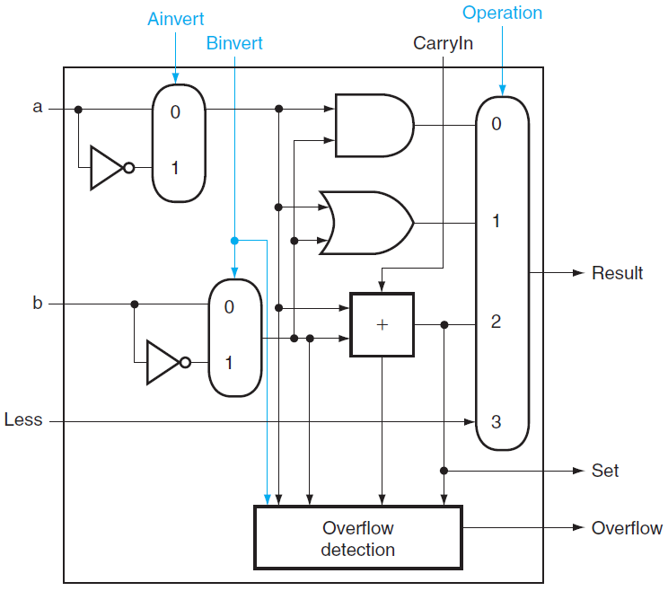
1-BIT ALU
Notes:
Although I haven’t shown it here, we combine Binvert and CarryIn.

Slide 14
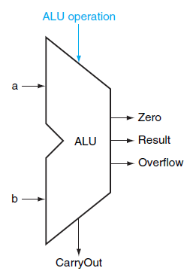
Symbol of ALU

Slide 15
Summary
1-bit ALU
Logic Functions
Arithmetic Functions
32-bit ALU
Set on less than
Test of Zero
Notes:
The adder we saw is too slow…

Slide 16
Carry lookAhead Addition (B.6)
Notes:
The ripple adder is too slow. The main issue is that we’re waiting on this chain of CarryIn values. What if we could compute them ahead of time?

Slide 17
Faster Addition
Carry Lookahead
Speeding up addition
Determining the carry in to the high-order bits sooner
Key mechanism
Hardware executes in parallel
Notes:
STOP! Explanation of gate delay, so we can compare the time for ripple carry vs. carry lookahead. Let’s assume a fixed time to pass through any gate, regardless of type or fan-in. Unrealistic, but that’s what we’ll assume. Give question about gate delay for sum of products formula, then ask about delays for each bit in a ripple adder. Careful: work through this example ahead of time! If you use the adder with XORs, the first XOR can be calculated directly from the input, so the gate delay is only 17.
However, it will cost us more gates to do this! So faster in terms of time, but more gates = more transistors/chip space + more power (actually power is contentious, since in some cases it is better for power since its faster).

Slide 18

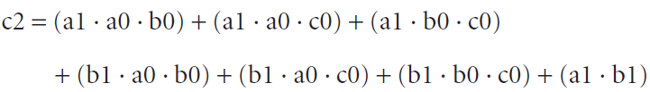
Explanation of Carry Lookahead
Remember
CarryOuti+1=CarryIni
Abbreviation of ci for CarryIni
Then c2 can be evaluated faster without waiting for c1
How about c30?
Grows rapidly with the number of bits
Very complex

Slide 19


Fast Carry Using the First Level of Abstraction
Consider
Generate (gi) and Propagate (pi)
Then

Slide 20
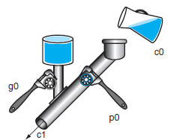
Generates and Propagates
Why gi is called generate?
when gi is 1
ci+1 is “generated”
Why pi is called propagate?
when gi is 0 and pi is 1
ci+1 is “propagated” from ci
Notes:
The other analogy for propagate is dominos

Slide 21
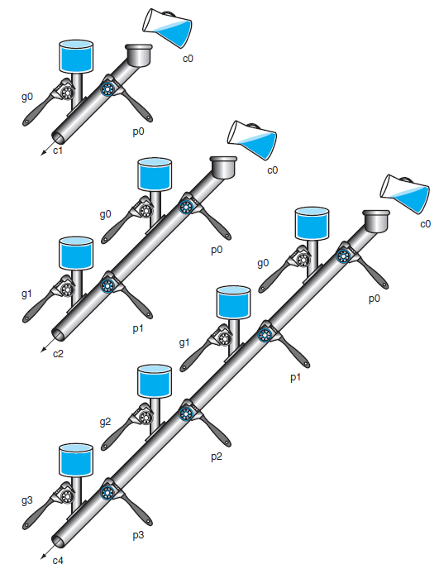
A Plumbing Analog
Wrenches open and close valves
ci+1 will be full
if the nearest generate value gi is on
or pi is on there is water further upstream
c0 can result in a carry out without the help of any generates but the help of all propagates

Slide 22
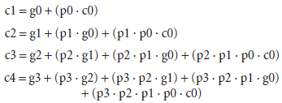
4-bit CarryIn
Notes:
Work out a 4-bit addition example here. Show what c4,c3,c2,c1,c0 are when using a 4-bit carry lookahead adder. Calculate propagate and generate for each.
So the steps are (draw diagram?) Hook up all the necessary to calculate propagate and generate for each (max 2 gate path), then calculate the sum result (also max 2 gate path).
This works well, but again, it starts to get complicated at the 4th carry bit, and it would be really complicated at the 31st carry bit. It’s still better than the alternative we talked about (full evaluation), but not great.
As the book talks about, one of the big ideas in computer architecture is abstraction. So we’re going to apply another level of abstraction…

Slide 23
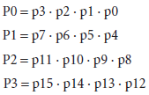
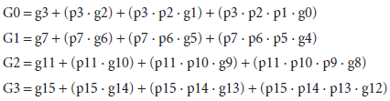
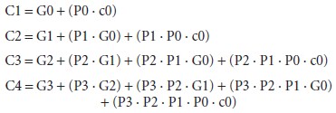
Second Level of Abstraction
Super Propagate
Super Generate
Carryin for 16-bit adder
Notes:
We’re going to group the bits to add into groups of 4, and use what we just talked about for each group. Now each group will compute whether or not the group AS A WHOLE generates a carry bit (to the next group), or propagates one.
Notice two more gate delays to compute the super propagage/generate

Slide 24
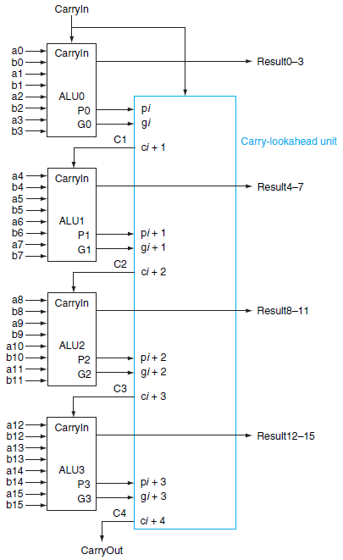
Four 4-bit ALUs with Carry Lookahead to form a 16-bit adder
Notes:
Each of the boxes on the left is a 4-bit Carry lookahead adder (actually ALU).
Each computes their p and g, then their P and G and pass this to carry-lookahead unit.
Consider adding 16-bit
0001 1010 0011 0011
1110 0101 1110 1011

Slide 25


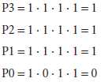
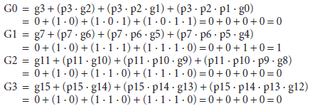
Example of Fast Carry Lookahead
Consider adding two 16-bit integers a and b
generate gi=ai·bi and propagate pi=ai+bi
Super generate and Super Propagate
Notes:
Column of zeros “absorbs” any previously generated 1.

Slide 26

Example of Fast Carry Lookahead (cont.)
Finally
How many “steps”?
step 1: produce generate and propagate
step 2: produce super generate and super propagate
step 3: produce carryout
much faster than adder without fast carry lookahead
Notes:
Still gets complicated! When you have 4 such (4-bit) groups, you have the same complication as the 4-bit adder. So a 16-bit adder is complex. But you can just add another layer of abstraction! Each group of 4 4-bit adders can generate a super-super generate and super-super propate!
So for a 64-bit adder we might have 4 groups of 16-bit adders, which are themselves 4 groups of 4-bit adders. And you can do this as many times as you need. Notice that each time we do this abstraction, we add another (fixed, constant) number of gates. Each time we’re group of gates into groups, so we start with n bits, then group them into n/4 groups, then n/16 groups, then n/4^3 groups, etc. For those of you in 220, what does this remind you of? It’s a little bit like a logarithm, and in general when you work this out, the time to do addition for ANY number of bits can be done in this way in O(log n) time. So why do we say in 220 that it’s just constant time (a primitive operation)? We’re missing an assumption…
The time is logarithmic – you can think of splitting into groups as division…
Lots of other adders that work efficiently: carry-select, carry save

