Slide 1
Memory Elements (B.8)
Instructor: Robert Utterback
Lecture 11

Slide 2
Logistics
HW 2 went out on Wednesday (see email)
Start early!
Come to office hours/tutoring

Slide 3
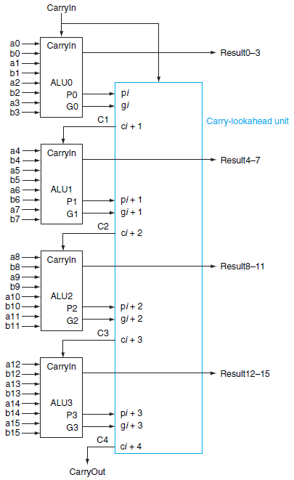
Four 4-bit ALUs with Carry Lookahead to form a 16-bit adder
Notes:
Given some bits a_i and b_i, how to compute p_i and g_i?
What are the steps to do this two-layer carry lookahead adder?

Slide 4
Clock Cycle
Clock cycle time (clock period)
Two portions
Clock is high
Clock is low
Edge-triggered clocking
All state changes occur on a clock edge

Slide 5
State Element and Valid State
State Element
A memory element
Signals written into state elements must be valid when the active clock edge occurs
Valid means stable (not changing)
Will not change again until the inputs change
Synchronous System
A memory system that employs clocks and where data signals are read only when the clock indicates that the signal values are stable

Slide 6
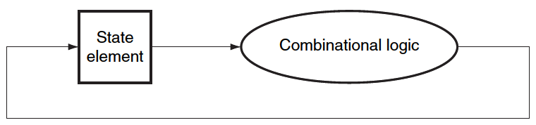
Read and Write in one cycle
Edge-triggered methodology allows a state element to be read and written in the same clock cycle
Read the value of a state element
Send it through some combinational logic
Value does not change during the clock cycle
Write it back to the same state element
All in one cycle

Slide 7
Memory Elements
Memory Elements
Store States
Output depends on
The inputs, and
The value stored in the memory element
Elements
Flip-Flops
Latches
Registers
Register Files
SRAMS
DRAMS

Slide 8
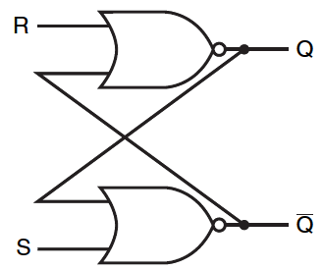
Set-Reset Latch (S-R Latch)
A pair of cross-coupled NOR gates
Unclocked
Do not have a clock input
Can store an internal value
Q represent the current state
Notes:
Draw a truth table for this (inputs are Q_old, ~Q_old, R and S, outputs are Q_new and ~Q_new)

Slide 9
S-R Latch (Cont.)
S=0 and R=0
Previous State is stored
S=1 and R=0
Q=1 and ~Q=0
S=0 and R=1
Q=0 and ~Q=1
S=1 and R=1
Q=0 and ~Q=0
???

Slide 10
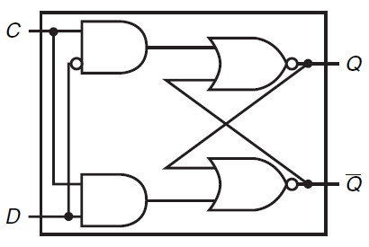
Flip-flops
D-Latch
Clock input C
Data input D

Slide 11
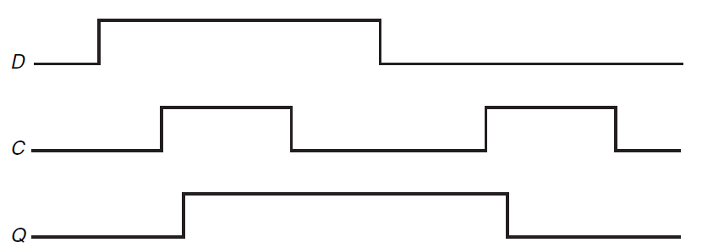
Operation of a D-Latch

Slide 12
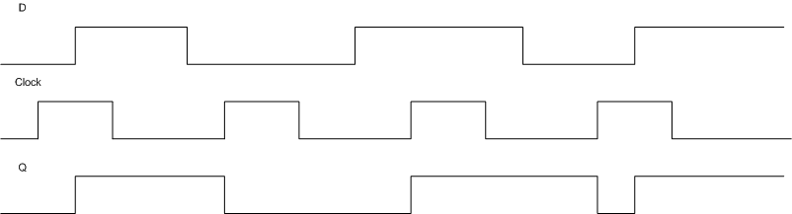
More on D-Latch
Q changes as D changes when clock is up
Not really edge-triggered
Notes:
Want edge-triggered to make sure everything is synchronized

Slide 13
Difference btw. Latch and Flip-flop
Latch
Asynchronous
Output changes soon after input changes
Flip-flop
Synchronous
Output changes at the clock edge
Notes:
Output changes soon after input changes [when the clock is asserted (?)]

Slide 14
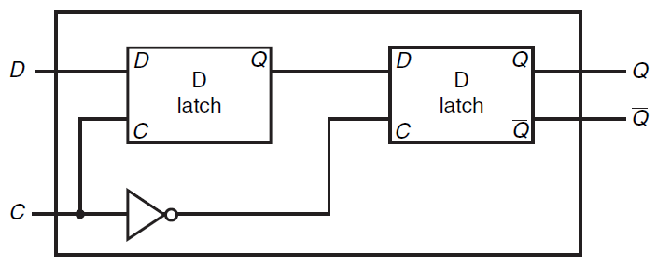
D Flip Flop
D Flip Flop with a Falling-Edge Trigger

Slide 15
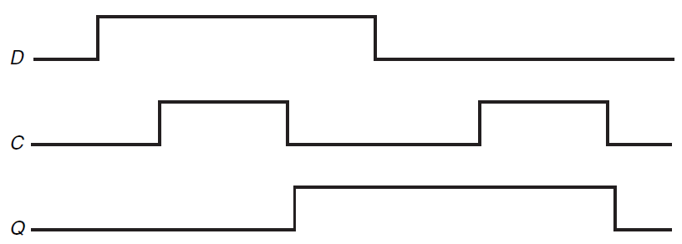
Operation of D Flip Flop
D Flip Flop with a Falling Edge Trigger

Slide 16
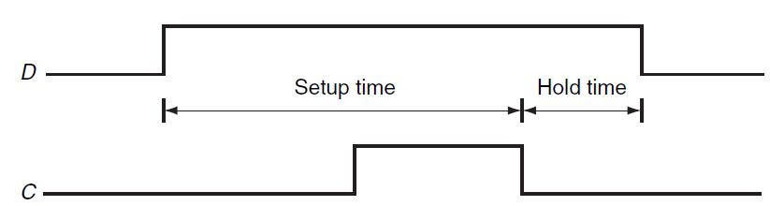
Setup Time and Hold Time
The input must be stable for a period of time before and after the clock edge
Setup Time
The minimum time the signal must be stable before clock edge
Hold Time
The minimum time the signal must be stable after clock edge
Usually very small

Slide 17
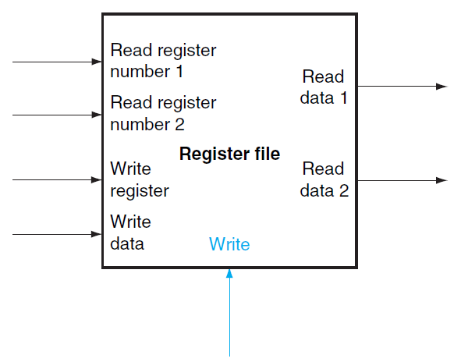
Register Files
A register file consists of a set of registers that can be read and written by supplying a register number
Built from an array of D Flip-Flops
A decoder is used to select a register in the register file

Slide 18
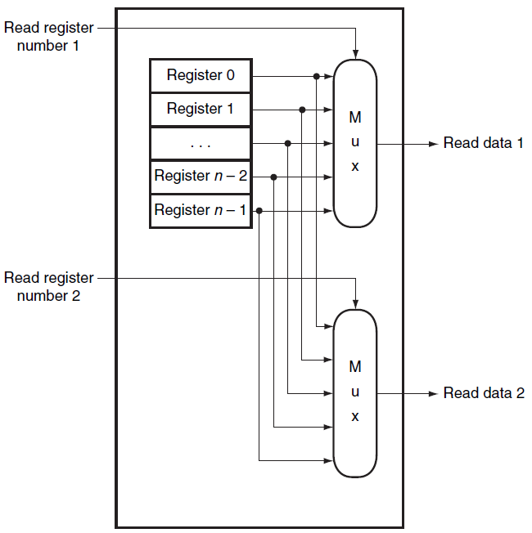
Reading Registers
Multiplexor
Select data from the specific register

Slide 19
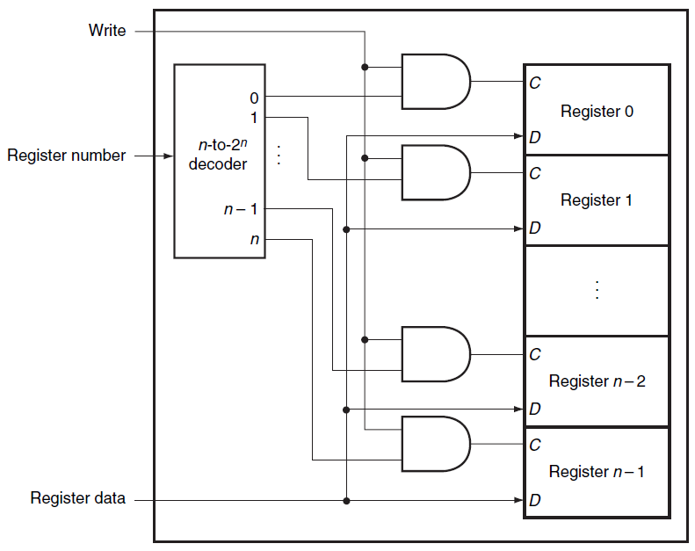
Writing to a register
Write Signal
Specify a write operation to the register
Decoder
Specify which register to write
Register Data
Data to write to the register

Slide 20
Register Files
Register Files
Can be used to build small memory
Too costly to build large amount of memory
Large Scale Memory
Static random access memories (SRAM)
Dynamic random access memories (DRAM)

Slide 21
SRAMs
SRAM
Integrated circuits of memory arrays
A single access port
Either read or write
Fixed access time to any datum
Height
Number of addressable locations
Width
Number of output bits per unit
Example: 8Mx8 SRAM
8M = 2²³, 23 address lines
8 output bits

Slide 22
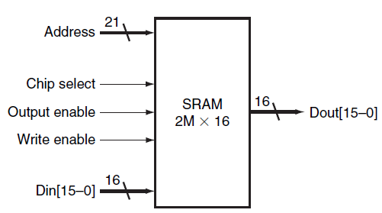
2Mx16 SRAM
21-bit address line
16-bit data input/output

Slide 23
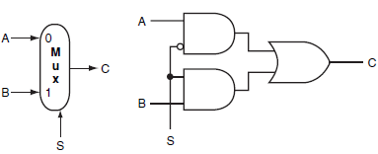
Implementation of Large SRAM
Register File
Use Multiplexor
32x1 Multiplexor
Large SRAM
Impractical to use a large multiplexor like 64kx1
Try to remember the implementation of a two input multiplexor
Solution
A more efficient implementation of Multiplexor
Shared output line (bit line)
Allow multiple sources to drive a single output line

Slide 24
Small SRAM (4 x 2)

Slide 25
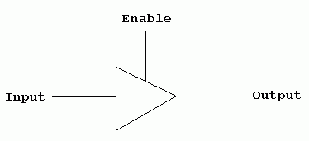
Three State Buffer
Two inputs
A data signal
An output enable (output select)
A single output
Three states
Output enable = 1
Asserted (1) state
Deasserted (0) state
Output enable = 0
High Impedance state
Allow the another three-state buffer with output enable =1 to determine the output

Slide 26
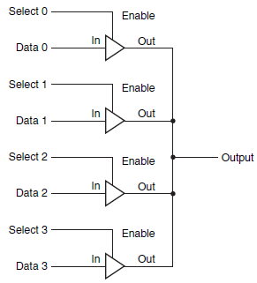
Multiplexor using Three-State Buffers
Three-State Buffer
Two inputs
A data signal
An output enable (output select)
A single output
Three states
Output enable = 1
Asserted (1) state
Deasserted (0) state
Output enable = 0
High Impedance state
Allow the another three-state buffer with output enable =1 to determine the output

Slide 27
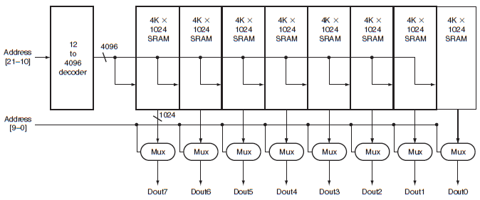
Organization of a 4M SRAM
Array of 8 Modules – Each for a bit
Addr 21-10
Use a 12 to 4096 decoder
Select an array of1024 bits out of 4K 1024 bits
Addr 9-0
Select 1 bit from the 1024 bits as an output bit

Slide 28
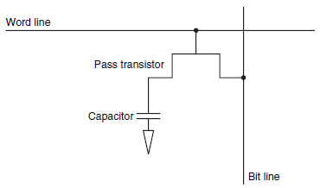
DRAM
SRAM
Requires 4-6 transistors per bit
Fast
But costly
DRAM
Requires 1 transistor per bit
Charge stored in a capacitor
Needs to be refreshed periodically
Slower than SRAM
But less expensive

Slide 29
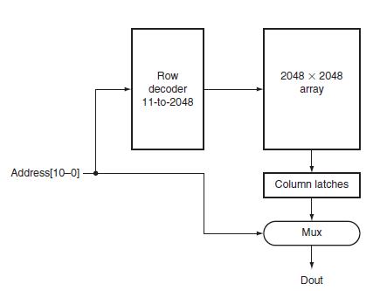
Organization of a 4M DRAM
Addr 11-21
Select 1 row from 2048 rows
Addr 10-0
Select 1 bit from the 2048 bits as an output bit
Column Latches
Store the selected output from 2048x2048 array temporally

Slide 30
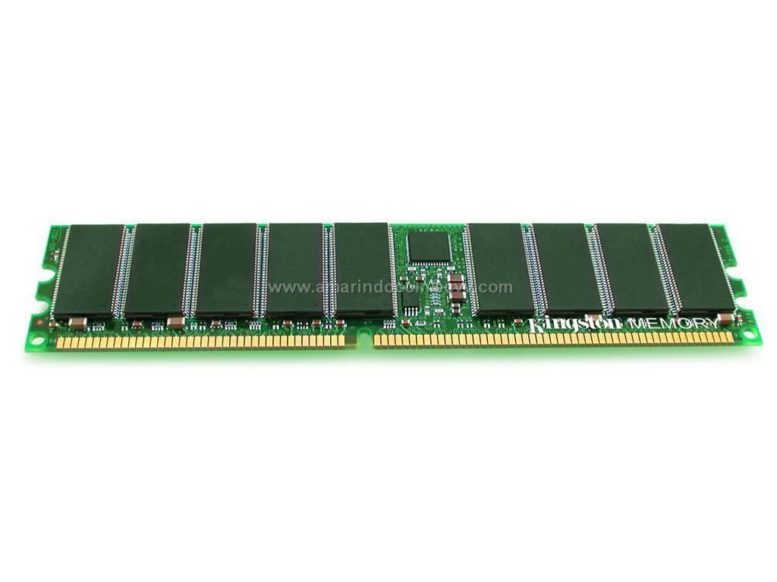
DRAM

Slide 31
SRAM and DRAM
SRAM
Fast but costly
Small amount
Used for Computer Cache
DRAM
Slow but less costly
Large amount
Used for Computer Main Memory

Slide 32
What I want you to do
Finish/Review Appendix B.1-3, B.5-B.9
Work on HW 2
Study for exam 1!

