Slide 1
Combinational Logic (B.3)
Instructor: Robert Utterback
Lecture 5
Notes:
In this lecture you’re going to learn a lot of new things: the basic building blocks of a computer. We’ll slowly combine these to learn how many components of a computer are built up.

Slide 2

Review
Implement $Y=\overline{\overline{\left(A+B\right)}∙C+D}$

Slide 3
Exercise
Show how to build AND, OR, and NOT functions from (two-input) NAND gates.

Slide 4
Decoder
Decoder
A logic block that has n-bit input and 2^{n} outputs, where only one output is asserted for each input combination
If the input is i (in binary),
then output i is 1
others are 0
Notes:
N bit input -> 2^N permutations. You’ll see this relationship everywhere, so I want to make it a little clearer for you. 2 choices for the first bit, 2 for the second, etc.

Slide 5
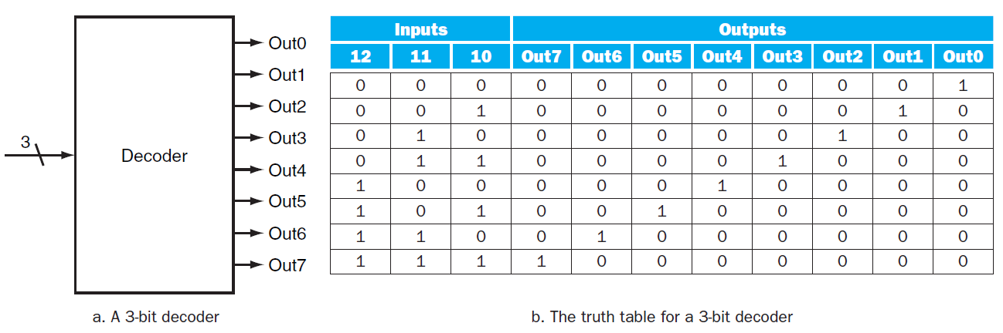
Decoder Example
3-8 Decoder
Notes:
There’s also such thing as an “encoder” to go in the other direction: n separate choices to a log_n bit number.
We’ll see in just a second an example of why you might need a decoder.

Slide 6
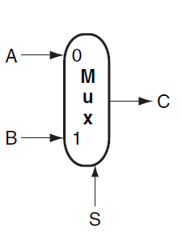
Multiplexor
Multiplexor
A selector
The output is selected by an input control

Slide 7
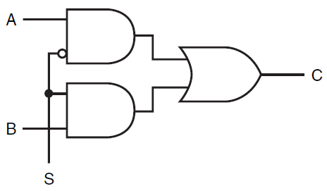

Implementation of a Multiplexor

Slide 8

n-input Multiplexor
A Multiplexor can have n-inputs
Require selective inputs
Implementation of an n-input Multiplexor
Decoder generates n signals. Each indicates different input value.
Array of n AND gates. Each combines one input with decoder signal
3. Single large OR gate taking all outputs of AND gates.
Notes:
To have n inputs, log n is enough, since we only need to select one at a time. x bits gives us 2^x permutations, hence log n gives us a way to select one input from n.

Slide 9
Two-level Logic
Remember: Any Boolean Logic function can be implemented with only NOT, AND, OR functions
We can also find that all logic functions can be written in a canonical form
Sum of Products
Logical Sum (OR) of terms joined by Product (AND)
Product of Sums
Logical Product (AND) of terms joined by Sum (OR)
Notes:
In fact, we can say something even stronger. The textbook uses Sum of Products.

Slide 10

Example
Consider the following:
$D=(\left(A∙B\right)+(A∙$C)+(B $∙$C)) $∙$($\overline{A∙B∙C})$
Convert to sum of products form
$D=(A∙$B $∙\overline{C})+(A∙C∙\overline{B})+(B∙C∙\overline{A})$
Notes:
Hint: draw a truth table. When the final result is one, just add another product group to the sum.

Slide 11
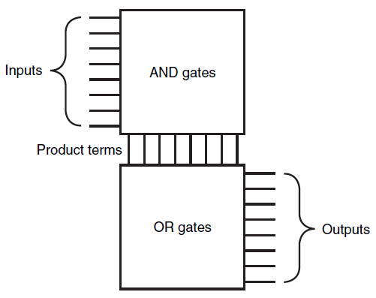
Programmable Logic Array
Programmable Logic Array (PLA)
Two stages of logic
An array of AND gates (product terms)
An array of OR gates
Notes:
Common logic implementation called PLA

Slide 12
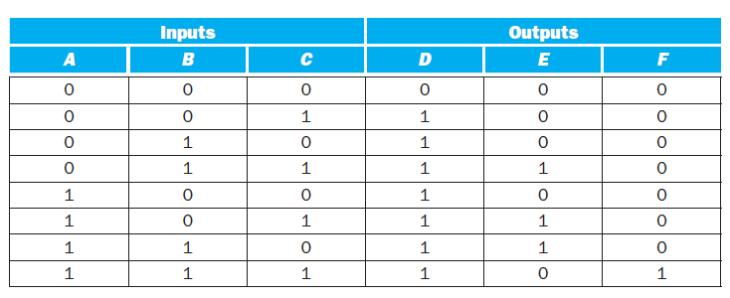
PLA Example
Considering the following table, implement the PLA for D, E, F
Notes:
For a particular output, look at each 1 value. Then AND together the inputs. OR together everything that produces a 1 value in this column. Notice that we don’t need to represent 0s at all, e.g. the first row.

Slide 13
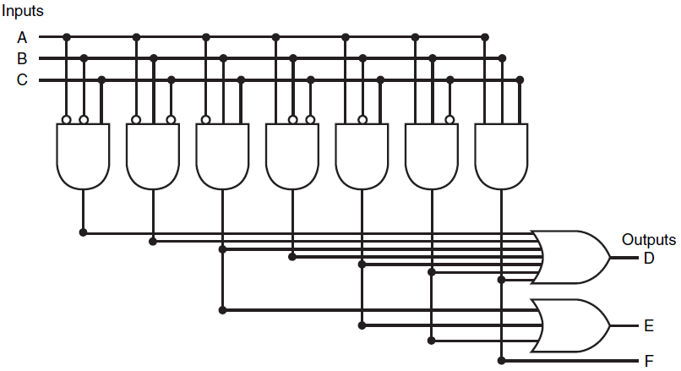
PLA Representation
Notes:
Two things make PLAs efficient:
(1) only truth table entries that produce a true value for at least one output need any logic gates!
(2) Each different product term will have only one entry in the PLA, even if the product term is used in multiple outputs

Slide 14
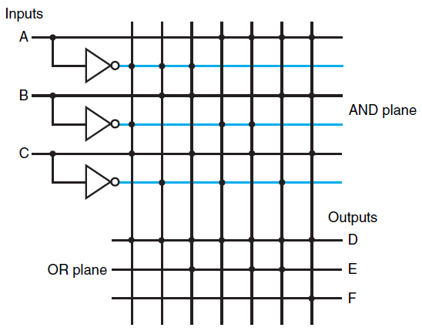
Another PLA Representation
Dot in the AND plane
Input, or its inverse, occurs in the product term
Dot in the OR plane
Corresponding product term appears in the corresponding output

