Slide 1
Simple DataPath Implementation (4.4)
Lecture 37
Notes:
Try to come up with as much of the data path diagram as we can

Slide 2
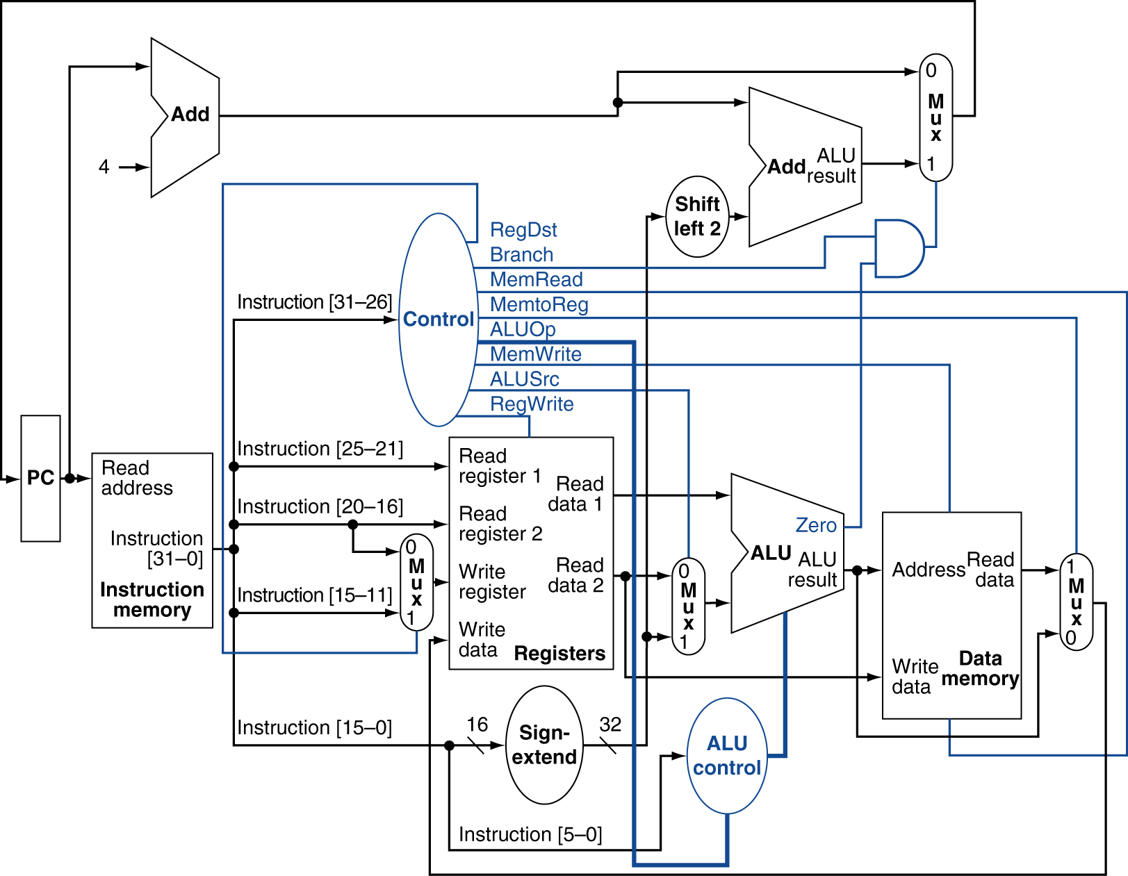
Datapath With Control
Notes:
We’ve implemented all but jump instructions…
What does a jump instruction look like (machine format)
And what does it need to do exactly?

Slide 3
Implementing Jumps
Jump
2
address
31:26
25:0
Jump uses word address
Update PC with concatenation of
Top 4 bits of old PC
26-bit jump address
00
Need an extra control signal decoded from opcode
Notes:
Why the 00?
Let’s see if we can add this to our diagram

Slide 4
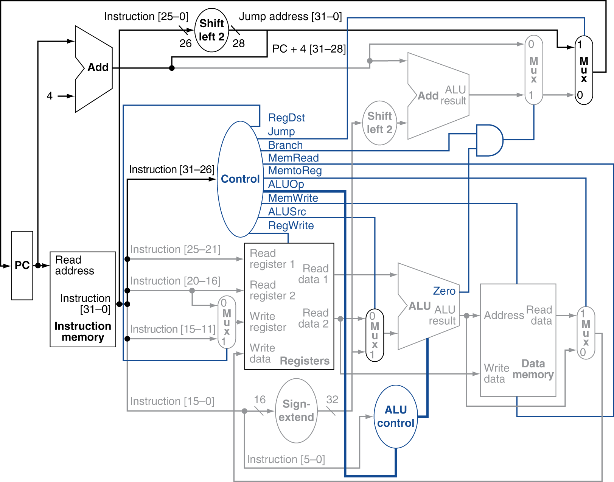
Datapath With Jumps Added
Notes:
Notice how EVERYTHING is happening in parallel, at the same time. For example, the 0-25 instruction bits get shifted and concatenated as if they were a jump address even when they were not. It’s the multiplexors that choose whether or not that value is actually used.

Slide 5
Performance Issues
Longest delay determines clock period
Critical path: load instruction
Instruction memory → register file → ALU → data memory → register file
Not feasible to vary period for different instructions
Violates design principle
Making the common case fast
We will improve performance by pipelining
Notes:
Notice CPI is 1 here, but clock period is long…
Before we go on, exercise:

Slide 6
Exercise
New instruction: lwi rt, rd(rs)
Meaning:
Reg[rt] = Mem[Reg[rd] + Reg[rs]]
How to implement this?
What datapath blocks are used?
What new blocks?
What new control signals?

Slide 7
Pipelining Overview
4.5
Notes:
Walk me through the process of doing laundry.

Slide 8
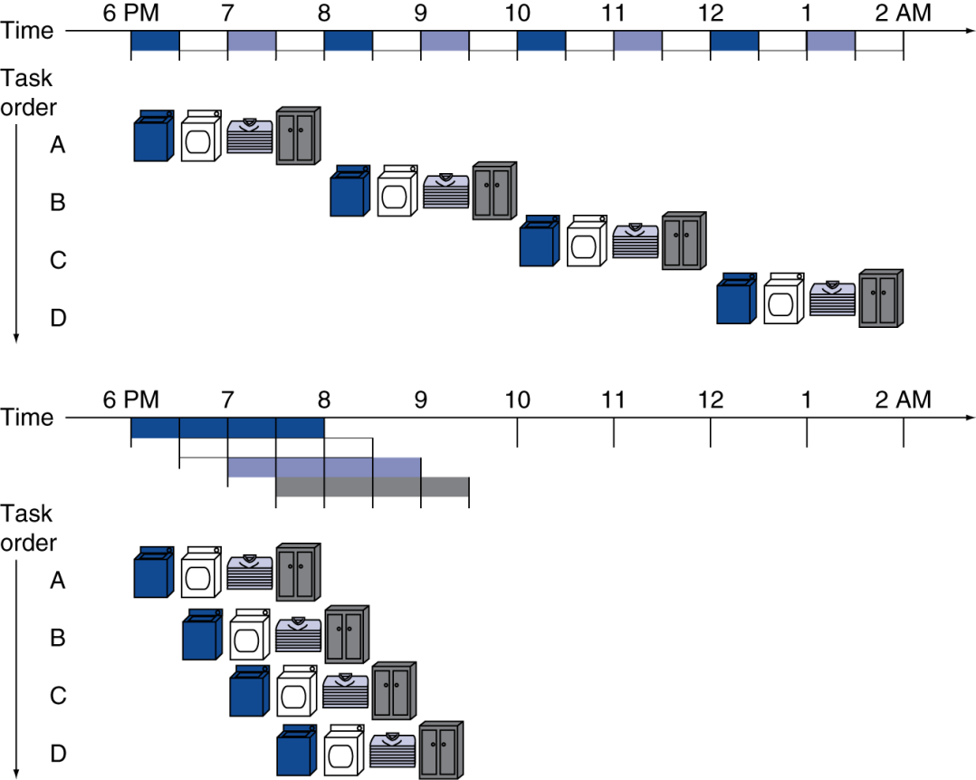
Pipelining Analogy
Pipelined laundry: overlapping execution
Parallelism improves performance
§4.5 An Overview of Pipelining
Four loads:
Speedup = 8/3.5 = 2.3
Non-stop:
Speedup = 2n/(0.5n + 1.5) ≈ 4 = number of stages
Notes:
0.5*4*n / (1.5 + 0.5n)
Not exactly 4 b/c of “startup”, pipeline is not full

Slide 9
MIPS Pipeline
Five stages, one step per stage
IF: Instruction fetch from memory
ID: Instruction decode & register read
EX: Execute operation or calculate address
MEM: Access memory operand
WB: Write result back to register

Slide 10
Pipeline Performance
Assume time for stages is
100ps for register read or write
200ps for other stages
Compare pipelined datapath with single-cycle datapath
Instr | Instr fetch | Register read | ALU op | Memory access | Register write | Total time
lw | 200ps | 100 ps | 200ps | 200ps | 100 ps | 800ps
sw | 200ps | 100 ps | 200ps | 200ps |  | 700ps
R-format | 200ps | 100 ps | 200ps |  | 100 ps | 600ps
beq | 200ps | 100 ps | 200ps |  |  | 500ps

Slide 11
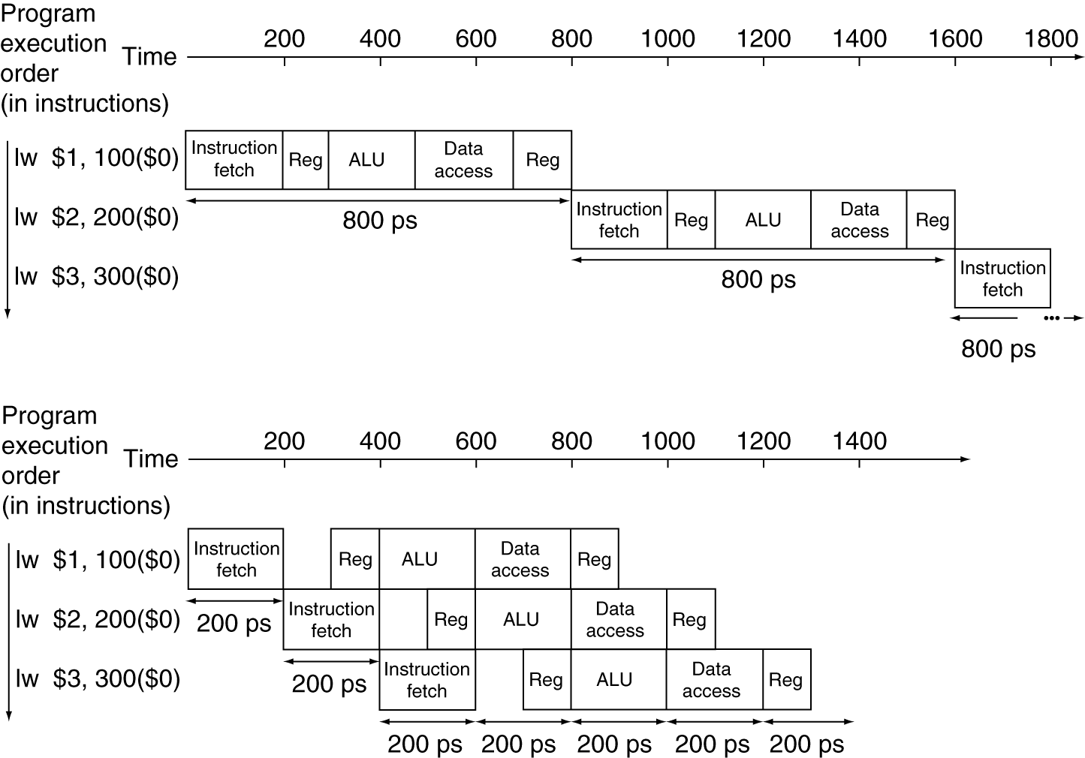
Pipeline Performance
Single-cycle (T_{c}= 800ps)
Pipelined (T_{c}= 200ps)
Notes:
What’s the speedup here?

Slide 12
Pipeline Speedup
If all stages are balanced
i.e., all take the same time
Time between instructions_{pipelined} = Time between instructions_{nonpipelined} Number of stages
If not balanced, speedup is less
Speedup due to increased throughput
Latency (time for each instruction) does not decrease
Notes:
Time between instructions is really talking about the cycle time…

Slide 13
Pipelining and ISA Design
MIPS ISA designed for pipelining
All instructions are 32-bits
Easier to fetch and decode in one cycle
c.f. x86: 1- to 17-byte instructions
Few and regular instruction formats
Can decode and read registers in one step
Load/store addressing
Can calculate address in 3rd stage, access memory in 4th stage
Alignment of memory operands
Memory access takes only one cycle

