Slide 1
Pipeline Implementation (4.6)
Lecture 38

Slide 2
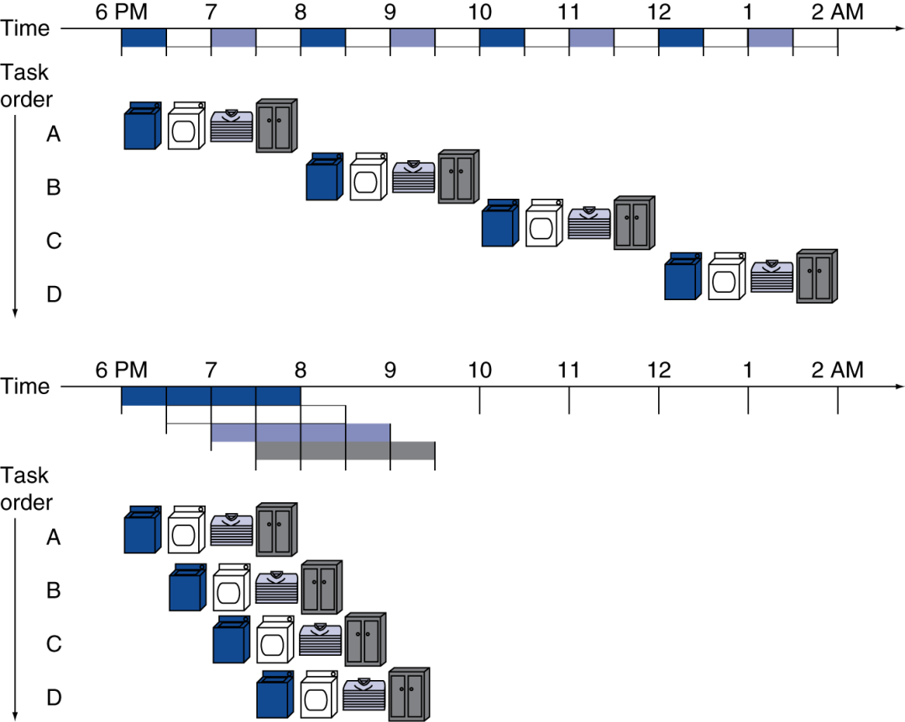
Pipelining Analogy
Pipelined laundry: overlapping execution
Parallelism improves performance
§4.5 An Overview of Pipelining
Four loads:
Speedup = 8/3.5 = 2.3
Non-stop:
Speedup = 2n/(0.5n + 1.5) ≈ 4 = number of stages
Notes:
What are the five stages for MIPS pipeline?

Slide 3
MIPS Pipeline
Five stages, one step per stage
IF: Instruction fetch from memory
ID: Instruction decode & register read
EX: Execute operation or calculate address
MEM: Access memory operand
WB: Write result back to register

Slide 4
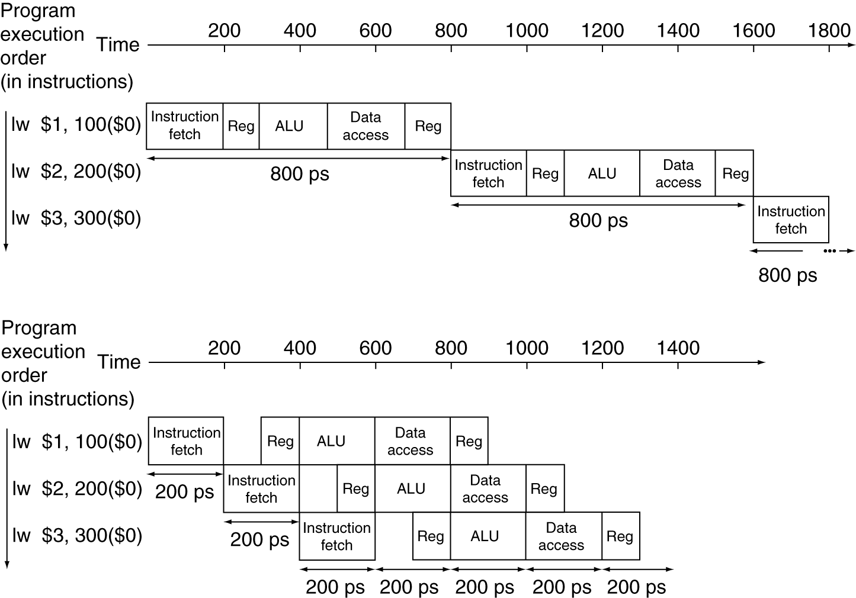
Pipeline Performance
Single-cycle (T_{c}= 800ps)
Pipelined (T_{c}= 200ps)
Notes:
What’s the speedup here?

Slide 5
Hazards
Situations that prevent starting the next instruction in the next cycle
Structure hazards
A required resource is busy
Data hazard
Need to wait for previous instruction to complete its data read/write
Control hazard
Deciding on control action depends on previous instruction

Slide 6
Structure Hazards
Conflict for use of a resource
In MIPS pipeline with a single memory
Load/store requires data access
Instruction fetch would have to stall for that cycle
Would cause a pipeline “bubble”
Hence, pipelined datapaths require separate instruction/data memories
Or separate instruction/data caches
Notes:
Laundry: a combination washer and dryer

Slide 7
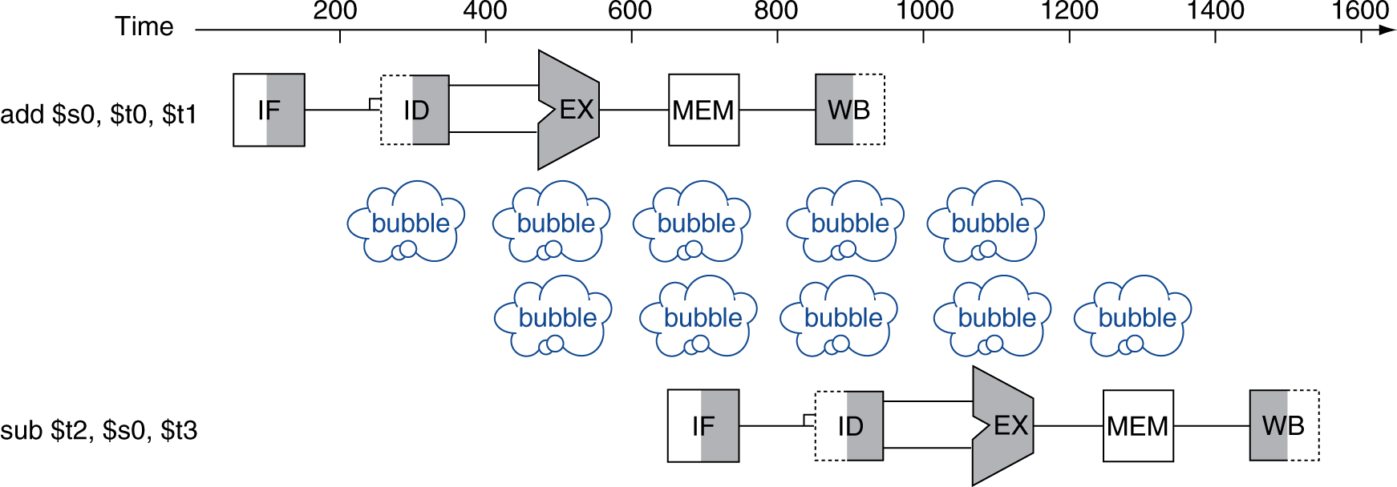
Data Hazards
An instruction depends on completion of data access by a previous instruction
add $s0, $t0, $t1 sub $t2, $s0, $t3

Slide 8
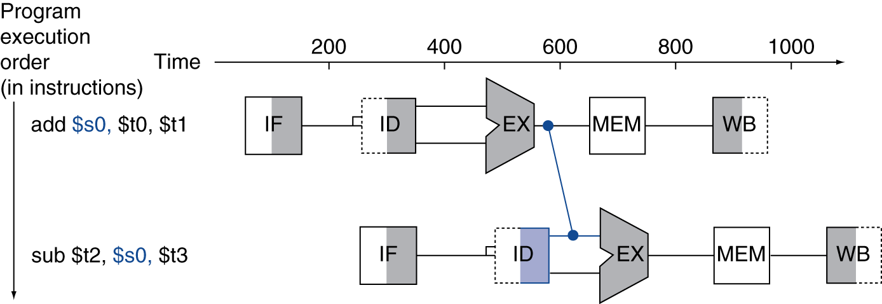
Forwarding (aka Bypassing)
Use result when it is computed
Don’t wait for it to be stored in a register
Requires extra connections in the datapath

Slide 9
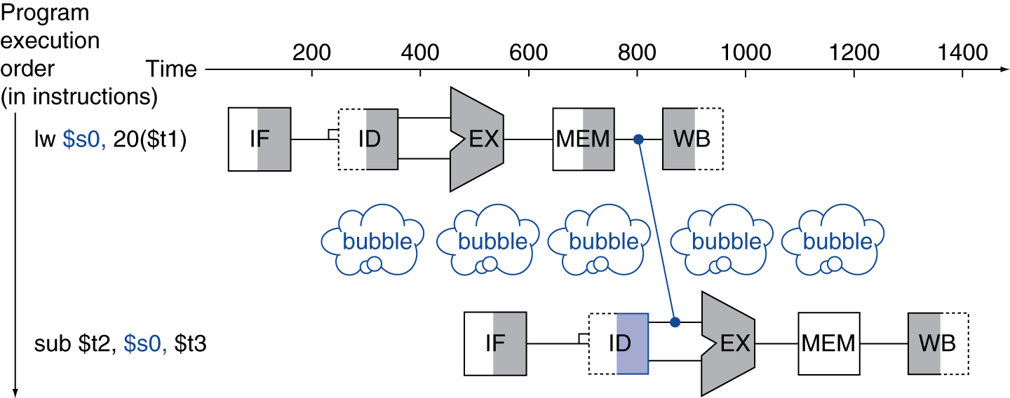
Load-Use Data Hazard
Can’t always avoid stalls by forwarding
If value not computed when needed
Can’t forward backward in time!

Slide 10
Class Exercise
Notes:
Example on page 280

Slide 11
Code Scheduling to Avoid Stalls
Reorder code to avoid use of load result in the next instruction
C code for A = B + E; C = B + F;
lw $t1, 0($t0)
lw $t2, 4($t0)
add $t3, $t1, $t2
sw $t3, 12($t0)
lw $t4, 8($t0)
add $t5, $t1, $t4
sw $t5, 16($t0)
lw $t1, 0($t0)
lw $t2, 4($t0)
lw $t4, 8($t0)
add $t3, $t1, $t2
sw $t3, 12($t0)
add $t5, $t1, $t4
sw $t5, 16($t0)
stall
stall
13 cycles
11 cycles

Slide 12
Control Hazards
Branch determines flow of control
Fetching next instruction depends on branch outcome
Pipeline can’t always fetch correct instruction
Still working on ID stage of branch
In MIPS pipeline
Need to compare registers and compute target early in the pipeline
Add hardware to do it in ID stage
Notes:
So first, branch uses relative addressing, so we need to add. But the result of the add won’t be ready until later in the pipeline, even though we need it immediately.

Slide 13
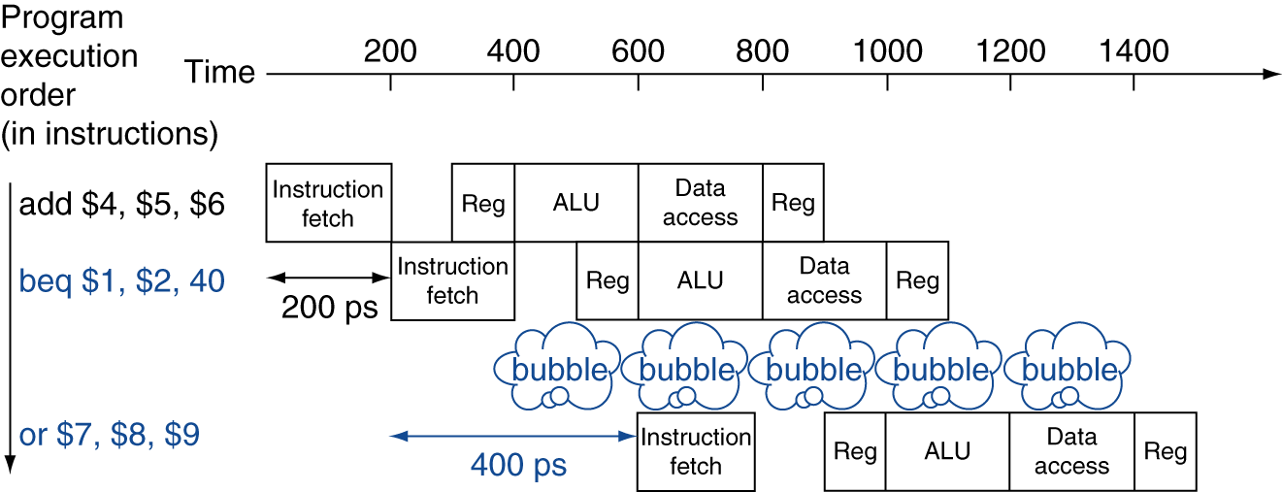
Stall on Branch
Wait until branch outcome determined before fetching next instruction

Slide 14
Branch Prediction
Longer pipelines can’t readily determine branch outcome early
Stall penalty becomes unacceptable
Predict outcome of branch
Only stall if prediction is wrong
In MIPS pipeline
Can predict branches not taken
Fetch instruction after branch, with no delay

Slide 15
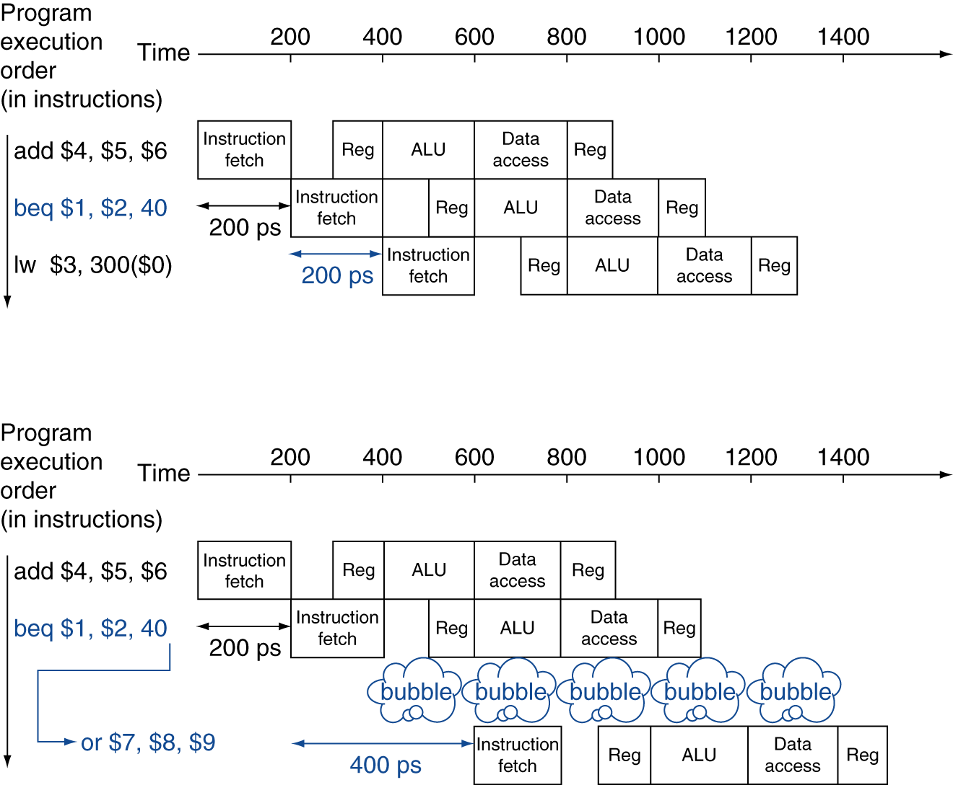
MIPS with Predict Not Taken
Prediction correct
Prediction incorrect

Slide 16
More-Realistic Branch Prediction
Static branch prediction
Based on typical branch behavior
Example: loop and if-statement branches
Predict backward branches taken
Predict forward branches not taken
Dynamic branch prediction
Hardware measures actual branch behavior
e.g., record recent history of each branch
Assume future behavior will continue the trend
When wrong, stall while re-fetching, and update history

Slide 17
Pipeline Summary
The BIG Picture
Pipelining improves performance by increasing instruction throughput
Executes multiple instructions in parallel
Each instruction has the same latency
Subject to hazards
Structure, data, control
Instruction set design affects complexity of pipeline implementation
Notes:
Examples on p. 285

