Slide 1
Combinational Logic (B.3)
Instructor: Robert Utterback
Lecture 6
Notes:
In this lecture you’re going to learn a lot of new things: the basic building blocks of a computer. We’ll slowly combine these to learn how many components of a computer are built up.

Slide 2
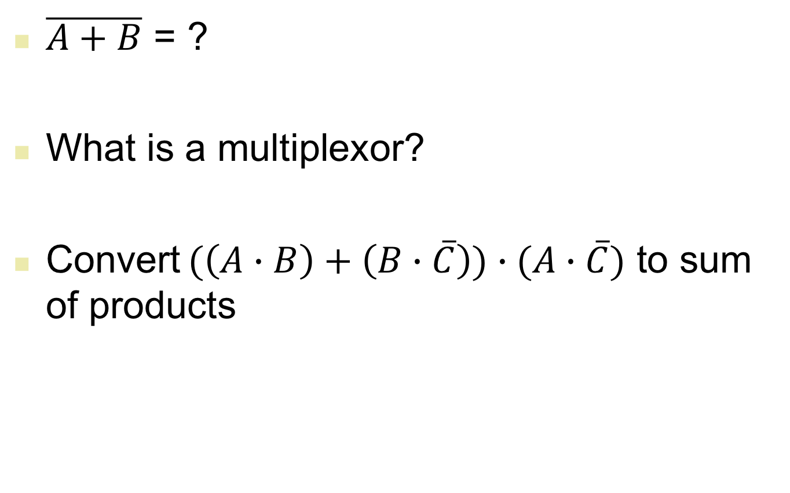
Review
$\overline{A+B}$ = ?
What is a multiplexor?
Convert $(\left(A∙B\right)+\left(B∙\overline{C}\right))∙(A∙\overline{C})$ to sum of products
Notes:
First, use DeMorgan’s
Third: AB~C

Slide 3
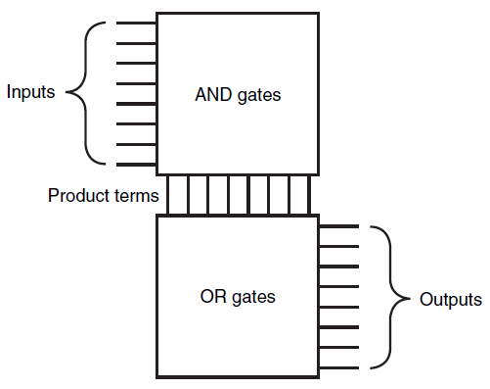
Programmable Logic Array
Programmable Logic Array (PLA)
Two stages of logic
An array of AND gates (product terms)
An array of OR gates
Notes:
Common logic implementation called PLA
AND, OR *plane*
We can use a PLA to directly implement the truth table of a set of logic functions easily.

Slide 4
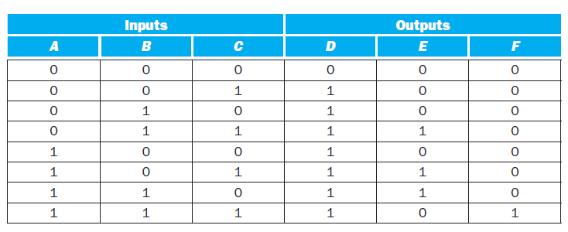
PLA Example
Considering the following table, implement the PLA for D, E, F
Notes:
For a particular output, look at each 1 value. Then AND together the inputs. OR together everything that produces a 1 value in this column. Notice that we don’t need to represent 0s at all, e.g. the first row.

Slide 5
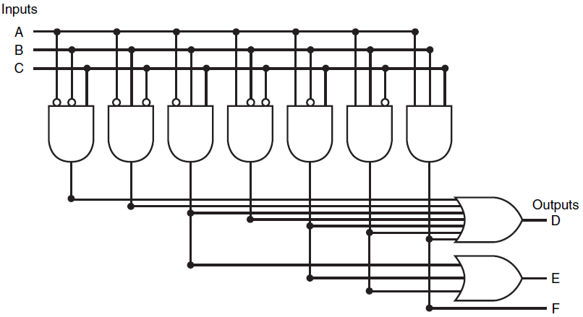
PLA Representation
Notes:
Two things make PLAs efficient:
(1) only truth table entries that produce a true value for at least one output need any logic gates!
(2) Each different product term will have only one entry in the PLA, even if the product term is used in multiple outputs

Slide 6
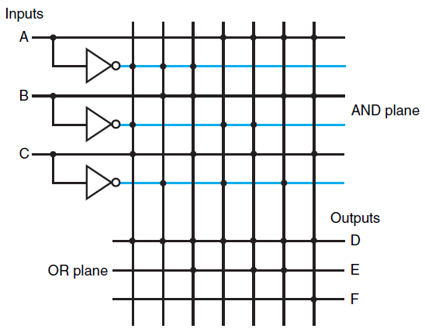
Another PLA Representation
Dot in the AND plane
Input, or its inverse, occurs in the product term
Dot in the OR plane
Corresponding product term appears in the corresponding output
Notes:
Another form of structured logic used to implement logic functions is…

Slide 7
Read Only Memory
Read Only Memory (ROM)
Has a set of locations that can be read
Contents of these locations are fixed
Programmable ROM (PROM)
Can be burnt using a device called a “ROM programmer”
Erasable Programmable Read Only Memory (EPROM)
Data in the ROM can be deleted under ultra-violet rays
EEPROM (Electrically Erasable Read Only Memory)
Data in the ROM can be erased by a simple electric current
Notes:
Called memory b/c it has a set of locations that can be read from
However, the contents of these locations are “fixed”, in that at least they are not easily changeable at running time

Slide 8
ROM
Height
m inputs
2^{m} addressable entries (input lines)
Width
n outputs (functions)
2^{n} output bits
mxn is the shape of the ROM
Notes:
Can encode logic functions basically as a lookup table: n functions with m inputs. Assign a number (label) to each possible input combination, that’s your address.

Slide 9

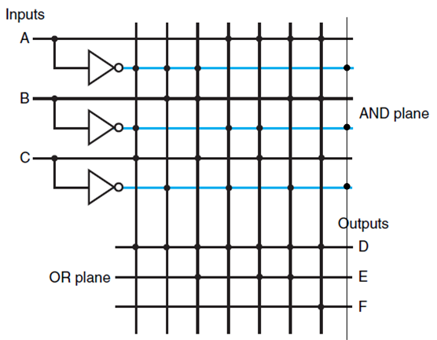
ROMs and PLAs
PLA is partially decoded
ROM is fully decoded
Contains a full output word for every possible input combination
Always contain at least as many entries as the PLA
PLA (7 entries)
ROM (8 entries – 1 unused)
Notes:
As the number of inputs grows, the number of entries in ROM grows exponentially. For most logic functions, the size of PLAs grows much more slowly, so it’s more efficient to use PLAs.
However, if your logic function changes, you made need to build a new PLA. A PROM can be changed to implement any logic function with the same # inputs and outputs.

Slide 10
Don’t Care
Don’t Care
We don’t care about the actual values
Output Don’t Care
We don’t care about the value of an output for some input combination
Input Don’t Care
An output only depends on some of the inputs
Advantages of Don’t Care
Easier to optimize the implementation of a logic function
Notes:
Basically this gives you lots of flexibility in how you can implement such a circuit, since for these don’t cares the output could be either 0 or 1.

Slide 11
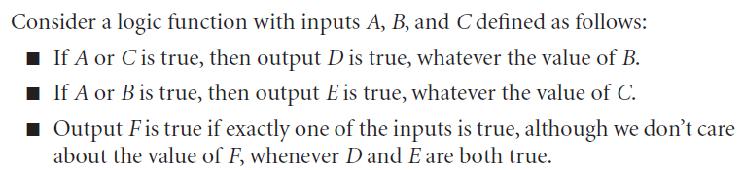
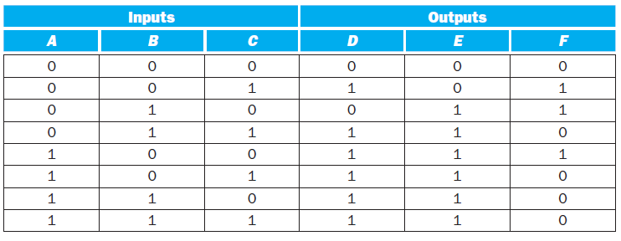
Example of Don’t Cares
Original Truth Table
Notes:
First, note that when D and E are true, we don’t care about F, so we can put X’s there…
A is in both the top two statements – if A is true, it forces both D and E to be true and we don’t care about B and C. This actually lets us remove multiple rows! Now if both B and C are true, then we don’t care about A.

Slide 12
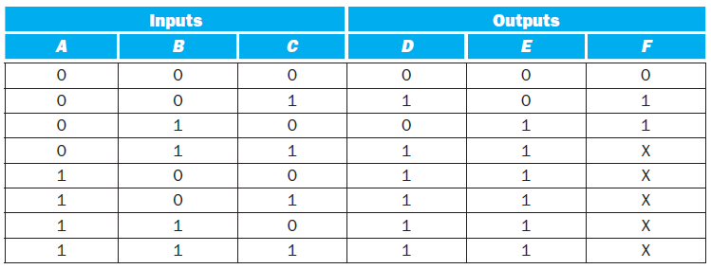
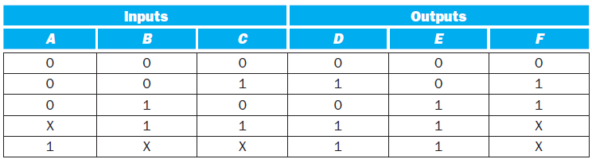
Example of Don’t Cares
Output Don’t Cares
Input Don’t Cares
Notes:
Don’t Care terms are key to getting efficient logic function implementations; they give us a lot of flexibility. These days, though, design tools can help you do logic minimization very well, without a lot of knowledge.

Slide 13
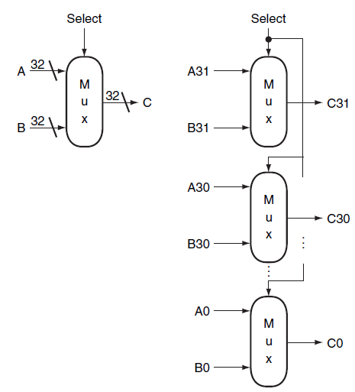
Array of Logic Elements
Bus
In logic design, a collection of data lines that is treated together as a single logical signal
Shared collection of lines with multiple sources
32-bit wide 2-to-1 multiplexor
Notes:
We’re almost to ALUs now. One other thing we need to talk about: “arrays” of logic elements.
Notice the difference between this and an n-to-1 multiplexor, say 32-to-1. Who can explain the difference to me?

Slide 14
A simple Arithmetic Logic Unit (B.5)
Notes:
In this lecture you’re going to learn a lot of new things: the basic building blocks of a computer. We’ll slowly combine these to learn how many components of a computer are built up.

Slide 15
Bit, Byte, and Word
1 Bit – 0 or 1
1 Byte – 8 bits
1 Word – N bytes (in general)
4 bytes in a word (in our book)

Slide 16


Most Significant Bit and Least Significant Bit
Most Significant Bit (High-Order Bit)
The bit position having the greatest value
Usually the left-most bit
Least Significant Bit (Low-Order Bit)
The bit position having the smallest value
Usually the right-most bit
Notes:
Some terminology…

Slide 17


Endianness
Big Endian
The Most Significant Bit is first
Little Endian
The Least Significant Bit is first
Notes:
MIPS is big-endian, but Intel x86 is little endian! You will not need to deal with this usually, unless you are working with something smaller than a word. Or if you take Networking -- most networking protocols are big-endian.

Slide 18
Binary Representation of Integers
Unsigned Integers
0 and positive integers only
Signed Integers
0, negative, and positive integers
Three ways
Sign-Magnitude
1’s Complement
2’s Complement
Notes:
We talked before about representing positive integers…we call those “unsigned.”
But obviously sometimes we want to talk about negative numbers. There are a few different ways to represent negative numbers.
Some of this is foreshadowing chapter 2, but it will help to understand how the Adder works.

Slide 19
Unsigned Integers
Unsigned Integers
Consider a word = 4 bytes
Can represent numbers from 0 to 4294967295
Decimal:
0 to 2³²-1
Binary:
0 to 11111111111111111111111111111111₂
Example
6712₁₀ = 00000000 00000000 00011010 00111000₂
Notes:
Now, take a moment: you’re a Cpu designer 50 years ago and you need to compute with negative numbers. How would you implement signed integers (the ability to have both positive and negative numbers)?

Slide 20
Signed Integer – Sign Magnitude
Sign Magnitude
Use the most significant bit of the word to represent the sign
0 – Positive
1 – Negative
Rest of the number is encoded in magnitude part
Example
6712₁₀ = 00000000 00000000 00011010 00111000₂
-6712₁₀ = 10000000 00000000 00011010 00111000₂
Two representations of 0
0 = 00000000 00000000 00000000 00000000
-0 = 10000000 00000000 00000000 00000000
Cumbersome in Arithmetic
Notes:
Think about adding a negative number and a positive number

Slide 21
1’s Complement
1’s Complement
Negative number is stored as bit-wise complement of corresponding positive number
Use the most significant bit of the word to represent the sign
0 – Positive
1 – Negative
Example
6712₁₀ = 00000000 00000000 00011010 00111000₂
-6712₁₀ = 11111111 11111111 11100101 11000111₂
Still two representations of zero
0 = 00000000 00000000 00000000 00000000
-0 = 11111111 11111111 11111111 11111111

Slide 22
2’s Complement
2’s Complement
Positive number represented in the same way as sign-magnitude and 1’s complement
Negative number obtained by taking 1’s complement of positive number and adding 1
6712₁₀ = 00000000 00000000 00011010 00111000₂
1’s comp: -6712₁₀ = 11111111 11111111 11100101 11000111₂
2’s comp: -6712₁₀ = 11111111 11111111 11100101 11001000₂
One version of 0
Convenient in arithmetic

Slide 23
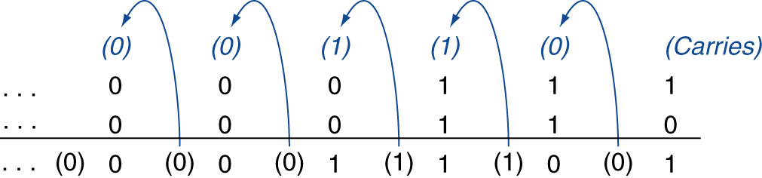
Integer Addition
Example: 7 + 6
00000000 00000000 00000000 00000111
+ 00000000 00000000 00000000 00000110
00000000 00000000 00000000 00001101
§3.2 Addition and Subtraction
Notes:
So let’s add two numbers…exercise with at least one negative number.

Slide 24
Integer Subtraction
Subtraction is actually an addition
Example: 7 – 6 = 7 + (-6)
2’s complement
00000000 00000000 00000000 00000111
+ 11111111 11111111 11111111 11111010
00000000 00000000 00000000 00000001
Notes:
Rather than implementing both add and subtract, we can save some transistors and just implement add.
This also exhibits how we don't need to treat negative numbers any differently when using 2's complement!

Slide 25
Overflow
Overflow if result out of range
Adding +value and –value operands, no overflow
Adding two +value operands
Overflow if result sign is -
Adding two –value operands
Overflow if result sign is +
Notes:
With an 8-bit word, let’s try to add 125 and 4.
Common bug of averaging two numbers.

Slide 26
Arithmetic Logic Unit
Arithmetic Logic Unit (ALU)
Heart of a CPU
Operations
Arithmetic operations
Addition
Subtraction
Logical operations
NOT
AND
OR

