Slide 1
Pipeline Implementation (4.6)
Lecture 39

Slide 2
Pipeline Summary
The BIG Picture
Pipelining improves performance by increasing instruction throughput
Executes multiple instructions in parallel
Each instruction has the same latency
Subject to hazards
Structure, data, control
Instruction set design affects complexity of pipeline implementation
Notes:
Examples on p. 285

Slide 3
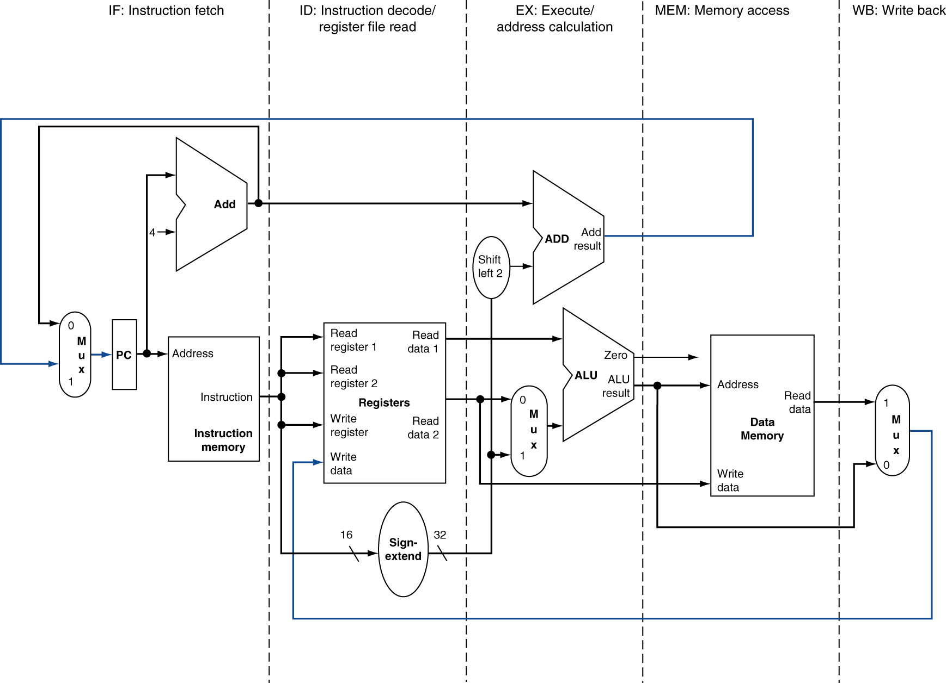
MIPS Pipelined Datapath
§4.6 Pipelined Datapath and Control
MEM
Right-to-left flow leads to hazards
WB
Notes:
Not only data hazards (WB) and control hazards (branch MEM), also just synchronization: time it takes to go down a wire vs. through the register file

Slide 4
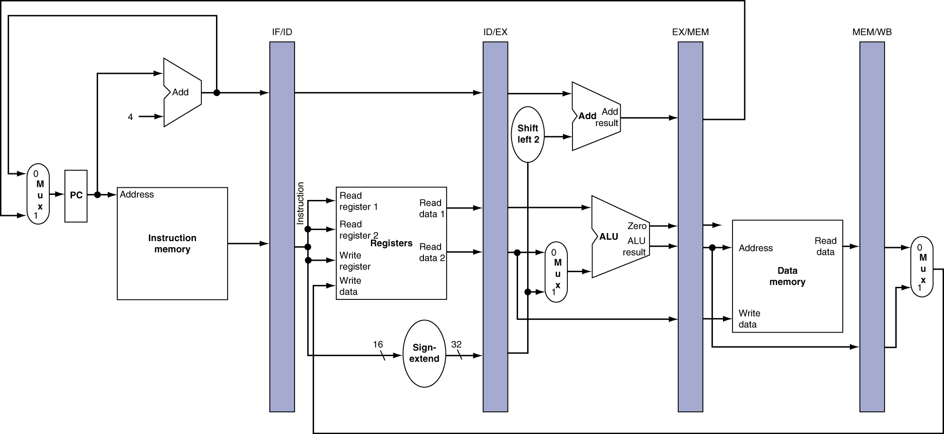
Pipeline registers
Need registers between stages
To hold information produced in previous cycle

Slide 5
Pipeline Operation
Cycle-by-cycle flow of instructions through the pipelined datapath
“Single-clock-cycle” pipeline diagram
Shows pipeline usage in a single cycle
Highlight resources used
c.f. “multi-clock-cycle” diagram
Graph of operation over time
We’ll look at “single-clock-cycle” diagrams for load & store

Slide 6
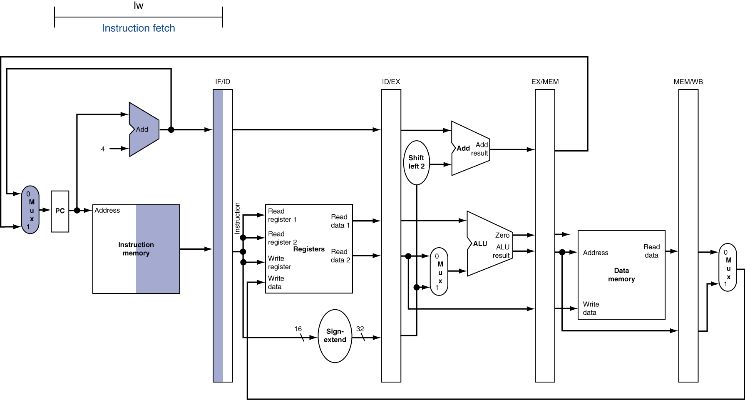
IF for Load, Store, …

Slide 7
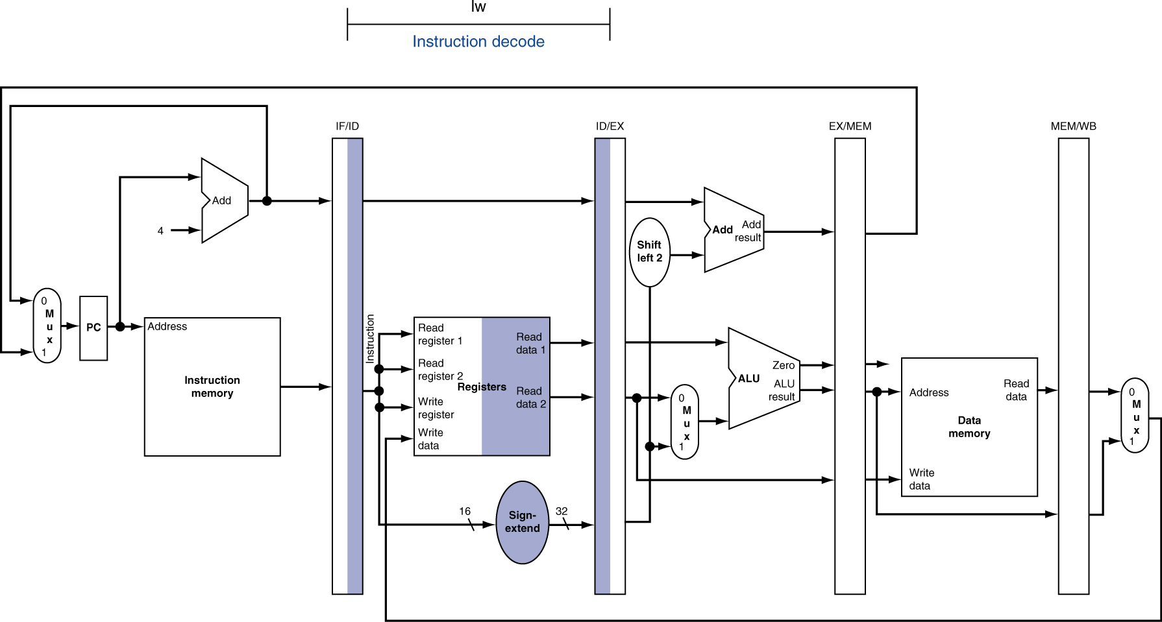
ID for Load, Store, …

Slide 8
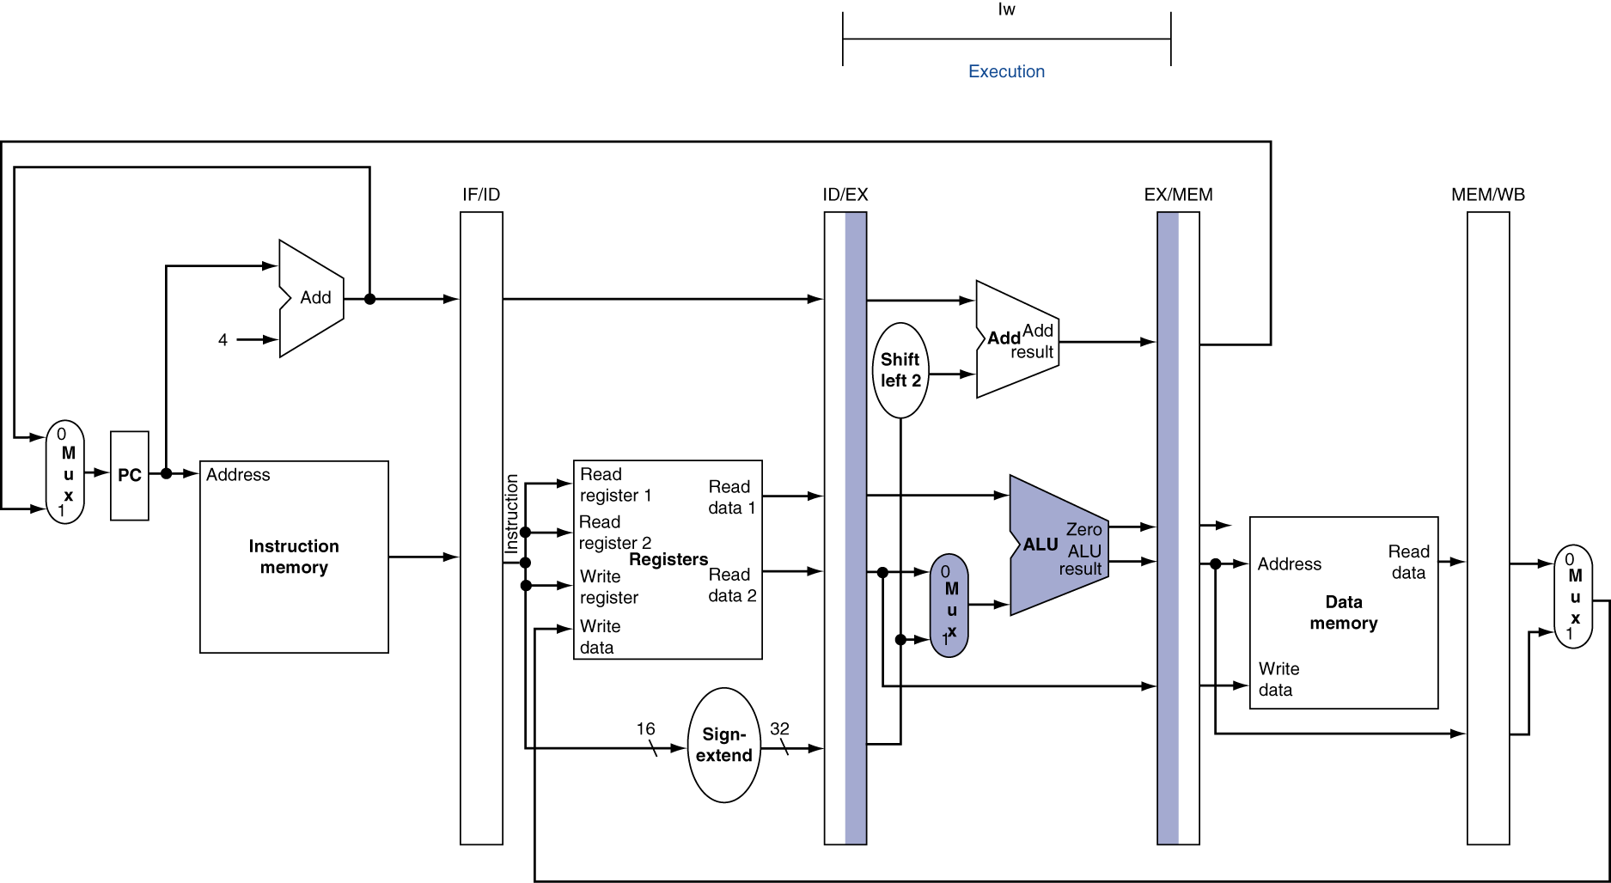
EX for Load

Slide 9
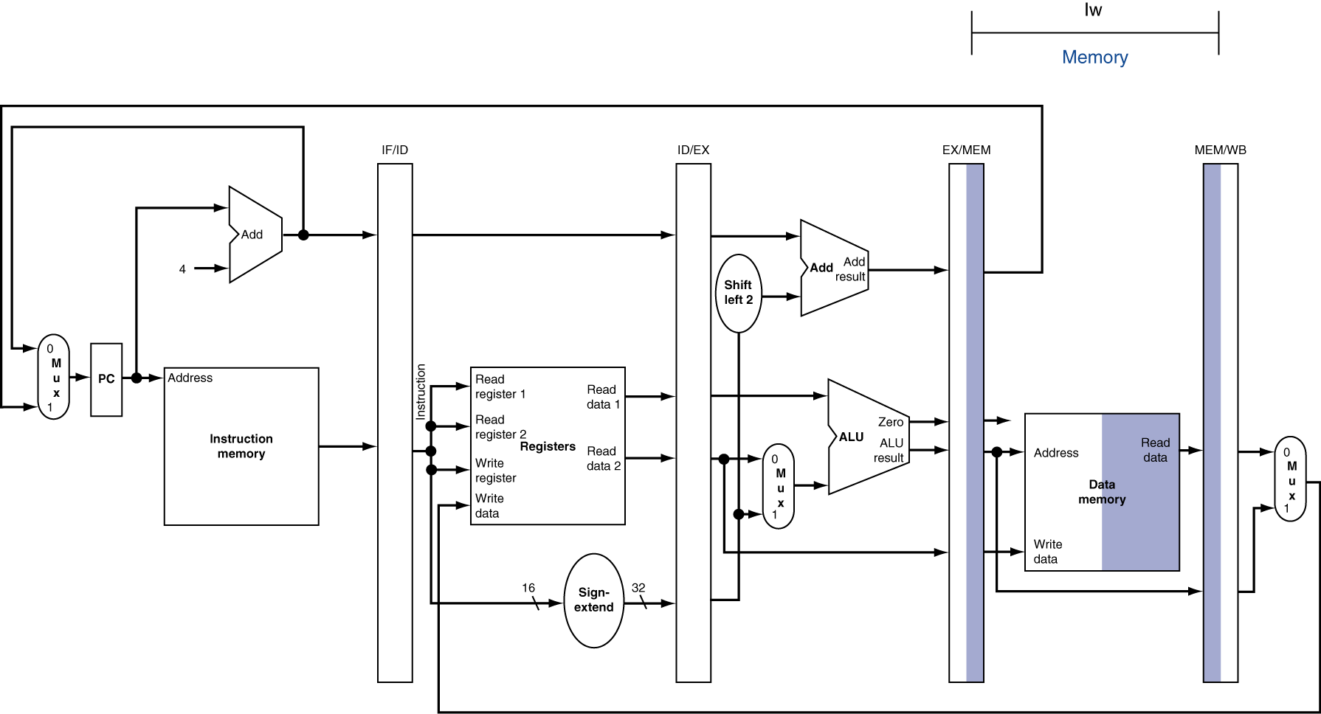
MEM for Load

Slide 10
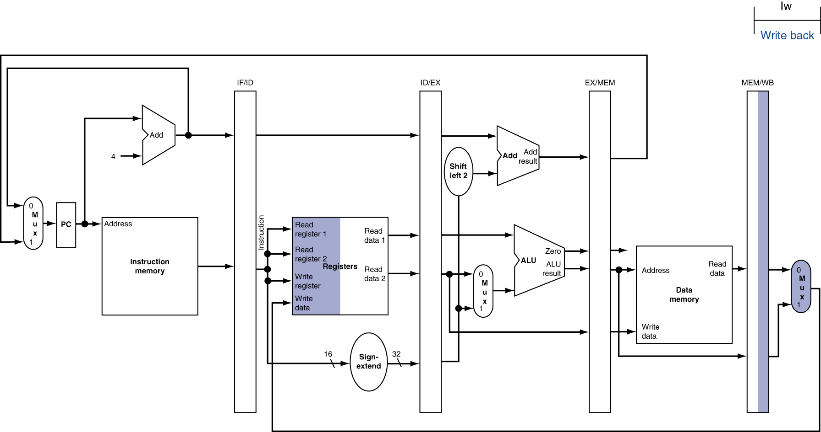
WB for Load
Wrong register number
Notes:
Anyone see a bug here?

Slide 11
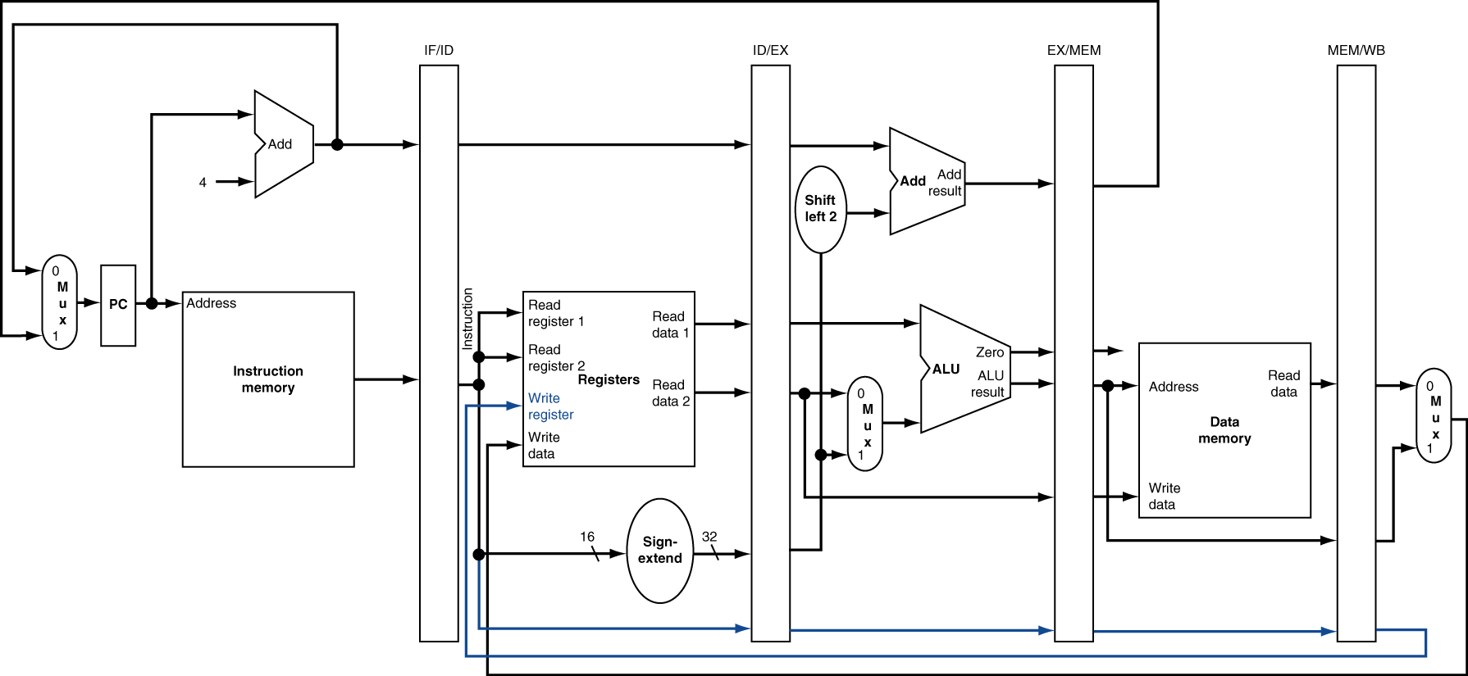
Corrected Datapath for Load

Slide 12

EX for Store

Slide 13
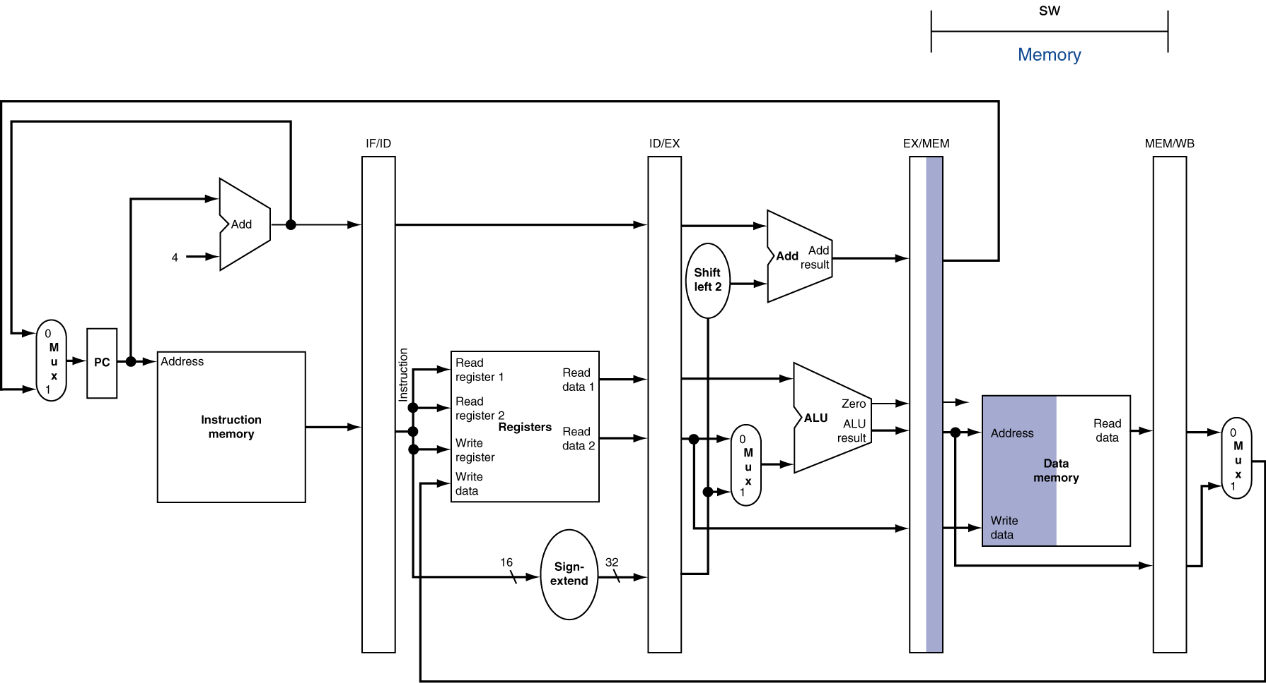
MEM for Store

Slide 14
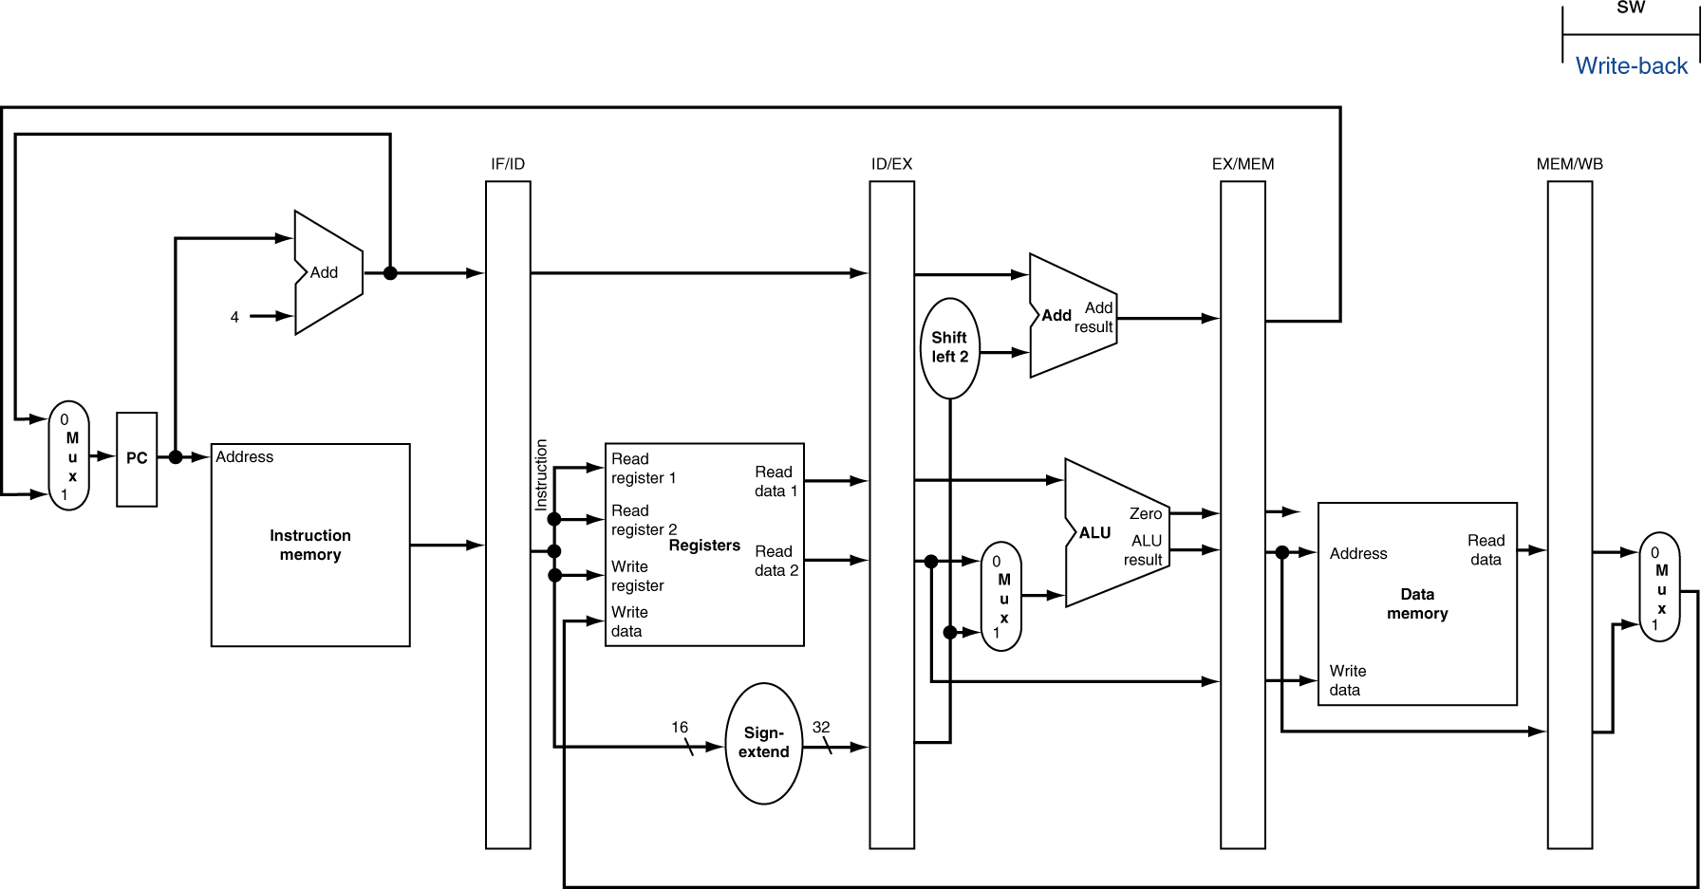
WB for Store

Slide 15
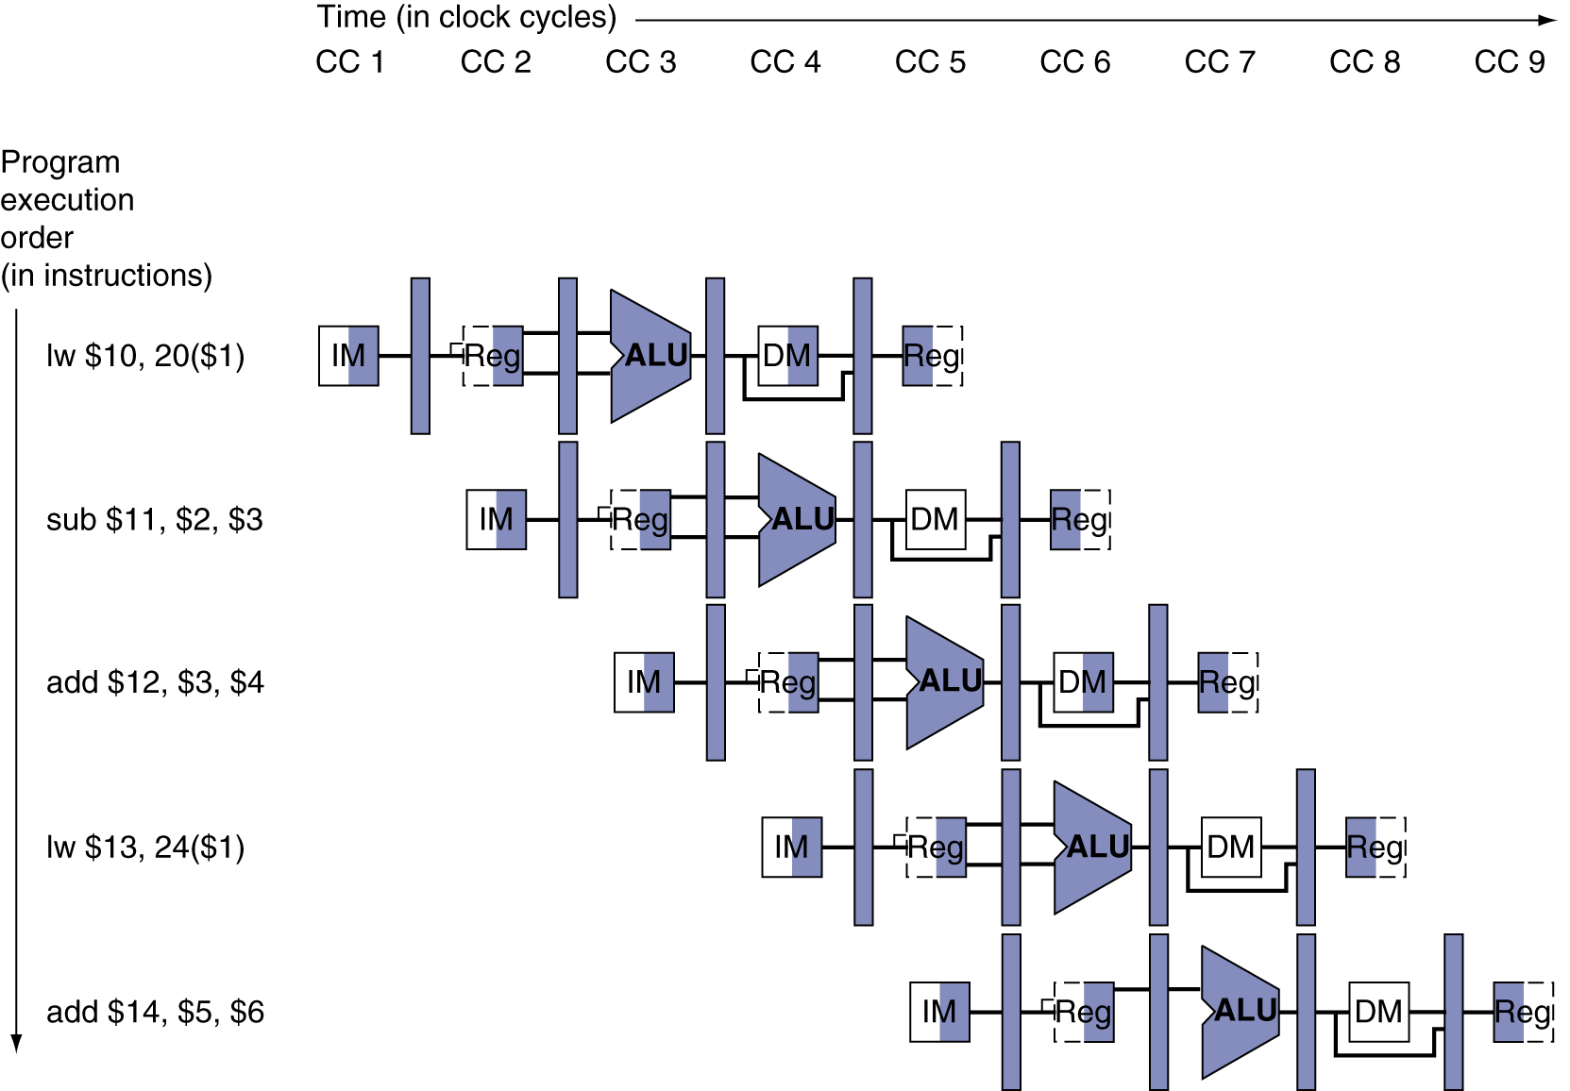
Multi-Cycle Pipeline Diagram
Form showing resource usage
Notes:
There are two bugs in the shading of this diagram…what are they?

Slide 16
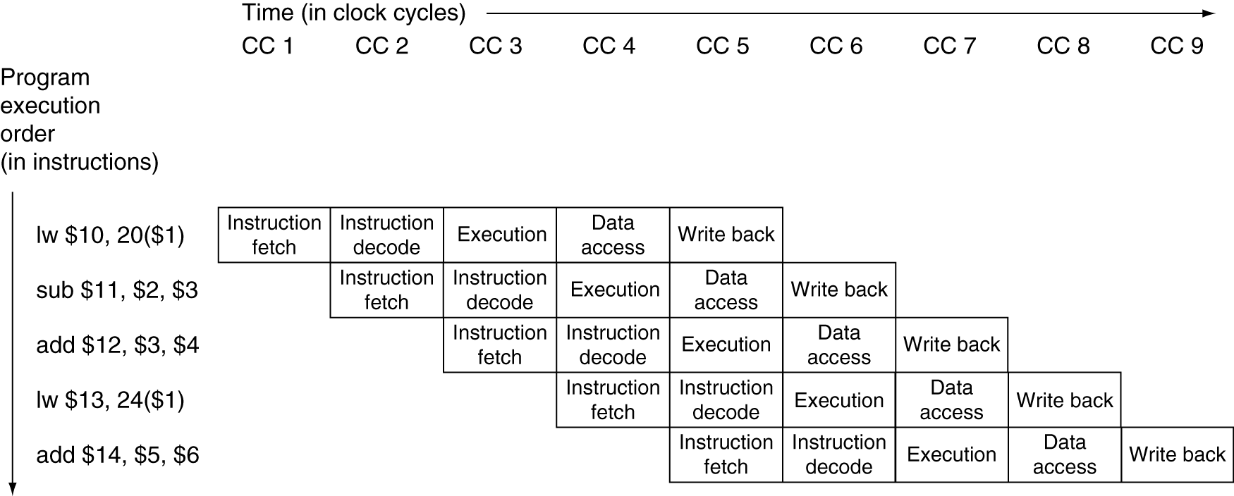
Multi-Cycle Pipeline Diagram
Traditional form
Notes:
Can take a vertical “cross cut” to get a more detailed look at any given clock cycle…
For example, take cycle 5 here

Slide 17
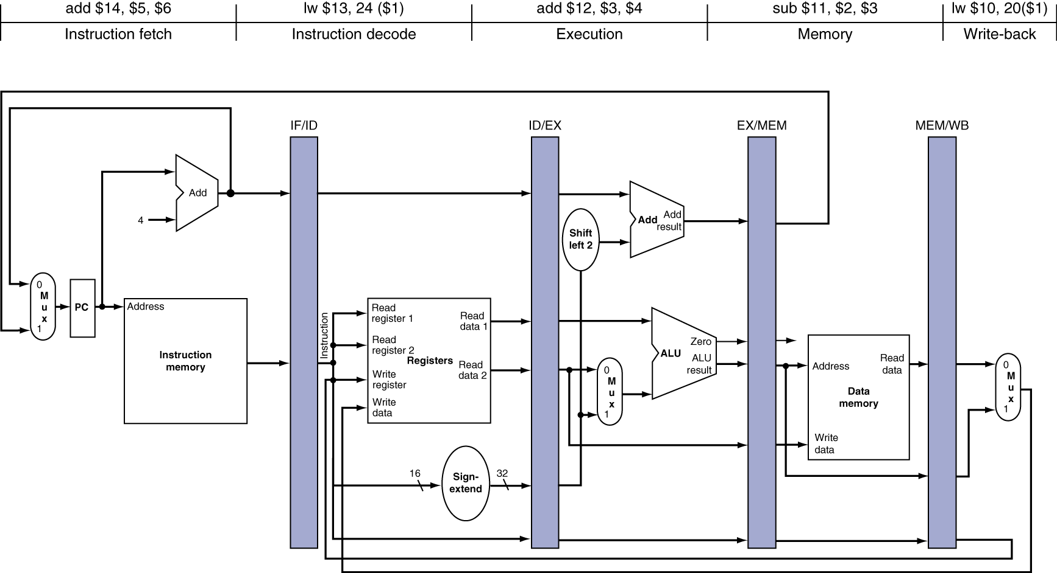
Single-Cycle Pipeline Diagram
State of pipeline in a given cycle
Notes:
Here’s where we get to really bring everything together in our heads at once…
Now let’s go back to talking about the control signals…

Slide 18
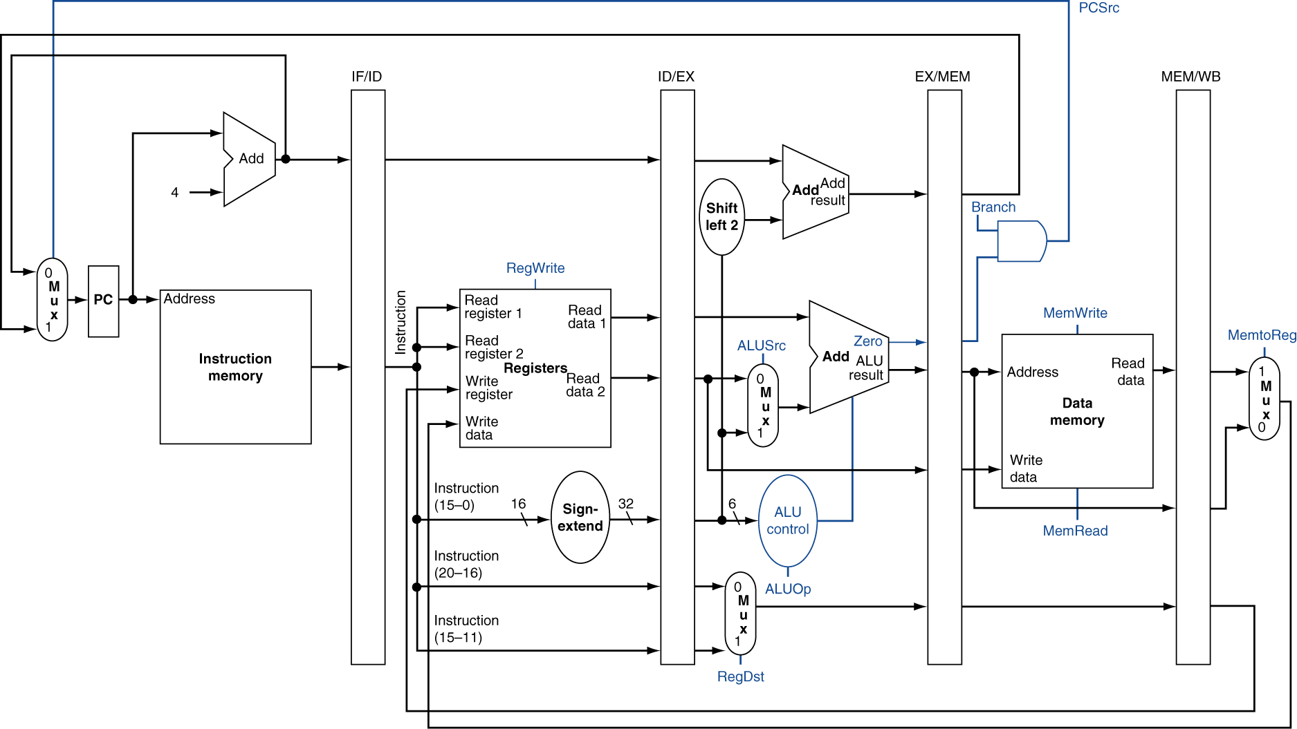
Pipelined Control (Simplified)
Notes:
Control has the same kind of synchronization issues as the data path, so we should also include them in the pipeline registers.

Slide 19
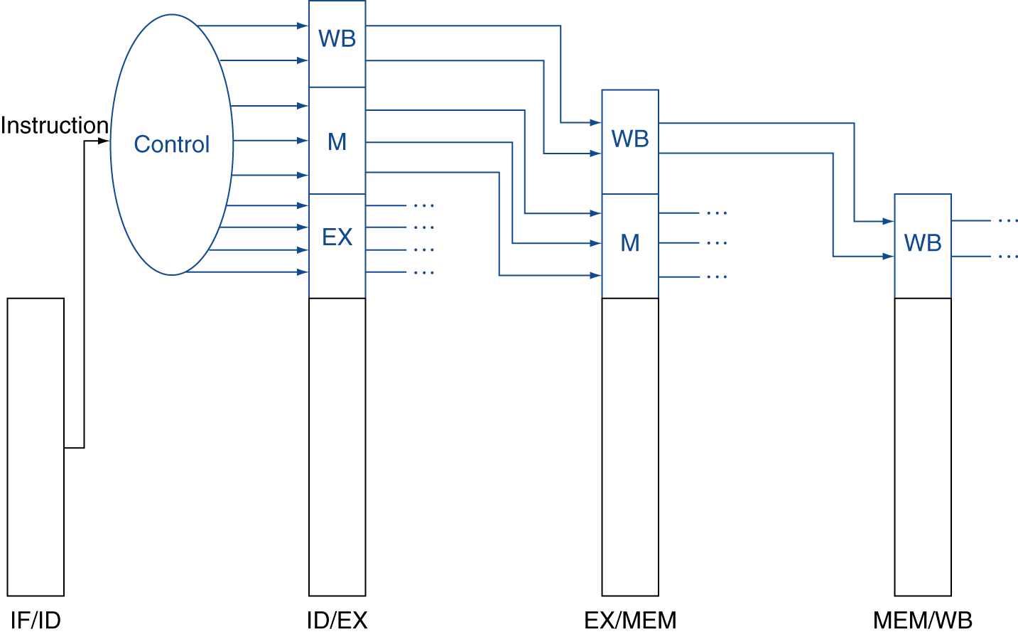
Pipelined Control
Control signals derived from instruction
As in single-cycle implementation
Notes:
Basically, save the multiplexor choices for a future stage (plus ALUop…)

Slide 20
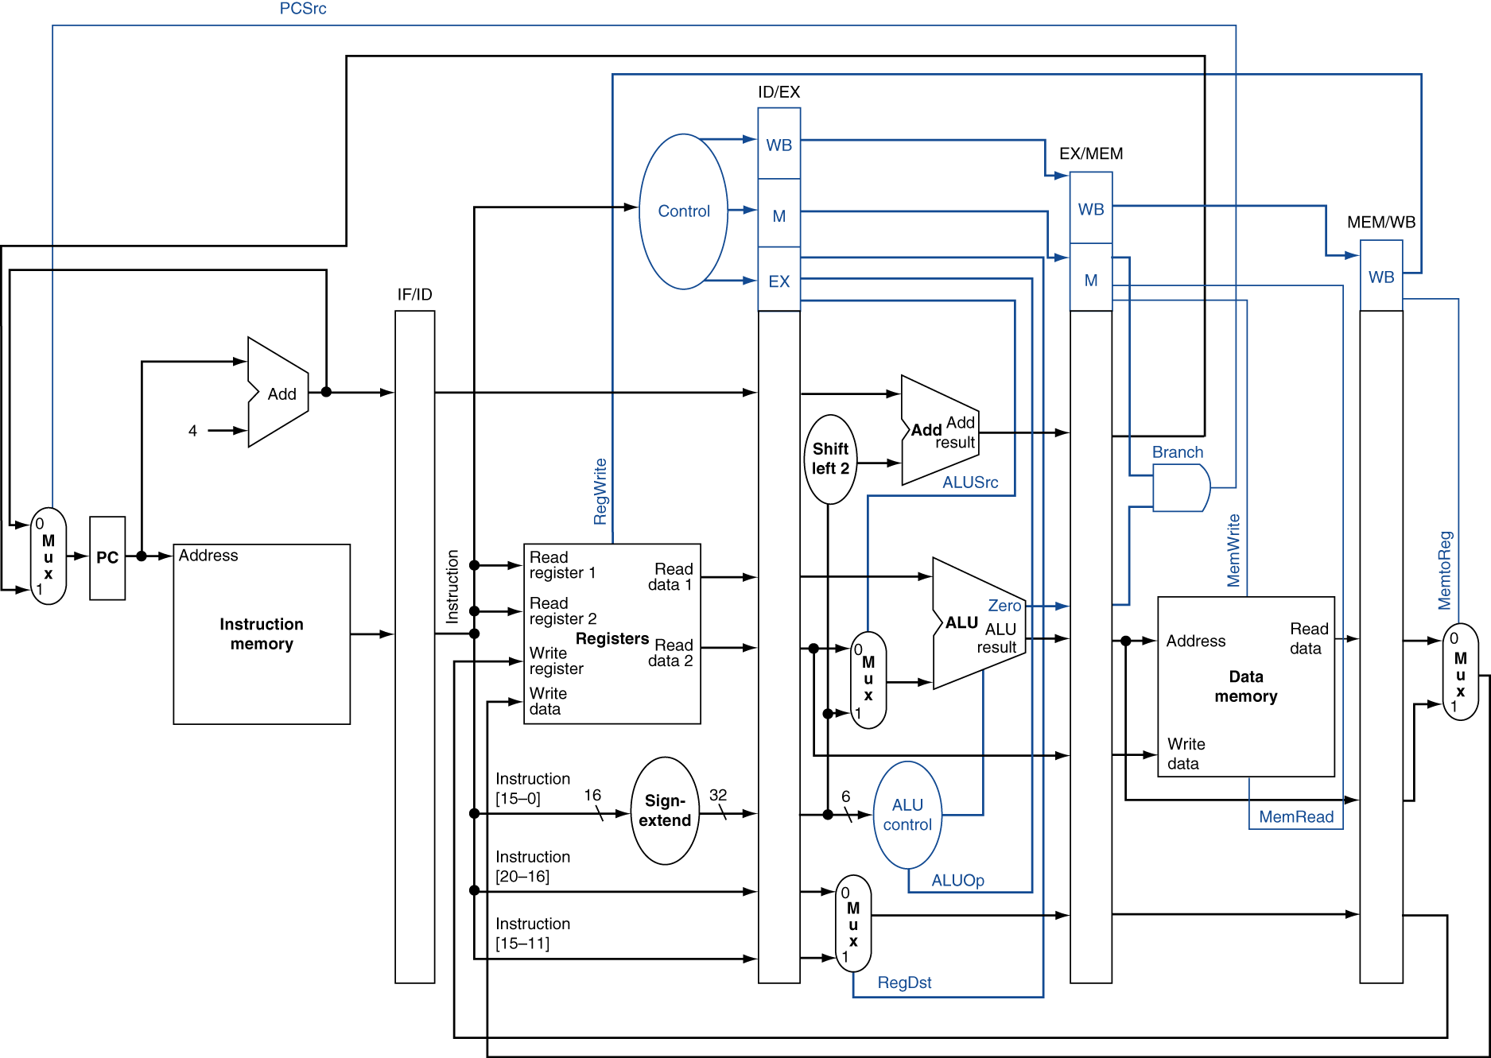
Pipelined Control

Slide 21
Pipelining Details
4.7 - Detecting and handling data hazards
4.8 – Control hazards
4.9 – Exceptions
Arithmetic overflow
I/O device request
Undefined operation
Hardware malfunction
Notes:
No time for the fun details :(

