Slide 1
Instruction-Level Parallelism Static Multiple-Issue (4.10)
Lecture 40

Slide 2
Homework Presentations

Slide 3
Pipeline Summary
The BIG Picture
Pipelining improves performance by increasing instruction throughput
Executes multiple instructions in parallel
Each instruction has the same latency
Subject to hazards
Structure, data, control
Instruction set design affects complexity of pipeline implementation
Notes:
Examples on p. 285

Slide 4
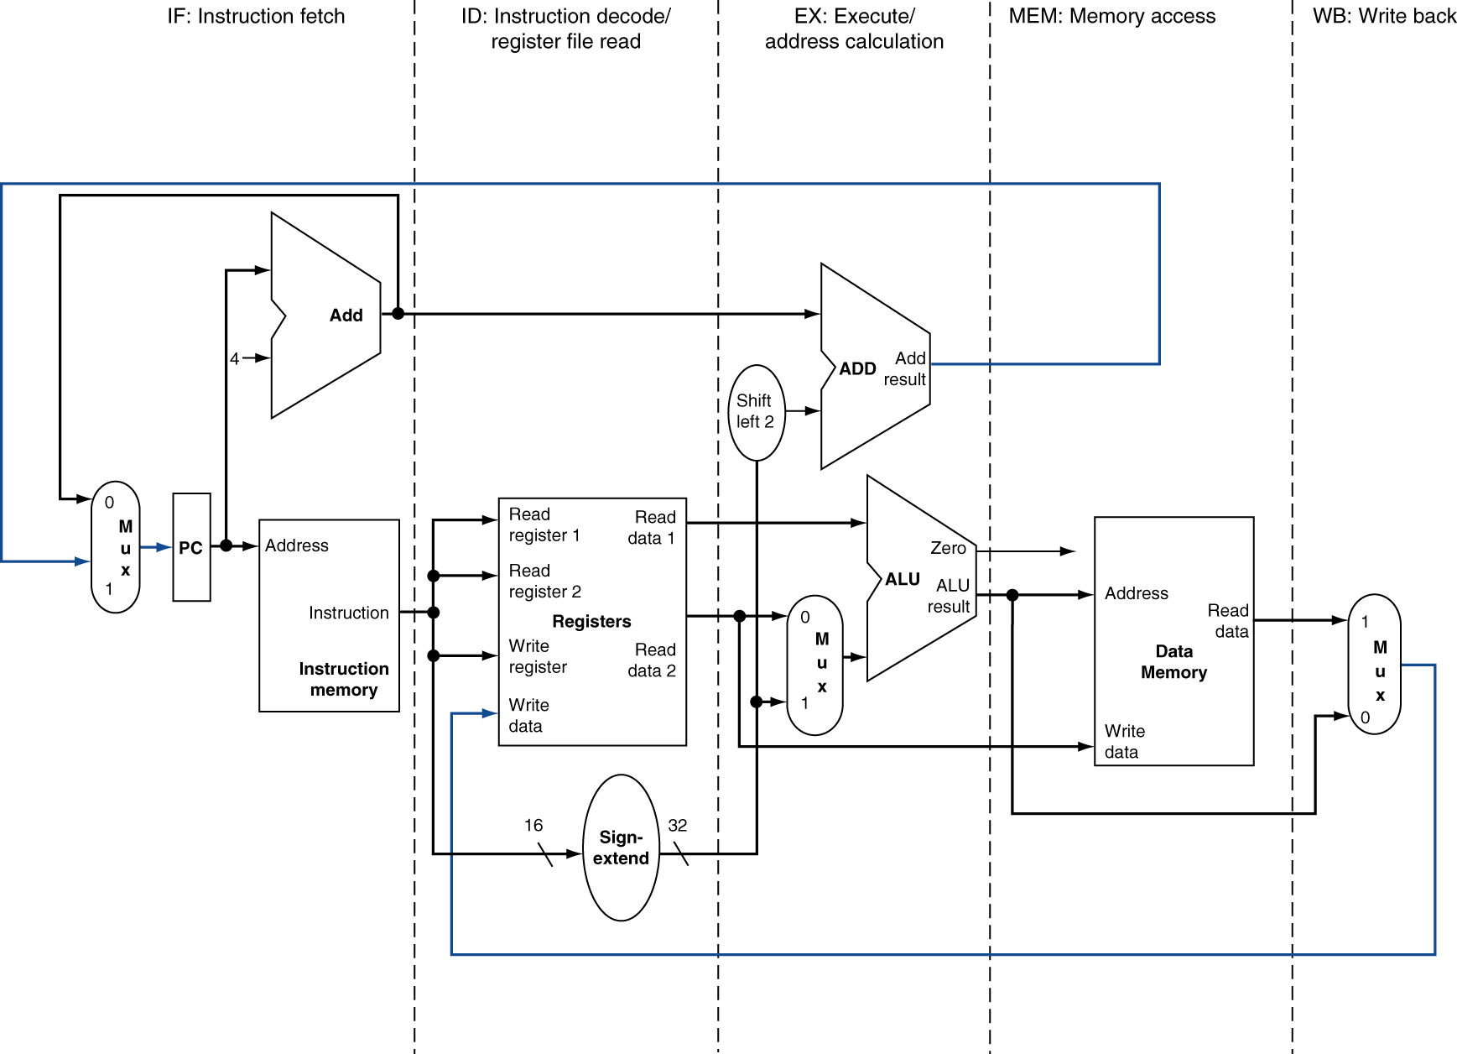
MIPS Pipelined Datapath
§4.6 Pipelined Datapath and Control
MEM
Right-to-left flow leads to hazards
WB
Notes:
Not only data hazards (WB) and control hazards (branch MEM), also just synchronization: time it takes to go down a wire vs. through the register file

Slide 5
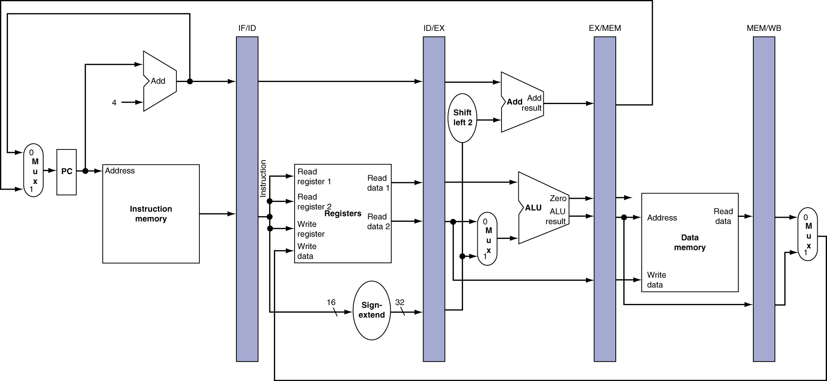
Pipeline registers
Need registers between stages
To hold information produced in previous cycle

Slide 6
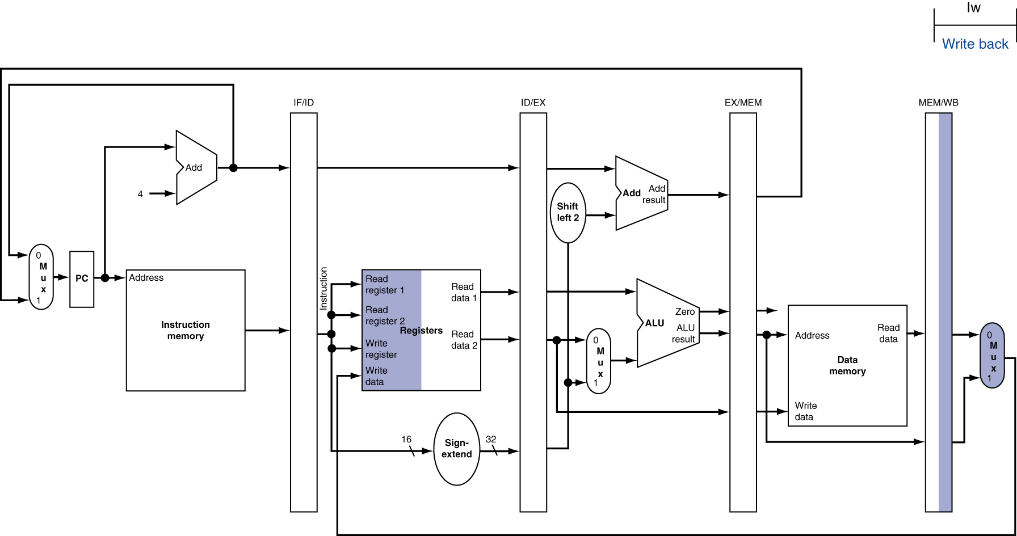
WB for Load
Wrong register number
Notes:
Anyone see a bug here?

Slide 7
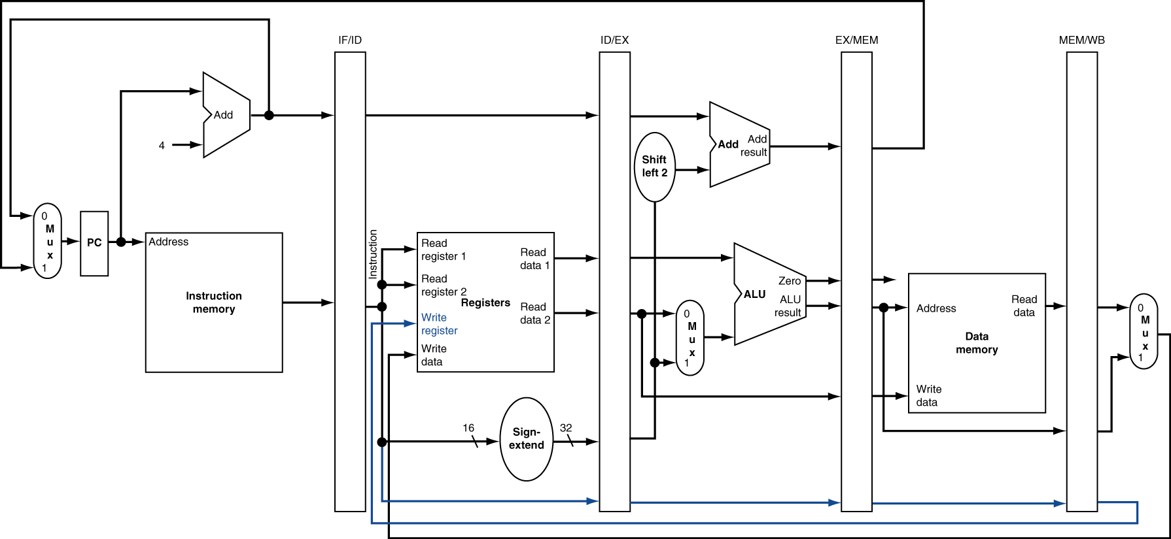
Corrected Datapath for Load

Slide 8
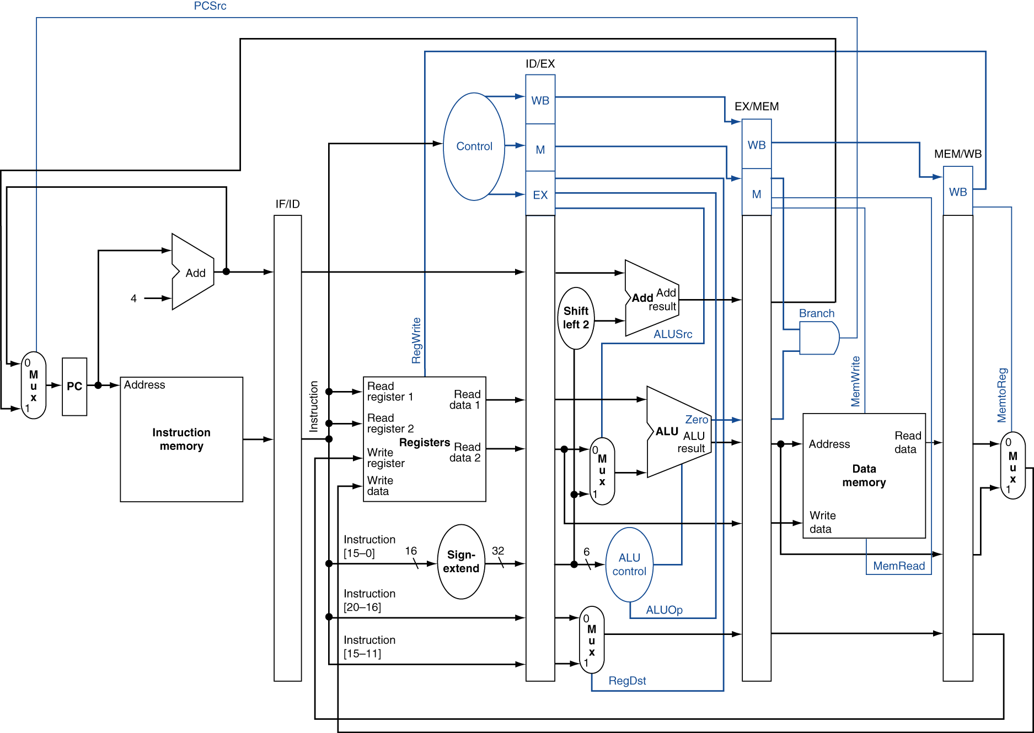
Pipelined Control

Slide 9
Pipelining Details
4.7 - Detecting and handling data hazards
4.8 – Control hazards
4.9 – Exceptions
Arithmetic overflow
I/O device request
Undefined operation
Hardware malfunction
Notes:
No time for the fun details :(

Slide 10
Instruction-Level Parallelism (ILP)
Pipelining: executing multiple instructions in parallel
To increase ILP
Deeper pipeline
Less work per stage ⇒ shorter clock cycle
Multiple issue
Replicate pipeline stages ⇒ multiple pipelines
Start multiple instructions per clock cycle
CPI < 1, so use Instructions Per Cycle (IPC)
E.g., 4GHz 4-way multiple-issue
16 BIPS, peak CPI = 0.25, peak IPC = 4
But dependencies reduce this in practice
§4.10 Parallelism via Instructions
Notes:
We’re going to go over the high level ideas first, so the details will be missing. Then we’ll at least dig a little deeper with some more details.
What does 4 GHz mean? How many IPS for 1Ghz 1-way multiple-issue?

Slide 11
Multiple Issue
Static multiple issue
Compiler groups instructions to be issued together
Packages them into “issue slots”
Compiler detects and avoids hazards
Dynamic multiple issue
CPU examines instruction stream and chooses instructions to issue each cycle
Compiler can help by reordering instructions
CPU resolves hazards using advanced techniques at runtime
Notes:
Sometimes the compiler can’t package them perfectly into slots b/c of dependencies…use what’s called a “nop”

