Slide 1
Logical Equations (B.2) & Combinational Logic (B.3)
Instructor: Robert Utterback
Lecture 5
Notes:
In this lecture you’re going to learn a lot of new things: the basic building blocks of a computer. We’ll slowly combine these to learn how many components of a computer are built up.

Slide 2
Review
57 in binary
What number is 1111 1011₂?

Slide 3






Boolean Logic Laws
Identity Law
Zero and One Law
Inverse Law
Commutative Law
Notes:
Notice that this is why we use + for OR and * for AND!

Slide 4



Boolean Logic Laws (cont.)
Associative Laws
Distributive Laws
De Morgan’s Laws
Notes:
Associative and distributive are as expected. DeMorgan’s laws are new to us.

Slide 5
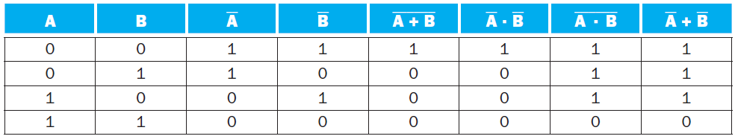
How to prove a logical law?
One approach: Truth table
Truth table for de Morgan Laws
Notes:
Exercise: draw the truth table for deMorgan’s laws. Now that we've talked about the boolean logic functions we're using, we need to implement them...

Slide 6



Gates
Gates
basic digital building blocks which correspond to and perform the basic logical functions
AND
OR
NOT
Complex digital functions that make up a computer are built from these basic digital building blocks
Notes:
Let's (together) design the block for implementing ~(~A + B)

Slide 7


Simplification of NOT Gate

Slide 8
Exercise
Design a Combinational Logic to implement the following logical expression
Y = (A + B) + C
Notes:
Occasionally you’ll just see a bunch of wires coming into a gate, since the operations are associative and commutative.

Slide 9
Exercise
Design a Combinational Logic to implement the following logical expression
Y = (A + B) · (C + A)

Slide 10
NAND
NAND
Its output = 1, only if both inputs are not 1
Boolean Expression: A • B
Truth Table
The NAND functions has traditionally been the universal gate in digital circuits. It is simple to implement in hardware and can be used to construct the other gates.
A | B | C
0 | 0 | 1
0 | 1 | 1
1 | 0 | 1
1 | 1 | 0

Slide 11
NOR
NOR
Its output = 1, only if no inputs are not 1
Boolean Expression: A + B
Truth Table
A | B | C
0 | 0 | 1
0 | 1 | 0
1 | 0 | 0
1 | 1 | 0

Slide 12
XOR
XOR is EXCLUSIVE-OR
Its output = 1 if the inputs are different and equal 0 if all are the same. Boolean Expression: A ⊕ B
Truth Table
Equivalent to (A•B) + (A•B) = C
A
B
C
A | B | C
0 | 0 | 0
0 | 1 | 1
1 | 0 | 1
1 | 1 | 0

Slide 13
Summary
0s and 1s in Computer
Binary
Boolean Logic
NOT, AND, OR
Boolean Logic Laws
Truth Table
Gates
Basic Gates
NOT, AND, OR
Other Gates
NAND, NOR, XOR

Slide 14
Exercise
Show how to build AND, OR, and NOT functions from (two-input) NAND gates.
Notes:
Start of B.3
Let Nand = @
~A = A @ A
AND = ~(A @ B) = (A @ B) @ (A @ B)
OR = ~A @ ~B = (A @ A) @ (B @ B)

Slide 15
Decoder
Decoder
A logic block that has n-bit input and 2^{n} outputs, where only one output is asserted for each input combination
If the input is i (in binary),
then output i is 1
others are 0
Notes:
N bit input -> 2^N permutations. You’ll see this relationship everywhere, so I want to make it a little clearer for you. 2 choices for the first bit, 2 for the second, etc.

Slide 16
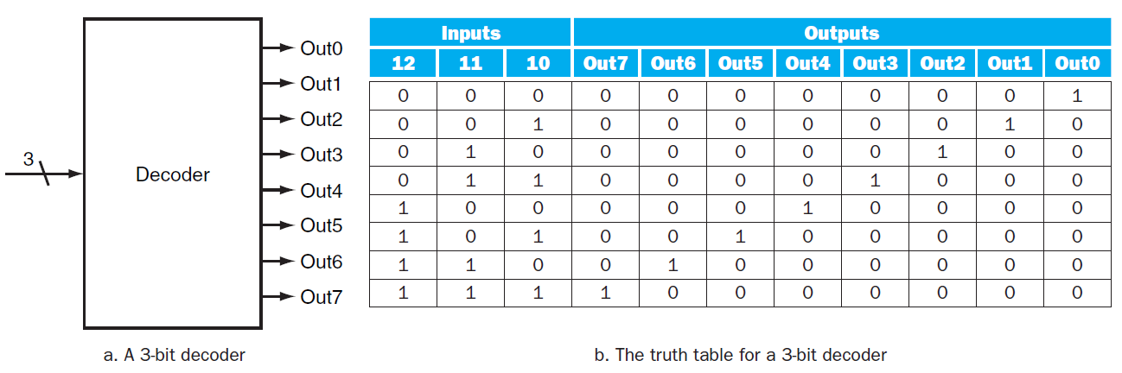
Decoder Example
3-8 Decoder
Notes:
There’s also such thing as an “encoder” to go in the other direction: n separate choices to a log_n bit number.
We’ll see in just a second an example of why you might need a decoder.

Slide 17
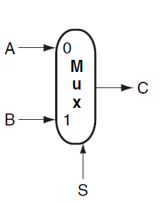
Multiplexor
Multiplexor
A selector
The output is selected by an input control

Slide 18
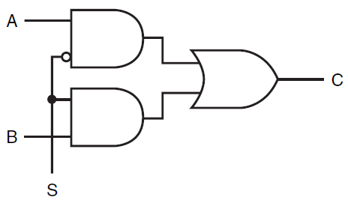

Implementation of a Multiplexor

Slide 19

n-input Multiplexor
A Multiplexor can have n-inputs
Require selective inputs
Implementation of an n-input Multiplexor
Decoder generates n signals. Each indicates different input value.
Array of n AND gates. Each combines one input with decoder signal
3. Single large OR gate taking all outputs of AND gates.
Notes:
To have n inputs, log n is enough, since we only need to select one at a time. x bits gives us 2^x permutations, hence log n gives us a way to select one input from n.

Slide 20
Two-level Logic
Remember: Any Boolean Logic function can be implemented with only NOT, AND, OR functions
We can also find that all logic functions can be written in a canonical form
Sum of Products
Logical Sum (OR) of terms joined by Product (AND)
Product of Sums
Logical Product (AND) of terms joined by Sum (OR)
Notes:
In fact, we can say something even stronger. The textbook uses Sum of Products.
Why? B/c It’s really easy to figure out from a truth table. For every 1 you see, just add another product!

Slide 21
Example
Consider the following:
$D=(\left(A∙B\right)+(A∙$C)+(B $∙$C)) $∙$($\overline{A∙B∙C})$
Convert to sum of products form
$D=(A∙$B $∙\overline{C})+(A∙C∙\overline{B})+(B∙C∙\overline{A})$
Notes:
Hint: draw a truth table. When the final result is one, just add another product group to the sum.

