Slide 1
Procedures (Functions)
Instructor: Robert Utterback
Lecture 16

Slide 2
Conditional Operations
Branch to a labeled instruction if a condition is true
Otherwise, continue sequentially
beq rs, rt, L1
if (rs == rt) branch to instruction labeled L1;
bne rs, rt, L1
if (rs != rt) branch to instruction labeled L1;
j L1
unconditional jump to instruction labeled L1
§2.7 Instructions for Making Decisions

Slide 3
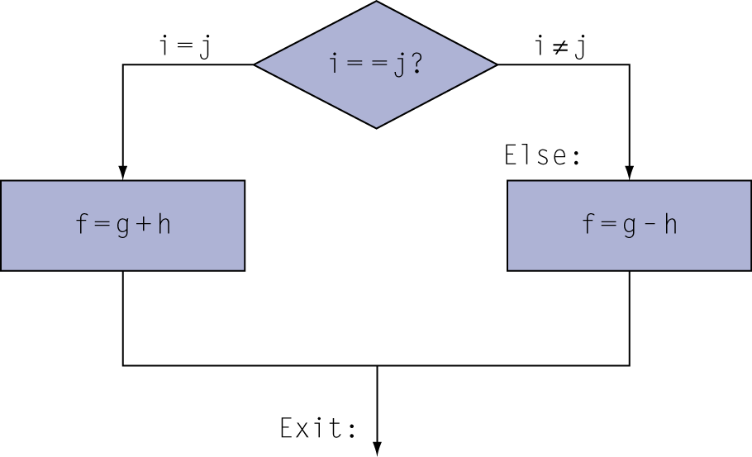
Compiling If Statements
C code:
if (i==j) f = g+h; else f = g-h;
f, g, … in $s0, $s1, …
Compiled MIPS code:
bne $s3, $s4, Else add $s0, $s1, $s2 j Exit Else: sub $s0, $s1, $s2 Exit: …
Assembler calculates addresses

Slide 4
Compiling Loop Statements
C code:
while (save[i] == k) i += 1;
i in $s3, k in $s5, address of save in $s6
Compiled MIPS code:
Loop: sll $t1, $s3, 2 add $t1, $t1, $s6 lw $t0, 0($t1) bne $t0, $s5, Exit addi $s3, $s3, 1 j Loop Exit: …

Slide 5
More Conditional Operations
Set result to 1 if a condition is true
Otherwise, set to 0
slt rd, rs, rt
if (rs < rt) rd = 1; else rd = 0;
slti rt, rs, constant
if (rs < constant) rt = 1; else rt = 0;
Use in combination with beq, bne
slt $t0, $s1, $s2 # if ($s1 < $s2) bne $t0, $zero, L # branch to L

Slide 6
Compiling a for loop
C code:
for (i = 0; i < n; i++)
v[i] = 0;
What does the MIPS assembly look like?
i in $s0, n in $s1, v in $s2
Notes:
add $s0, $zero, $zero
Loop: slt $t0, $s0, $s1
beq $t0, $zero, Exit
sll $t1, $s0, 2 # let’s us index v
add $t1, $t1, $s2
sw $zero, 0($t1)
j Loop
Exit:

Slide 7
Procedures (C Functions)
Section 2.8
Notes:
It seems like a very simple, natural thing to call functions. Actually, there is a lot going on…

Slide 8
Procedure
Procedure (function)
A stored subroutine that performs a specific task based on the parameters with which it is provided
Important when writing a large program
Allow a programmer to focus on a specific task

Slide 9
Example
int main()
{
int a = 10;
int b = 20;
int result = add (a, b);
cout << a << “,” << b << endl;
}
int result(int a, int b)
{
return a + b;
}

Slide 10
Procedure Calling
Don’t overwrite registers other procedures are using
Don’t overwrite memory used in other procedures
Need to pass in parameters
Need to get result from function
§2.8 Supporting Procedures in Computer Hardware
Notes:
The previous procedure (e.g. main) was using some registers…what if the procedure it calls also wants to use those registers.
It is way to complex to always be aware of which procedures are active and which registers they are using…

Slide 11
Procedure Calling
Steps required
Place parameters in registers
Transfer control to procedure
Acquire storage for procedure
Each procedure instance has own storage area
Perform procedure’s operations
Place result in register for caller
Return to place of call
§2.8 Supporting Procedures in Computer Hardware
Notes:
All the procedures use an area of memory called the stack, and each procedure instance has its own stack FRAME.
So far I have just assumed everything is in registers…

Slide 12
Caller and Callee
Caller
The program that instigates a procedure and provides the necessary parameter values
Callee
A procedure that executes a series of stored instructions based on parameters provided by the caller and then returns control to the caller

Slide 13
Register Usage
$a0 – $a3: arguments (reg’s 4 – 7)
$v0, $v1: result values (reg’s 2 and 3)
$t0 – $t9: temporaries
Can be overwritten by callee
$s0 – $s7: saved
Must be saved/restored by callee
$gp: global pointer for static data (reg 28)
$sp: stack pointer (reg 29)
$fp: frame pointer (reg 30)
$ra: return address (reg 31)
Notes:
Need to save the s registers, use them, then restore them when we’re done…where do we save them?
Any compiled language will have an ABI, which defines, among other things, the registers used for parameters.

Slide 14
Stack
Stack
A last-in-first-out data structure
Stack pointer
$sp
Point to the address of the most recent element in the stack
Push
Add element onto the stack
Pop
Remove element from the stack

Slide 15
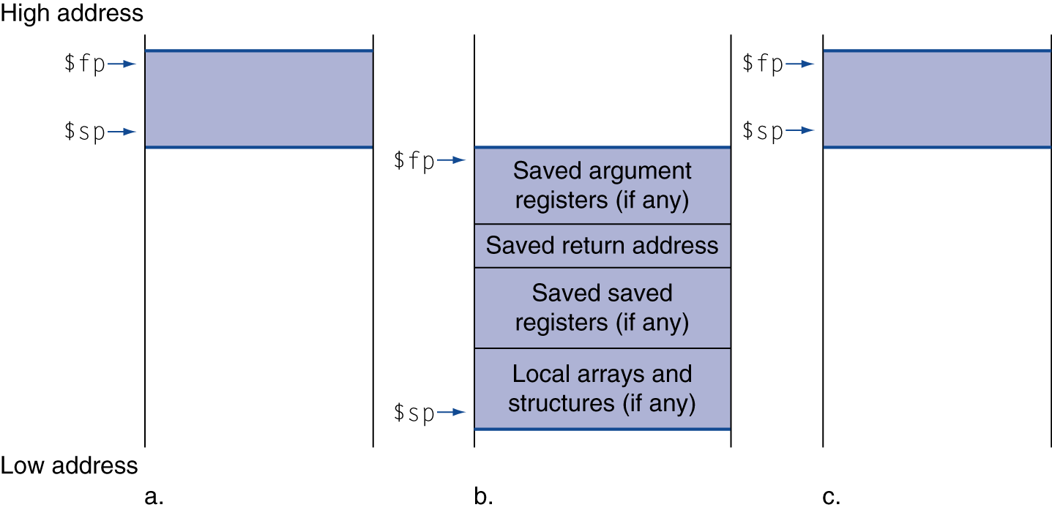
Local Data on the Stack
Local data allocated by callee
e.g., C automatic variables
Procedure frame (activation record)
Used by some compilers to manage stack storage

Slide 16
Program Counter (PC)
Program Counter
A register in CPU
Containing the address of the instruction in the program being executed
Not directly accessible

Slide 17
Procedure Call Instructions
Procedure call: jump and link
jal ProcedureLabel
Address of following instruction put in $ra
Jumps to target address
Procedure return: jump register
jr $ra
Copies $ra to program counter
Can also be used for computed jumps
e.g., for case/switch statements

