Slide 1
Procedures (Functions)
Instructor: Robert Utterback
Lecture 17

Slide 2
Compiling Loop Statements
C code:
while (save[i] == k) i += 1;
i in $s3, k in $s5, address of save in $s6
Compiled MIPS code:
Loop: sll $t1, $s3, 2 add $t1, $t1, $s6 lw $t0, 0($t1) bne $t0, $s5, Exit addi $s3, $s3, 1 j Loop Exit: …

Slide 3
Procedure Calling
Don’t overwrite registers other procedures are using
Don’t overwrite memory used in other procedures
Need to pass in parameters
Need to get result from function
§2.8 Supporting Procedures in Computer Hardware
Notes:
The previous procedure (e.g. main) was using some registers…what if the procedure it calls also wants to use those registers.
It is way to complex to always be aware of which procedures are active and which registers they are using…

Slide 4
Procedure Calling
Steps required
Place parameters in registers
Transfer control to procedure
Acquire storage for procedure
Each procedure instance has own storage area
Perform procedure’s operations
Place result in register for caller
Return to place of call
§2.8 Supporting Procedures in Computer Hardware
Notes:
All the procedures use an area of memory called the stack, and each procedure instance has its own stack FRAME.
So far I have just assumed everything is in registers…

Slide 5
Caller and Callee
Caller
The program that instigates a procedure and provides the necessary parameter values
Callee
A procedure that executes a series of stored instructions based on parameters provided by the caller and then returns control to the caller

Slide 6
Register Usage
$a0 – $a3: arguments (reg’s 4 – 7)
$v0, $v1: result values (reg’s 2 and 3)
$t0 – $t9: temporaries
Can be overwritten by callee
$s0 – $s7: saved
Must be saved/restored by callee
$gp: global pointer for static data (reg 28)
$sp: stack pointer (reg 29)
$fp: frame pointer (reg 30)
$ra: return address (reg 31)
Notes:
Need to save the s registers, use them, then restore them when we’re done…where do we save them?
Any compiled language will have an ABI, which defines, among other things, the registers used for parameters. Notice this is a feature of a language and/or compiler, NOT the assembly language.

Slide 7
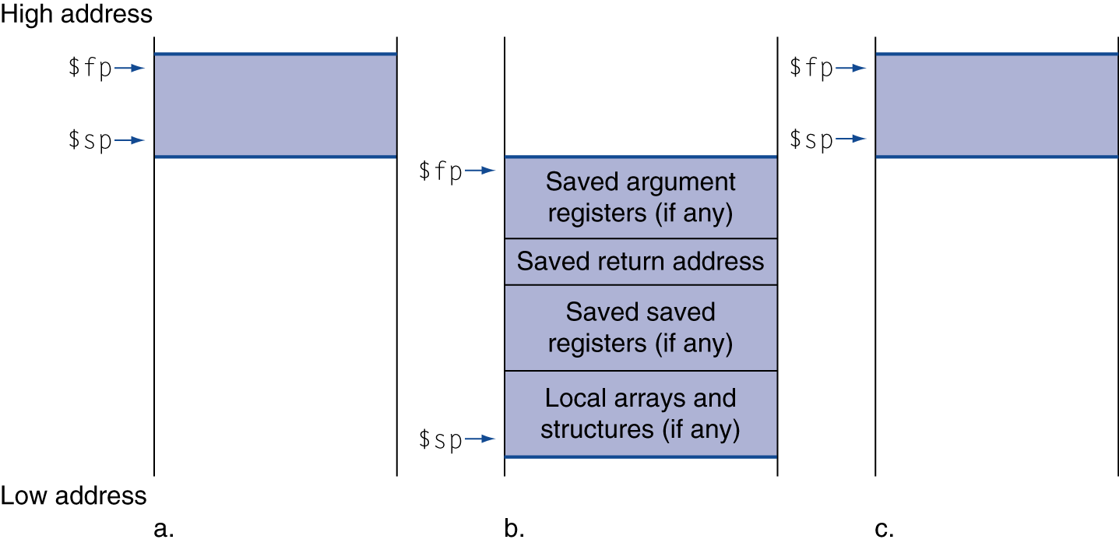
Local Data on the Stack
Local data allocated by callee
e.g., C automatic variables
Procedure frame (activation record)
Used by some compilers to manage stack storage

Slide 8
Procedure Call Instructions
Procedure call: jump and link
jal ProcedureLabel
Address of following instruction put in $ra
Jumps to target address
Procedure return: jump register
jr $ra
Copies $ra to program counter
Can also be used for computed jumps
e.g., for case/switch statements

Slide 9
Leaf Procedure and non-Leaf Procedure
Leaf Procedure
Procedures that do not call other procedures
Non-leaf Procedure
Procedures that call other procedures
Notes:
We’re going to go through a few examples here, and it helps to distinguish between two different kinds of procedures.

Slide 10
Leaf Procedure Example
C code:
int leaf_example (int g, h, i, j) { int f; f = (g + h) - (i + j); return f; }
Arguments g, …, j in $a0, …, $a3
f in $s0 (hence, need to save $s0 on stack)
Result in $v0
Notes:
We’re going to show the MIPS code for this. (1) Save S registers (2) function body (3) Set result (4) Restore S registers (5) return
leaf_example: addi $sp, $sp, -4 sw $s0, 0($sp) add $t0, $a0, $a1 add $t1, $a2, $a3 sub $s0, $t0, $t1 add $v0, $s0, $zero lw $s0, 0($sp) addi $sp, $sp, 4 jr $ra

Slide 11
Leaf Procedure Example
MIPS code:
leaf_example: addi $sp, $sp, -4 sw $s0, 0($sp) add $t0, $a0, $a1 add $t1, $a2, $a3 sub $s0, $t0, $t1 add $v0, $s0, $zero lw $s0, 0($sp) addi $sp, $sp, 4 jr $ra
Save $s0 on stack
Procedure body
Result
Restore $s0
Return
Notes:
Note: you don’t actually need to use s0 here…could just use another t register…or $v0 !
Okay, now, what is the MIPS code for some function that wants to CALL this leaf_example?

Slide 12
Non-Leaf Procedures
Procedures that call other procedures
For nested call, caller needs to save on the stack:
Its return address
Any arguments and temporaries needed after the call
Restore from the stack after the call

Slide 13
Non-Leaf Procedure Example
C code:
int fact (int n) { if (n < 1) return 1; else return n * fact(n - 1); }
Argument n in $a0
Result in $v0
Notes:
fact: addi $sp, $sp, -8 # adjust stack for 2 items sw $ra, 4($sp) # save return address sw $a0, 0($sp) # save argument slti $t0, $a0, 1 # test for n < 1 beq $t0, $zero, L1 addi $v0, $zero, 1 # if so, result is 1 addi $sp, $sp, 8 # pop 2 items from stack jr $ra # and return L1: addi $a0, $a0, -1 # else decrement n jal fact # recursive call lw $a0, 0($sp) # restore original n lw $ra, 4($sp) # and return address addi $sp, $sp, 8 # pop 2 items from stack mul $v0, $a0, $v0 # multiply to get result jr $ra # and return

Slide 14
Non-Leaf Procedure Example
MIPS code:
fact: addi $sp, $sp, -8 # adjust stack for 2 items sw $ra, 4($sp) # save return address sw $a0, 0($sp) # save argument slti $t0, $a0, 1 # test for n < 1 beq $t0, $zero, L1 addi $v0, $zero, 1 # if so, result is 1 addi $sp, $sp, 8 # pop 2 items from stack jr $ra # and return L1: addi $a0, $a0, -1 # else decrement n jal fact # recursive call lw $a0, 0($sp) # restore original n lw $ra, 4($sp) # and return address addi $sp, $sp, 8 # pop 2 items from stack mul $v0, $a0, $v0 # multiply to get result jr $ra # and return
Notes:
Notice there is some waste here…

