Slide 1
Pipelining Overview
4.5
Notes:
Walk me through the process of doing laundry.

Slide 2
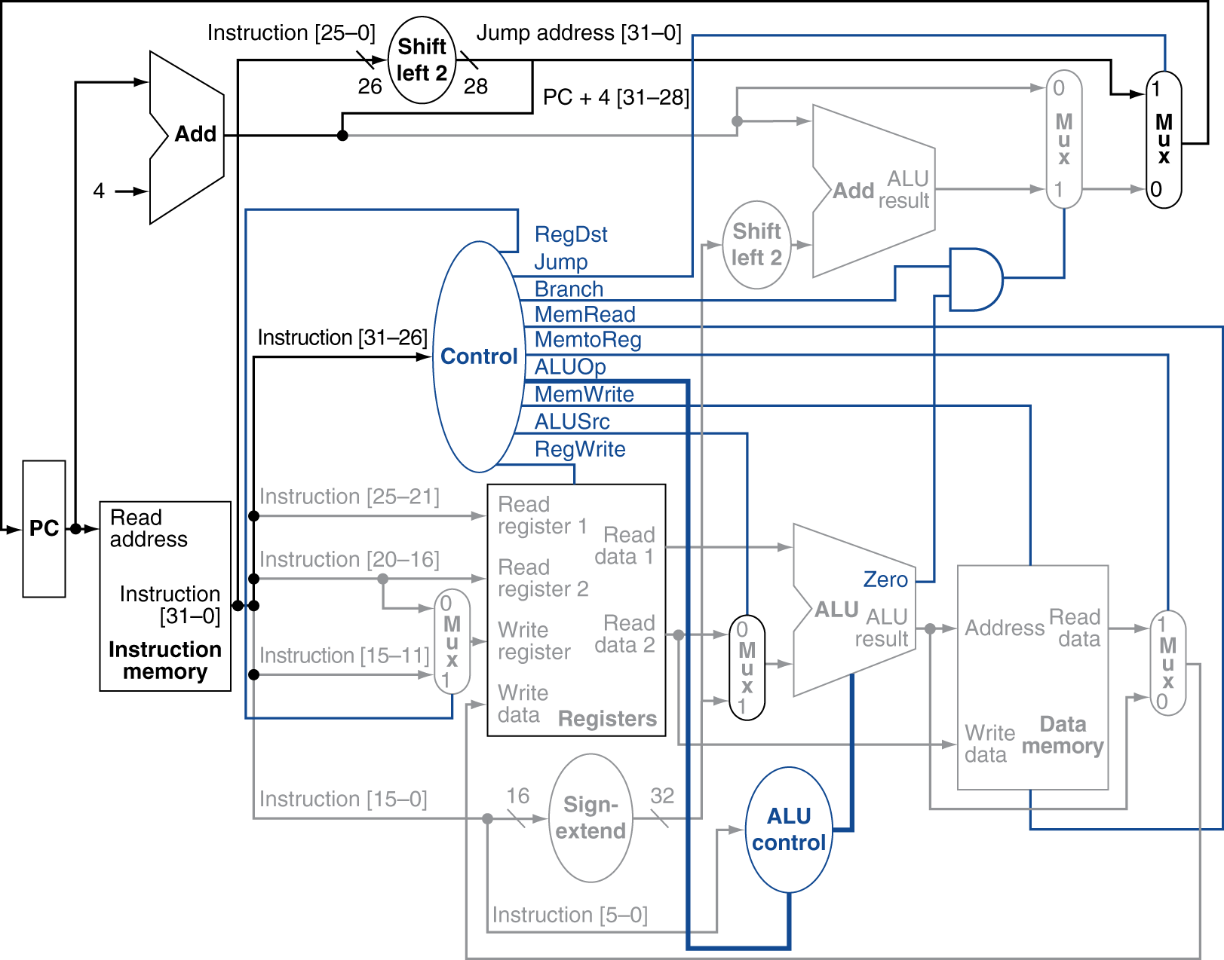
Datapath With Jumps Added
Notes:
Notice how EVERYTHING is happening in parallel, at the same time. For example, the 0-25 instruction bits get shifted and concatenated as if they were a jump address even when they were not. It’s the multiplexors that choose whether or not that value is actually used.

Slide 3
Performance Issues
Longest delay determines clock period
Critical path: load instruction
Instruction memory → register file → ALU → data memory → register file
Not feasible to vary period for different instructions
Violates design principle
Making the common case fast
We will improve performance by pipelining

Slide 4
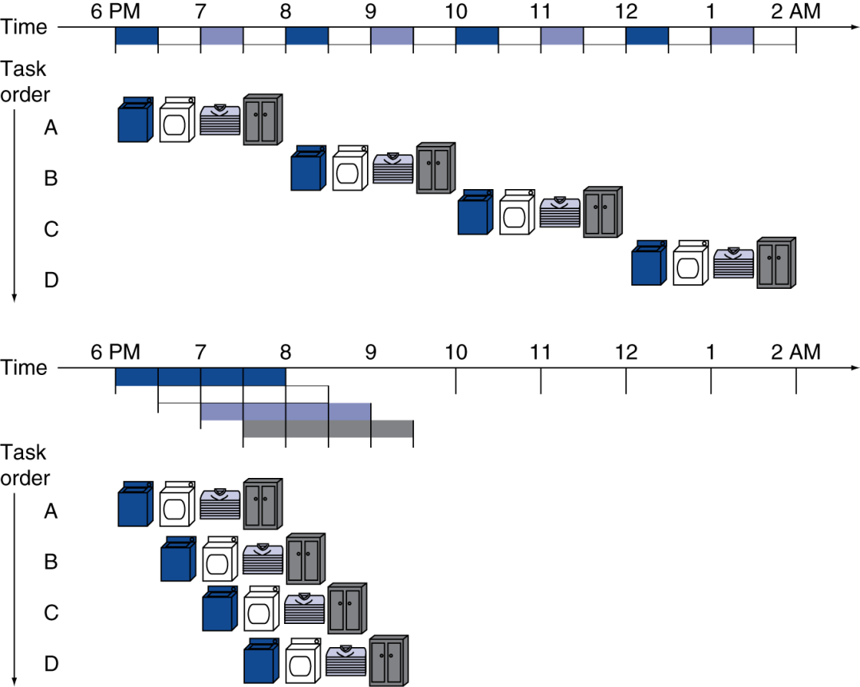
Pipelining Analogy
Pipelined laundry: overlapping execution
Parallelism improves performance
§4.5 An Overview of Pipelining
Four loads:
Speedup = 8/3.5 = 2.3
Non-stop:
Speedup = 2n/(0.5n + 1.5) ≈ 4 = number of stages
Notes:
0.5*4*n / (1.5 + 0.5n)
Not exactly 4 b/c of “startup”, pipeline is not full

Slide 5
MIPS Pipeline
Five stages, one step per stage
IF: Instruction fetch from memory
ID: Instruction decode & register read
EX: Execute operation or calculate address
MEM: Access memory operand
WB: Write result back to register

Slide 6
Pipeline Performance
Assume time for stages is
100ps for register read or write
200ps for other stages
Compare pipelined datapath with single-cycle datapath
Instr | Instr fetch | Register read | ALU op | Memory access | Register write | Total time
lw | 200ps | 100 ps | 200ps | 200ps | 100 ps | 800ps
sw | 200ps | 100 ps | 200ps | 200ps |  | 700ps
R-format | 200ps | 100 ps | 200ps |  | 100 ps | 600ps
beq | 200ps | 100 ps | 200ps |  |  | 500ps
Notes:
Clock cycle must be 800ps in single-cycle processor.

Slide 7
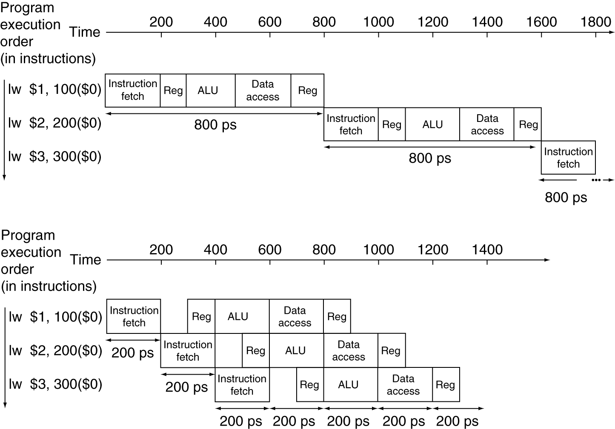
Pipeline Performance
Single-cycle (T_{c}= 800ps)
Pipelined (T_{c}= 200ps)
Notes:
Q: What’s actual speedup? A: 2400/1400
Q: After we “warmup” the pipeline, each lw finishes in 200 ps. Each in the single-cycle takes 800ps.
So if we have a lot of instructions (say, 1M), the speedup is approximately what? A: ~2400/200 = 12

Slide 8
Pipeline Speedup
If all stages are balanced
i.e., all take the same time
Time between instructions_{pipelined} = Time between instructions_{nonpipelined} Number of stages
If not balanced, speedup is less
Speedup due to increased throughput
Latency (time for each instruction) does not decrease
Notes:
Time between instructions is really talking about the cycle time…
Can evenly split cycle time if all steps are balanced

Slide 9
Pipelining and ISA Design
MIPS ISA designed for pipelining
All instructions are 32-bits
Easier to fetch and decode in one cycle
c.f. x86: 1- to 17-byte instructions
Few and regular instruction formats
Can decode and read registers in one step
Load/store addressing
Can calculate address in 3rd stage, access memory in 4th stage
Alignment of memory operands
Memory access takes only one cycle

Slide 10
Hazards
Situations that prevent starting the next instruction in the next cycle
Structure hazards
A required resource is busy
Data hazard
Need to wait for previous instruction to complete its data read/write
Control hazard
Deciding on control action depends on previous instruction

Slide 11
Structure Hazards
Conflict for use of a resource
In MIPS pipeline with a single memory
Load/store requires data access
Instruction fetch would have to stall for that cycle
Would cause a pipeline “bubble”
Hence, pipelined datapaths require separate instruction/data memories
Or separate instruction/data caches
Notes:
Laundry: a combination washer and dryer
Also: FP units

Slide 12
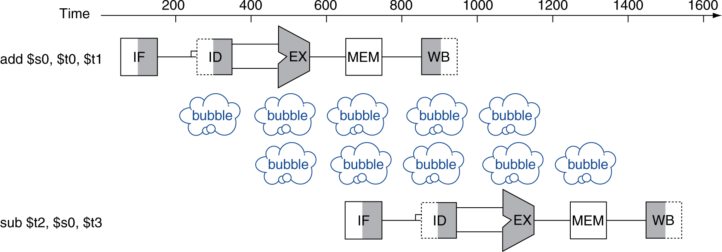
Data Hazards
An instruction depends on completion of data access by a previous instruction
add $s0, $t0, $t1 sub $t2, $s0, $t3

Slide 13
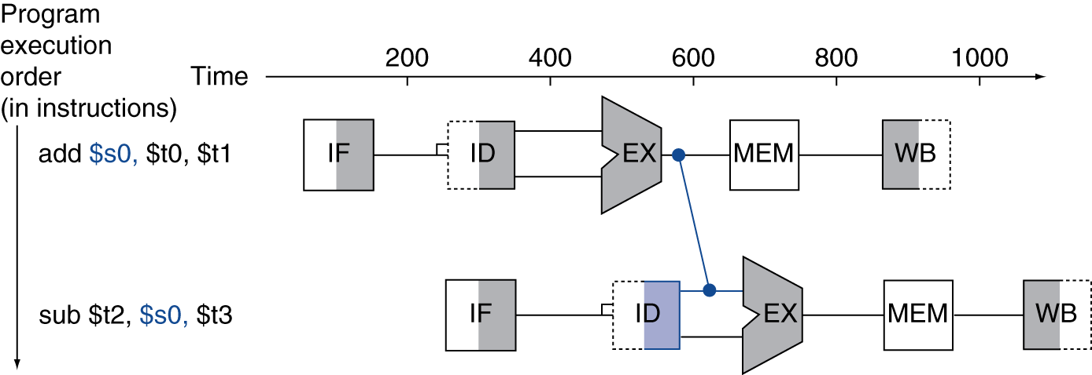
Forwarding (aka Bypassing)
Use result when it is computed
Don’t wait for it to be stored in a register
Requires extra connections in the datapath
Notes:
Result of add is actually read ahead of time! Just twiddling thumbs during mem stage, then writing it back.
How about a shortcut?
Also extra control signals to decide when to use that value!

Slide 14
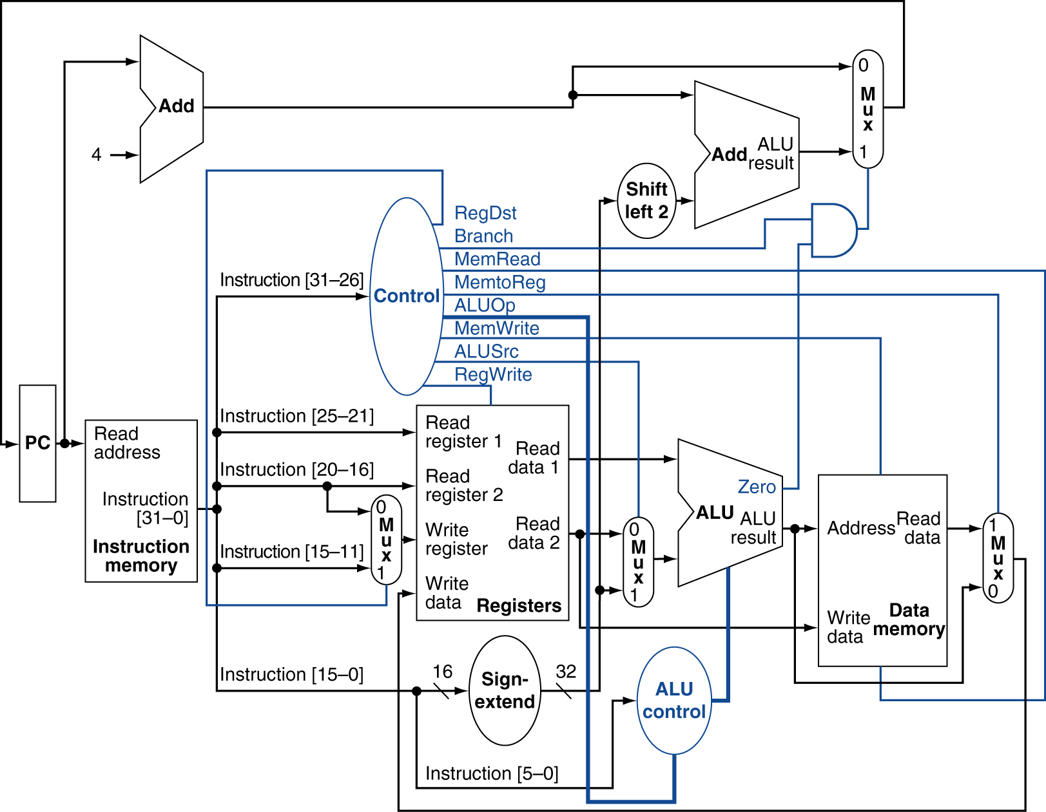
Forwarding
Notes:
Draw ALU -> ALU forwarding loop.
Makes control a bit harder…doesn’t just depend on instruction now, can depend on instructions surrounding!

Slide 15
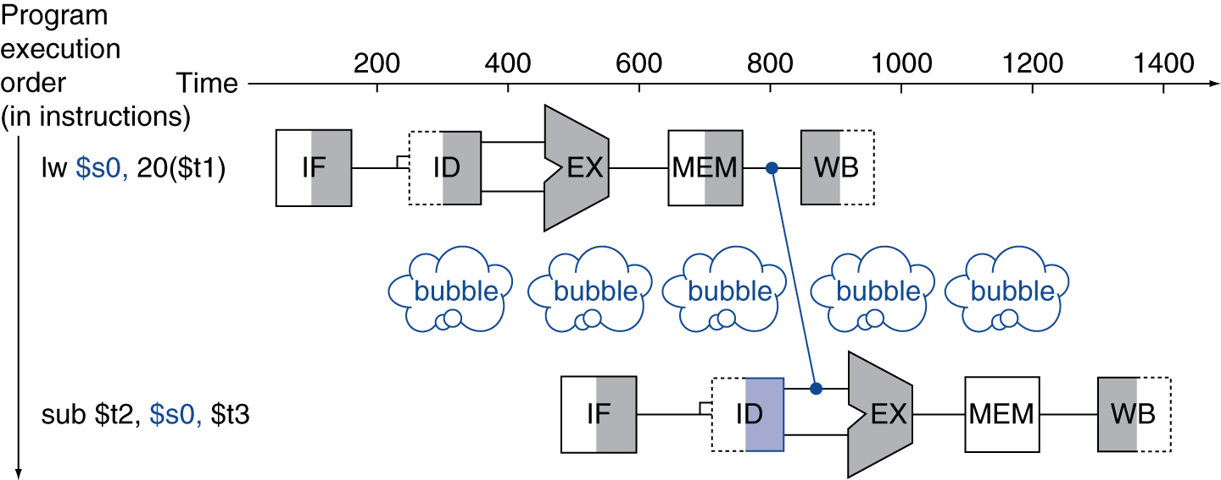
Load-Use Data Hazard
Can’t always avoid stalls by forwarding
If value not computed when needed
Can’t forward backward in time!

Slide 16
Code Scheduling to Avoid Stalls
Reorder code to avoid use of load result in the next instruction
C code for A = B + E; C = B + F;
lw $t1, 0($t0)
lw $t2, 4($t0)
add $t3, $t1, $t2
sw $t3, 12($t0)
lw $t4, 8($t0)
add $t5, $t1, $t4
sw $t5, 16($t0)
lw $t1, 0($t0)
lw $t2, 4($t0)
lw $t4, 8($t0)
add $t3, $t1, $t2
sw $t3, 12($t0)
add $t5, $t1, $t4
sw $t5, 16($t0)
stall
stall
13 cycles
11 cycles
Notes:
Example on page 280
Q: Left: What are the stalls? How many cycles total?
Q: How could you rearrange to do better?
Q: How many stalls/cycles?

