Slide 1
Pipelining IMPLEMENTATION
4.6
Notes:
Q: What was our analogy for pipelining? Give me a high-level overview of pipelining

Slide 2
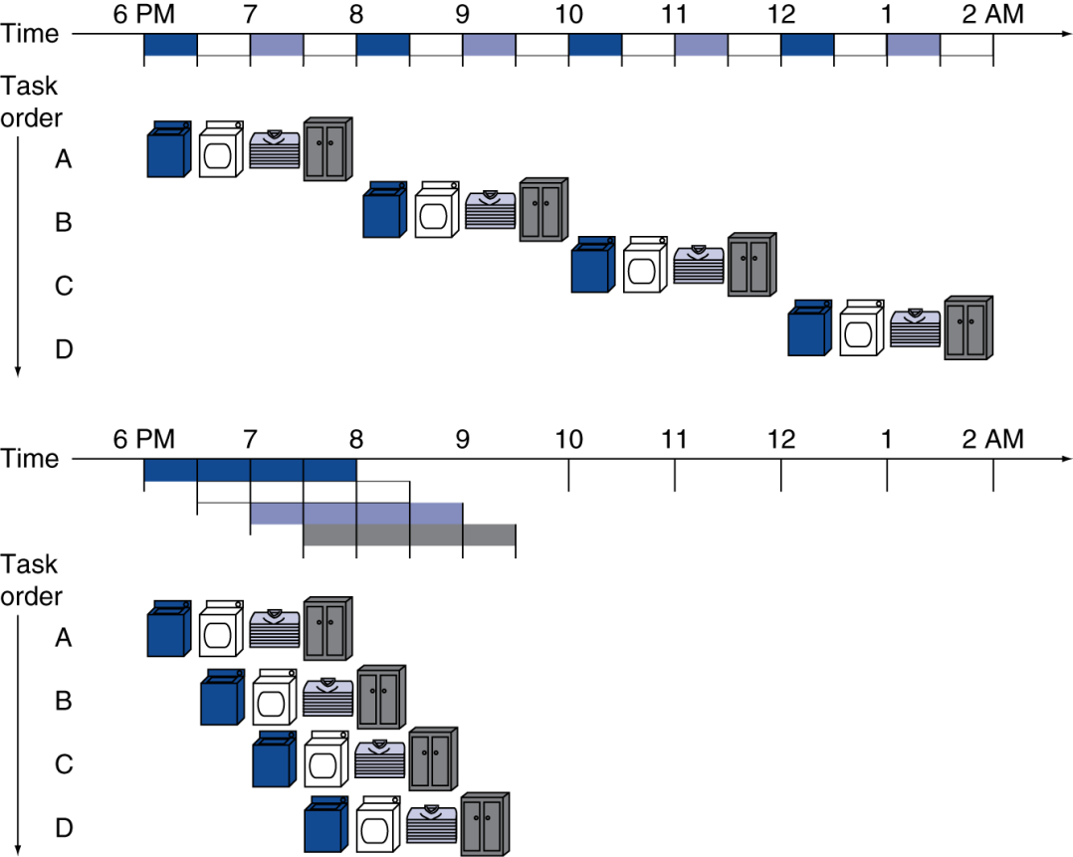
Pipelining Analogy
Pipelined laundry: overlapping execution
Parallelism improves performance
§4.5 An Overview of Pipelining
Four loads:
Speedup = 8/3.5 = 2.3
Non-stop:
Speedup = 2n/(0.5n + 1.5) ≈ 4 = number of stages
Notes:
Q: What’s a hazard? What types of hazards did we have?

Slide 3
Pipelining Performance
Which of the statements below is true about a pipelined processor?
Selection | Statement
A | Instruction latency remains essentially unchanged from single-cycle (minus some overheads); Instruction throughput increases
B | Instruction latency decreases; Instruction throughput increases
C | Instruction latency remains essentially unchanged (minus some overheads); Instruction throughput decreases
D | Instruction latency improves (decreases); Instruction throughput increases
E | None of the above
Notes:
Correct Answer – A
Also better utilization

Slide 4
Pipeline Stages
Should we force every instruction to go through all 5 stages? Can we break it up so that R-type takes only 4 cycles instead of 5? Skip the Mem. Stage and WB immediately after ALU.
Selection | Yes/No | Reason (Choose BEST answer)
A | Yes | Decreasing R-type to 4 cycles improves instruction throughput
B | Yes | Decreasing R-type to 4 cycles improves instruction latency
C | No | Decreasing R-type to 4 cycles causes hazards
D | No | Decreasing R-type to 4 cycles causes hazards and doesn’t impact throughput
E | No | Decreasing R-type to 4 cycles causes hazards and doesn’t impact latency
Notes:
Tails - flipped
Correct Answer - C

Slide 5
Hazards
Situations that prevent starting the next instruction in the next cycle
Structure hazards
A required resource is busy
Data hazard
Need to wait for previous instruction to complete its data read/write
Control hazard
Deciding on control action depends on previous instruction

Slide 6
Structure Hazards
Conflict for use of a resource
In MIPS pipeline with a single memory
Load/store requires data access
Instruction fetch would have to stall for that cycle
Would cause a pipeline “bubble”
Hence, pipelined datapaths require separate instruction/data memories
Or separate instruction/data caches
Notes:
Laundry: a combination washer and dryer
Also: FP units

Slide 7
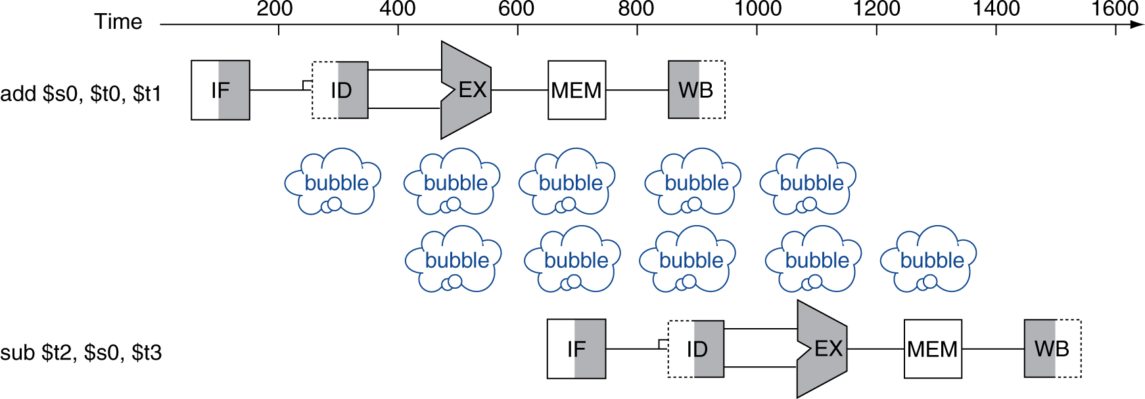
Data Hazards
An instruction depends on completion of data access by a previous instruction
add $s0, $t0, $t1 sub $t2, $s0, $t3

Slide 8
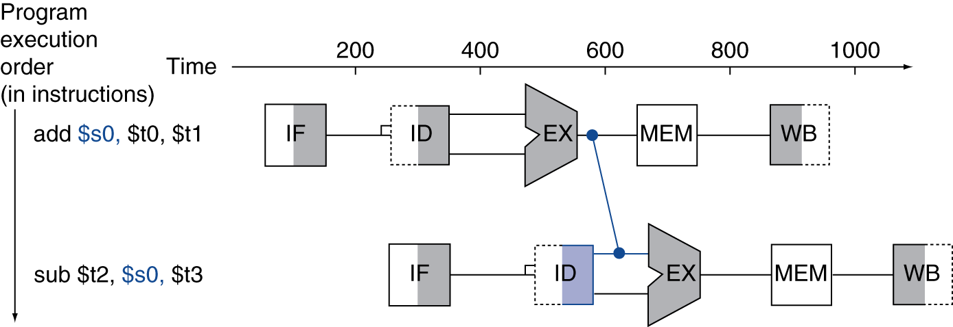
Forwarding (aka Bypassing)
Use result when it is computed
Don’t wait for it to be stored in a register
Requires extra connections in the datapath
Notes:
Result of add is actually read ahead of time! Just twiddling thumbs during mem stage, then writing it back.
How about a shortcut?
Also extra control signals to decide when to use that value!

Slide 9
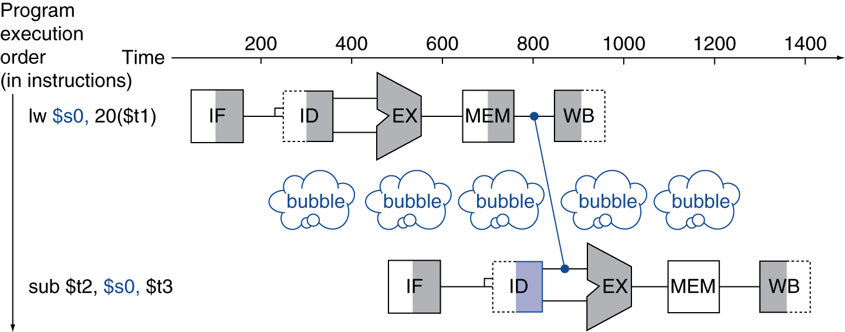
Load-Use Data Hazard
Can’t always avoid stalls by forwarding
If value not computed when needed
Can’t forward backward in time!

Slide 10
Code Scheduling to Avoid Stalls
Reorder code to avoid use of load result in the next instruction
C code for A = B + E; C = B + F;
lw $t1, 0($t0)
lw $t2, 4($t0)
add $t3, $t1, $t2
sw $t3, 12($t0)
lw $t4, 8($t0)
add $t5, $t1, $t4
sw $t5, 16($t0)
lw $t1, 0($t0)
lw $t2, 4($t0)
lw $t4, 8($t0)
add $t3, $t1, $t2
sw $t3, 12($t0)
add $t5, $t1, $t4
sw $t5, 16($t0)
stall
stall
13 cycles
11 cycles
Notes:
Example on page 280
Q: Left: What are the stalls? How many cycles total?
Q: How could you rearrange to do better?
Q: How many stalls/cycles?

Slide 11
Control Hazards
Branch determines flow of control
Fetching next instruction depends on branch outcome
Pipeline can’t always fetch correct instruction
Still working on ID stage of branch
In MIPS pipeline
Need to compare registers and compute target early in the pipeline
Add hardware to do it in ID stage
Notes:
So first, branch uses relative addressing, so we need to add. But the result of the add won’t be ready until later in the pipeline, even though we need it immediately.

Slide 12
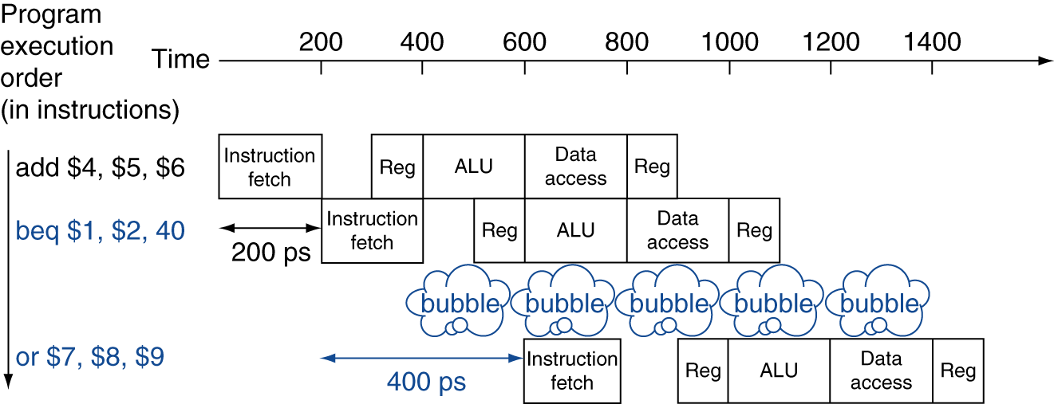
Stall on Branch
Wait until branch outcome determined before fetching next instruction
Notes:
Even when we add hardware to compute the address in the ID stage (Reg), we still have to stall!

Slide 13
Branch Prediction
Longer pipelines can’t readily determine branch outcome early
Stall penalty becomes unacceptable
Predict outcome of branch
Only stall if prediction is wrong
In MIPS pipeline
Can predict branches not taken
Fetch instruction after branch, with no delay
Notes:
Modern chips often split their pipeline into more stages (30+).

Slide 14
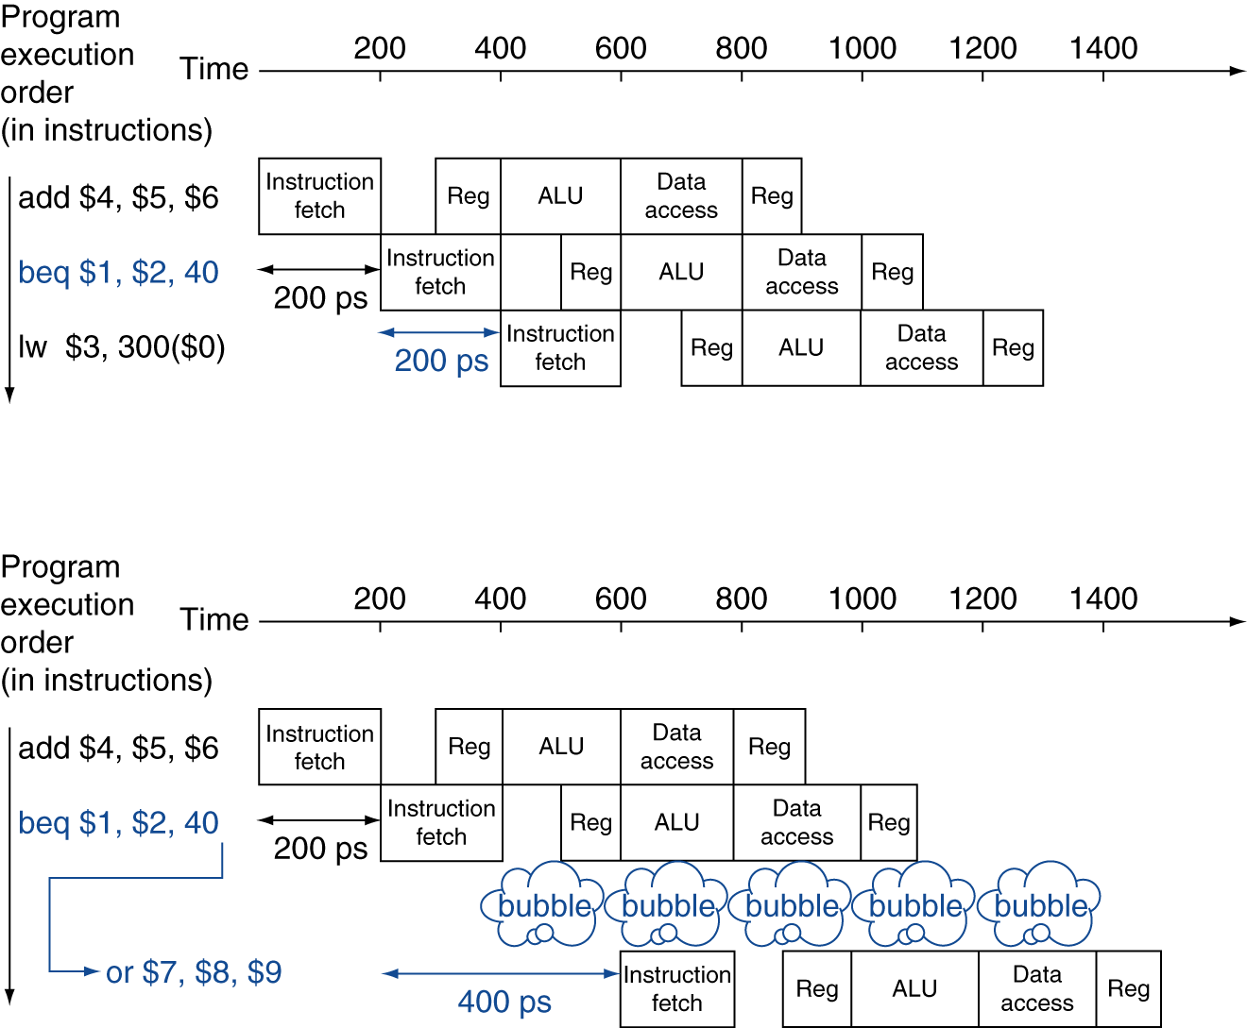
MIPS with Predict Not Taken
Prediction correct
Prediction incorrect
Notes:
Actually lots of details here, may need to “undo” things.

Slide 15
More-Realistic Branch Prediction
Static branch prediction
Based on typical branch behavior
Example: loop and if-statement branches
Predict backward branches taken
Predict forward branches not taken
Dynamic branch prediction
Hardware measures actual branch behavior
e.g., record recent history of each branch
Assume future behavior will continue the trend
When wrong, stall while re-fetching, and update history
Notes:
This kind of speculation is great for performance…
…but also led to the recent Spectre and Meltdown security exploits!

Slide 16
Pipeline Summary
The BIG Picture
Pipelining improves performance by increasing instruction throughput
Executes multiple instructions in parallel
Each instruction has the same latency
Subject to hazards
Structure, data, control
Instruction set design affects complexity of pipeline implementation
Notes:
Examples on p. 285
Stall on lw result
Bypass the first add result written into $t1
No stall or bypass required.

