Slide 1
procedures
Instructor: Robert Utterback
Lecture 17
Notes:
What did we talk about last time?
A: basics of procedures

Slide 2
Procedure
Procedure (function)
A stored subroutine that performs a specific task based on the parameters with which it is provided
Important when writing a large program
Allow a programmer to focus on a specific task

Slide 3
Example
int main() {
int a = 10;
int b = 20;
int result = add (a, b);
cout << a << “,” << b << endl;
}
int add(int a, int b) {
return a + b;
}
Notes:
When we call result from main, we need to basically put main on pause, execute result, and then return..
Note that each procedure call needs some storage since it may need more variables than we have registers!

Slide 4
Procedure Calling
Don’t overwrite registers other procedures are using
Don’t overwrite memory used in other procedures
Need to pass in parameters
Need to get result from function
§2.8 Supporting Procedures in Computer Hardware
Notes:
The previous procedure (e.g. main) was using some registers…what if the procedure it calls also wants to use those registers.
It is way too complex to always be aware of which procedures are active and which registers they are using…

Slide 5
Procedure Calling
Steps required
Place parameters in registers
Transfer control to procedure
Acquire storage for procedure
Each procedure instance has own storage area
Perform procedure’s operations
Place result in register for caller
Return to place of call
§2.8 Supporting Procedures in Computer Hardware
Notes:
All the procedures use an area of memory called the stack, and each procedure instance has its own stack FRAME.
So far I have just assumed everything is in registers, but it may not fit! Especially if the procedure calls a lot of other procedures.

Slide 6
Caller and Callee
Caller
The program that instigates a procedure and provides the necessary parameter values
Callee
A procedure that executes a series of stored instructions based on parameters provided by the caller and then returns control to the caller

Slide 7
Register Usage
$a0 – $a3: arguments (reg’s 4 – 7)
$v0, $v1: result values (reg’s 2 and 3)
$t0 – $t9: temporaries
Can be overwritten by callee
$s0 – $s7: saved
Must be saved/restored by callee
$gp: global pointer for static data (reg 28)
$sp: stack pointer (reg 29)
$fp: frame pointer (reg 30)
$ra: return address (reg 31)
Notes:
Need to save the s registers, use them, then restore them when we’re done…where do we save them? Stack.
Any compiled language will have an ABI, which defines, among other things, the registers used for parameters.

Slide 8
Stack
A last-in-first-out data structure
Stack pointer
$sp
Point to the address of the most recent element in the stack
Push
Add element onto the stack
Pop
Remove element from the stack

Slide 9
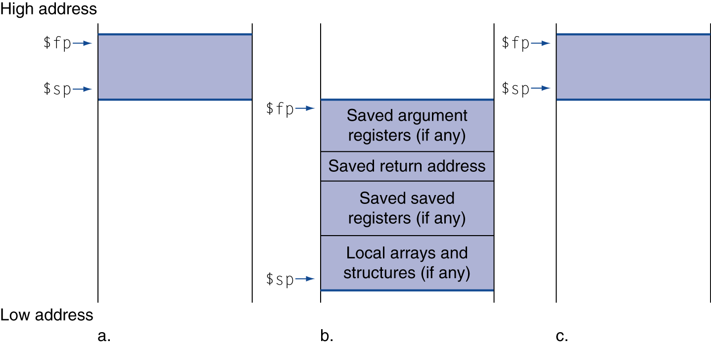
Local Data on the Stack
Local data allocated by callee
e.g., C automatic variables
Procedure frame (activation record)
Used by some compilers to manage stack storage
Notes:
A,b,c = before, during, after
Stack “grows down”, by tradition.
We are actually not going to worry about $fp for now.

Slide 10
Program Counter (PC)
A register in CPU
Containing the address of the instruction in the program being executed
Not directly accessible
Notes:
But indirectly accessible through branch/jump instructions

Slide 11
Procedure Call Instructions
Procedure call: jump and link
jal ProcedureLabel
Address of following instruction put in $ra
Jumps to target address
Procedure return: jump register
jr $ra
Copies $ra to program counter
Can also be used for computed jumps
e.g., for case/switch statements

Slide 12
Leaf Procedure and non-Leaf Procedure
Leaf Procedure
Procedures that do not call other procedures
Non-leaf Procedure
Procedures that call other procedures
Notes:
We’re going to go through a few examples here, and it helps to distinguish between two different kinds of procedures.

Slide 13
Leaf Procedure Example
C code:
int leaf_example (int g, h, i, j) { int f; f = (g + h) - (i + j); return f; }
Arguments g, …, j in $a0, …, $a3
f in $s0 (hence, need to save $s0 on stack)
Result in $v0
Notes:
We’re going to show the MIPS code for this. (1) Save S registers (2) function body (3) Set result (4) Restore S registers (5) return
leaf_example: addi $sp, $sp, -4 sw $s0, 0($sp) add $t0, $a0, $a1 add $t1, $a2, $a3 sub $s0, $t0, $t1 add $v0, $s0, $zero lw $s0, 0($sp) addi $sp, $sp, 4 jr $ra

Slide 14
Leaf Procedure Example
MIPS code:
leaf_example: addi $sp, $sp, -4 sw $s0, 0($sp) add $t0, $a0, $a1 add $t1, $a2, $a3 sub $s0, $t0, $t1 add $v0, $s0, $zero lw $s0, 0($sp) addi $sp, $sp, 4 jr $ra
Save $s0 on stack
Procedure body
Result
Restore $s0
Return
Notes:
Note: you don’t actually need to use s0 here…could just use another t register…or $v0 !
Okay, now, what is the MIPS code for some function that wants to CALL this leaf_example?

Slide 15
Non-Leaf Procedures
Procedures that call other procedures
For nested call, caller needs to save on the stack:
Its return address
Any arguments and temporaries needed after the call
Restore from the stack after the call

Slide 16
Non-Leaf Procedure Example
C code:
int fact (int n) { if (n < 1) return 1; else return n * fact(n - 1); }
Argument n in $a0
Result in $v0

Slide 17
Non-Leaf Procedure Example
MIPS code:
fact: addi $sp, $sp, -8 # adjust stack for 2 items sw $ra, 4($sp) # save return address sw $a0, 0($sp) # save argument slti $t0, $a0, 1 # test for n < 1 beq $t0, $zero, L1 addi $v0, $zero, 1 # if so, result is 1 addi $sp, $sp, 8 # pop 2 items from stack jr $ra # and return L1: addi $a0, $a0, -1 # else decrement n jal fact # recursive call lw $a0, 0($sp) # restore original n lw $ra, 4($sp) # and return address addi $sp, $sp, 8 # pop 2 items from stack mul $v0, $a0, $v0 # multiply to get result jr $ra # and return
Notes:
Notice there is some waste here…
Why must we load $a0 back from the stack instead of just adding 1 to the new a0?
A: other recursive calls will change a0!

