Slide 1
Measuring Performance II and Logic Design
Instructor: Robert Utterback
Lecture 3

Slide 2
Performance Summary
The BIG Picture
Performance depends on
Algorithm: affects IC, possibly CPI
Programming language: affects IC, CPI
Compiler: affects IC, CPI
Instruction set architecture: affects IC, CPI, T_{c}
Notes:
Note that CPI differs for different instructions, so we need the average for a particular set of instructions.
In this course we will assume the clock period is fixed, but I should note that in modern CPUs this is not necessarily the case. Recent CPUs will actually lower their clock speed when the machine isn't busy to save energy.

Slide 3
Review
Three processors, same ISA:
Each executes a program in 10s.
How many cycles?
How many instructions?
 | P1 | P2 | P3
Clock rate | 3 GHz | 2.5 GHz | 4.0 GHz
CPI | 1.5 | 1.0 | 2.2

Slide 4
SPEC CPU Benchmark
Programs used to measure performance
Supposedly typical of actual workload
Standard Performance Evaluation Corp (SPEC)
Develops benchmarks for CPU, I/O, Web, …
SPEC CPU2006
Elapsed time to execute a selection of programs
Negligible I/O, so focuses on CPU performance
Normalize relative to reference machine
Summarize as geometric mean of performance ratios
CINT2006 (integer) and CFP2006 (floating-point)
Notes:
Section 1.9
In general, for units that are proportional to time (like latency or response time), use arithmetic mean.
For unitless quantities (e.g. speedup ratios) use the geometric mean

Slide 5
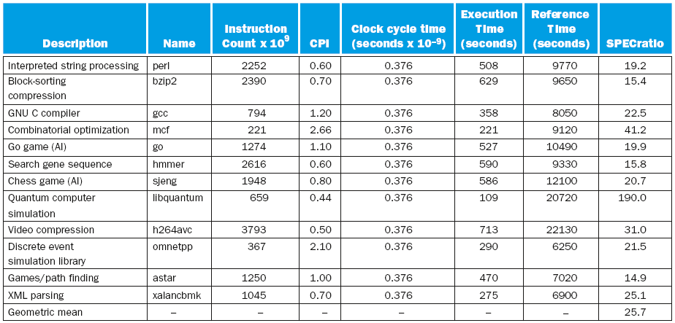
CINT2006 for Intel Core i7 920
Notes:
Notice the high CPI values in some of the benchmarks. This is typically because of high cache miss rates.

Slide 6
SPEC Power Benchmark
Power consumption of server at different workload levels
Performance: ssj_ops/sec
Power: Watts (Joules/sec)

Slide 7
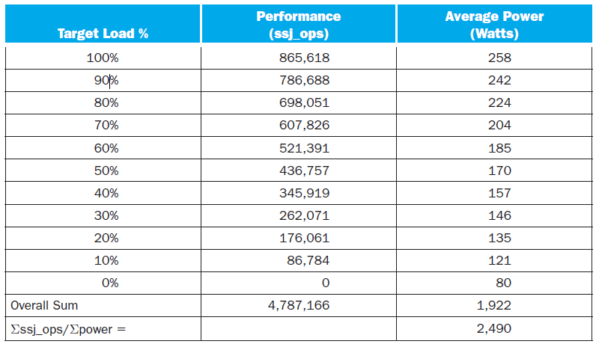
SPECpower_ssj2008 for Xeon X5650

Slide 8
Fallacy: Low Power at Idle
Look back at i7 power benchmark
At 100% load: 258W
At 50% load: 170W (66%)
At 10% load: 121W (47%)
Google data center
Mostly operates at 10% – 50% load
At 100% load less than 1% of the time
Consider designing processors to make power proportional to load

Slide 9
Pitfall: MIPS as a Performance Metric
MIPS: Millions of Instructions Per Second
Doesn’t account for
Differences in ISAs between computers
Differences in complexity between instructions
CPI varies between programs on a given CPU
Notes:
Big picture: execution time is the only measure of performance that is always valid. Sometimes other metrics are valid in a limited context, but it is an error to use them beyond that context.

Slide 10
Pitfall: Amdahl’s Law
Improving an aspect of a computer and expecting a proportional improvement in overall performance
§1.10 Fallacies and Pitfalls
Notes:
Section 1.10
A pitfall to expect that performance improvement, but Amdahl's law itself is actually a really useful tool.

Slide 11
Pitfall: Amdahl’s Law
Improving an aspect of a computer and expecting a proportional improvement in overall performance
§1.10 Fallacies and Pitfalls
Example: A program runs for 100 s. 80 s are due to multiplication instructions.
How much do we need to improve the multiply to achieve 2x performance?
Notes:
Section 1.10
Example: a program runs 100 s, with multiply operations accounting for 80 s of the time
Basically law of diminishing returns

Slide 12
Amdahl’s Law
Example: A program runs for 100 seconds. Of the 100 seconds, 80 seconds are due to multiplies.
2x improvement: n = 2.66
3x improvement: n = 6
4x improvement: n = 16
5x improvement: n = ?
Can’t be done!
Corollary: make the common case fast
Notes:
Also used for calculating how much improvement you can get when writing a parallel program.

Slide 13
Concluding Remarks
Cost/performance is improving
Due to underlying technology development
Hierarchical layers of abstraction
In both hardware and software
Instruction set architecture
The hardware/software interface
Execution time: the best performance measure
Power is a limiting factor
Use parallelism to improve performance
§1.9 Concluding Remarks
Notes:
Section 1.11

Slide 14
What I want you to do
Finish Chapter 1
Read Appendix B.1-B.3
Work on homework 1

