Slide 1
Addressing Modes
Instructor: Robert Utterback
Lecture 19

Slide 2
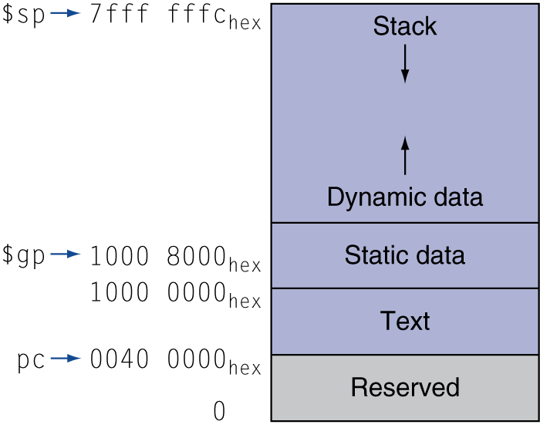
Memory Layout
Text: program code
Static data: global variables
e.g., static variables in C, constant arrays and strings
$gp initialized to address allowing ±offsets into this segment
Dynamic data: heap
E.g., malloc in C, new in Java and C++
Stack: automatic storage
Notes:
Use free to deallocate storage in C – very important! Many bugs caused by freeing too early/late.
C++ uses delete, Java does not require this --- uses garbage collection, prevents these bugs.

Slide 3
String Copy Example
MIPS code:
strcpy: addi $sp, $sp, -4 # adjust stack for 1 item sw $s0, 0($sp) # save $s0 add $s0, $zero, $zero # i = 0 L1: add $t1, $s0, $a1 # addr of y[i] in $t1 lbu $t2, 0($t1) # $t2 = y[i] add $t3, $s0, $a0 # addr of x[i] in $t3 sb $t2, 0($t3) # x[i] = y[i] beq $t2, $zero, L2 # exit loop if y[i] == 0 addi $s0, $s0, 1 # i = i + 1 j L1 # next iteration of loop L2: lw $s0, 0($sp) # restore saved $s0 addi $sp, $sp, 4 # pop 1 item from stack jr $ra # and return

Slide 4
Addressing Modes
2.10
Instructor: Robert Utterback
Notes:
Start with handling large constants

Slide 5
32-bit Constants
Most constants are small
16-bit immediate is sufficient
For the occasional 32-bit constant
lui rt, constant
Copies 16-bit constant to left 16 bits of rt
Clears right 16 bits of rt to 0
§2.10 MIPS Addressing for 32-Bit Immediates and Addresses
lui $s0, 61
0000 0000 0111 1101 0000 0000 0000 0000
ori $s0, $s0, 2304
0000 0000 0111 1101 0000 1001 0000 0000
Notes:
61 -> 007d 0000
2304 = 0900
Ori: 007d 0900 = 8192000
This is kind of a pain, but we’ll see later how the assembler can do this automatically for us.

Slide 6
Branch Addressing
Branch instructions specify
Opcode, two registers, target address
Most branch targets are near branch
Forward or backward
op
rs
rt
constant or address
6 bits
5 bits
5 bits
16 bits
PC-relative addressing
Target address = PC + offset × 4
PC already incremented by 4 by this time
Notes:
Problem: Only 16 bits for branch target addresses! 2^16 is not that big…64K
PC already incremented for efficiency reasons, we’ll see in Ch 4. Basically, we need to load an instruction from memory, and THEN go through the process of executing it. Well, as soon as the instruction is fetched from memory (before it has executed), the PC is incremented.
Notice that this doesn’t completely solve our problem! It only solves it for the common case. Which means we can afford expensive solutions for the uncommon case, i.e. when we need to branch very far away. We’ll see that in a minute.
Big picture: You don’t need to worry about this when writing in MIPS assembly, since you just need labels. But the assembler needs to do this, and if you want to understand what it’s doing you should understand it.

Slide 7
Jump Addressing
Jump (j and jal) targets could be anywhere in text segment
Encode full address in instruction
op
address
6 bits
26 bits
(Pseudo)Direct jump addressing
Target address = PC_{31…28} : (address × 4)
Notes:
Does anyone see why we have 26 bits in the address but we only concatenate with 31..28, not 31..26?

Slide 8
Address Example
Loop: sll $t1, $s3, 2
add $t1, $t1, $s6
lw $t0, 0($t1)
bne $t0, $s5, Exit
addi $s3, $s3, 1
j Loop
Exit: …
Notes:
Q: Assuming the “Loop” instruction is at memory address 60000_10, what should Exit and Loop be replaced with by the assembler?
A: Exit is 8/4=2 (two beyond the addi), Loop is 15000

Slide 9
Target Addressing Example
Loop code from earlier example
Assume Loop at location 60000
Loop: sll $t1, $s3, 2 | 60000 | 0 | 0 | 19 | 9 | 4 | 0
add $t1, $t1, $s6 | 60004 | 0 | 9 | 22 | 9 | 0 | 32
lw $t0, 0($t1) | 60008 | 35 | 9 | 8 | 0
bne $t0, $s5, Exit | 60012 | 5 | 8 | 21 | 2
addi $s3, $s3, 1 | 60016 | 8 | 19 | 19 | 1
j Loop | 60020 | 2 | 15000
Exit: … | 60024
Notes:
15000 = 0011 1010 1001 1000
60020 = 1110 1010 0111 0100
60000 = 1110 1010 0110 0000

Slide 10
Branching Far Away
If branch target is too far to encode with 16-bit offset, assembler rewrites the code
Example
beq $s0,$s1, L1
↓
bne $s0,$s1, L2 j L1 L2: …
Notes:
Occasionally, even this branching isn’t enough…
Compiler must compute address and put into a register, then use jr
But this is pretty rare

Slide 11
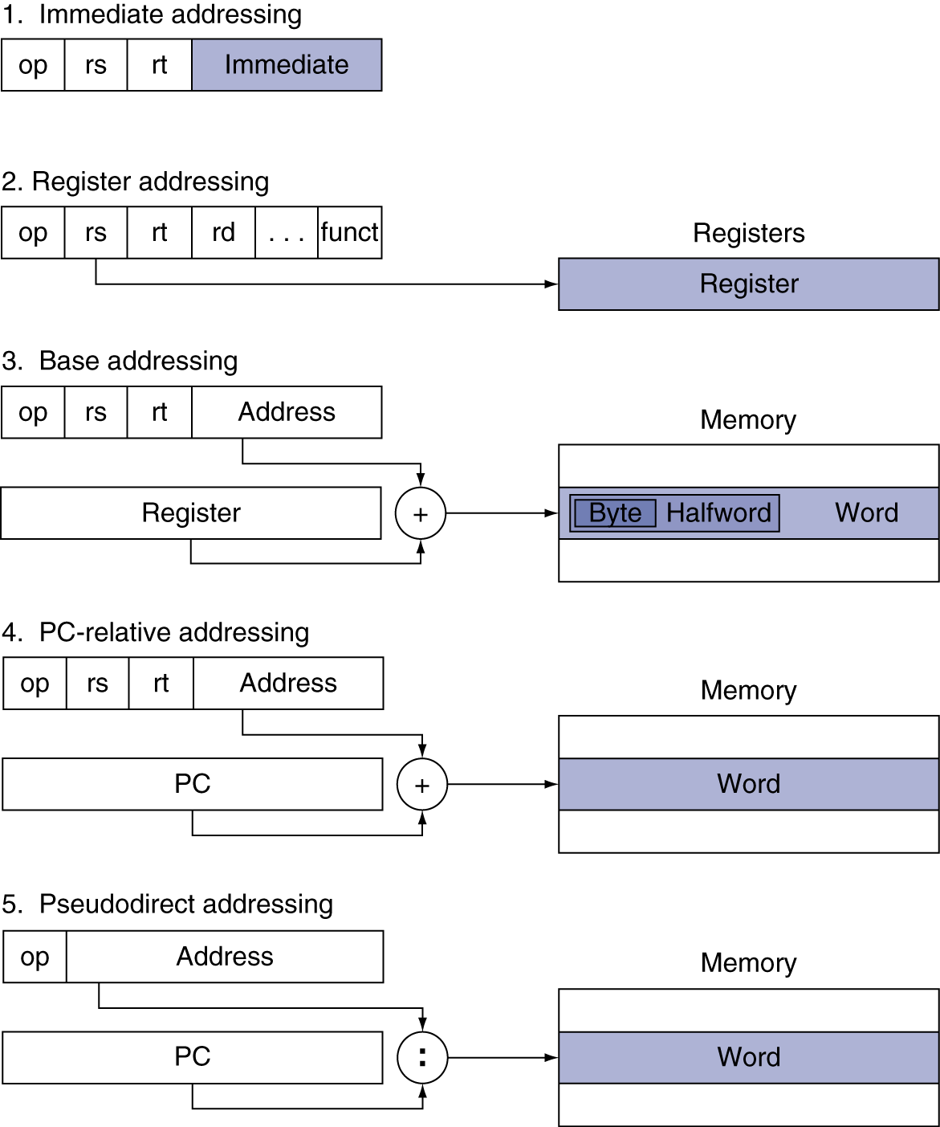
Addressing Mode Summary
Notes:
Example of 1? (addi)
Example of 2? (jr, add, etc.)
3? (lw,sw)
4? (bne)
5? (j,jal)

Slide 12
Translating and Starting Programs
2.11
Instructor: Robert Utterback
Notes:
Skipping 2.10 on parallel synchronization, may come back if time allows.

Slide 13
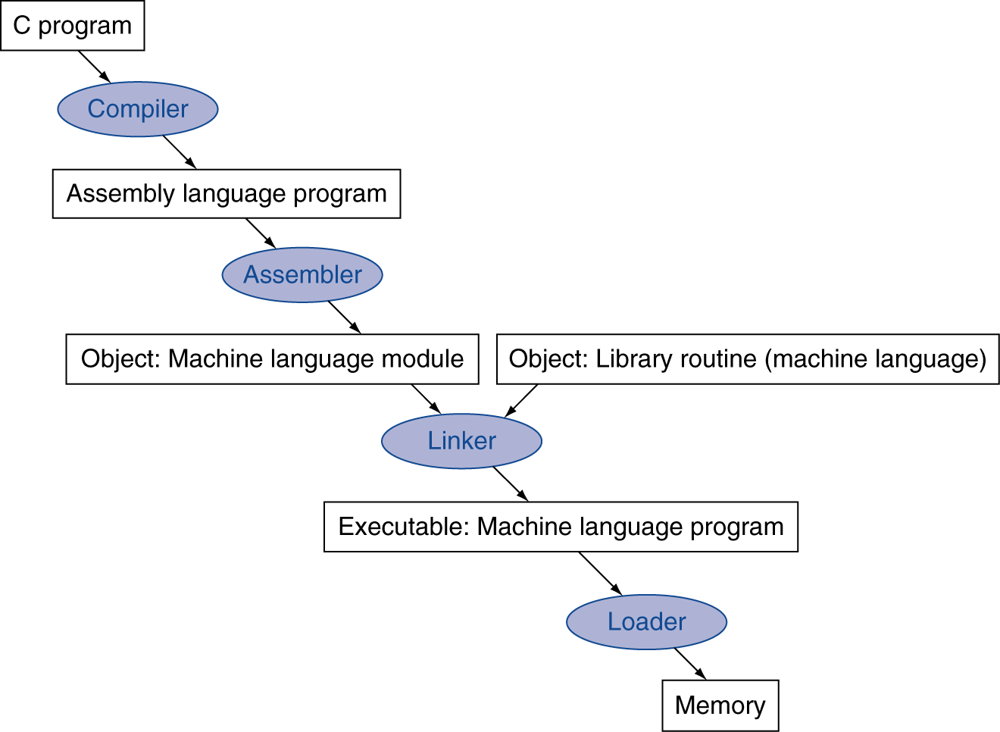
Translation and Startup
Many compilers produce object modules directly
§2.12 Translating and Starting a Program
Static linking
Notes:
When we have said compiler previously, really we mean this whole process, which often happens automatically for us.
This is an overview of the process, now let’s go into detail…

Slide 14
Assembler Pseudoinstructions
Most assembler instructions represent machine instructions one-to-one
Pseudoinstructions: figments of the assembler’s imagination
move $t0, $t1 → add $t0, $zero, $t1
blt $t0, $t1, L → slt $at, $t0, $t1 bne $at, $zero, L
$at (register 1): assembler temporary
Notes:
In some sense, we’re defining another language just slightly more convenient than assembly…
Don’t use these on the exam…
Another example is the mul inst I mentioned earlier. There is an actual mult instruction, but it is a little more complicated than the pseudoinstruction “mul”.
Also: “li” – load immediate. This is what helps us avoid having to use lui…
In addition to handling large constants, what about large addresses? Beq,bne only have 16 bits to specify an address!

Slide 15
Producing an Object Module
Assembler (or compiler) translates program into machine instructions
Provides information for building a complete program from the pieces
Header: described contents of object module
Text segment: translated instructions
Static data segment: data allocated for the life of the program
Symbol table: global definitions and external refs
Debug info: for associating with source code
Relocation info: for contents that depend on absolute location of loaded program

Slide 16
Linking Object Modules
Produces an executable image
1. Merges segments
2. Resolve labels (determine their addresses)
3. Patch location-dependent and external refs
This only works because of virtual memory
Every program thinks it has the entire memory to itself (Ch. 5)
Program can be loaded into absolute location in virtual memory space
Notes:
In a nutshell, virtual memory makes every process thinks it has the entire memory to itself.
An alternative would be to leave the location dependencies for the loader, adding extra work at load-time.
Show example of p. 127

Slide 17
Loading a Program
Load from image file on disk into memory
1. Read header to determine segment sizes
2. Create virtual address space
3. Copy text and initialized data into memory
Or set page table entries so they can be faulted in
4. Set up arguments on stack
5. Initialize registers (including $sp, $fp, $gp)
6. Jump to startup routine
Copies arguments to $a0, … and calls main
When main returns, cleanup and exit

