Slide 1
The Memory Hierarchy
Chapter 5
Notes:
On a write hit, one thing we could do it always write the result back to memory. What is this called (write-through)
What’s the alternative? (write-back, which only writes back to memory when a block is kicked out of memory)
It’s a waste to write back to memory if we haven’t changed the block since it came into cache. How do we handle this? (dirty bit)

Slide 2
Measuring Cache Performance
Components of CPU time
Program execution cycles
Includes cache hit time
Memory stall cycles
Mainly from cache misses
With simplifying assumptions:
§5.4 Measuring and Improving Cache Performance
Notes:
Now let’s dig a little deeper into cache performance.
In particular, we assume that our write buffer never gets too full, or if it does it’s too infrequent to matter.

Slide 3
Associative Caches
Fully associative
Allow a given block to go in any cache entry
Requires all entries to be searched at once
Comparator per entry (expensive)
n-way set associative
Each set contains n entries
Block number determines which set
(Block number) modulo (#Sets in cache)
Search all entries in a given set at once
n comparators (less expensive)
Notes:
Fully associative is actually the scheme Abhi suggested, though it’s faster than I implied, since we can do all the searches in parallel.

Slide 4
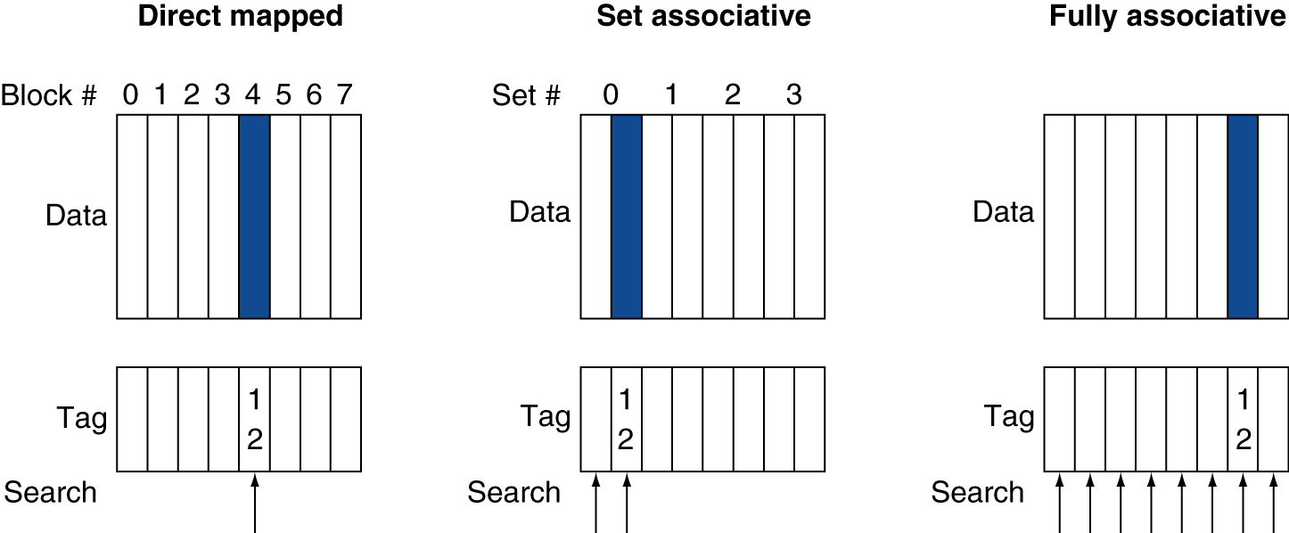
Associative Cache Example

Slide 5
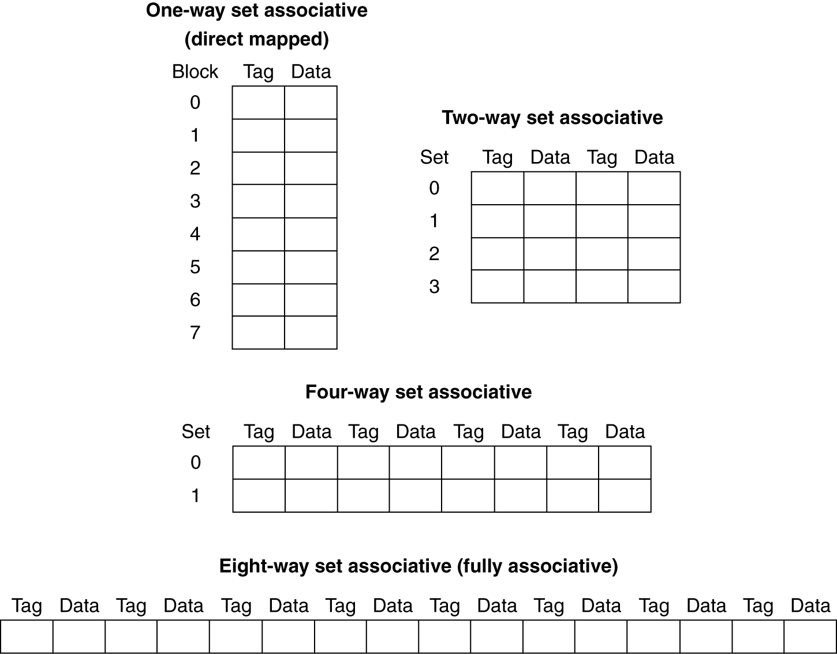
Spectrum of Associativity
For a cache with 8 entries

Slide 6
Associativity Example
Compare 4-block caches
Direct mapped, 2-way set associative, fully associative
Block access sequence: 0, 8, 0, 6, 8
Direct mapped
Block address | Cache index | Hit/miss | Cache content after access
 |  |  | 0 | 1 | 2 | 3
0
8
0
6
8
Notes:
What does it look like (contents, misses)
| Block address | Cache index | Hit/miss | 0 | 1 | 2 | 3 |
|---------------+-------------+----------+--------+---+--------+---|
| 0 | 0 | miss | Mem[0] | | | |
| 8 | 0 | miss | Mem[8] | | | |
| 0 | 0 | miss | Mem[0] | | | |
| 6 | 2 | miss | Mem[0] | | Mem[6] | |
| 8 | 0 | miss | Mem[8] | | Mem[6] | |

Slide 7
Associativity Example
Compare 4-block caches
Direct mapped, 2-way set associative, fully associative
Block access sequence: 0, 8, 0, 6, 8
Direct mapped
Block address | Cache index | Hit/miss | Cache content after access
 |  |  | 0 | 1 | 2 | 3
0 | 0 | miss | Mem[0]
8 | 0 | miss | Mem[8]
0 | 0 | miss | Mem[0]
6 | 2 | miss | Mem[0] |  | Mem[6]
8 | 0 | miss | Mem[8] |  | Mem[6]

Slide 8
Associativity Example
2-way set associative
Block address | Cache index | Hit/miss | Cache content after access
 |  |  | Set 0 |  | Set 1
0
8
0
6
8
Fully associative
Block address | Cache index | Hit/miss | Cache content after access
0
8
0
6
8
Notes:
Now what do these look like? In particular, how many misses?
| Block address | Cache index | Hit/miss | 0 | 1 | 2 | 3 |
|---------------+-------------+----------+--------+--------+---+---|
| 0 | 0 | miss | Mem[0] | | | |
| 8 | 0 | miss | Mem[0] | Mem[8] | | |
| 0 | 0 | hit | Mem[0] | Mem[8] | | |
| 6 | 0 | miss | Mem[0] | Mem[6] | | |
| 8 | 0 | miss | Mem[8] | Mem[6] | | |
| Block address | Cache index | Hit/miss | 0 | 1 | 2 | 3 |
|---------------+-------------+----------+--------+--------+--------+---|
| 0 | | miss | Mem[0] | | | |
| 8 | | miss | Mem[0] | Mem[8] | | |
| 0 | | hit | Mem[0] | Mem[8] | | |
| 6 | | miss | Mem[0] | Mem[8] | Mem[6] | |
| 8 | | hit | Mem[0] | Mem[8] | Mem[6] | |

Slide 9
Associativity Example
2-way set associative
Block address | Cache index | Hit/miss | Cache content after access
 |  |  | Set 0 |  | Set 1
0 | 0 | miss | Mem[0]
8 | 0 | miss | Mem[0] | Mem[8]
0 | 0 | hit | Mem[0] | Mem[8]
6 | 0 | miss | Mem[0] | Mem[6]
8 | 0 | miss | Mem[8] | Mem[6]
Fully associative
Block address |  | Hit/miss | Cache content after access
0 |  | miss | Mem[0]
8 |  | miss | Mem[0] | Mem[8]
0 |  | hit | Mem[0] | Mem[8]
6 |  | miss | Mem[0] | Mem[8] | Mem[6]
8 |  | hit | Mem[0] | Mem[8] | Mem[6]

Slide 10
How Much Associativity
Increased associativity decreases miss rate
But with diminishing returns
Simulation of a system with 64KB D-cache, 16-word blocks, SPEC2000
1-way: 10.3%
2-way: 8.6%
4-way: 8.3%
8-way: 8.1%

