Slide 1
Multiplication and Division
Instructor: Robert Utterback
Lecture 26

Slide 2
Sequential Version of Multiplication Algorithm and Hardware
Start with long-multiplication approach
multiplicand
1000
× 1001
1000
0000
0000
1000
1001000
multiplier
product
Length of product is the sum of operand lengths

Slide 3
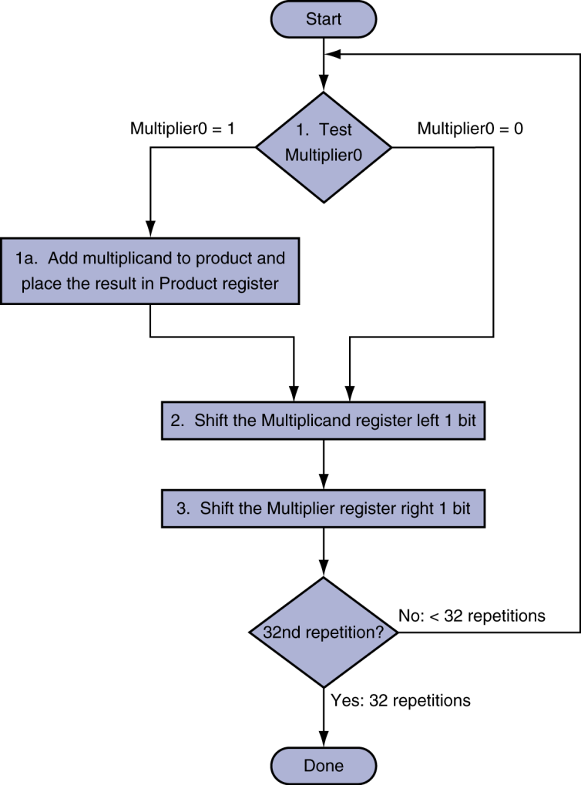
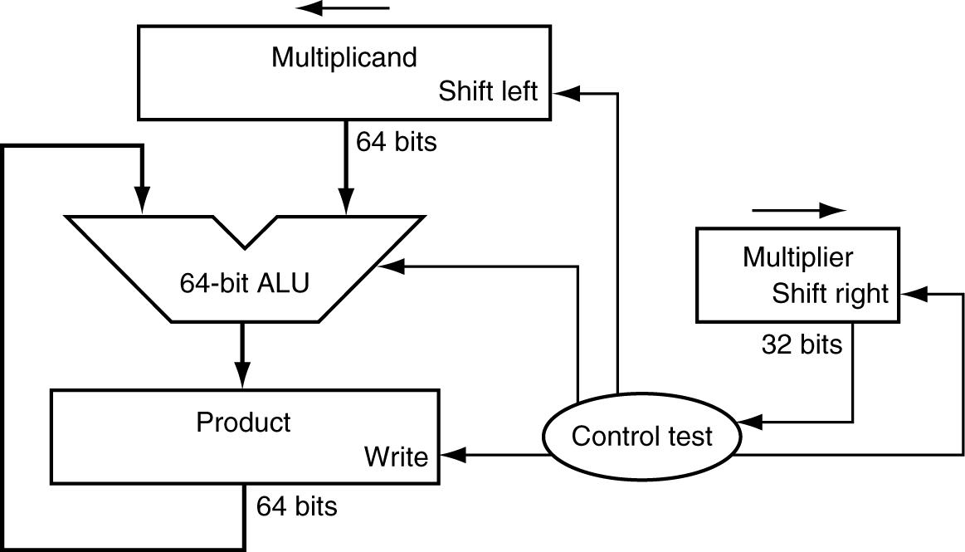
Multiplication Hardware
Initially 0
Notes:
Try an example: 2 * 3 with just 4 bits
Table:
Iteration #, Step (1a,2,3), Multiplier, Multiplicand, Product

Slide 4
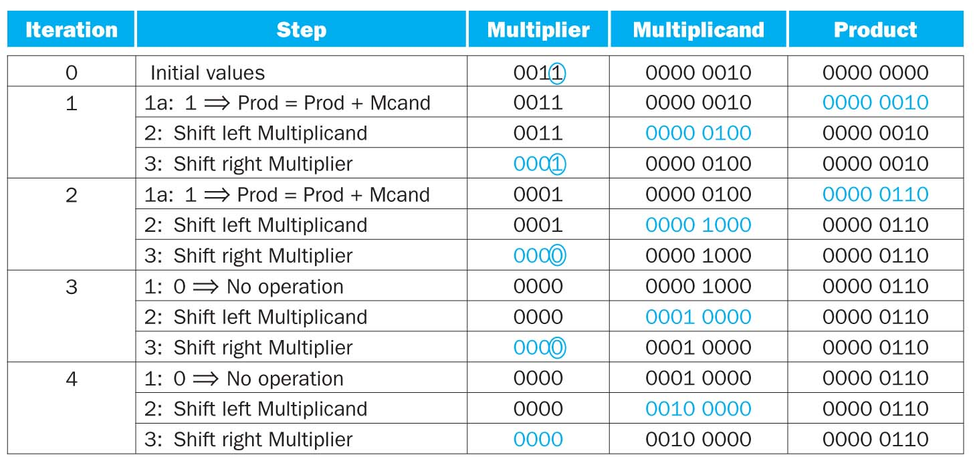
Example
2*3
Notes:
#Now do an example with 8 bits: 0x62 * 0x12
What about -4 * 3 (don’t need to do the hardware process, you can work it out by hand)
Use 4 bits for multiplicand and multiplier, 8 for result.
Results is 40! Should be -12!

Slide 5
Signed Multiplication
Option 1:
Multiply with absolute value
Compute the correct sign at end
Option 2:
Previously algorithm almost works
“Sign extend” when shifting
Notes:
Show idea for -4*3. If you represent -4 as 1111 1100 (with same # bits as result), you get the right answer.

Slide 6
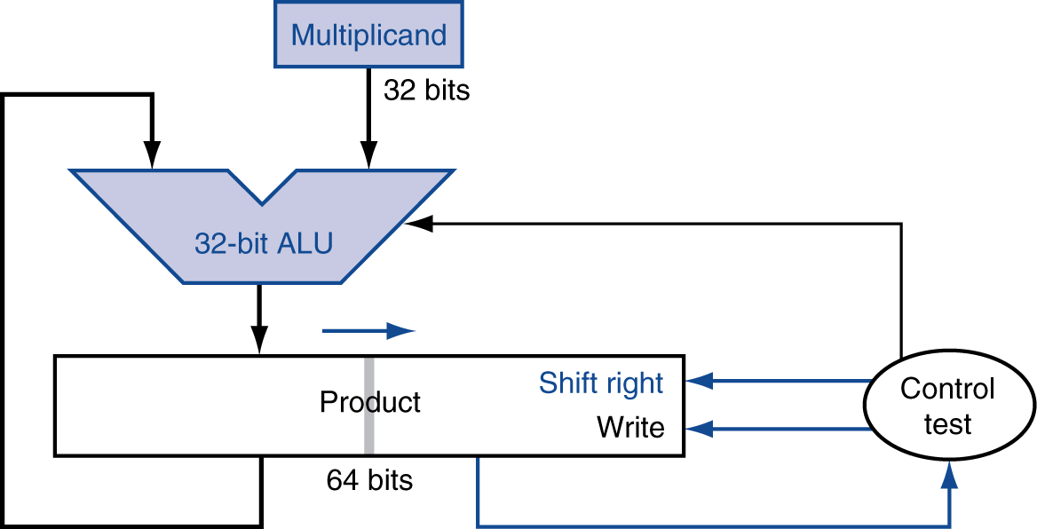
Optimized Multiplier
Refined Multiplier
32-bit multiplicand and ALU
Multiplier is placed in the right half of the product register
64-bit product register
Notes:
Imagine xxxx * yyy1. First we’ll add xxxx, and it seems like it goes to the wrong place. But then we keep shifting this register over and over, so it eventually makes it to the right place.

Slide 7
Optimized Multiplier
Perform steps in parallel: add/shift
One cycle per partial-product addition
That’s ok, if frequency of multiplications is low
Notes:
“One cycle” assuming a single cycle for add…

Slide 8
Alternative Multiplier
One 32-bit adder for each bit of multiplier
Input1 is multiplicand AND multiplier bit
Input2 is output of previous adder
“Chain” of adders, 32 high

Slide 9
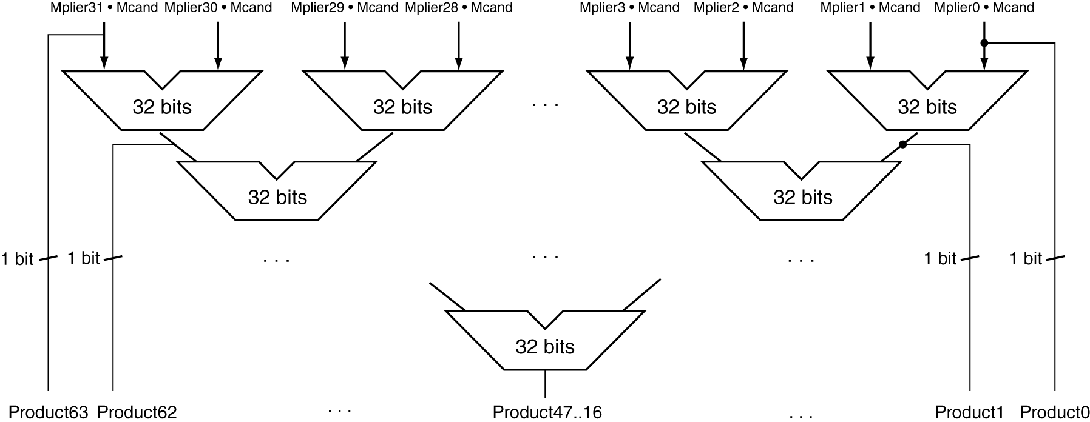
Faster Multiplier
Uses multiple adders
Cost/performance tradeoff
Can be pipelined
Several multiplication performed in parallel
Notes:
Not correct! First Explain what this is trying so say.
Q: Do you see what’s wrong?
A: The left product bits cannot possibly be right…we must wait for the carry-in bits!
But there are more complicated schemes that can do better, see Booth’s algorithm and Wallace trees.
Can do in O(log n) time, but in practice still much slower than addition.

Slide 10
MIPS Multiplication
Two 32-bit registers for product
HI: most-significant 32 bits
LO: least-significant 32-bits
Instructions
mult rs, rt / multu rs, rt
64-bit product in HI/LO
mfhi rd / mflo rd
Move from HI/LO to rd
Can test HI value to see if product overflows 32 bits
mul rd, rs, rt
Least-significant 32 bits of product –> rd
Notes:
This last is a pseudoinstruction.
Q: But if we’re multiplying by a power of 2, what’s the fastest thing to do? A: shift!
Q: When the compiler makes this optimization, what’s it called? A: Strength reduction.

Slide 11
Back to the Example
A better way to do 2*3?
3 << 1
using SLL
Almost all compilers will perform a strength reduction optimization by replacing multiplication of power of 2 by shifting

Slide 12
Division
§3.4 Division
Check for 0 divisor
Long division approach
If divisor ≤ dividend bits
1 bit in quotient, subtract
Otherwise
0 bit in quotient, bring down next dividend bit
Restoring division
Do the subtract, and if remainder goes < 0, add divisor back
Signed division
Divide using absolute values
Adjust sign of quotient and remainder as required
quotient
dividend
1001
1000 1001010
-1000
10
101
1010
-1000
10
divisor
remainder
n-bit operands yield n-bit quotient and remainder
Notes:
See if the divisor “fits” into the part of the dividend we’re looking at.
Except how does a computer know if it fits? If just checks if it’s less than, which it does by subtracting and checking < 0.

Slide 13
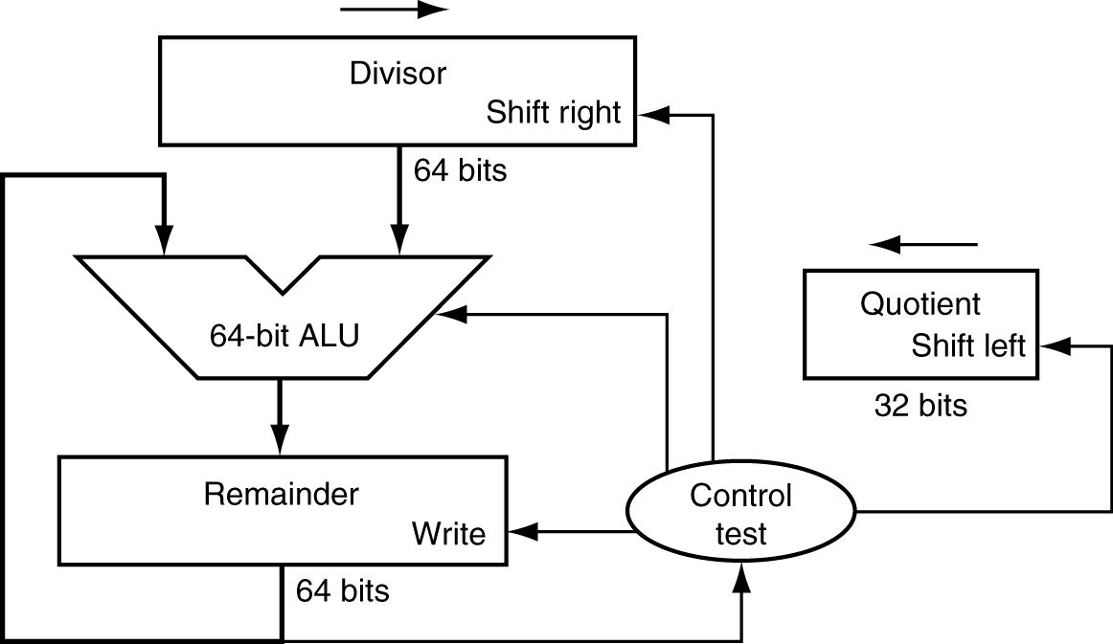
Division Hardware
First version of Division Hardware
32-bit quotient
64-bit ALU
64-bit remainder
Initially divisor in left half
Initially dividend
Notes:
Note the similarity to multiplication HW:
Multiplicand * multiplier = product
Dividend = quotient * divisor + remainder -> Divisor * quotient = dividend - remainder
Divisor starts in left half of divisor register, remainder initialized to dividend

Slide 14
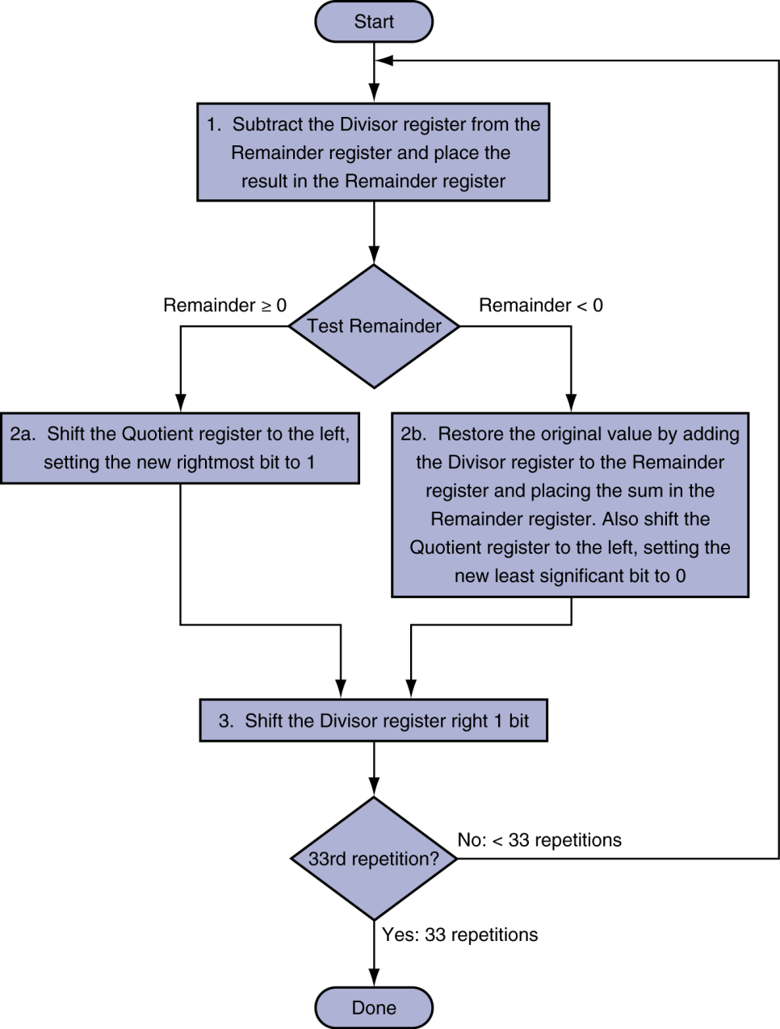
First Version Division Hardware
Initially divisor in left half
Initially dividend
Notes:
Shifting divisor to the right is basically considering another digit of dividend.
Example: Fill out a table for 7/2
Table:
Iteration, Step (1,2b,3), Quotient, Divisor, Remainder

Slide 15
Iter | Step | Quotient | Divisor | Remainder
0 | Initial | 0000 | 0010 0000 | 0000 0111
1 | Rem = Rem - Div
 | Rem < 0?
 | Shift Div right
2 | Rem = Rem - Div
 | Rem < 0?
 | Shift Div right
3 | Rem = Rem - Div
 | Rem < 0?
 | Shift Div right
4 | Rem = Rem - Div
 | Rem < 0?
 | Shift Div right
5 | Rem = Rem - Div
 | Rem < 0?
 | Shift Div right
Notes:
7/2 Example.
Need n+1 iterations!

Slide 16
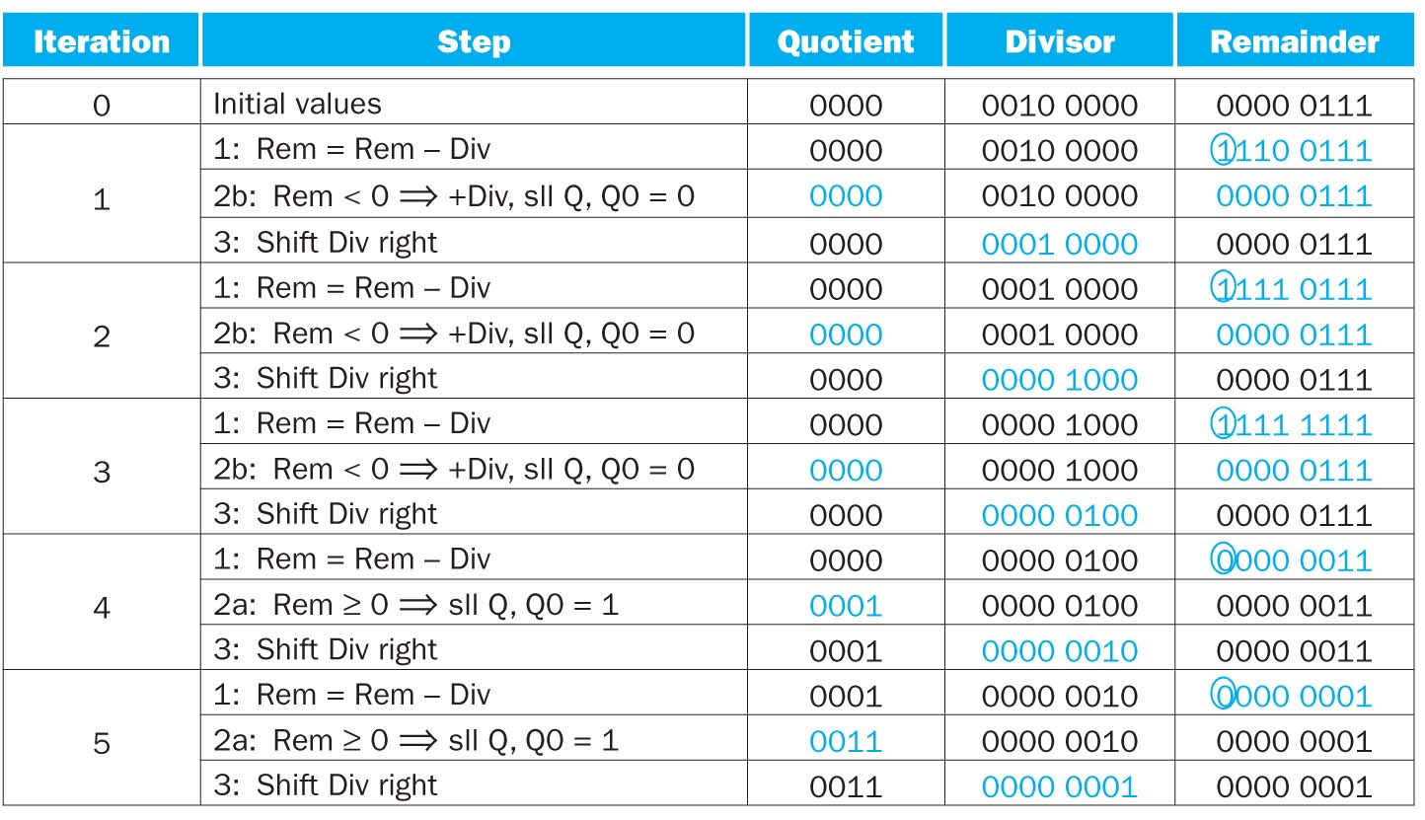
Example
7/2
Notes:
Need n+1 iterations.

