Slide 1
Instructions: Language of the Computer (Ch 2)
Instructor: Robert Utterback
Lecture 14
Notes:
What did we talk about last time?
I-format, what’s that? What instructions do we know are I-format?

Slide 2
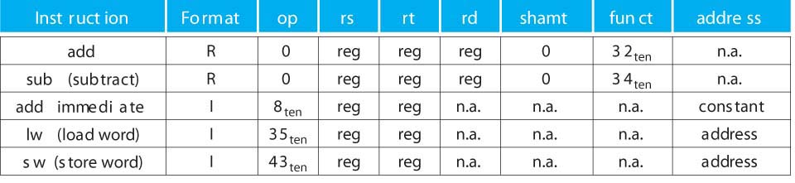
Mini Green Sheet
MIPS instructions
R:
I:
Register numbers
$t0 – $t7 : 8 – 15, $t8 – $t9 : 24 – 25
$s0 – $s7 : 16 – 23, $zero : 0
op
rs
rt
rd
shamt
funct
6 bits
5 bits
5 bits
5 bits
5 bits
6 bits
op
rs
rt
constant or address
6 bits
5 bits
5 bits
16 bits
Notes:
With a single exception, when op=0 it’s in R format

Slide 3
Convert into MIPS Assembly
ae51 0000
1010 1110 0101 0001 0000 0000 0000 0000
101011 10010 10001 0…
43 18 17 0
sw $s1, 0($s2)

Slide 4
In Class Exercise
Convert the following MIPS instructions into Machine Instructions (hex)
lw $t0, 200($s0)
Notes:
35 16 8 200
100011 10000 01000 00000000 11000100
1000 1110 0000 1000 0000 0000 1100 0100
8e0800c4

Slide 5
Logical and Conditional Instructions
Instructor: Robert Utterback

Slide 6
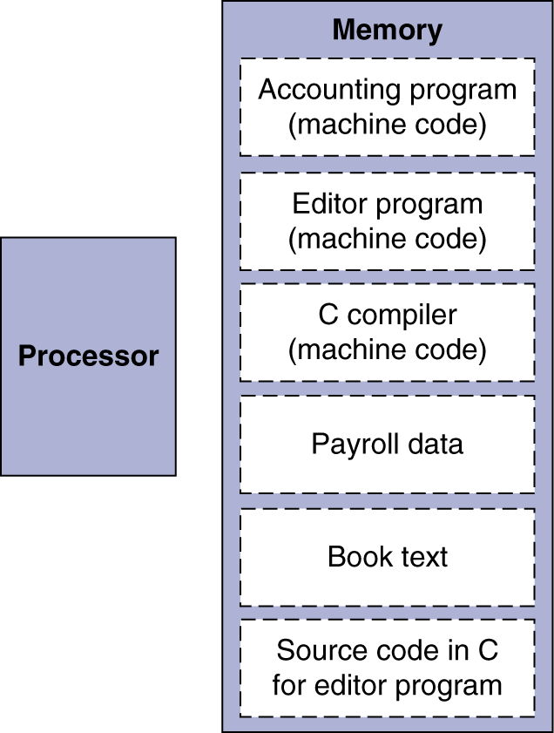
Stored Program Computers
The BIG Picture
Instructions represented in binary, just like data
Instructions and data stored in memory
Programs can operate on programs
e.g., compilers, linkers, …
Binary compatibility allows compiled programs to work on different computers
Standardized ISAs
Notes:
The binary compatibility also requires same OS, libraries… but can use different chip that is same ISA.

Slide 7
Logical Operations (2.6)
Instructions for bitwise manipulation
§2.6 Logical Operations
Operation | C | Java | MIPS
Shift left | << | << | sll
Shift right | >> | >>> | srl
Bitwise AND | & | & | and, andi
Bitwise OR | | | | | or, ori
Bitwise NOT | ~ | ~ | nor
Useful for extracting and inserting groups of bits in a word
Notes:
^ in C does bitwise XOR, which produces subtle bugs if you think it does exponentiation.

Slide 8
Shift Operations
op
rs
rt
rd
shamt
funct
6 bits
5 bits
5 bits
5 bits
5 bits
6 bits
shamt: how many positions to shift
Shift left logical
Shift left and fill with 0 bits
sll by i bits multiplies by 2^{i}
Shift right logical
Shift right and fill with 0 bits
srl by i bits divides by 2^{i} (unsigned only)
Notes:
We sometimes use this to get different bytes from a word.
Compare to base 10, multiplying by 10

Slide 9
AND Operations
Useful to mask bits in a word
Select some bits, clear others to 0
and $t0, $t1, $t2
$t2
0000 0000 0000 0000 0000 1101 1100 0000
$t1
0000 0000 0000 0000 0011 1100 0000 0000
$t0
0000 0000 0000 0000 0000 1100 0000 0000

Slide 10
OR Operations
Useful to include bits in a word
Set some bits to 1, leave others unchanged
or $t0, $t1, $t2
$t2
0000 0000 0000 0000 0000 1101 1100 0000
$t1
0000 0000 0000 0000 0011 1100 0000 0000
$t0
0000 0000 0000 0000 0011 1101 1100 0000

Slide 11
NOT Operations
Useful to invert bits in a word
Change 0 to 1, and 1 to 0
MIPS has NOR 3-operand instruction
a NOR b == NOT ( a OR b )
nor $t0, $t1, $zero
Register 0: always read as zero
$t1
0000 0000 0000 0000 0011 1100 0000 0000
$t0
1111 1111 1111 1111 1100 0011 1111 1111

Slide 12
Making Decisions (2.7)

Slide 13
Conditional Operations
Branch to a labeled instruction if a condition is true
Otherwise, continue sequentially
beq rs, rt, L1
if (rs == rt) branch to instruction labeled L1;
bne rs, rt, L1
if (rs != rt) branch to instruction labeled L1;
j L1
unconditional jump to instruction labeled L1
§2.7 Instructions for Making Decisions

Slide 14
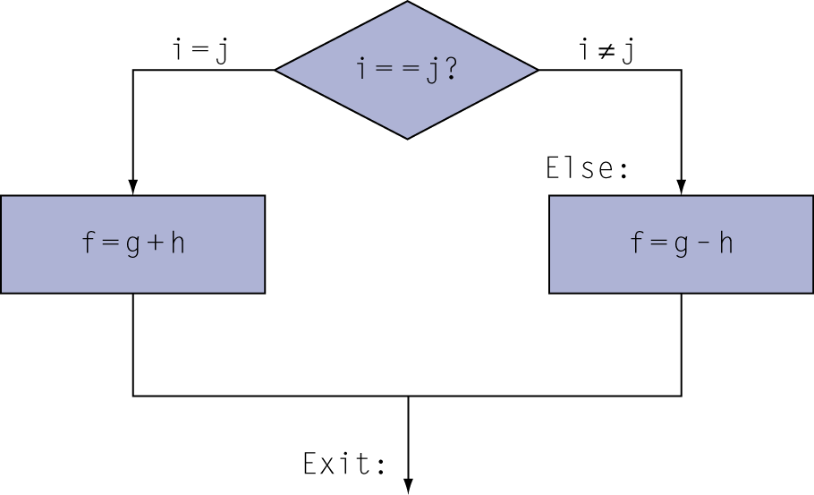
Compiling If Statements
C code:
if (i==j) f = g+h; else f = g-h;
f, g, … in $s0, $s1, …
Compiled MIPS code:
bne $s3, $s4, Else add $s0, $s1, $s2 j Exit Else: sub $s0, $s1, $s2 Exit: …
Assembler calculates addresses
Notes:
The book seems to oversimply and say bne will be used. There are actually lots of factors here, and compilers try to decide which branch will be used more frequently and put that one right after the branch.

Slide 15
Compiling Loop Statements
C code:
while (i != n) i += 1;
i in $s3, nin $s5
Compiled MIPS code:
Loop: bne $s3, $s5, Exit addi $s3, $s3, 1 j Loop Exit: …
Notes:
Need to pause to explain while loops for those who haven’t had 161…start with a simpler while loop.

Slide 16
Compiling Loop Statements
C code:
while (save[i] == k) i += 1;
i in $s3, k in $s5, address of save in $s6
Compiled MIPS code:
Loop: sll $t1, $s3, 2 add $t1, $t1, $s6 lw $t0, 0($t1) bne $t0, $s5, Exit addi $s3, $s3, 1 j Loop Exit: …
Notes:
Note the addressing here: we don’t know the actual slot of the array ahead of time, so we have to do the multiplication first, then add, then use lw with 0(reg).

Slide 17
Basic Blocks
A basic block is a sequence of instructions with
No embedded branches (except at end)
No branch targets (except at beginning)
A compiler identifies basic blocks for optimization
An advanced processor can accelerate execution of basic blocks

Slide 18
More Conditional Operations
Set result to 1 if a condition is true
Otherwise, set to 0
slt rd, rs, rt
if (rs < rt) rd = 1; else rd = 0;
slti rt, rs, constant
if (rs < constant) rt = 1; else rt = 0;
Use in combination with beq, bne
slt $t0, $s1, $s2 # if ($s1 < $s2) bne $t0, $zero, L # branch to L

Slide 19
Branch Instruction Design
Why not blt, bge, etc?
Hardware for <, ≥, … slower than =, ≠
Combining with branch involves more work per instruction, requiring a slower clock
All instructions penalized!
beq and bne are the common case
This is a good design compromise
Notes:
Q: How to do >? What about <=?
A: slt (<), beq else, beq else

Slide 20
Signed vs. Unsigned
Signed comparison: slt, slti
Unsigned comparison: sltu, sltui
Example
$s0 = 1111 1111 1111 1111 1111 1111 1111 1111
$s1 = 0000 0000 0000 0000 0000 0000 0000 0001
slt $t0, $s0, $s1 # signed
–1 < +1 ⇒ $t0 = 1
sltu $t0, $s0, $s1 # unsigned
+4,294,967,295 > +1 ⇒ $t0 = 0

Slide 21
Exercise
C code:
if (x < y)
x--;
What does the MIPS assembly look like?
x in $s0, y in $s1
Notes:
Slt $t0, $s0, $s1
Bne $t0, $zero, exit
Addi $s0, $s0, -1
Exit: …

Slide 22
Exercise
C code:
if (x > y)
x--;
Else
x = y--
What does the MIPS assembly look like?
x in $s0, y in $s1
Notes:
Slt $t0, $s0, $s1
Beq $t0, $zero, else
Beq $s0, $s1, else #if starts after this
Addi $s0, $s0, -1
J Exit
Else: add $s0, $s1, $zero
Addi $s1, $s1, -1
Exit:

Slide 23
Exercise
C code:
for (i = 0; i < n; i++)
v[i] = 0;
What does the MIPS assembly look like?
i in $s0, n in $s1, v in $s2
Notes:
add $s0, $zero, $zero
Loop: slt $t0, $s0, $s1
beq $t0, $zero, Exit
sll $t1, $s0, 2 # let’s us index v
add $t1, $t1, $s2
sw $zero, 0($t1)
j Loop
Exit:

