Slide 1
Parallelism
Chapter 6
Notes:
Why Parallelism?
Heat (power) & energy
Difference between power and energy?

Slide 2
Strong vs Weak Scaling
Strong scaling: problem size fixed
As in example
Weak scaling: problem size proportional to number of processors
10 processors, 10 × 10 matrix
Time = 20 × t_{add}
100 processors, 32 × 32 matrix
Time = 10 × t_{add} + 1000/100 × t_{add} = 20 × t_{add}
Constant performance in this example
Notes:
Exception: memory hierarchy!

Slide 3
Instruction and Data Streams
An alternate classification
 |  | Data Streams
 |  | Single | Multiple
Instruction Streams | Single | SISD: Intel Pentium 4 | SIMD: SSE instructions of x86
 | Multiple | MISD: No examples today | MIMD: Intel Xeon e5345
§6.3 SISD, MIMD, SIMD, SPMD, and Vector
SPMD: Single Program Multiple Data
A parallel program on a MIMD computer
Conditional code for different processors

Slide 4
Example: DAXPY (Y = a × X + Y)
Conventional MIPS code
l.d $f0,a($sp) ;load scalar a addiu r4,$s0,#512 ;upper bound of what to load loop: l.d $f2,0($s0) ;load x(i) mul.d $f2,$f2,$f0 ;a × x(i) l.d $f4,0($s1) ;load y(i) add.d $f4,$f4,$f2 ;a × x(i) + y(i) s.d $f4,0($s1) ;store into y(i) addiu $s0,$s0,#8 ;increment index to x addiu $s1,$s1,#8 ;increment index to y subu $t0,r4,$s0 ;compute bound bne $t0,$zero,loop ;check if done
Vector MIPS code
l.d $f0,a($sp) ;load scalar a lv $v1,0($s0) ;load vector x mulvs.d $v2,$v1,$f0 ;vector-scalar multiply lv $v3,0($s1) ;load vector y addv.d $v4,$v2,$v3 ;add y to product sv $v4,0($s1) ;store the result

Slide 5
Vector Processors
Highly pipelined function units
Stream data from/to vector registers to units
Data collected from memory into registers
Results stored from registers to memory
Example: Vector extension to MIPS
32 × 64-element registers (64-bit elements)
Vector instructions
lv, sv: load/store vector
addv.d: add vectors of double
addvs.d: add scalar to each element of vector of double
Significantly reduces instruction-fetch bandwidth

Slide 6
Vector vs. Scalar
Vector architectures and compilers
Simplify data-parallel programming
Explicit statement of absence of loop-carried dependences
Reduced checking in hardware
Regular access patterns benefit from interleaved and burst memory
Avoid control hazards by avoiding loops
More general than ad-hoc media extensions (such as MMX, SSE)
Better match with compiler technology

Slide 7
SIMD
Operate elementwise on vectors of data
E.g., MMX and SSE instructions in x86
Multiple data elements in 128-bit wide registers
All processors execute the same instruction at the same time
Each with different data address, etc.
Simplifies synchronization
Reduced instruction control hardware
Works best for highly data-parallel applications

Slide 8
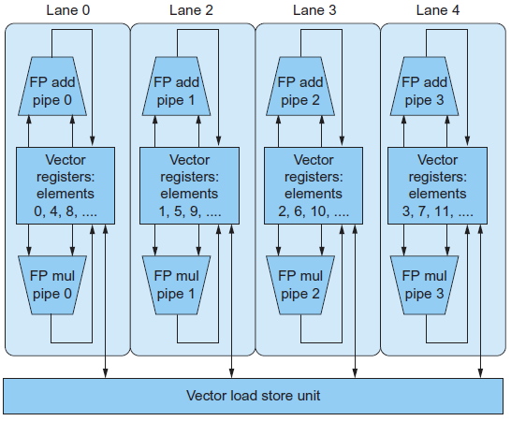
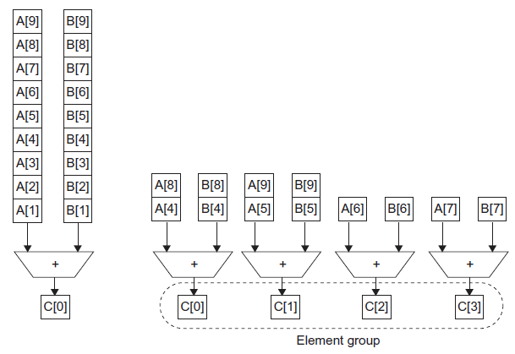
Vector vs. Multimedia Extensions
Vector instructions have a variable vector width, multimedia extensions have a fixed width
Vector instructions support strided access, multimedia extensions do not
Vector units can be combination of pipelined and arrayed functional units:

Slide 9
Multithreading
Performing multiple threads of execution in parallel
Replicate registers, PC, etc.
Fast switching between threads
Fine-grain multithreading
Switch threads after each cycle
Interleave instruction execution
If one thread stalls, others are executed
Coarse-grain multithreading
Only switch on long stall (e.g., L2-cache miss)
Simplifies hardware, but doesn’t hide short stalls (eg, data hazards)
§6.4 Hardware Multithreading

Slide 10
Simultaneous Multithreading
In multiple-issue dynamically scheduled processor
Schedule instructions from multiple threads
Instructions from independent threads execute when function units are available
Within threads, dependencies handled by scheduling and register renaming
Example: Intel Pentium-4 HT
Two threads: duplicated registers, shared function units and caches
Notes:
Think about a dual-issue chip, and how we talked about low utilization

Slide 11
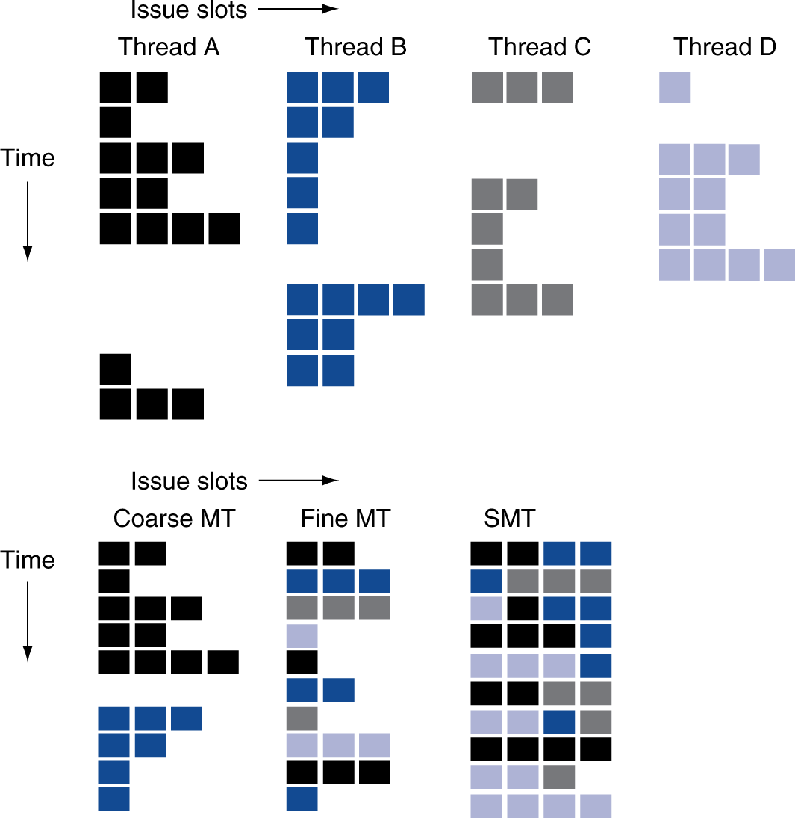
Multithreading Example

Slide 12
Future of Multithreading
Will it survive? In what form?
Power considerations ⇒ simplified microarchitectures
Simpler forms of multithreading
Tolerating cache-miss latency
Thread switch may be most effective
Multiple simple cores might share resources more effectively

Slide 13
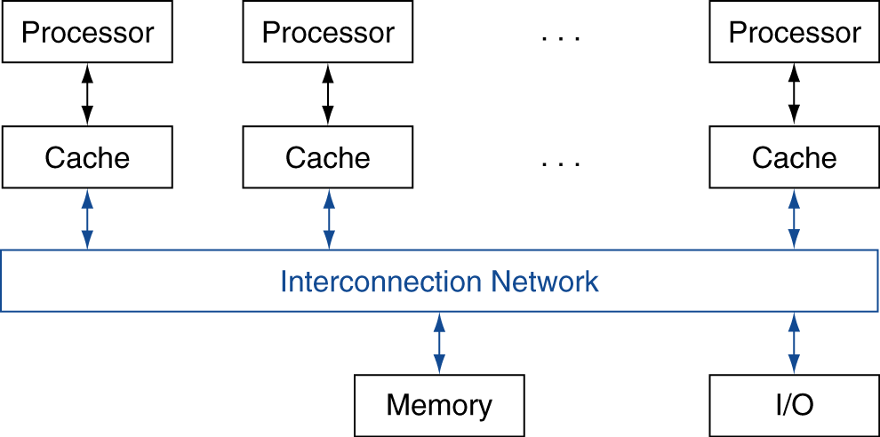
Shared Memory
SMP: shared memory multiprocessor
Hardware provides single physical address space for all processors
Synchronize shared variables using locks
Memory access time
UMA (uniform) vs. NUMA (nonuniform)
§6.5 Multicore and Other Shared Memory Multiprocessors
Notes:
Sometimes people use SMP for Symmetric Multiprocessor, though this conflates with UMA.

Slide 14
Example: Sum Reduction
Sum 100,000 numbers on 100 processor UMA

Slide 15
Example: Sum Reduction
Sum 100,000 numbers on 100 processor UMA
Each processor has ID: 0 ≤ Pn ≤ 99
Partition 1000 numbers per processor
Initial summation on each processor
sum[Pn] = 0; for (i = 1000*Pn; i < 1000*(Pn+1); i = i + 1) sum[Pn] = sum[Pn] + A[i];
Now need to add these partial sums
Reduction: divide and conquer
Half the processors add pairs, then quarter, …
Need to synchronize between reduction steps

Slide 16
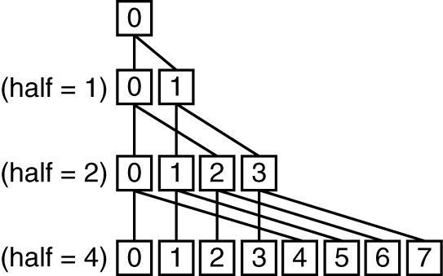
Example: Sum Reduction
half = 100;
repeat
synch();
if (half%2 != 0 && Pn == 0)
sum[0] = sum[0] + sum[half-1];
/* Conditional sum needed when half is odd;
Processor0 gets missing element */
half = half/2; /* dividing line on who sums */
if (Pn < half) sum[Pn] = sum[Pn] + sum[Pn+half];
until (half == 1);

Slide 17
History of GPUs
Early video cards
Frame buffer memory with address generation for video output
3D graphics processing
Originally high-end computers (e.g., SGI)
Moore’s Law ⇒ lower cost, higher density
3D graphics cards for PCs and game consoles
Graphics Processing Units
Processors oriented to 3D graphics tasks
Vertex/pixel processing, shading, texture mapping, rasterization
§6.6 Introduction to Graphics Processing Units

Slide 18
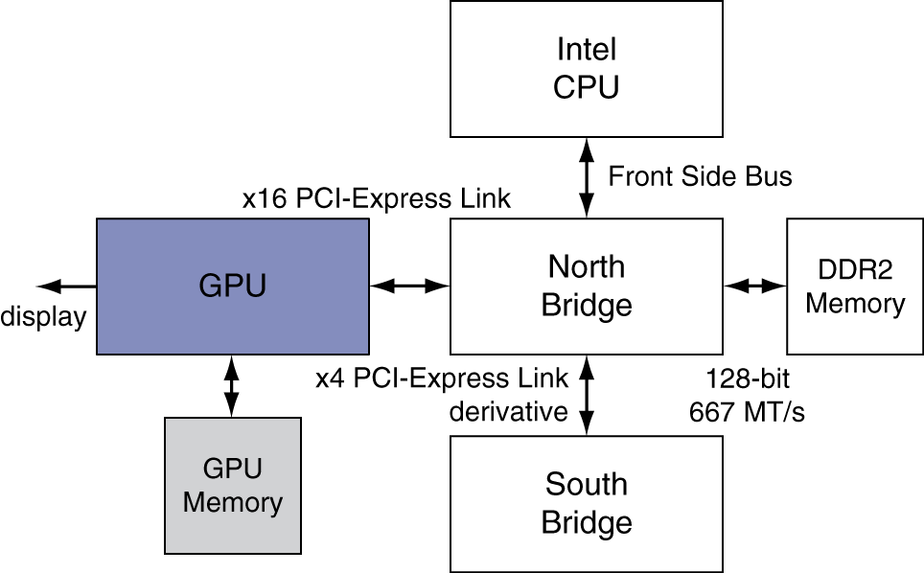
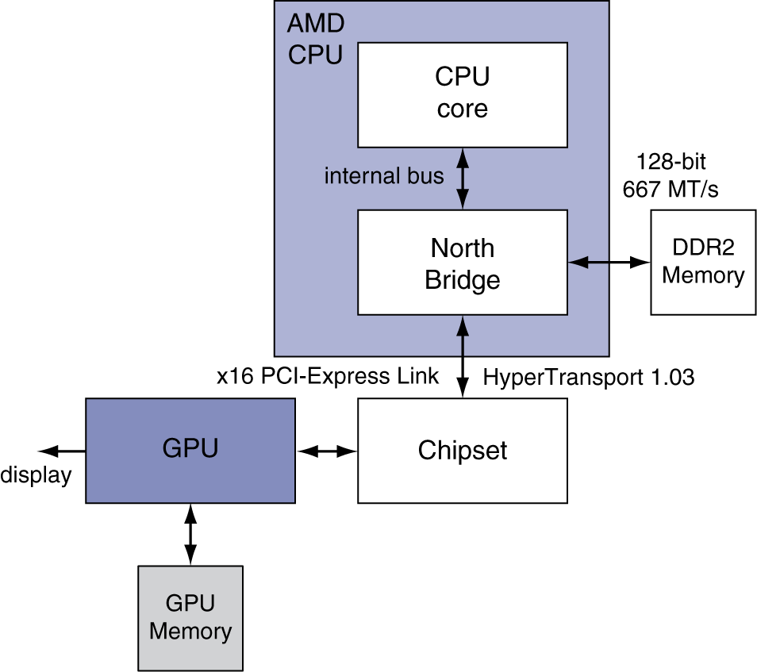
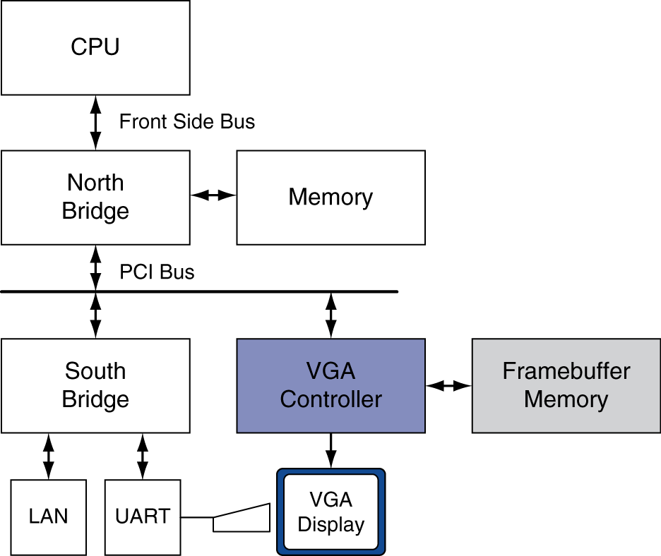
Graphics in the System

Slide 19
GPU Architectures
Processing is highly data-parallel
GPUs are highly multithreaded
Use thread switching to hide memory latency
Less reliance on multi-level caches
Graphics memory is wide and high-bandwidth
Trend toward general purpose GPUs
Heterogeneous CPU/GPU systems
CPU for sequential code, GPU for parallel code
Programming languages/APIs
DirectX, OpenGL
C for Graphics (Cg), High Level Shader Language (HLSL)
Compute Unified Device Architecture (CUDA)

Slide 20
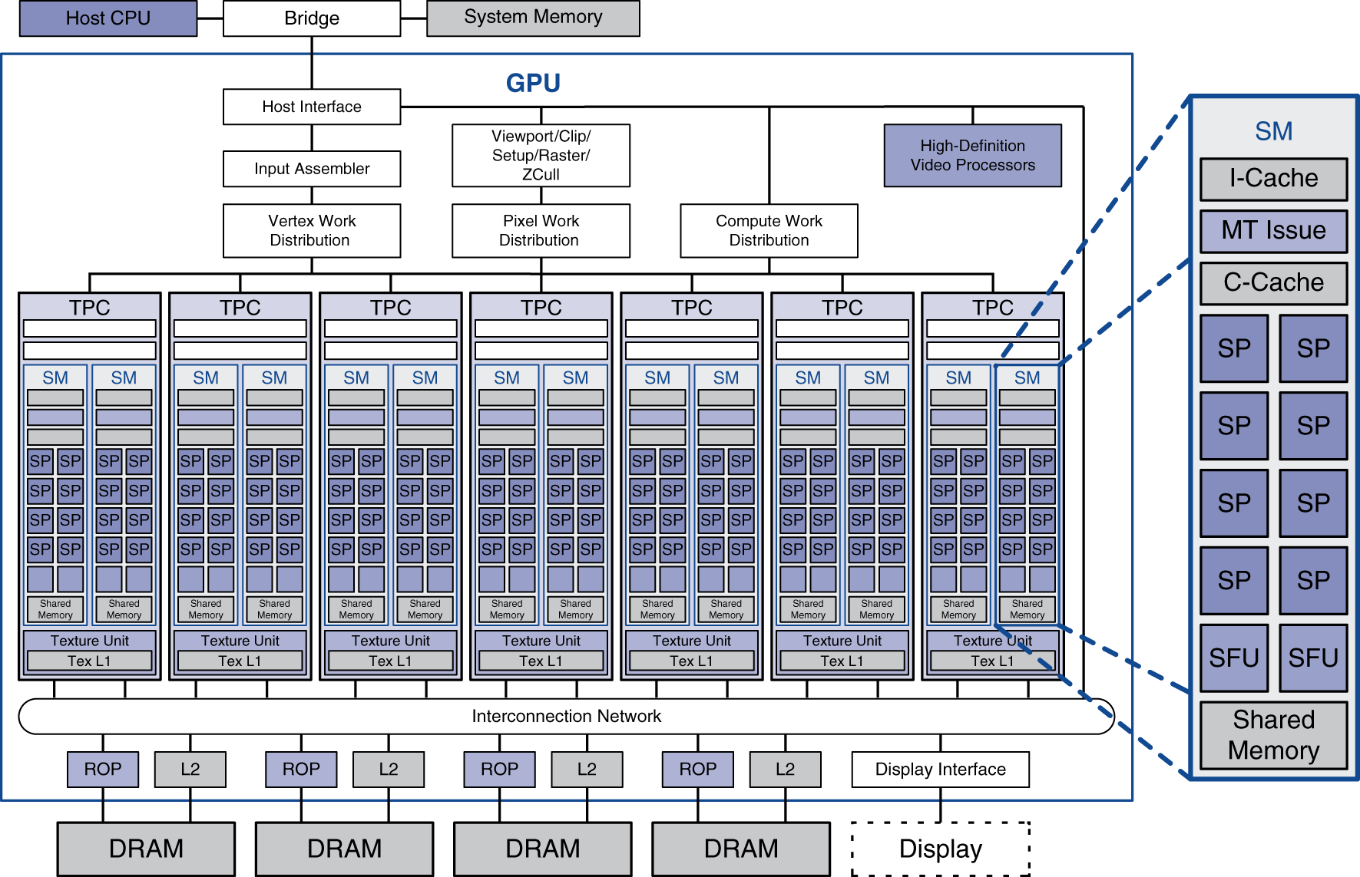
Example: NVIDIA Tesla
Streaming multiprocessor
8 × Streaming processors

Slide 21
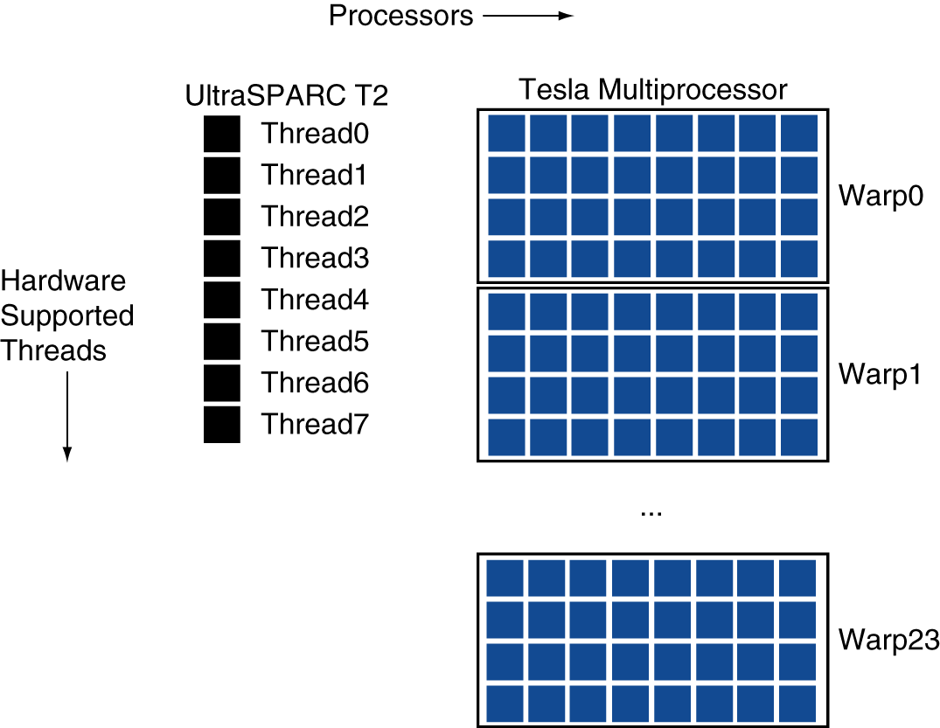
Example: NVIDIA Tesla
Streaming Processors
Single-precision FP and integer units
Each SP is fine-grained multithreaded
Warp: group of 32 threads
Executed in parallel, SIMD style
8 SPs × 4 clock cycles
Hardware contexts for 24 warps
Registers, PCs, …

Slide 22
Classifying GPUs
Don’t fit nicely into SIMD/MIMD model
Conditional execution in a thread allows an illusion of MIMD
But with performance degredation
Need to write general purpose code with care
 | Static: Discovered at Compile Time | Dynamic: Discovered at Runtime
Instruction-Level Parallelism | VLIW | Superscalar
Data-Level Parallelism | SIMD or Vector | Tesla Multiprocessor

Slide 23
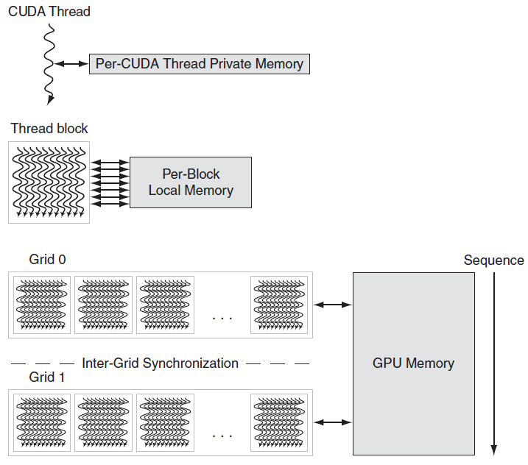
GPU Memory Structures
Notes:
CUDA thread -> one iteration of a loop (with SIMD instructions
Thread block -> one vectorized loop
Grid -> vectorized loop made up of several thread blocks

Slide 24
Putting GPUs into Perspective
Feature | Multicore with SIMD | GPU
SIMD processors | 4 to 8 | 8 to 16
SIMD lanes/processor | 2 to 4 | 8 to 16
Multithreading hardware support for SIMD threads | 2 to 4 | 16 to 32
Typical ratio of single precision to double-precision performance | 2:1 | 2:1
Largest cache size | 8 MB | 0.75 MB
Size of memory address | 64-bit | 64-bit
Size of main memory | 8 GB to 256 GB | 4 GB to 6 GB
Memory protection at level of page | Yes | Yes
Demand paging | Yes | No
Integrated scalar processor/SIMD processor | Yes | No
Cache coherent | Yes | No
Notes:
Extreme data locality => only small caches are necessary.

Slide 25
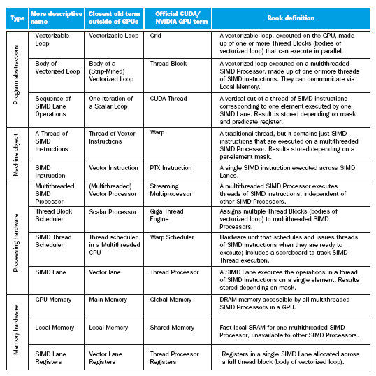
Guide to GPU Terms

