Slide 1
Parallelism
Chapter 6
Notes:
Why Parallelism?
Heat (power) & energy
Difference between power and energy?

Slide 2
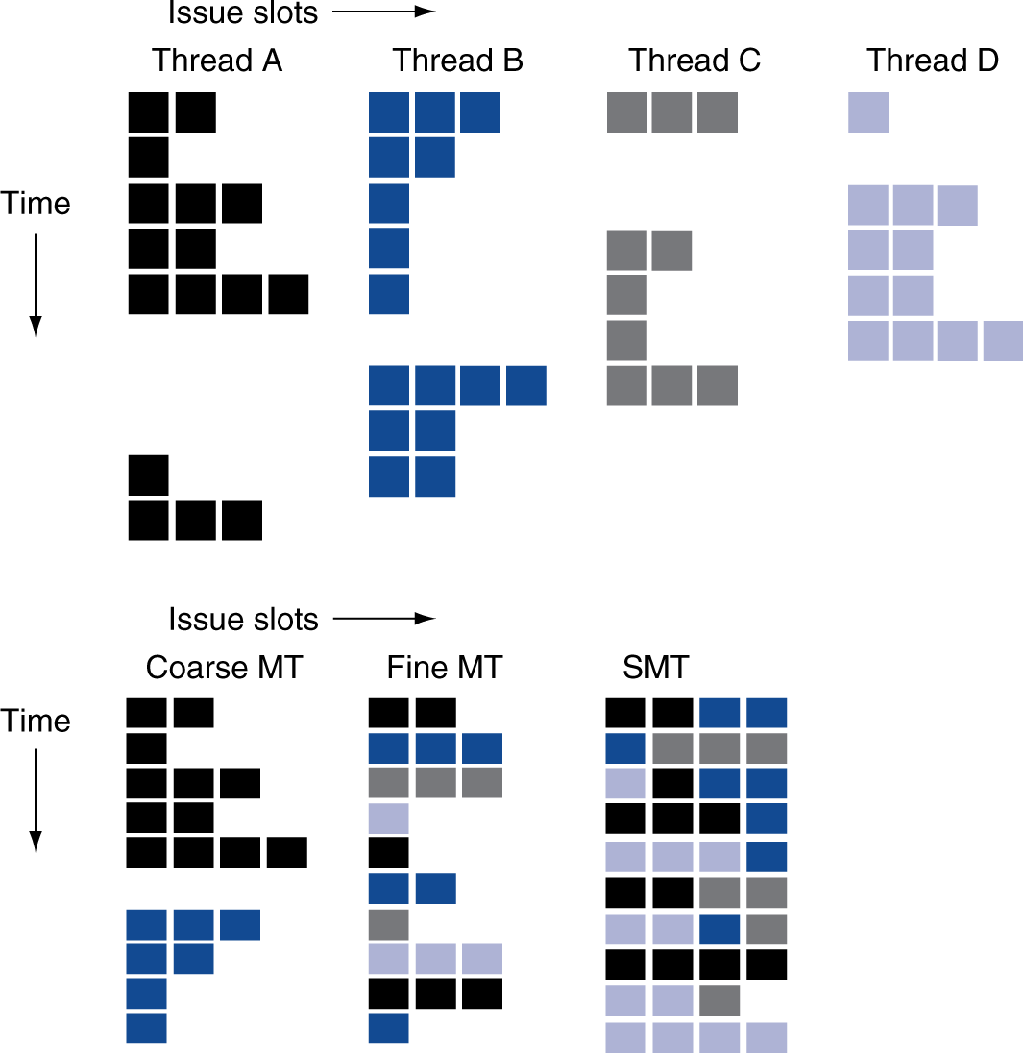
Multithreading Example

Slide 3
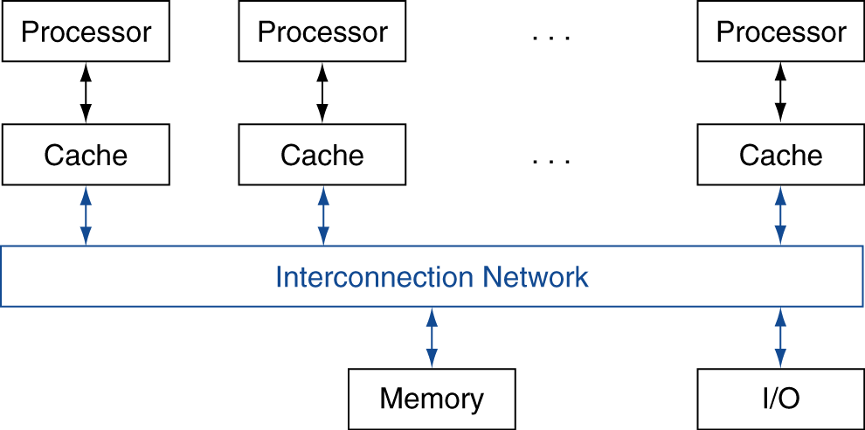
Shared Memory
SMP: shared memory multiprocessor
Hardware provides single physical address space for all processors
Synchronize shared variables using locks
Memory access time
UMA (uniform) vs. NUMA (nonuniform)
§6.5 Multicore and Other Shared Memory Multiprocessors
Notes:
Sometimes people use SMP for Symmetric Multiprocessor, though this conflates with UMA.

Slide 4
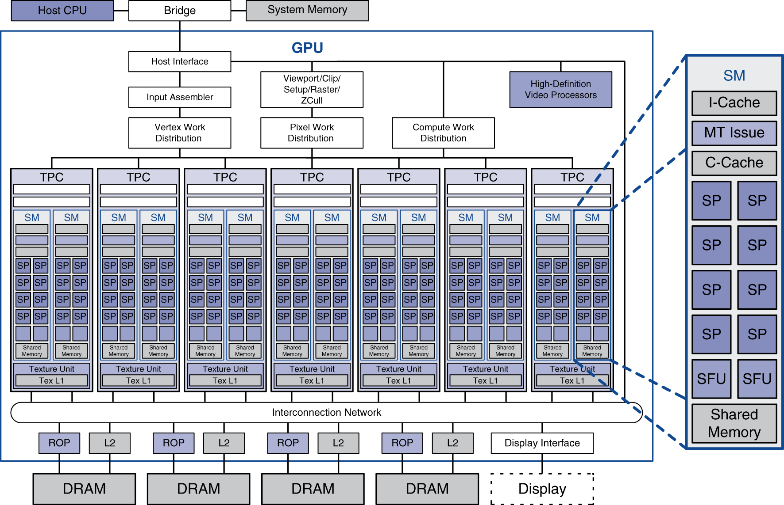
Example: NVIDIA Tesla
Streaming multiprocessor
8 × Streaming processors

Slide 5
Classifying GPUs
Don’t fit nicely into SIMD/MIMD model
Conditional execution in a thread allows an illusion of MIMD
But with performance degredation
Need to write general purpose code with care
 | Static: Discovered at Compile Time | Dynamic: Discovered at Runtime
Instruction-Level Parallelism | VLIW | Superscalar
Data-Level Parallelism | SIMD or Vector | Tesla Multiprocessor

Slide 6
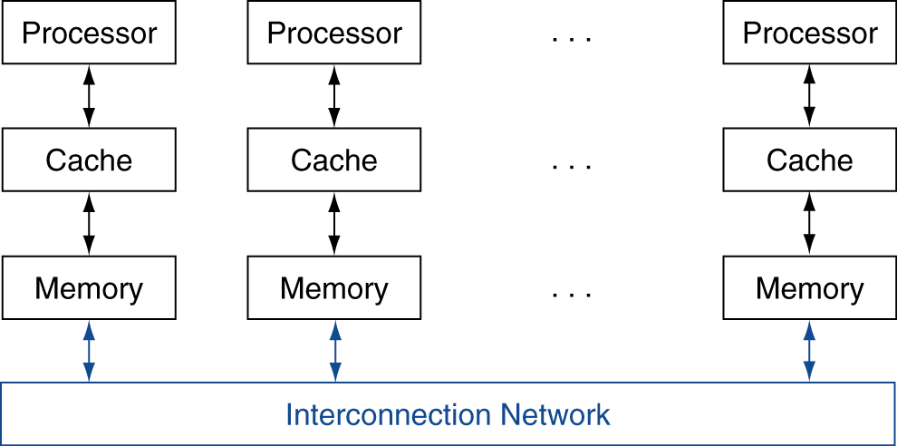
Message Passing
Each processor has private physical address space
Hardware sends/receives messages between processors
§6.7 Clusters, WSC, and Other Message-Passing MPs

Slide 7
Loosely Coupled Clusters
Network of independent computers
Each has private memory and OS
Connected using I/O system
E.g., Ethernet/switch, Internet
Suitable for applications with independent tasks
Web servers, databases, simulations, …
High availability, scalable, affordable
Problems
Administration cost (prefer virtual machines)
Low interconnect bandwidth
c.f. processor/memory bandwidth on an SMP
Notes:
A lot of supercomputers use message passing, but as one large system, vs. clusters…

Slide 8
Sum Reduction (Again)
Sum 100,000 on 100 processors
First distribute 100 numbers to each
The do partial sums
sum = 0; for (i = 0; i<1000; i = i + 1) sum = sum + AN[i];
Reduction
Half the processors send, other half receive and add
The quarter send, quarter receive and add, …

Slide 9
Sum Reduction (Again)
Given send() and receive() operations
limit = 100; half = 100;/* 100 processors */ repeat half = (half+1)/2; /* send vs. receive dividing line */ if (Pn >= half && Pn < limit) send(Pn - half, sum); if (Pn < (limit/2)) sum = sum + receive(); limit = half; /* upper limit of senders */ until (half == 1); /* exit with final sum */
Send/receive also provide synchronization
Assumes send/receive take similar time to addition
Notes:
There’s lots of details to how send() and receive() work
In real life you’d probably be using MPI

Slide 10
Grid Computing
Separate computers interconnected by long-haul networks
E.g., Internet connections
Work units farmed out, results sent back
Can make use of idle time on PCs
E.g., SETI@home, World Community Grid

Slide 11


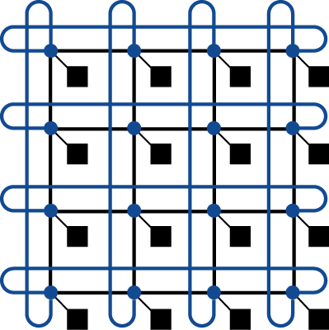

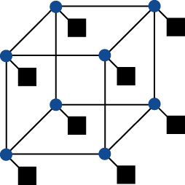
Interconnection Networks
Network topologies
Arrangements of processors, switches, and links
§6.8 Introduction to Multiprocessor Network Topologies
Bus
Ring
N-cube (N = 3)
2D Mesh
Fully connected

Slide 12
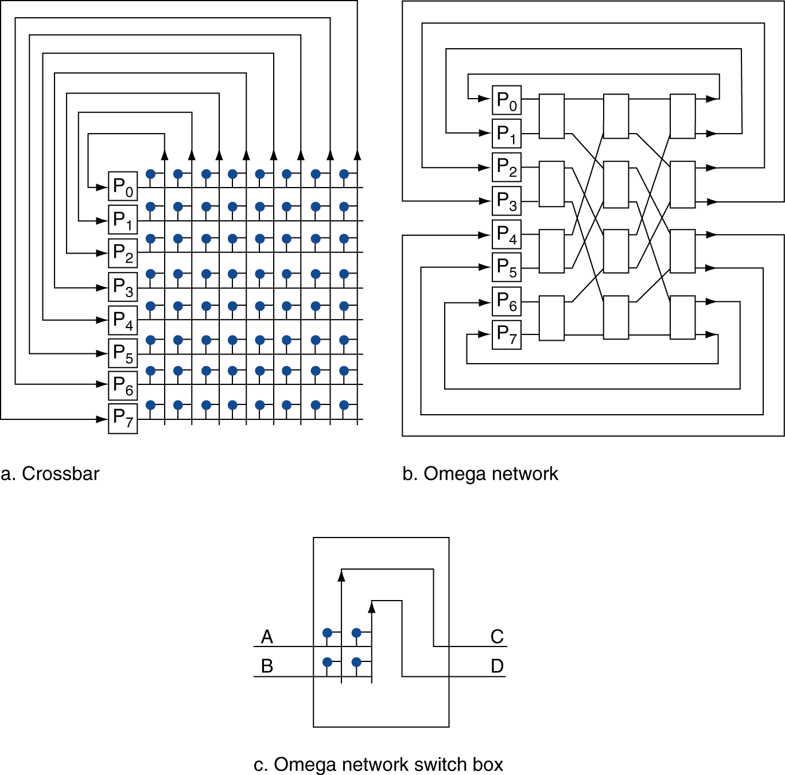
Multistage Networks

Slide 13
Network Characteristics
Performance
Latency per message (unloaded network)
Throughput
Link bandwidth
Total network bandwidth
Bisection bandwidth
Congestion delays (depending on traffic)
Cost
Power
Routability in silicon
Notes:
Fully connected total bandwidth: P(P-1)/2 (sum of (P-1)+(P-2)+(P-3)…+1+0)
Full connected bisection bandwith: (P/2)^2

Slide 14
Parallel Benchmarks
Linpack: matrix linear algebra
SPECrate: parallel run of SPEC CPU programs
Job-level parallelism
SPLASH: Stanford Parallel Applications for Shared Memory
Mix of kernels and applications, strong scaling
NAS (NASA Advanced Supercomputing) suite
computational fluid dynamics kernels
PARSEC (Princeton Application Repository for Shared Memory Computers) suite
Multithreaded applications using Pthreads and OpenMP
§6.10 Multiprocessor Benchmarks and Performance Models

Slide 15
Code or Applications?
Traditional benchmarks
Fixed code and data sets
Parallel programming is evolving
Should algorithms, programming languages, and tools be part of the system?
Compare systems, provided they implement a given application
E.g., Linpack, Berkeley Design Patterns
Would foster innovation in approaches to parallelism

Slide 16
Modeling Performance
Assume performance metric of interest is achievable GFLOPs/sec
Measured using computational kernels from Berkeley Design Patterns
Arithmetic intensity of a kernel
FLOPs per byte of memory accessed
For a given computer, determine
Peak GFLOPS (from data sheet)
Peak memory bytes/sec (using Stream benchmark)

Slide 17
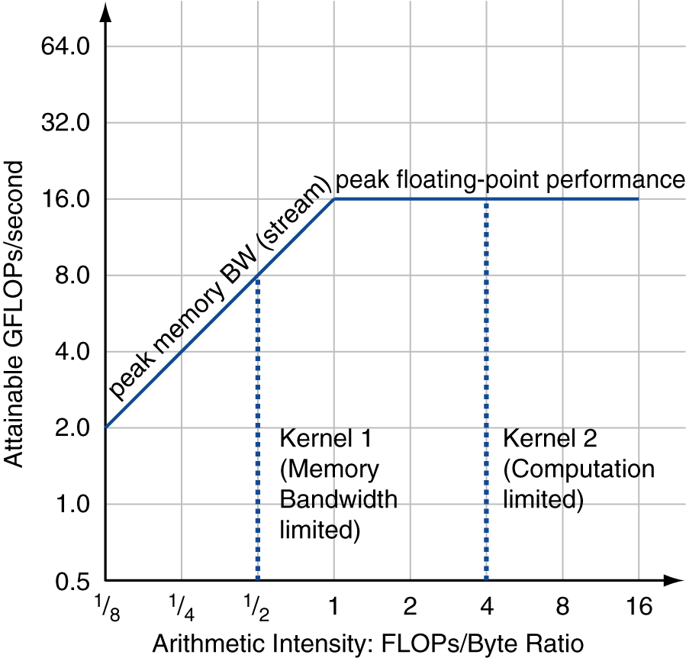
Roofline Diagram
Attainable GPLOPs/sec
= Max ( Peak Memory BW × Arithmetic Intensity, Peak FP Performance )

Slide 18
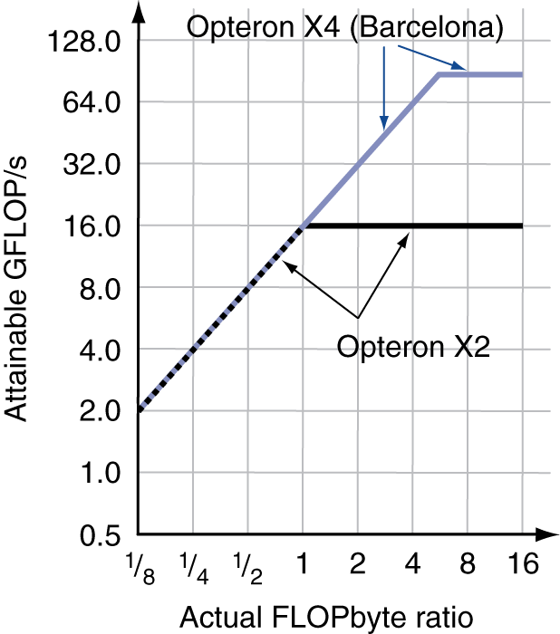
Comparing Systems
Example: Opteron X2 vs. Opteron X4
2-core vs. 4-core, 2× FP performance/core, 2.2GHz vs. 2.3GHz
Same memory system
To get higher performance on X4 than X2
Need high arithmetic intensity
Or working set must fit in X4’s 2MB L-3 cache

Slide 19
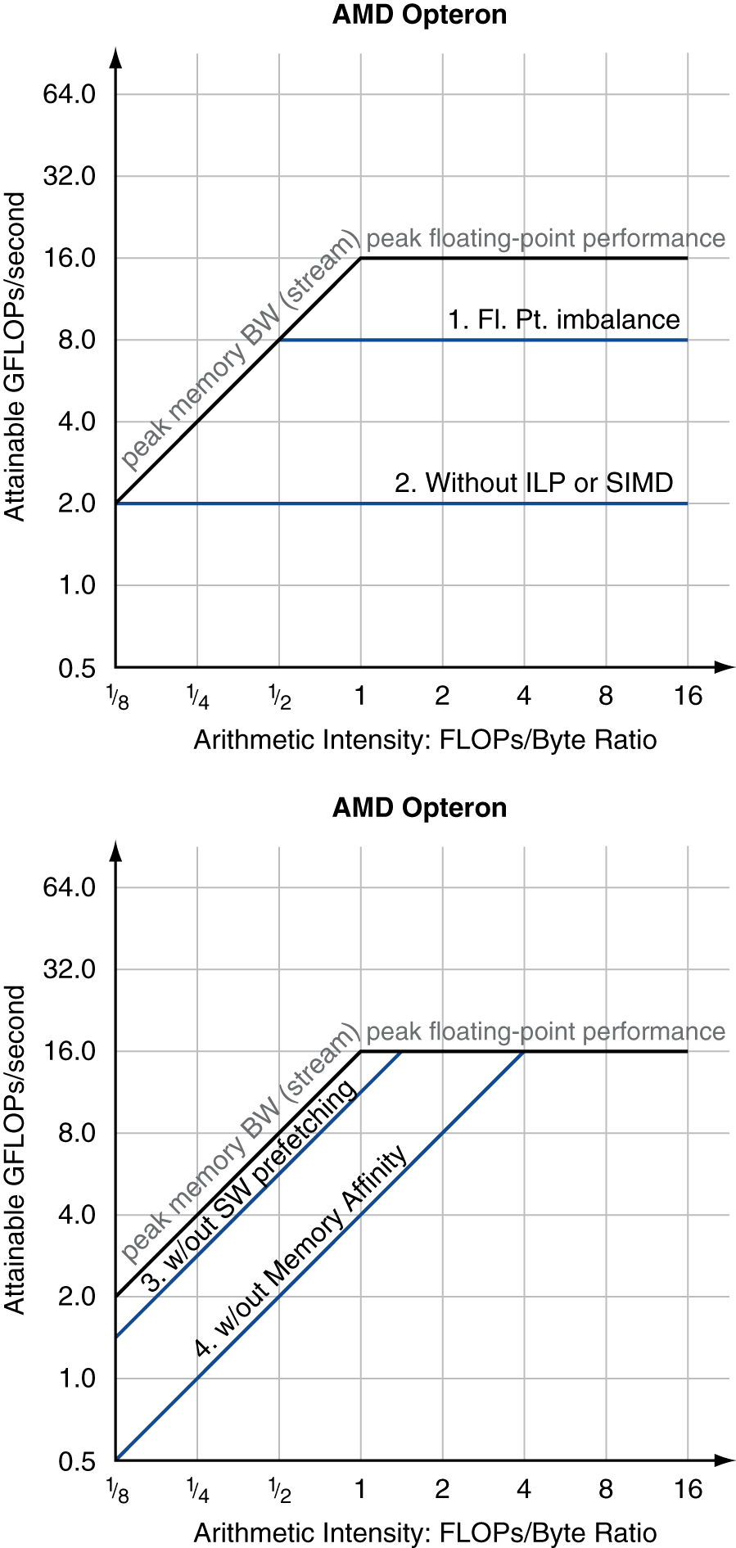
Optimizing Performance
Optimize FP performance
Balance adds & multiplies
Improve superscalar ILP and use of SIMD instructions
Optimize memory usage
Software prefetch
Avoid load stalls
Memory affinity
Avoid non-local data accesses

Slide 20
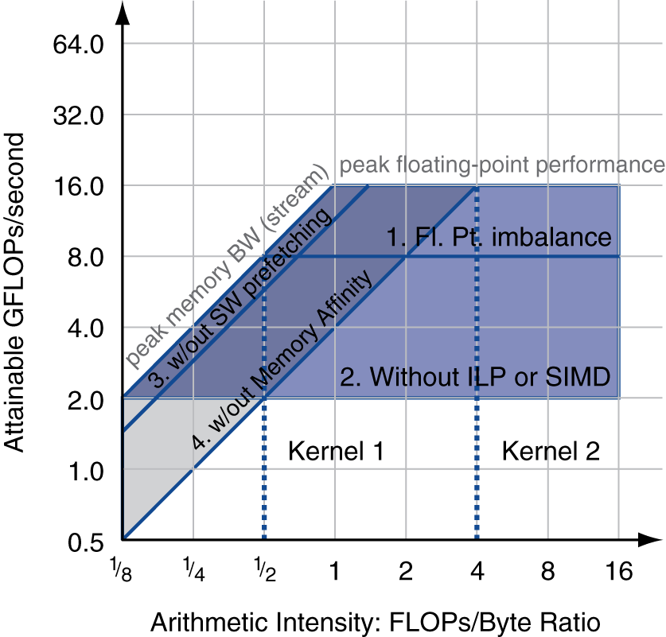
Optimizing Performance
Choice of optimization depends on arithmetic intensity of code
Arithmetic intensity is not always fixed
May scale with problem size
Caching reduces memory accesses
Increases arithmetic intensity

Slide 21
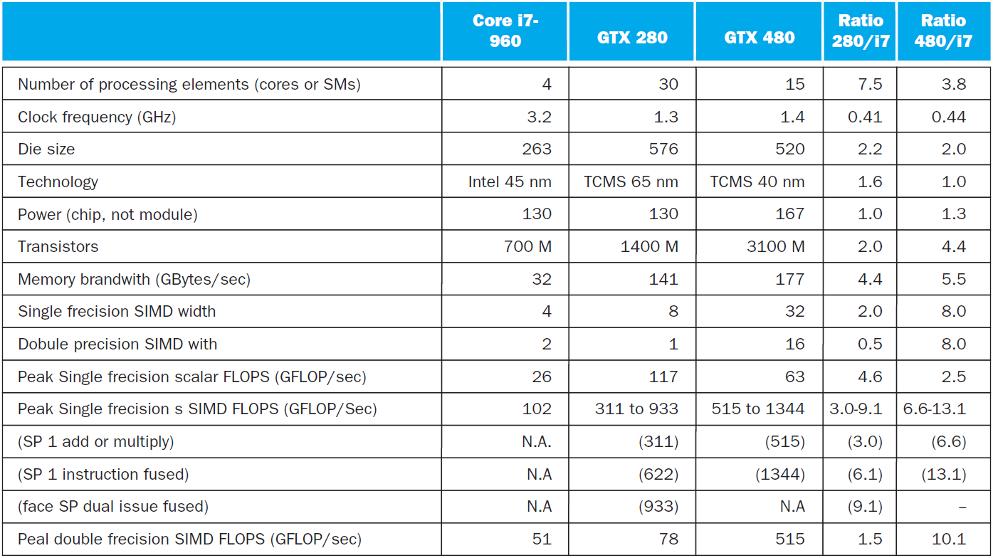
i7-960 vs. NVIDIA Tesla 280/480
§6.11 Real Stuff: Benchmarking and Rooflines i7 vs. Tesla

Slide 22
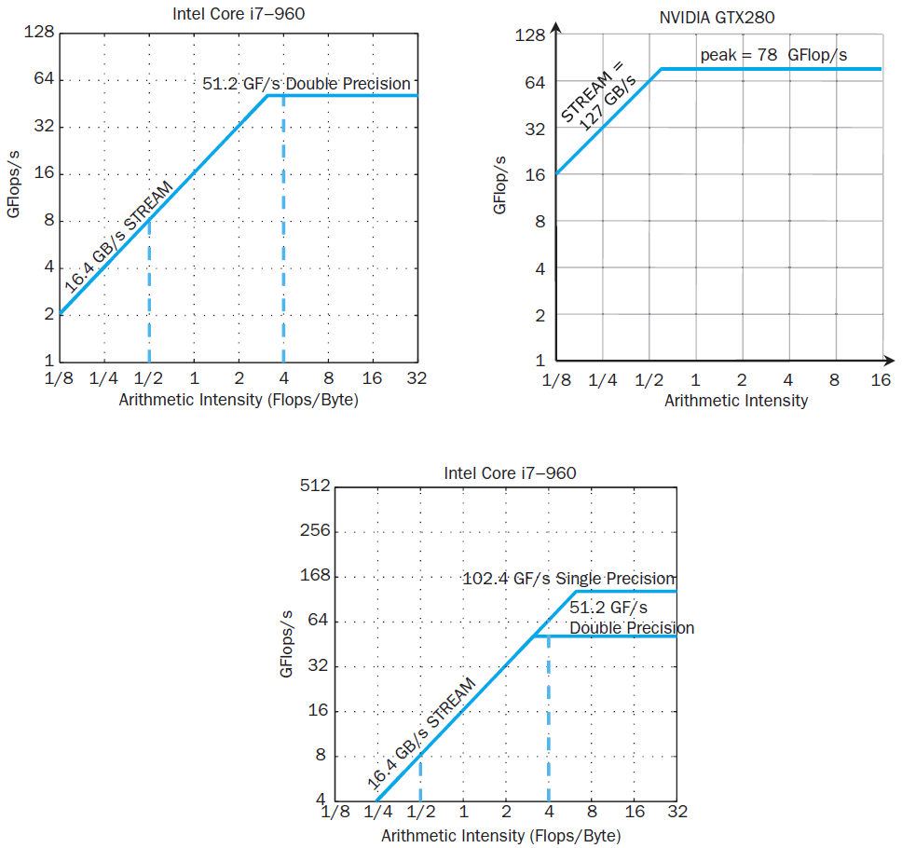
Rooflines

Slide 23
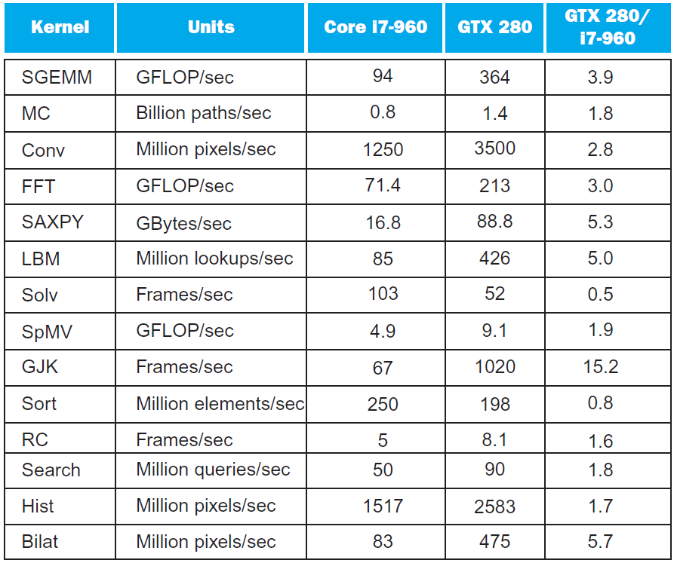
Benchmarks

Slide 24
Performance Summary
GPU (480) has 4.4 X the memory bandwidth
Benefits memory bound kernels
GPU has 13.1 X the single precision throughout, 2.5 X the double precision throughput
Benefits FP compute bound kernels
CPU cache prevents some kernels from becoming memory bound when they otherwise would on GPU
GPUs offer scatter-gather, which assists with kernels with strided data
Lack of synchronization and memory consistency support on GPU limits performance for some kernels

Slide 25
Multi-threading DGEMM
Use OpenMP:
void dgemm (int n, double* A, double* B, double* C)
{
#pragma omp parallel for
for ( int sj = 0; sj < n; sj += BLOCKSIZE )
for ( int si = 0; si < n; si += BLOCKSIZE )
for ( int sk = 0; sk < n; sk += BLOCKSIZE )
do_block(n, si, sj, sk, A, B, C);
}
§6.12 Going Faster: Multiple Processors and Matrix Multiply

Slide 26
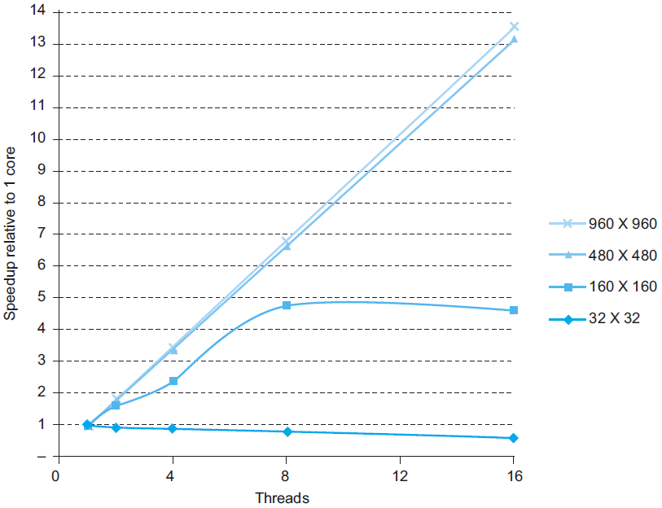
Multithreaded DGEMM

Slide 27
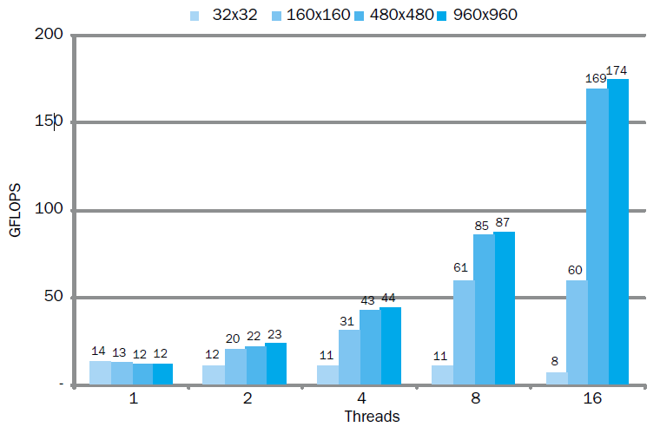
Multithreaded DGEMM

Slide 28
Fallacies
Amdahl’s Law doesn’t apply to parallel computers
Since we can achieve linear speedup
But only on applications with weak scaling
Peak performance tracks observed performance
Marketers like this approach!
But compare Xeon with others in example
Need to be aware of bottlenecks
§6.13 Fallacies and Pitfalls

Slide 29
Pitfalls
Not developing the software to take account of a multiprocessor architecture
Example: using a single lock for a shared composite resource
Serializes accesses, even if they could be done in parallel
Use finer-granularity locking

Slide 30
Concluding Remarks
Goal: higher performance by using multiple processors
Difficulties
Developing parallel software
Devising appropriate architectures
SaaS importance is growing and clusters are a good match
Performance per dollar and performance per Joule drive both mobile and WSC
§6.14 Concluding Remarks

Slide 31
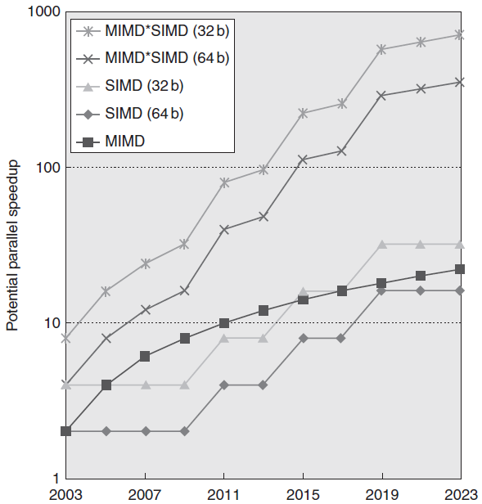
Concluding Remarks (con’t)
SIMD and vector operations match multimedia applications and are easy to program

