Slide 1
ECC, Instructions
Instructor: Robert Utterback
Lecture 12

Slide 2
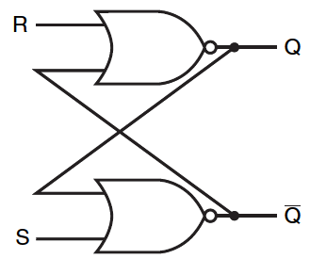
Set-Reset Latch (S-R Latch)
A pair of cross-coupled NOR gates
Unclocked
Do not have a clock input
Can store an internal value
Q represent the current state
Notes:
Draw a truth table for this (inputs are Q_old, ~Q_old, R and S, outputs are Q_new and ~Q_new)

Slide 3
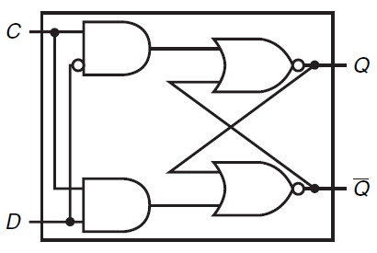
Flip-flops
D-Latch
Clock input C
Data input D

Slide 4
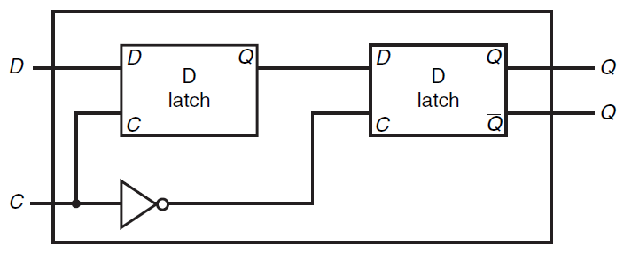
D Flip Flop
D Flip Flop with a Falling-Edge Trigger

Slide 5
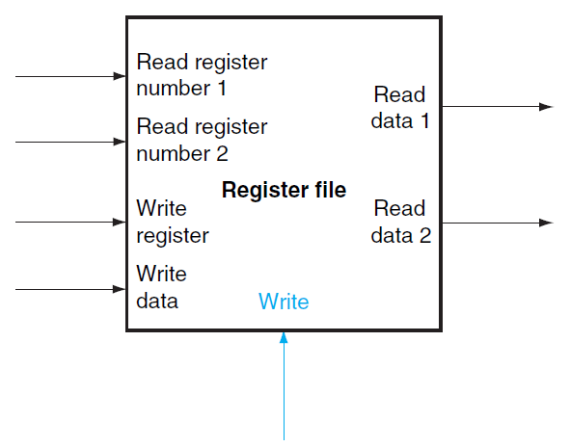
Register Files
A register file consists of a set of registers that can be read and written by supplying a register number
Built from an array of D Flip-Flops
A decoder is used to select a register in the register file

Slide 6
Register Files
Register Files
Can be used to build small memory
Too costly to build large amount of memory
Large Scale Memory
Static random access memories (SRAM)
Dynamic random access memories (DRAM)

Slide 7
SRAM and DRAM
SRAM
Fast but costly
Small amount
Used for Computer Cache
DRAM
Slow but less costly
Large amount
Used for Computer Main Memory

Slide 8
Error Detection and Correction
Error in large memory
Potential of data corruption
Error Checking Code
Detect possible corruption data
Error Correction Code
Correct possible corruption data

Slide 9
Parity Code
Mechanism of (Even) Parity Code
Count the number of 1s in a word
If the number of 1s is odd
1
If the number of 1s is even
0
Example
Data Parity bit
01100111 1
When a word is written into memory, the parity bit is also calculated and written
When a word is read, if the parity bit does not match, there is an error

Slide 10
Parity Scheme
1-bit Parity Scheme
Can detect at most 1 bit of error
Cannot detect 2 bits of error
Cannot correct an error

Slide 11
Error Correction Code (ECC)
Error Correction Code (ECC)
Can correct certain errors
Requires more bits
7 bits for 64-bit word
8 bits for 128-bit word
Most computers use ECC for
Detection of 2 bits of error
Correction of 1 bit of error

Slide 12
Instructions: Language of the Computer (Ch 2)
Instructor: Robert Utterback
Lecture 12

Slide 13
Instruction Set
§2.1 Introduction
The repertoire of instructions of a computer
Different computers have different instruction sets
But with many aspects in common
Early computers had very simple instruction sets
Simplified implementation
Many modern computers also have simple instruction sets
Notes:
Instructions: commands that a computer can understand

Slide 14
CISC and RISC
CISC (complex instruction set computer)
VAX, Intel X86, IBM 360/370, etc.
RISC (reduced instruction set computer)
MIPS, DEC Alpha, SUN Sparc, IBM RS6000
Boundaries have blurred
Modern CPUs utilize features of both
Notes:
Basically two camps…
RISC are simple instructions, that are easier to implement and also to understand
CISC is complex instructions, harder to understand and implement, but each instruction can do more complicated and fancy things.

Slide 15
The MIPS Instruction Set
Used as the example throughout the book
Stanford MIPS commercialized by MIPS Technologies (www.mips.com)
Large share of embedded core market
Applications in consumer electronics, network/storage equipment, cameras, printers, …
Typical of many modern ISAs
See MIPS Reference Data tear-out card, and Appendixes B and E

Slide 16
Arithmetic Operations
Add and subtract, three operands
Two sources and one destination
add a, b, c # a gets b + c
All arithmetic operations have this form
How about a = b + c + d?
§2.2 Operations of the Computer Hardware
Notes:
add a, b, c
add a, a, d
OR
Add t0, b, c
add a, t0, d

Slide 17
ISA Design
Design Principle 1: Simplicity favors regularity
Regularity makes implementation simpler
Simplicity enables higher performance at lower cost
§2.2 Operations of the Computer Hardware
Notes:
A, b, and c are just abstract locations here…

Slide 18
Arithmetic Example
C code:
f = (g + h) - (i + j);
Compiled MIPS code:
add t0, g, h # temp t0 = g + h add t1, i, j # temp t1 = i + j sub f, t0, t1 # f = t0 - t1

Slide 19
More Arithmetic Example
C code:
f = g + h + i + j + k;
Compiled MIPS code:
add t0, g, h # temp t0 = g + h add t1, t0, i # temp t1 = t0 + i add t2, t1, j # temp t2 = t1 + j add f, t2, k # f = t2 + k
Do we really need three registers?

Slide 20
Register Operands
Arithmetic instructions use register operands
MIPS has a 32 × 32-bit register file
Use for frequently accessed data
Numbered 0 to 31
32-bit data called a “word”
Assembler names
$t0, $t1, …, $t9 for temporary values
$s0, $s1, …, $s7 for saved variables
Why only 32?
§2.3 Operands of the Computer Hardware
Notes:
For now, just s and t. We’ll get to why these names, and use the rest of the registers, in 2.8.

Slide 21
ISA Design
Design Principle 2: Smaller is faster
c.f. main memory: millions of locations

Slide 22
Register Operand Example
C code:
f = (g + h) - (i + j);
f, …, j in $s0, …, $s4
Compiled MIPS code:
add $t0, $s1, $s2 add $t1, $s3, $s4 sub $s0, $t0, $t1

Slide 23
Memory Operands
Main memory used for composite data
Arrays, structures, dynamic data
To apply arithmetic operations
Load values from memory into registers
Store result from register to memory
Memory is byte addressed
Each address identifies an 8-bit byte
Words are aligned in memory
Address must be a multiple of 4

Slide 24
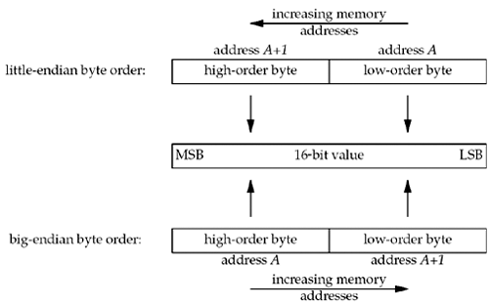
Byte Ordering
Little-endian byte order
With the low-order byte at the starting address
Example: Intel, DEC
Big-endian byte order
With the high-order byte at the starting address
Example: HP, IBM, Motorola 68000
Internet standard byte ordering
Format 256₁₀ in little-endian and big-endian using 16 bits
Format
Value
Little-Endian
00000000 00000001
Big-Endian
00000001 00000000
Notes:
MIPS is Big Endian
Most-significant byte at least address of a word
c.f. Little Endian: least-significant byte at least address

Slide 25
Memory Operand Example 1
C code:
g = h + A[8];
g in $s1, h in $s2, base address of A in $s3
Compiled MIPS code:
Index 8 requires offset of 32
4 bytes per word
lw $t0, 32($s3) # load word add $s1, $s2, $t0
offset
base register
Notes:
Need to pause a define an array, e.g. just a fixed area in memory that we can treat as a “vector” of memory words…no operations defined on it, can’t add to its size….

Slide 26
Memory Operand Example 2
C code:
A[12] = h + A[8];
h in $s2, base address of A in $s3
Compiled MIPS code:
Index 8 requires offset of 32
lw $t0, 32($s3) # load word add $t0, $s2, $t0 sw $t0, 48($s3) # store word
Notes:
Exercise: what about A[2] = A[0] + A[1], with base of A in $s0?

