Slide 1
The Memory Hierarchy
Chapter 5
Notes:
4 Design choices for a cache
Block placement
Finding a block (these first two are really the shape of the cache)
Replacement policy
Write policy
Types of cache misses:
Cold
Capacity
Conflict
How to reduce each?

Slide 2
Cache Design Trade-offs
Design change | Effect on miss rate | Negative performance effect
Increase cache size | Decrease capacity misses | May increase access time
Increase associativity | Decrease conflict misses | May increase access time
Increase block size | Decrease compulsory misses | Increases miss penalty. For very large block size, may increase miss rate due to pollution.

Slide 3
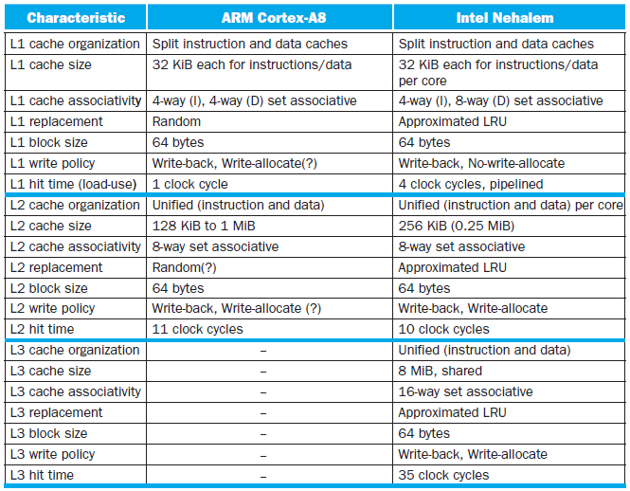
Multilevel On-Chip Caches
§5.13 The ARM Cortex-A8 and Intel Core i7 Memory Hierarchies

Slide 4
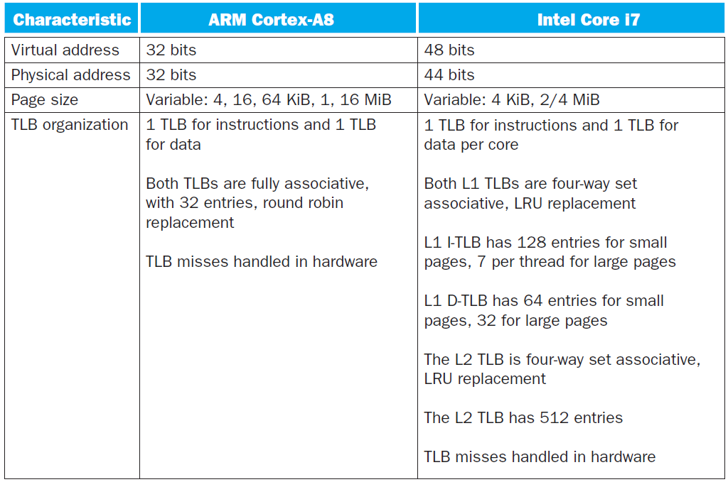
2-Level TLB Organization

Slide 5
Supporting Multiple Issue
Both have multi-banked caches that allow multiple accesses per cycle assuming no bank conflicts
Core i7 cache optimizations
Return requested word first
Non-blocking cache
Hit under miss
Miss under miss
Data prefetching

Slide 6
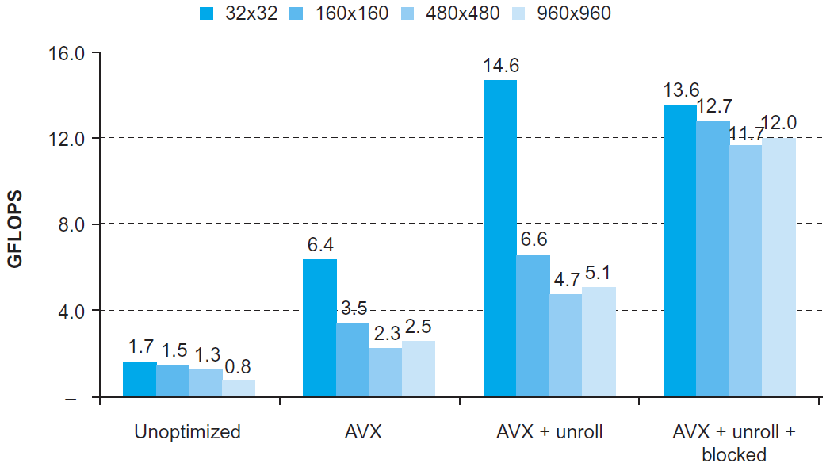
DGEMM
Combine cache blocking and subword parallelism
§5.14 Going Faster: Cache Blocking and Matrix Multiply

Slide 7
Pitfalls
Byte vs. word addressing
Example: 32-byte direct-mapped cache, 4-byte blocks
Byte 36 maps to block 1
Word 36 maps to block 4
Ignoring memory system effects when writing or generating code
Example: iterating over rows vs. columns of arrays
Large strides result in poor locality
§5.15 Fallacies and Pitfalls

Slide 8
Pitfalls
In multiprocessor with shared L2 or L3 cache
Less associativity than cores results in conflict misses
More cores ⇒ need to increase associativity
Using AMAT to evaluate performance of out-of-order processors
Ignores effect of non-blocked accesses
Instead, evaluate performance by simulation

Slide 9
Pitfalls
Extending address range using segments
E.g., Intel 80286
But a segment is not always big enough
Makes address arithmetic complicated
Implementing a VMM on an ISA not designed for virtualization
E.g., non-privileged instructions accessing hardware resources
Either extend ISA, or require guest OS not to use problematic instructions
Notes:
Someone summarize this chapter for me.

Slide 10
Concluding Remarks
Fast memories are small, large memories are slow
We really want fast, large memories ☹
Caching gives this illusion ☺
Principle of locality
Programs use a small part of their memory space frequently
Memory hierarchy
L1 cache ↔ L2 cache ↔ … ↔ DRAM memory ↔ disk
Memory system design is critical for multiprocessors
§5.16 Concluding Remarks

