Slide 1
Parallelism
Chapter 6
Notes:
Why Parallelism?
Heat (power) & energy
Difference between power and energy?

Slide 2
Introduction
§6.1 Introduction
Goal: connecting multiple computers to get higher performance
Multiprocessors
Scalability, availability, power efficiency
Task-level (process-level) parallelism
High throughput for independent jobs
Parallel processing program
Single program run on multiple processors
Multicore microprocessors
Chips with multiple processors (cores)

Slide 3
Hardware and Software
Hardware
Serial: e.g., Pentium 4
Parallel: e.g., quad-core Xeon e5345
Software
Sequential: e.g., matrix multiplication
Concurrent: e.g., operating system
Sequential/concurrent software can run on serial/parallel hardware
Challenge: making effective use of parallel hardware

Slide 4
Parallelism in the Book
§2.11: Parallelism and Instructions
Synchronization
§3.6: Parallelism and Computer Arithmetic
Subword Parallelism
§4.10: Parallelism and Advanced Instruction-Level Parallelism
§5.10: Parallelism and Memory Hierarchies
Cache Coherence

Slide 5
Parallel Programming
Parallel software is the problem
Need to get significant performance improvement
Otherwise, just use a faster uniprocessor, since it’s easier!
Difficulties
Partitioning
Coordination
Communications overhead
§6.2 The Difficulty of Creating Parallel Processing Programs
Notes:
Reporting analogy – equal sized pieces, communication overhead, balancing the load, time to synchronize
The more processors (reporters), the harder this coordination becomes…

Slide 6
Amdahl’s Law
Notes:
Who remembers Amdahl’s law? If not the details, then what is means at a high level…

Slide 7
Amdahl’s Law
Sequential part can limit speedup
Example: 100 processors, 90× speedup?
T_{new} = T_{parallelizable}/100 + T_{sequential}
Solving: F_{parallelizable} = 0.999
Need sequential part to be 0.1% of original time
Notes:
Speedup = T_old / T_new = T_old / (T_par/100 + T_seq)
= 1/( (T_par/100/T_old) + (T_seq/T_old) = 1 / ((F_par/100) + F_seq)

Slide 8
Scaling Example
Workload: sum of 10 scalars, and 10 × 10 matrix sum
Speed up from 10 to 100 processors
Single processor: Time = (10 + 100) × t_{add}
10 processors
Time = 10 × t_{add} + 100/10 × t_{add} = 20 × t_{add}
Speedup = 110/20 = 5.5 (55% of potential)
100 processors
Time = 10 × t_{add} + 100/100 × t_{add} = 11 × t_{add}
Speedup = 110/11 = 10 (10% of potential)
Assumes load can be balanced across processors
Notes:
Now I want you do repeat these calculations with a 100x100 matrix.

Slide 9
Scaling Example (cont)
What if matrix size is 100 × 100?
Single processor: Time = (10 + 10000) × t_{add}
10 processors
Time = 10 × t_{add} + 10000/10 × t_{add} = 1010 × t_{add}
Speedup = 10010/1010 = 9.9 (99% of potential)
100 processors
Time = 10 × t_{add} + 10000/100 × t_{add} = 110 × t_{add}
Speedup = 10010/110 = 91 (91% of potential)
Assuming load balanced

Slide 10
Strong vs Weak Scaling
Strong scaling: problem size fixed
As in example
Weak scaling: problem size proportional to number of processors
10 processors, 10 × 10 matrix
Time = 20 × t_{add}
100 processors, 32 × 32 matrix
Time = 10 × t_{add} + 1000/100 × t_{add} = 20 × t_{add}
Constant performance in this example
Notes:
Exception: memory hierarchy!

Slide 11
Instruction and Data Streams
An alternate classification
 |  | Data Streams
 |  | Single | Multiple
Instruction Streams | Single | SISD: Intel Pentium 4 | SIMD: SSE instructions of x86
 | Multiple | MISD: No examples today | MIMD: Intel Xeon e5345
§6.3 SISD, MIMD, SIMD, SPMD, and Vector
SPMD: Single Program Multiple Data
A parallel program on a MIMD computer
Conditional code for different processors

Slide 12
Example: DAXPY (Y = a × X + Y)
Conventional MIPS code
l.d $f0,a($sp) ;load scalar a addiu r4,$s0,#512 ;upper bound of what to load loop: l.d $f2,0($s0) ;load x(i) mul.d $f2,$f2,$f0 ;a × x(i) l.d $f4,0($s1) ;load y(i) add.d $f4,$f4,$f2 ;a × x(i) + y(i) s.d $f4,0($s1) ;store into y(i) addiu $s0,$s0,#8 ;increment index to x addiu $s1,$s1,#8 ;increment index to y subu $t0,r4,$s0 ;compute bound bne $t0,$zero,loop ;check if done
Vector MIPS code
l.d $f0,a($sp) ;load scalar a lv $v1,0($s0) ;load vector x mulvs.d $v2,$v1,$f0 ;vector-scalar multiply lv $v3,0($s1) ;load vector y addv.d $v4,$v2,$v3 ;add y to product sv $v4,0($s1) ;store the result

Slide 13
Vector Processors
Highly pipelined function units
Stream data from/to vector registers to units
Data collected from memory into registers
Results stored from registers to memory
Example: Vector extension to MIPS
32 × 64-element registers (64-bit elements)
Vector instructions
lv, sv: load/store vector
addv.d: add vectors of double
addvs.d: add scalar to each element of vector of double
Significantly reduces instruction-fetch bandwidth

Slide 14
Vector vs. Scalar
Vector architectures and compilers
Simplify data-parallel programming
Explicit statement of absence of loop-carried dependences
Reduced checking in hardware
Regular access patterns benefit from interleaved and burst memory
Avoid control hazards by avoiding loops
More general than ad-hoc media extensions (such as MMX, SSE)
Better match with compiler technology

Slide 15
SIMD
Operate elementwise on vectors of data
E.g., MMX and SSE instructions in x86
Multiple data elements in 128-bit wide registers
All processors execute the same instruction at the same time
Each with different data address, etc.
Simplifies synchronization
Reduced instruction control hardware
Works best for highly data-parallel applications

Slide 16
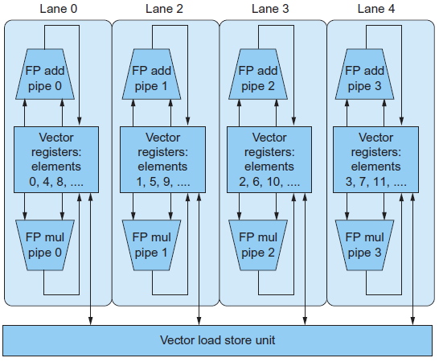
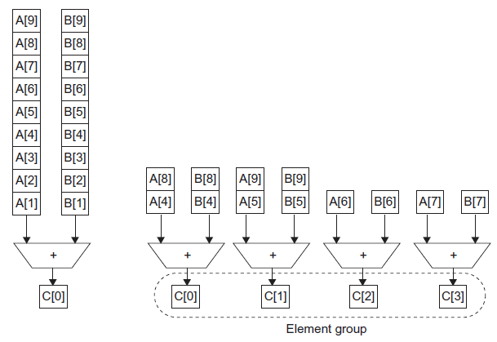
Vector vs. Multimedia Extensions
Vector instructions have a variable vector width, multimedia extensions have a fixed width
Vector instructions support strided access, multimedia extensions do not
Vector units can be combination of pipelined and arrayed functional units:

