Slide 1
The Memory Hierarchy
Chapter 5

Slide 2
Virtual Machines
Host computer emulates guest operating system and machine resources
Improved isolation of multiple guests
Avoids security and reliability problems
Aids sharing of resources
Virtualization has some performance impact
Feasible with modern high-performance comptuers
Examples
IBM VM/370 (1970s technology!)
VMWare
Microsoft Virtual PC
§5.6 Virtual Machines
Notes:
Who’s heard of VirtualBox? Similar concept is containers; might have heard of Docker.
Amazon and lots of cloud providers are using these heavily.
Most of the time people aren’t using full capabilities of a server, so try to get multiple people to use the same hardware.

Slide 3
The Problem with Memory
§5.7 Virtual Memory
Two programs running at the same time
Prog A has bug – bad pointer value
Overwrites into memory used by Prog B!
Buying from Amazon.com
Enter CC info into browser
Another program reads the browser memory and gets CC info
Some memory locations reserved for OS, communication with devices, etc.
Some programs need more memory than a machine has
But we have plenty of disk space

Slide 4
Virtual Memory
Use main memory as a “cache” for secondary (disk) storage
Managed jointly by CPU hardware and the operating system (OS)
Programs share main memory
Each gets a private virtual address space holding its frequently used code and data
Protected from other programs
CPU and OS translate virtual addresses to physical addresses
VM “block” is called a page
VM translation “miss” is called a page fault

Slide 5
Page Fault Penalty
On page fault, the page must be fetched from disk
Takes millions of clock cycles
Handled by OS code
Try to minimize page fault rate
Fully associative placement
Smart replacement algorithms
Notes:
Disks are slow, so okay to handle in software and be smart about it…
…BUT this is changing! SSDs are changing everything – much faster than disks!

Slide 6
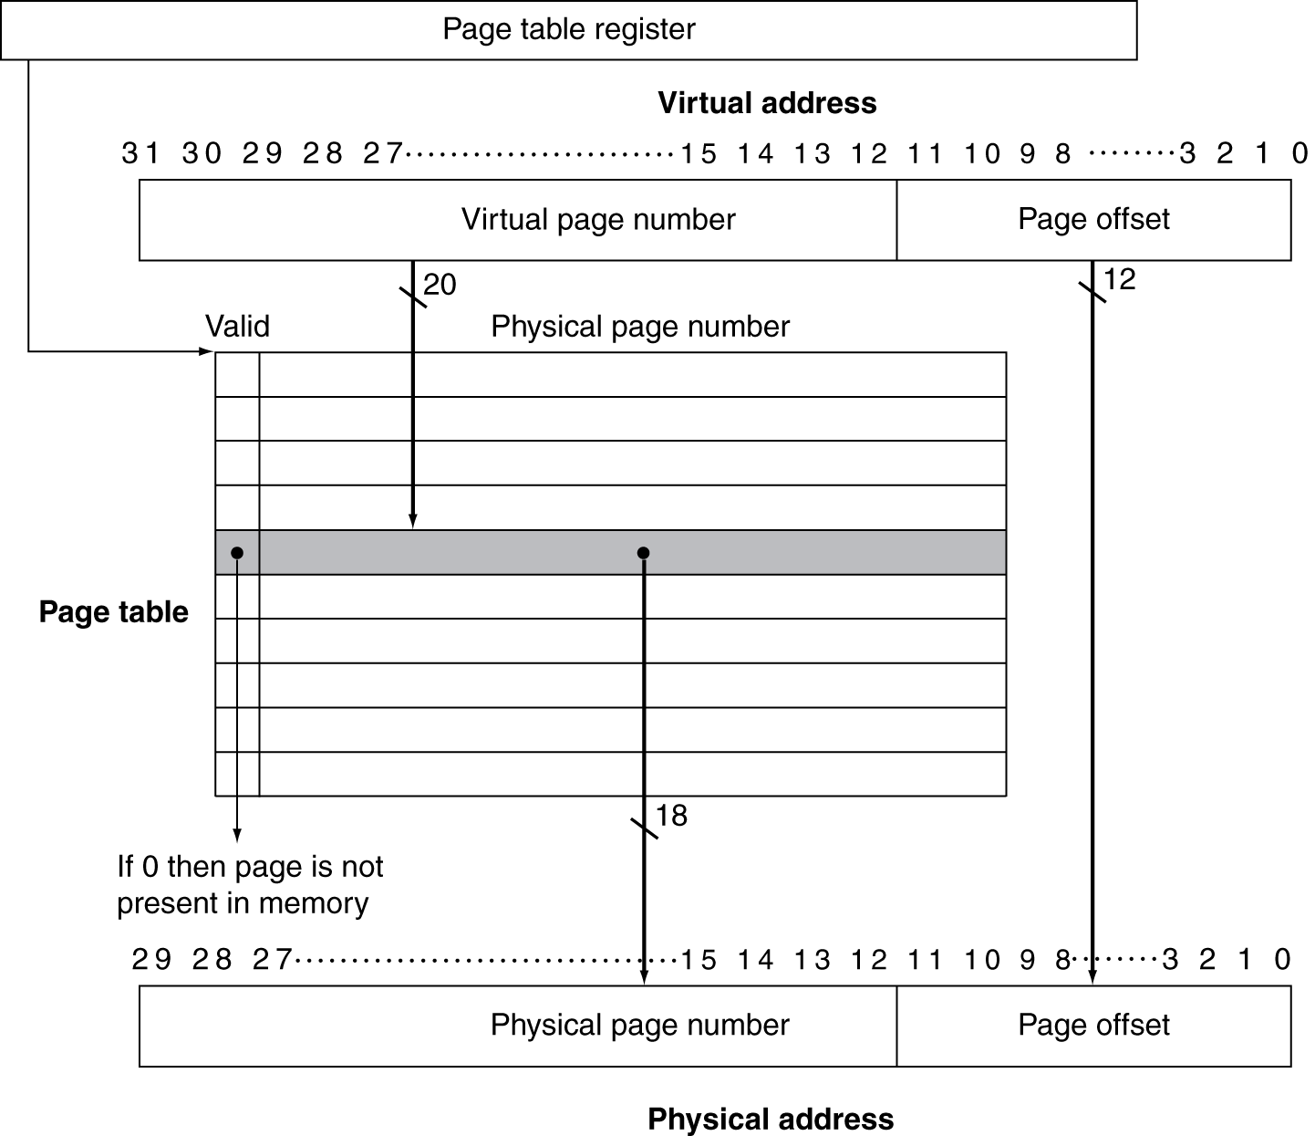
Translation Using a Page Table
Notes:
Notice that the physical page number means something different depending on the valid bit.
If valid, it’s the physical address in memory
If not, it’s a disk address.

Slide 7
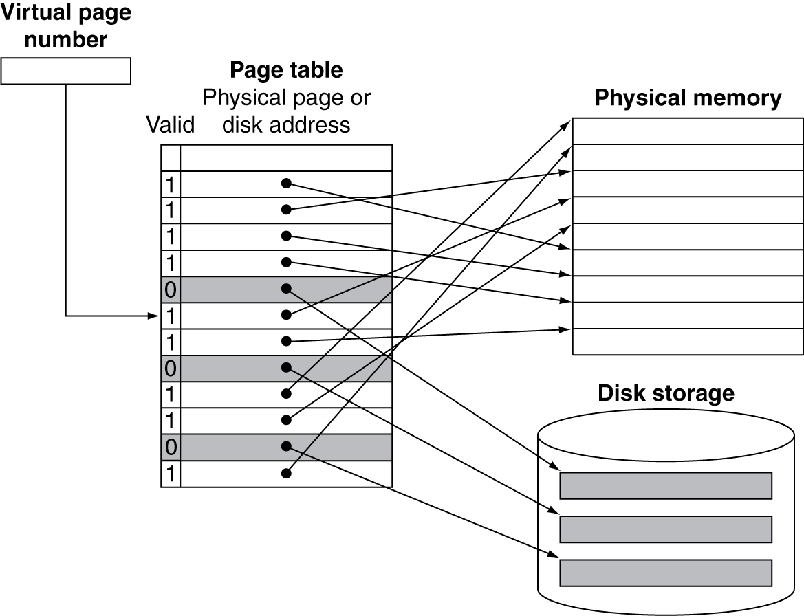
Mapping Pages to Storage
Notes:
Q: Do you think we use write-through or write-back for virtual memory?

Slide 8
Replacement and Writes
To reduce page fault rate, prefer least-recently used (LRU) replacement
Reference bit (aka use bit) in PTE set to 1 on access to page
Periodically cleared to 0 by OS
A page with reference bit = 0 has not been used recently
Disk writes take millions of cycles
Block at once, not individual locations
Write through is impractical
Use write-back
Dirty bit in PTE set when page is written

Slide 9
Fast Translation Using a TLB
Address translation would appear to require extra memory references
One to access the PTE
Then the actual memory access
But access to page tables has good locality
So use a fast cache of PTEs within the CPU
Called a Translation Look-aside Buffer (TLB)
Typical: 16–512 PTEs, 0.5–1 cycle for hit, 10–100 cycles for miss, 0.01%–1% miss rate
Misses could be handled by hardware or software

Slide 10
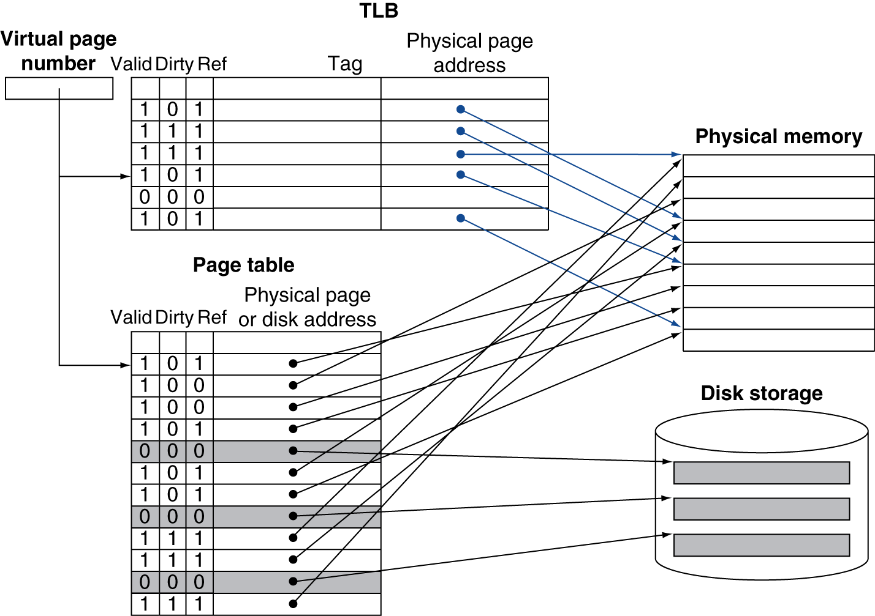
Fast Translation Using a TLB
Notes:
Draw a matrix:
TLB hit vs. miss x page table valid vs. not valid
If TLB hit, must be in physical memory

Slide 11
TLB Misses
If page is in memory
Load the PTE from memory and retry
Could be handled in hardware
Can get complex for more complicated page table structures
Or in software
Raise a special exception, with optimized handler
If page is not in memory (page fault)
OS handles fetching the page and updating the page table
Then restart the faulting instruction

Slide 12
TLB Miss Handler
TLB indicates miss
Page present, but PTE not in TLB
Page not present
Must recognize TLB miss before destination register overwritten
Raise exception
Handler copies PTE from memory to TLB
Then restarts instruction
If page not present, page fault will occur
Notes:
Particularly bad case: lw $t1, 0($t1)

Slide 13
Page Fault Handler
Use faulting virtual address to find PTE
Locate page on disk
Choose page to replace
If dirty, write to disk first
Read page into memory and update page table
Make process runnable again
Restart from faulting instruction

Slide 14
Page Fault Details
Page fault raises special exception
Save registers to stack, set stack pointer
General purpose, hi, lo, exception registers
Disable more exceptions or allow nested exceptions
Call C code (in OS) to handle page fault
Restore registers, stack pointer
Enable regular exceptions
Notes:
This is for page fault, but it’s basically the same for any kind of exception
Switches control (PC) to special operating system code for handling exceptions
This corresponds to figure 5.34 in the book.
BTW OS does same thing for scheduling all your programs running at the same time.
But now we have two addresses: physical and virtual. How does this interact with our normal caches?

Slide 15
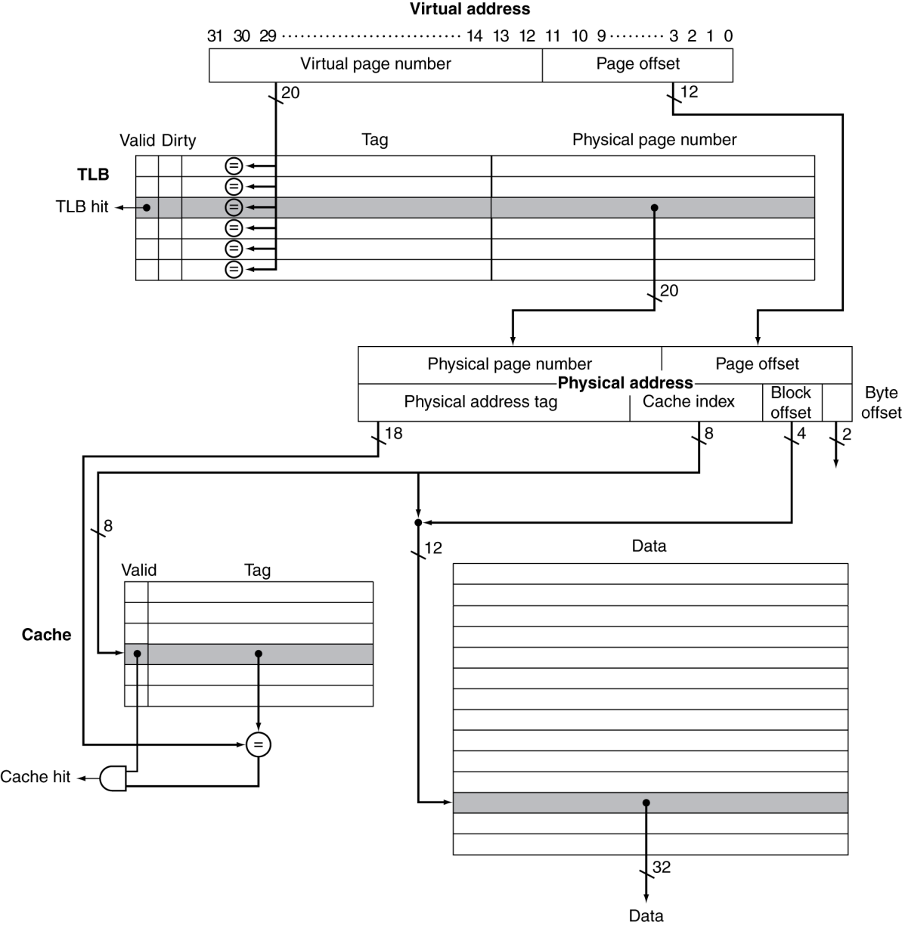
TLB and Cache Interaction
If cache tag uses physical address
Need to translate before cache lookup
Alternative: use virtual address tag
Complications due to aliasing
Different virtual addresses for shared physical address
Notes:
First is easy but slow, second can be faster but is also more complicated. We won’t get into the details.
Modern Intel often use virtual indexed, physically tagged (VIPT) for L1, physical for L2 + L3.

Slide 16
Memory Protection
Different tasks can share parts of their virtual address spaces
But need to protect against errant access
Requires OS assistance
Hardware support for OS protection
Privileged supervisor mode (aka kernel mode)
Privileged instructions
Page tables and other state information only accessible in supervisor mode
System call exception (e.g., syscall in MIPS)

Slide 17
The Memory Hierarchy
The BIG Picture
Common principles apply at all levels of the memory hierarchy
Based on notions of caching
At each level in the hierarchy
Block placement
Finding a block
Replacement on a miss
Write policy
§5.8 A Common Framework for Memory Hierarchies
Notes:
Connect everything about caching and virtual memory together.

Slide 18
Block Placement
Determined by associativity
Direct mapped (1-way associative)
One choice for placement
n-way set associative
n choices within a set
Fully associative
Any location
Higher associativity reduces miss rate
Increases complexity, cost, and access time

Slide 19
Finding a Block
Associativity | Location method | Tag comparisons
Direct mapped | Index | 1
n-way set associative | Set index, then search entries within the set | n
Fully associative | Search all entries | #entries
 | Full lookup table | 0
Hardware caches
Reduce comparisons to reduce cost
Virtual memory
Full table lookup makes full associativity feasible
Benefit in reduced miss rate

Slide 20
Replacement
Choice of entry to replace on a miss
Least recently used (LRU)
Complex and costly hardware for high associativity
Random
Close to LRU, easier to implement
Virtual memory
LRU approximation with hardware support

Slide 21
Write Policy
Write-through
Update both upper and lower levels
Simplifies replacement, but may require write buffer
Write-back
Update upper level only
Update lower level when block is replaced
Need to keep more state
Virtual memory
Only write-back is feasible, given disk write latency

Slide 22
Sources of Misses
Compulsory misses (aka cold start misses)
First access to a block
Capacity misses
Due to finite cache size
A replaced block is later accessed again
Conflict misses (aka collision misses)
In a non-fully associative cache
Due to competition for entries in a set
Would not occur in a fully associative cache of the same total size

Slide 23
Cache Design Trade-offs
Design change | Effect on miss rate | Negative performance effect
Increase cache size | Decrease capacity misses | May increase access time
Increase associativity | Decrease conflict misses | May increase access time
Increase block size | Decrease compulsory misses | Increases miss penalty. For very large block size, may increase miss rate due to pollution.

Slide 24
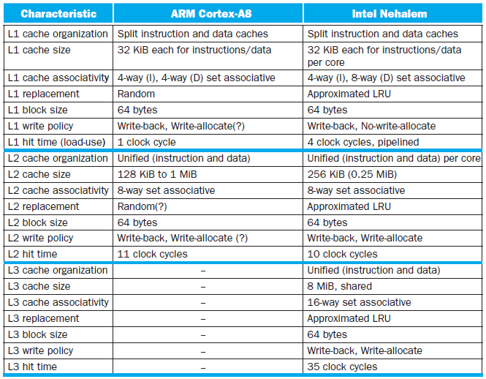
Multilevel On-Chip Caches
§5.13 The ARM Cortex-A8 and Intel Core i7 Memory Hierarchies

Slide 25
Cache Coherence Problem
Suppose two CPU cores share a physical address space
Write-through caches
Time step | Event | CPU A’s cache | CPU B’s cache | Memory
0 |  |  |  | 0
1 | CPU A reads X | 0 |  | 0
2 | CPU B reads X | 0 | 0 | 0
3 | CPU A writes 1 to X | 1 | 0 | 1
§5.10 Parallelism and Memory Hierarchies: Cache Coherence

Slide 26
Coherence Defined
Informally: Reads return most recently written value
Formally:
P writes X; P reads X (no intervening writes) ⇒ read returns written value
P₁ writes X; P₂ reads X (sufficiently later) ⇒ read returns written value
c.f. CPU B reading X after step 3 in example
P₁ writes X, P₂ writes X ⇒ all processors see writes in the same order
End up with the same final value for X

Slide 27
Cache Coherence Protocols
Operations performed by caches in multiprocessors to ensure coherence
Migration of data to local caches
Reduces bandwidth for shared memory
Replication of read-shared data
Reduces contention for access
Snooping protocols
Each cache monitors bus reads/writes
Directory-based protocols
Caches and memory record sharing status of blocks in a directory

Slide 28
Invalidating Snooping Protocols
Cache gets exclusive access to a block when it is to be written
Broadcasts an invalidate message on the bus
Subsequent read in another cache misses
Owning cache supplies updated value
CPU activity | Bus activity | CPU A’s cache | CPU B’s cache | Memory
 |  |  |  | 0
CPU A reads X | Cache miss for X | 0 |  | 0
CPU B reads X | Cache miss for X | 0 | 0 | 0
CPU A writes 1 to X | Invalidate for X | 1 |  | 0
CPU B read X | Cache miss for X | 1 | 1 | 1

Slide 29
Memory Consistency
When are writes seen by other processors
“Seen” means a read returns the written value
Can’t be instantaneously
Assumptions
A write completes only when all processors have seen it
A processor does not reorder writes with other accesses
Consequence
P writes X then writes Y ⇒ all processors that see new Y also see new X
Processors can reorder reads, but not writes

Slide 30
Multilevel On-Chip Caches
§5.13 The ARM Cortex-A8 and Intel Core i7 Memory Hierarchies

Slide 31
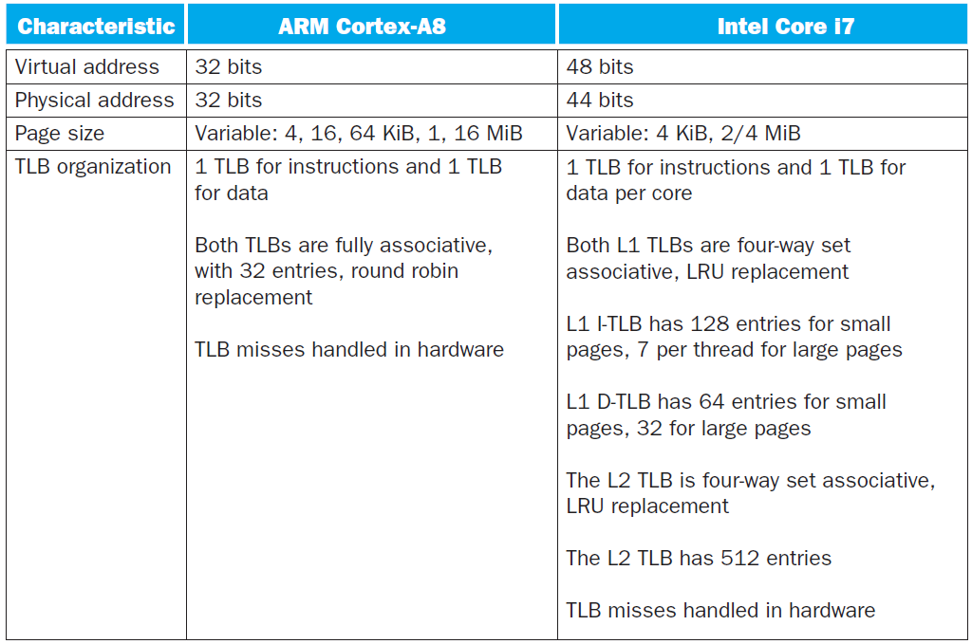
2-Level TLB Organization

Slide 32
Supporting Multiple Issue
Both have multi-banked caches that allow multiple accesses per cycle assuming no bank conflicts
Core i7 cache optimizations
Return requested word first
Non-blocking cache
Hit under miss
Miss under miss
Data prefetching

Slide 33
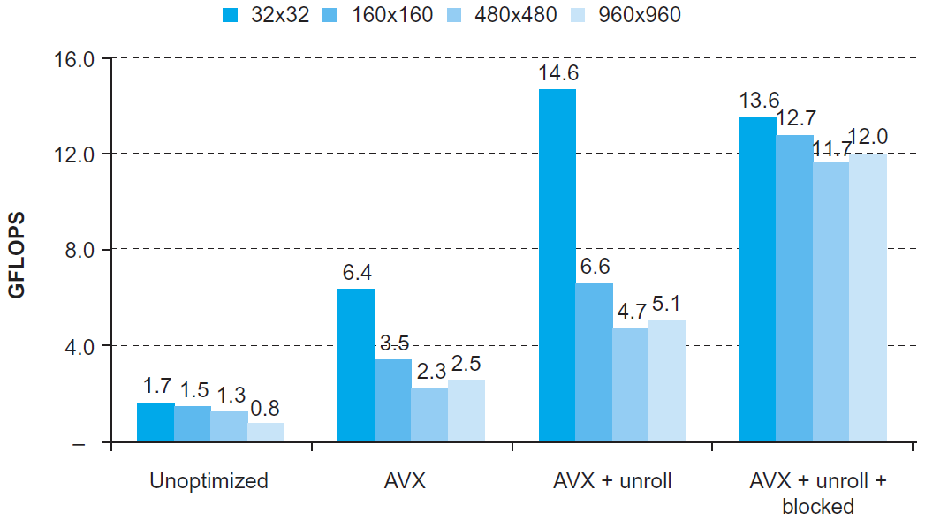
DGEMM
Combine cache blocking and subword parallelism
§5.14 Going Faster: Cache Blocking and Matrix Multiply

Slide 34
Pitfalls
Byte vs. word addressing
Example: 32-byte direct-mapped cache, 4-byte blocks
Byte 36 maps to block 1
Word 36 maps to block 4
Ignoring memory system effects when writing or generating code
Example: iterating over rows vs. columns of arrays
Large strides result in poor locality
§5.15 Fallacies and Pitfalls

Slide 35
Pitfalls
In multiprocessor with shared L2 or L3 cache
Less associativity than cores results in conflict misses
More cores ⇒ need to increase associativity
Using AMAT to evaluate performance of out-of-order processors
Ignores effect of non-blocked accesses
Instead, evaluate performance by simulation

Slide 36
Pitfalls
Extending address range using segments
E.g., Intel 80286
But a segment is not always big enough
Makes address arithmetic complicated
Implementing a VMM on an ISA not designed for virtualization
E.g., non-privileged instructions accessing hardware resources
Either extend ISA, or require guest OS not to use problematic instructions
Notes:
Someone summarize this chapter for me.

Slide 37
Concluding Remarks
Fast memories are small, large memories are slow
We really want fast, large memories ☹
Caching gives this illusion ☺
Principle of locality
Programs use a small part of their memory space frequently
Memory hierarchy
L1 cache ↔ L2 cache ↔ … ↔ DRAM memory ↔ disk
Memory system design is critical for multiprocessors
§5.16 Concluding Remarks

