Slide 1
3.4: Division
Instructor: Robert Utterback
Lecture 30

Slide 2
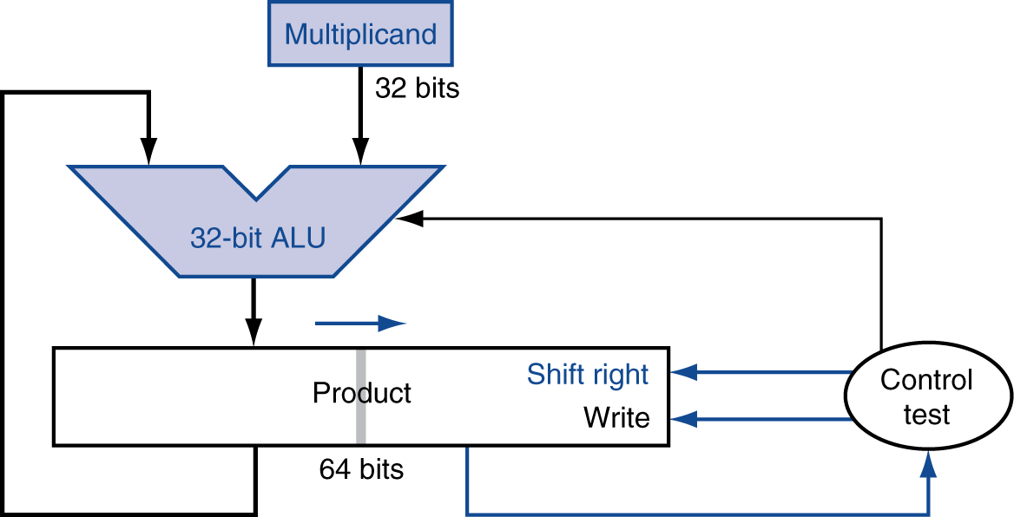
Optimized Multiplier
Perform steps in parallel: add/shift
One cycle per partial-product addition
That’s ok, if frequency of multiplications is low
Notes:
Multiplier is in the right half of the product register.

Slide 3
MIPS Multiplication
Two 32-bit registers for product
HI: most-significant 32 bits
LO: least-significant 32-bits
Instructions
mult rs, rt / multu rs, rt
64-bit product in HI/LO
mfhi rd / mflo rd
Move from HI/LO to rd
Can test HI value to see if product overflows 32 bits
mul rd, rs, rt
Least-significant 32 bits of product –> rd
Notes:
This last is a pseudoinstruction

Slide 4
Division
§3.4 Division
Check for 0 divisor
Long division approach
If divisor ≤ dividend bits
1 bit in quotient, subtract
Otherwise
0 bit in quotient, bring down next dividend bit
Restoring division
Do the subtract, and if remainder goes < 0, add divisor back
Signed division
Divide using absolute values
Adjust sign of quotient and remainder as required
quotient
dividend
1001
1000 1001010
-1000
10
101
1010
-1000
10
divisor
remainder
n-bit operands yield n-bit quotient and remainder

Slide 5
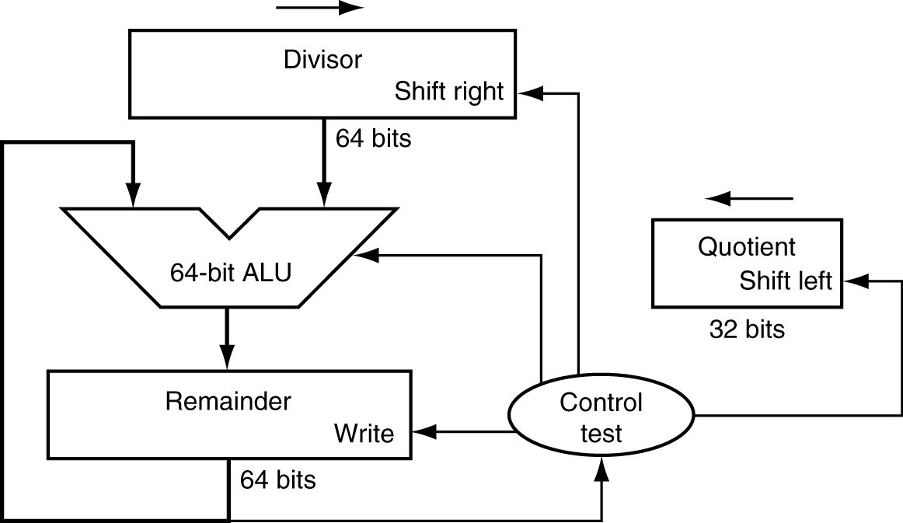
Division Hardware
First version of Division Hardware
32-bit quotient
64-bit ALU
64-bit remainder
Initially divisor in left half
Initially dividend
Notes:
Divisor starts in left half of divisor register, remainder initialized to dividend

Slide 6
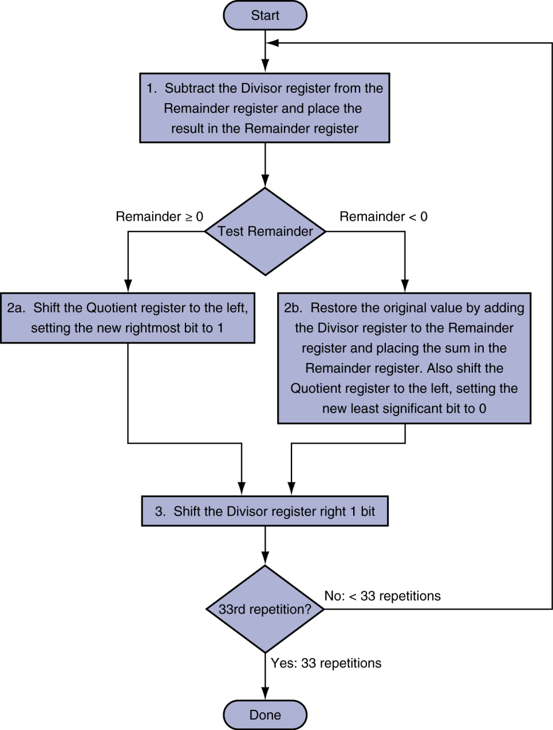
First Version Division Hardware
Initially divisor in left half
Initially dividend
Notes:
Example: Fill out a table for 7/2
Table:
Iteration, Step (1,2b,3), Quotient, Divisor, Remainder

Slide 7
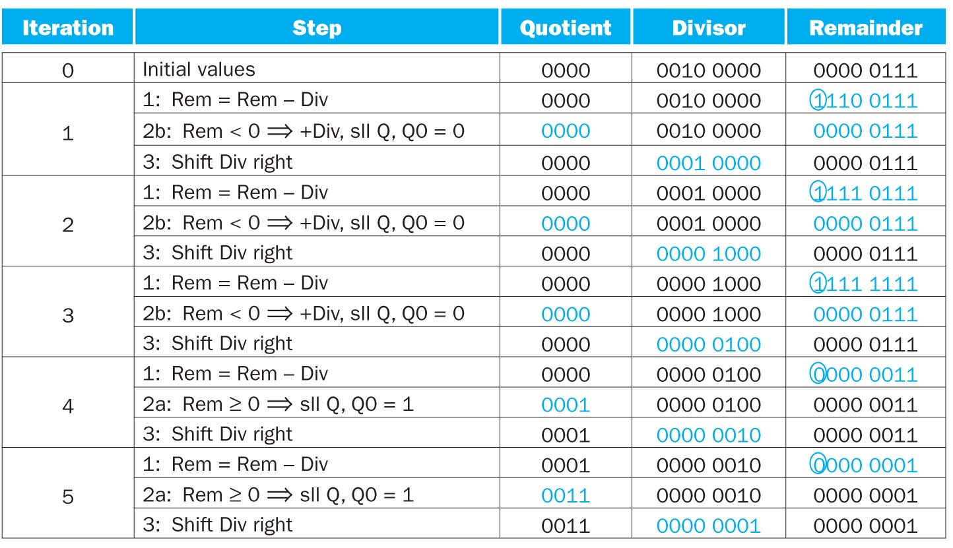
Example
7/2

Slide 8
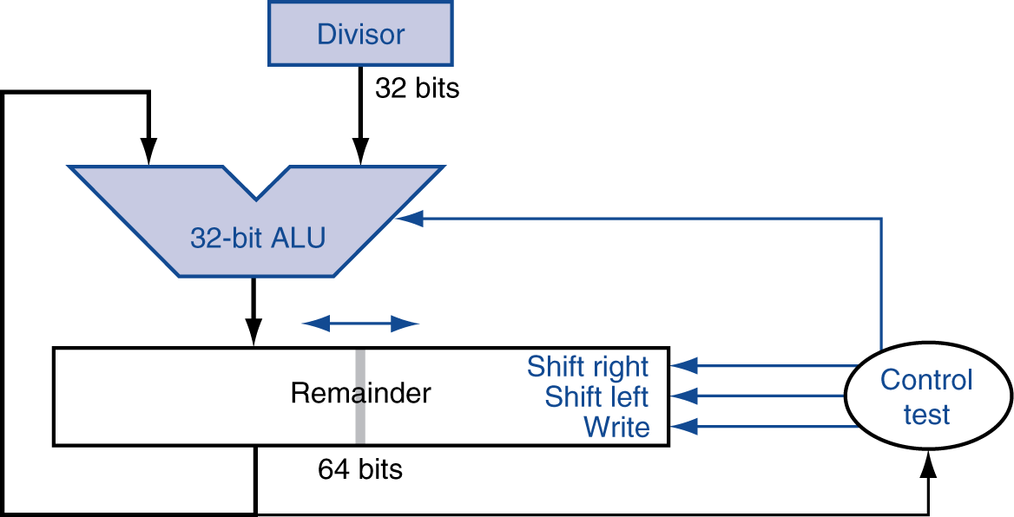
Optimized Divider
One cycle per partial-remainder subtraction
Looks a lot like a multiplier!
Same hardware can be used for both
Notes:
Remainder in left half, Dividend in right half

Slide 9
Faster Division
Can’t use parallel hardware as in multiplier
Subtraction is conditional on sign of remainder
Faster dividers (e.g. SRT division) generate multiple quotient bits per step
Still require multiple steps

Slide 10
MIPS Division
Use HI/LO registers for result
HI: 32-bit remainder
LO: 32-bit quotient
Instructions
div rs, rt / divu rs, rt
No overflow or divide-by-0 checking
Software must perform checks if required
Use mfhi, mflo to access result

Slide 11
Example Revisit
A better way to do 7/2?
7>>2
SRL
Most compiler will replace divide by power of 2 using right shift operations

Slide 12
Summary
Multiplication
First version of multiplication
Optimized multiplication
Division

Slide 13
Floating Point
§3.5 Floating Point
Representation for non-integral numbers
Including very small and very large numbers
Like scientific notation
–2.34 × 10⁵⁶
+0.002 × 10^{–4}
+987.02 × 10⁹
In binary
±1.xxxxxxx₂ × 2^{yyyy}
Types float and double in C
normalized
not normalized
Notes:
Normalized: >= 1 < 10

Slide 14
Floating Point Standard
Defined by IEEE Std 754-1985
Developed in response to divergence of representations
Portability issues for scientific code
Now almost universally adopted
Two representations
Single precision (32-bit)
Double precision (64-bit)

Slide 15
IEEE Floating-Point Format
single: 8 bits double: 11 bits
single: 23 bits double: 52 bits
S
Exponent
Fraction
$$x={(−1)}^{S}×(1+\text{Fraction}\text{)}×2^{\text{Exponent}}$$
S: sign bit (0 ⇒ non-negative, 1 ⇒ negative)
Normalize significand: 1.0 ≤ |significand| < 2.0
Always has a leading pre-binary-point 1 bit, so no need to represent it explicitly (hidden bit)
Significand is Fraction with the “1.” restored
Not really, though
Exponent is slightly more complicated
Notes:
Try an example on
Sign: 1
Exponent: 0 0 0 0 0 0 0 1
Fraction: 0 1 0 (0…)
Which is -1.25 * 2^1 = -2.5, exception not really

Slide 16
IEEE Floating-Point Format
single: 8 bits double: 11 bits
single: 23 bits double: 52 bits
S
Exponent
Fraction
S: sign bit (0 ⇒ non-negative, 1 ⇒ negative)
Normalize significand: 1.0 ≤ |significand| < 2.0
Always has a leading pre-binary-point 1 bit, so no need to represent it explicitly (hidden bit)
Significand is Fraction with the “1.” restored
Exponent: excess representation: actual exponent + Bias
Ensures exponent is unsigned
Single: Bias = 127; Double: Bias = 1203
Notes:
See p.200 for the reason behind biasing --- basically, it makes comparison a lot easier, hence sorting can be done efficiently.
The bias makes the most negative exponent (which makes a small number) 0…0 and the most positive exponent 1..1
Now let’s do the example of p.202
Now example on p.201

