Slide 1
Procedures (Functions)
Instructor: Robert Utterback
Lecture 19

Slide 2
Procedure Calling
Don’t overwrite registers other procedures are using
Don’t overwrite memory used in other procedures
Need to pass in parameters
Need to get result from function
§2.8 Supporting Procedures in Computer Hardware
Notes:
The previous procedure (e.g. main) was using some registers…what if the procedure it calls also wants to use those registers.
It is way to complex to always be aware of which procedures are active and which registers they are using…

Slide 3
Procedure Calling
Steps required
Place parameters in registers
Transfer control to procedure
Acquire storage for procedure
Each procedure instance has own storage area
Perform procedure’s operations
Place result in register for caller
Return to place of call
§2.8 Supporting Procedures in Computer Hardware
Notes:
All the procedures use an area of memory called the stack, and each procedure instance has its own stack FRAME.
So far I have just assumed everything is in registers…

Slide 4
Register Usage
$a0 – $a3: arguments (reg’s 4 – 7)
$v0, $v1: result values (reg’s 2 and 3)
$t0 – $t9: temporaries
Can be overwritten by callee
$s0 – $s7: saved
Must be saved/restored by callee
$gp: global pointer for static data (reg 28)
$sp: stack pointer (reg 29)
$fp: frame pointer (reg 30)
$ra: return address (reg 31)
Notes:
Need to save the s registers, use them, then restore them when we’re done…where do we save them?
Any compiled language will have an ABI, which defines, among other things, the registers used for parameters. Notice this is a feature of a language and/or compiler, NOT the assembly language.

Slide 5
Registers to Save
Every function:
Save any $s registers you want to use
Restore at end
Any function that needs to call another (non-leaf)
Save $ra (jal will change this!)
Save $a registers if you need them
Save $t registers if you’re using them
Bottom line: save anything that might change!

Slide 6
Non-Leaf Procedure Example
C code:
int foo(int n) { return bar() + n;
}
Argument n in $a0
Result in $v0
Notes:
fact: addi $sp, $sp, -8 # adjust stack for 2 items sw $ra, 4($sp) # save return address sw $a0, 0($sp) # save argument slti $t0, $a0, 1 # test for n < 1 beq $t0, $zero, L1 addi $v0, $zero, 1 # if so, result is 1 addi $sp, $sp, 8 # pop 2 items from stack jr $ra # and return L1: addi $a0, $a0, -1 # else decrement n jal fact # recursive call lw $a0, 0($sp) # restore original n lw $ra, 4($sp) # and return address addi $sp, $sp, 8 # pop 2 items from stack mul $v0, $a0, $v0 # multiply to get result jr $ra # and return

Slide 7
Non-Leaf Procedure Example
MIPS code:
foo: addi $sp, $sp, -4 # adjust stack for 1 items sw $ra, 0($sp) # save return address jal bar # call (no arguments) add $v0, $v0, $a0 # compute result lw $ra, 0($sp) # restore return address
addi $sp, $sp, 4 # restore stack pointer jr $ra # and return
Notes:
Notice there is some waste here…

Slide 8
Non-Leaf Procedure Example
C code:
int foo(int n) {
int f; // store in $t0
f = bar(); return f - n;
}
Argument n in $a0
Result in $v0
Notes:
fact: addi $sp, $sp, -8 # adjust stack for 2 items sw $ra, 4($sp) # save return address sw $a0, 0($sp) # save argument slti $t0, $a0, 1 # test for n < 1 beq $t0, $zero, L1 addi $v0, $zero, 1 # if so, result is 1 addi $sp, $sp, 8 # pop 2 items from stack jr $ra # and return L1: addi $a0, $a0, -1 # else decrement n jal fact # recursive call lw $a0, 0($sp) # restore original n lw $ra, 4($sp) # and return address addi $sp, $sp, 8 # pop 2 items from stack mul $v0, $a0, $v0 # multiply to get result jr $ra # and return

Slide 9
Non-Leaf Procedure Example
MIPS code:
foo: addi $sp, $sp, -8 # adjust stack for 1 items sw $ra, 0($sp) # save return address
sw $t0, 4($sp) # save t0, bar might use it jal bar # call (no arguments)
lw $t0, 4($sp) # restore $t0 to use it add $v0, $v0, $t0 # compute result lw $ra, 0($sp) # restore return address
addi $sp, $sp, 8 # restore stack pointer jr $ra # and return
Notes:
Notice there is some waste here…

Slide 10
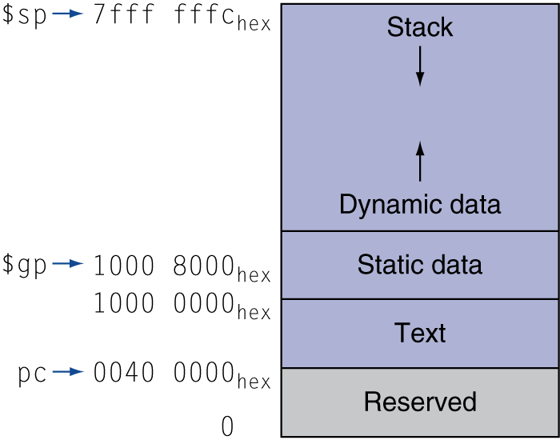
Memory Layout
Text: program code
Static data: global variables
e.g., static variables in C, constant arrays and strings
$gp initialized to address allowing ±offsets into this segment
Dynamic data: heap
E.g., malloc in C, new in Java and C++
Stack: automatic storage

Slide 11
Summary
Procedure Call
Registers used
Stack
jal and jr
leaf and no-leaf procedure
Allocating space for new data on the heap

Slide 12
A Note on Arrays
So far we’ve seen only arrays of words
But in general, arrays can have elements of any # numbers
Array of bytes
Array of half-words (2 bytes)
Array of double words (8 bytes, for floating point)
Changes indexing
Memory indexed by byte
lw and sw address must be multiple of 4

Slide 13
Byte/Halfword Operations
Could use bitwise operations
MIPS byte/halfword load/store
String processing is a common case
lb rt, offset(rs) lh rt, offset(rs)
Sign extend to 32 bits in rt
lbu rt, offset(rs) lhu rt, offset(rs)
Zero extend to 32 bits in rt
sb rt, offset(rs) sh rt, offset(rs)
Store just rightmost byte/halfword

Slide 14
Character Data
Byte-encoded character sets
ASCII: 128 characters
95 graphic, 33 control
Latin-1: 256 characters
ASCII, +96 more graphic characters
Unicode: 32-bit character set
Used in Java, C++ wide characters, …
Most of the world’s alphabets, plus symbols
UTF-8, UTF-16: variable-length encodings
§2.9 Communicating with People
Notes:
A mapping from numbers to characters. First 7 bits of Unicode are ASCII, which is convenient.

