Slide 1
DataPath (4.3)
Lecture 35

Slide 2
Introduction
§4.1 Introduction
CPU performance factors
Instruction count
Determined by ISA and compiler
CPI and Cycle time
Determined by CPU hardware
We will examine two MIPS implementations
A simplified version
A more realistic pipelined version
Simple subset, shows most aspects
Memory reference: lw, sw
Arithmetic/logical: add, sub, and, or, slt
Control transfer: beq, j

Slide 3
Instruction Execution
PC → instruction memory, fetch instruction
Register numbers → register file, read registers
Depending on instruction class
Use ALU to calculate
Arithmetic result
Memory address for load/store
Branch target address
Access data memory for load/store
PC ← target address or PC + 4

Slide 4
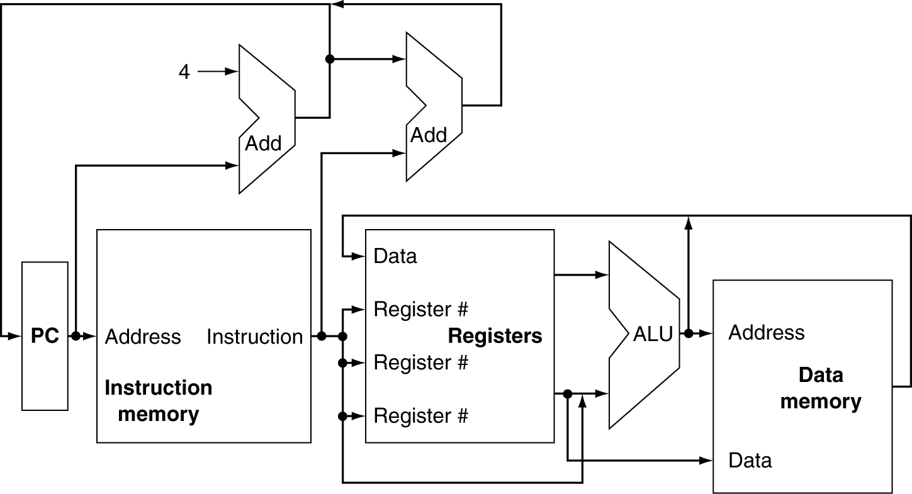
CPU Overview

Slide 5
Multiplexers
Can’t just join wires together
Use multiplexers
Notes:
What logic component can we use to choose between multiple inputs?

Slide 6
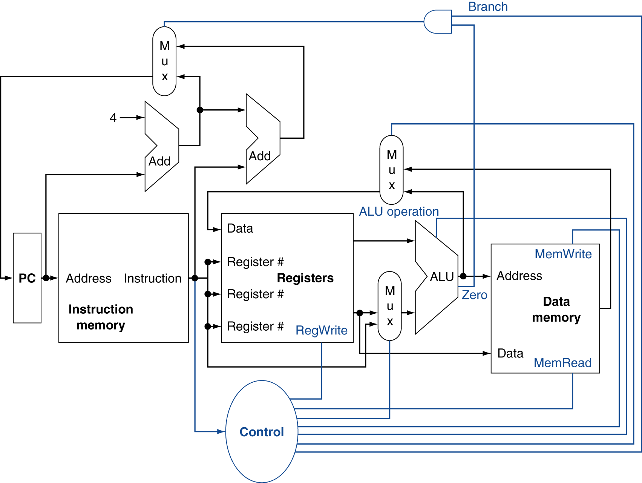
Control
Notes:
Typically we won’t show all these control wires b/c they make the picture messy. Instead we’ll just show a blue line segment going in to the appropriate place.

Slide 7
Logic Design Basics
Information encoded in binary
Low voltage = 0, High voltage = 1
One wire per bit
Multi-bit data encoded on multi-wire buses
Combinational element
Operate on data
Output is a function of input
State (sequential) elements
Store information
§4.2 Logic Design Conventions

Slide 8
Combinational Elements
AND-gate
Y = A & B
Adder
Y = A + B
A
+
Y
B
A
Y
B
Arithmetic/Logic Unit
Y = F(A, B)
Multiplexer
Y = S ? I1 : I0
A
I0
M u x
Y
Y
ALU
I1
B
S
F

Slide 9
Sequential Elements
Register: stores data in a circuit
Uses a clock signal to determine when to update the stored value
Edge-triggered: update when Clk changes from 0 to 1
Clk
D
Q
D
Clk
Q

Slide 10
Sequential Elements
Register with write control
Only updates on clock edge when write control input is 1
Used when stored value is required later
Clk
D
Q
Write
Write
D
Clk
Q

Slide 11
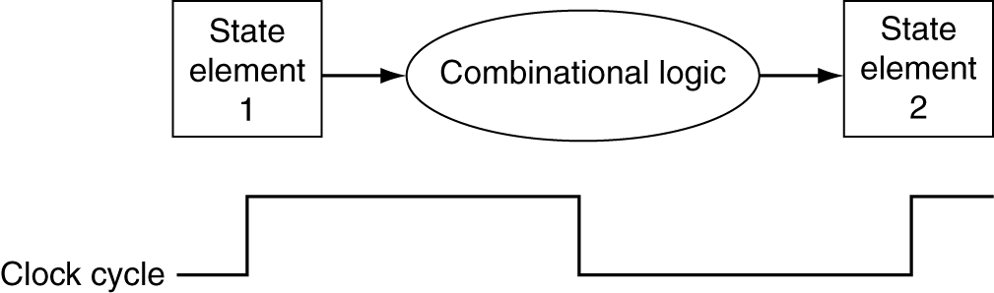
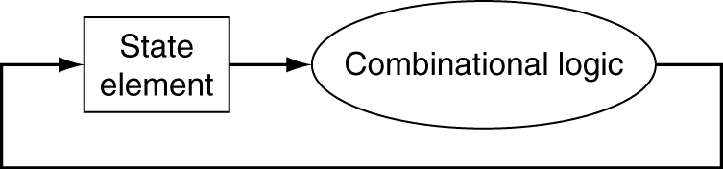
Clocking Methodology
Combinational logic transforms data during clock cycles
Between clock edges
Input from state elements, output to state element
Longest delay determines clock period

Slide 12
Building a Datapath
Datapath
Elements that process data and addresses in the CPU
Registers, ALUs, mux’s, memories, …
We will build a MIPS datapath incrementally
Refining the overview design
§4.3 Building a Datapath

Slide 13
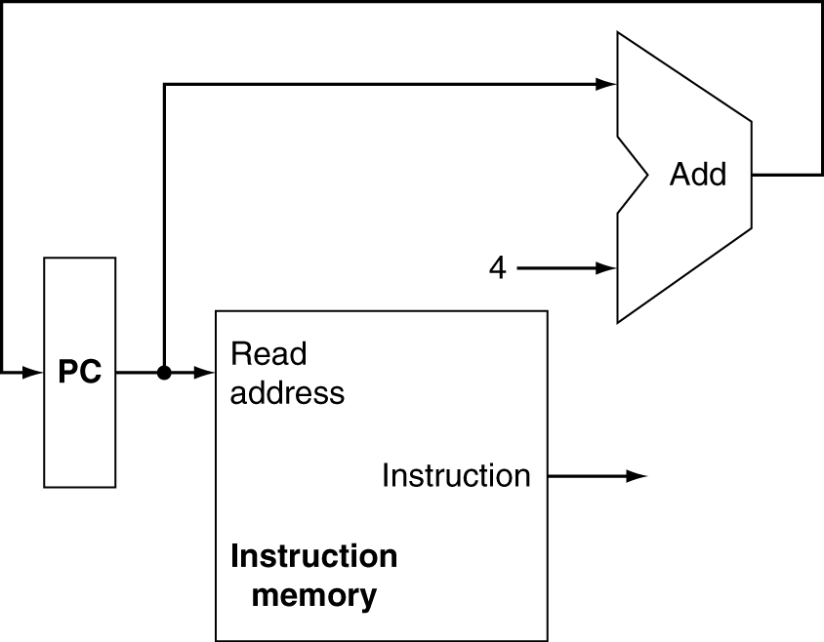
Instruction Fetch
Increment by 4 for next instruction
32-bit register
Notes:
Why do we need to increment by 4? So how big is the PC?

Slide 14
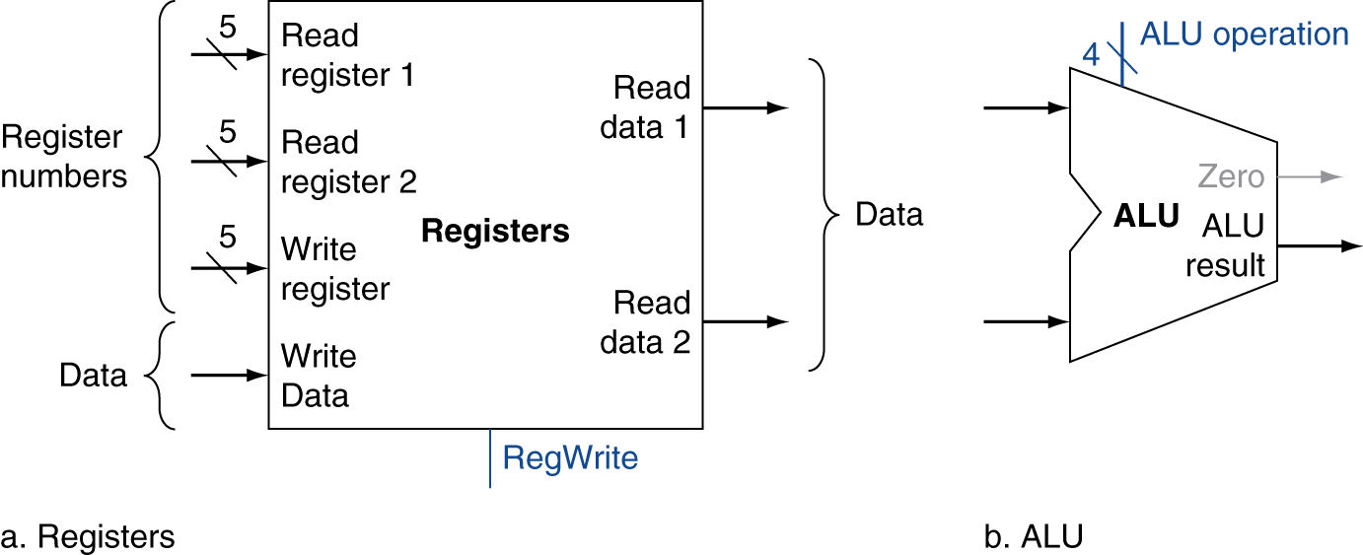
R-Format Instructions
Read two register operands
Perform arithmetic/logical operation
Write register result
Notes:
Why 5 bits?

Slide 15
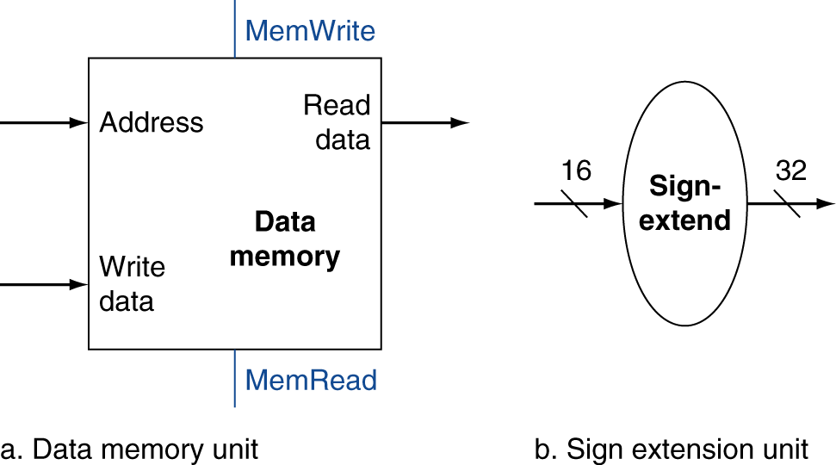
Load/Store Instructions
Read register operands
Calculate address using 16-bit offset
Use ALU, but sign-extend offset
Load: Read memory and update register
Store: Write register value to memory

Slide 16
Branch Instructions
Read register operands
Compare operands
Use ALU, subtract and check Zero output
Calculate target address
Sign-extend displacement
Shift left 2 places (word displacement)
Add to PC + 4
Already calculated by instruction fetch
Notes:
What addressing mode do branch instructions use?

Slide 17
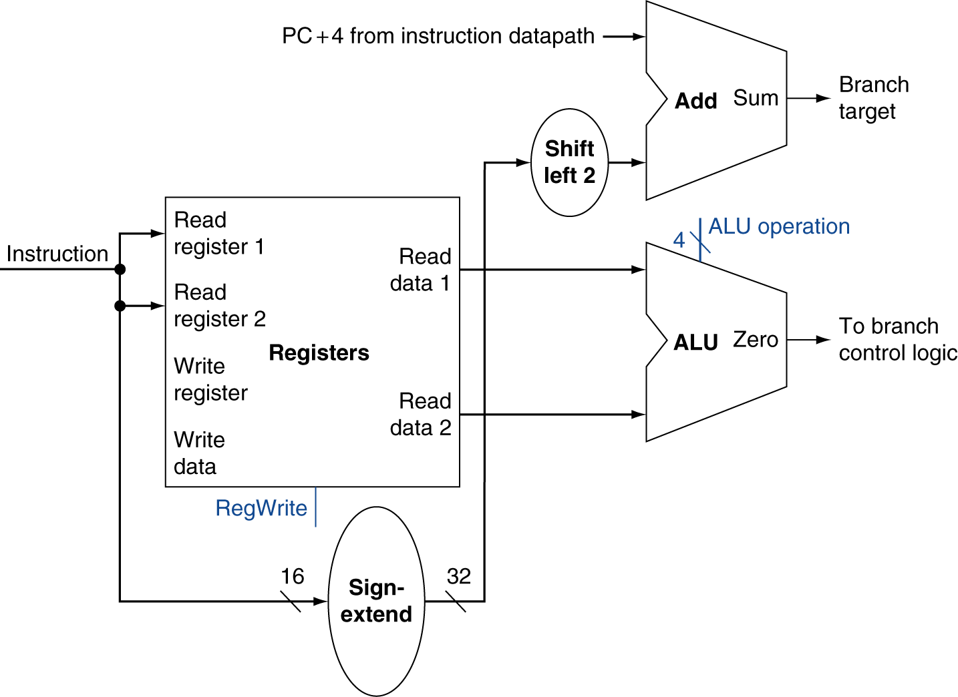
Branch Instructions
Just re-routes wires
Sign-bit wire replicated

Slide 18
Composing the Elements
First-cut data path does an instruction in one clock cycle
Each datapath element can only do one function at a time
Hence, we need separate instruction and data memories
Use multiplexers where alternate data sources are used for different instructions

Slide 19
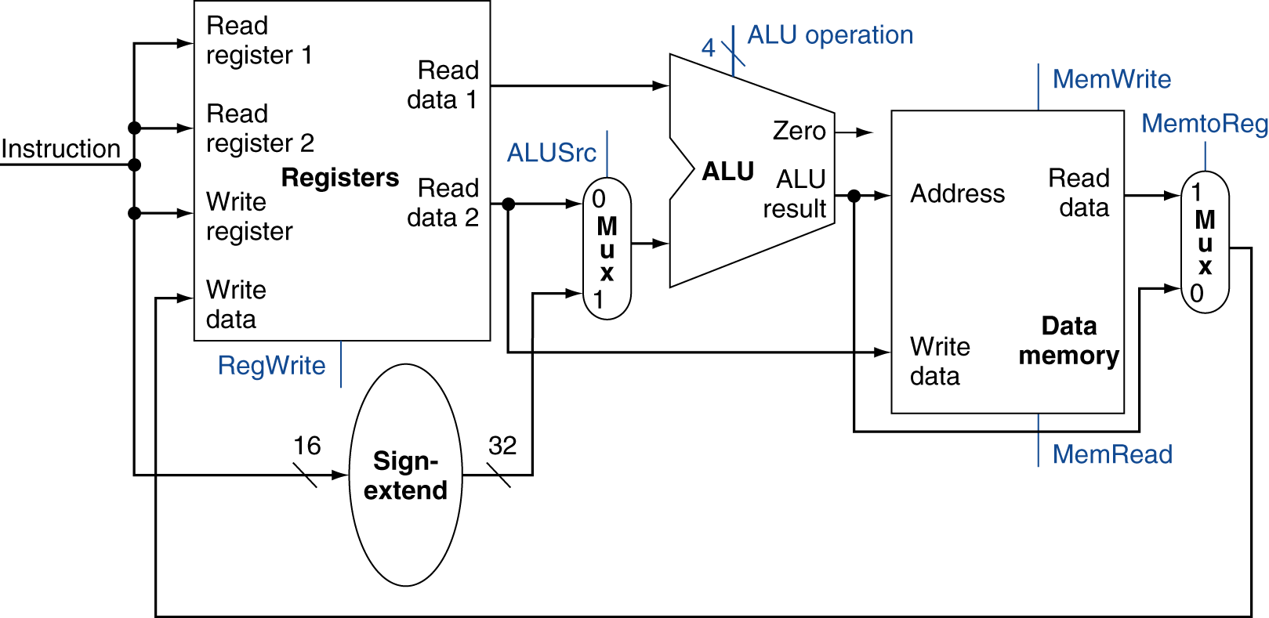
R-Type/Load/Store Datapath

Slide 20
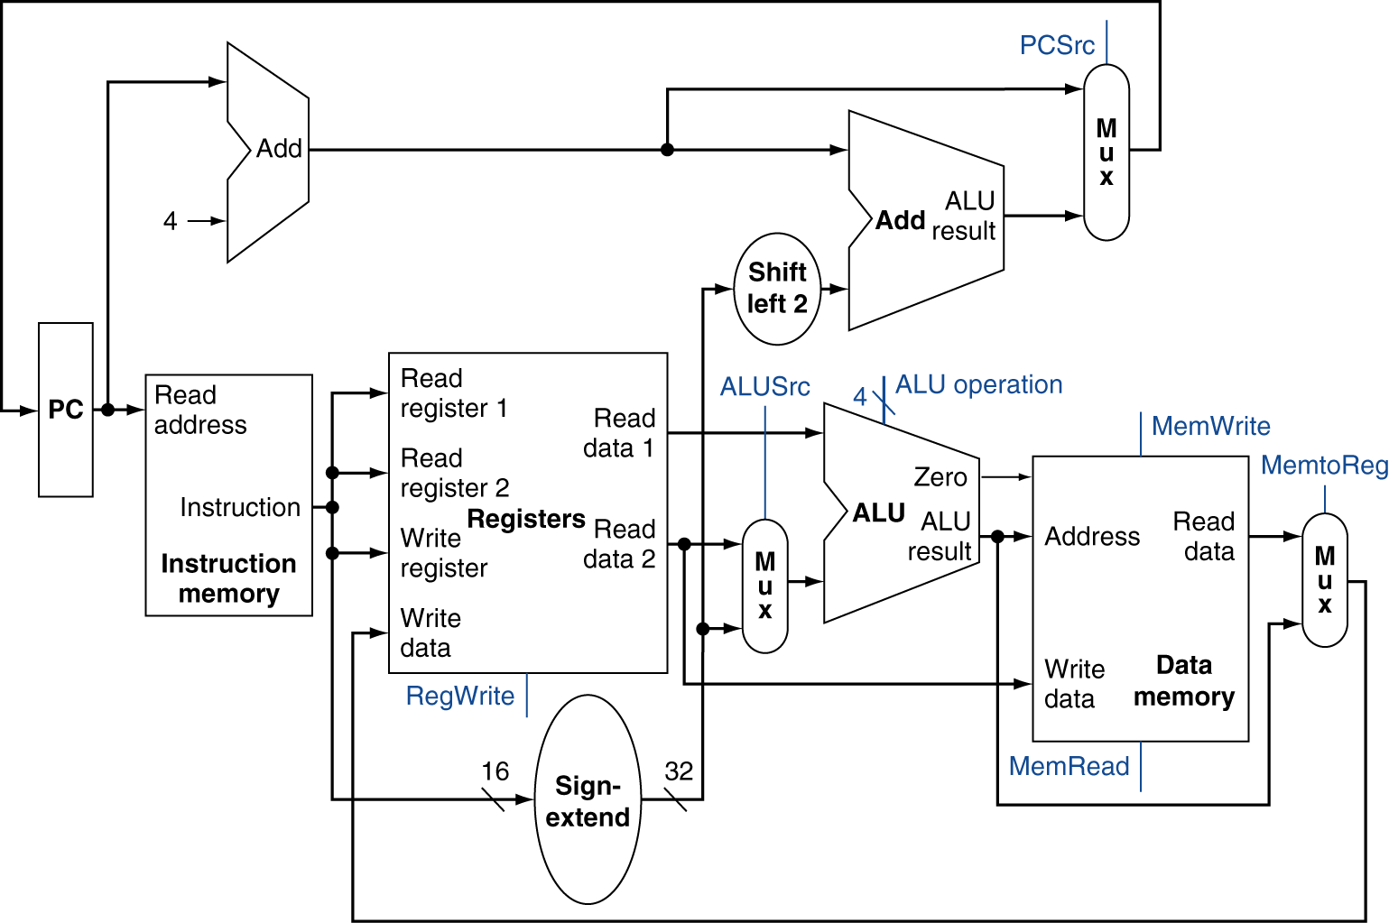
Full Datapath

Slide 21
ALU Control
ALU used for
Load/Store: add
Branch: subtract
R-type: depends on funct field
§4.4 A Simple Implementation Scheme
ALU control | Function
0000 | AND
0001 | OR
0010 | add
0110 | subtract
0111 | set-on-less-than
1100 | NOR
Notes:
Why that relationship between add and subtract? Remember the picture of our ALU?
Need to generate these 4 ALU control bits based on the instruction we are currently executing..

